Slide 1


First steps with Power Automate for Excel users

Slide 2
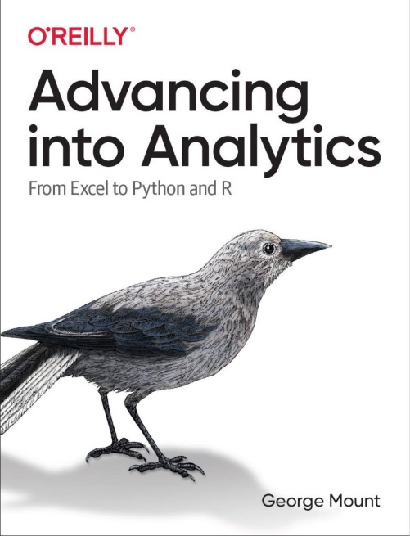
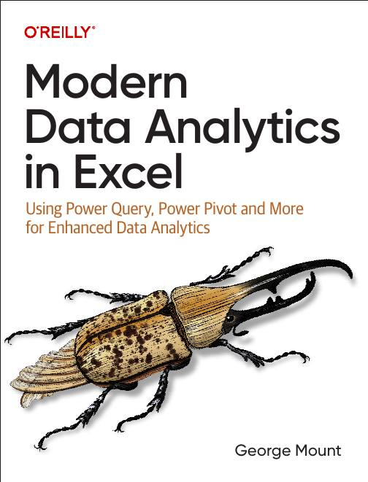



Hi, I’m George

Slide 3

Objectives for this session
Build your first Power Automate workflow for Excel
Reformat the flow’s output with Power Fx
Getting help building flows with Copilot

Slide 4
First flow with Power Automate
Use Power Automate templates for Excel
Create clock in/clock out workflow
File: first-flow.xlsx
Notes:
False!
Function, Formula, Function
Argument

Slide 5
Customizing outputs with Power Fx
Continue with the previous example
How can we improve appearance of outputs in Excel?
Resource: https://stringfestanalytics.com/power-automate-for-excel-how-to-understand-the-power-fx-programming-language/
Notes:
False!
Function, Formula, Function
Argument

Slide 6
Building flows with Copilot
Get AI assistance to build a flow
Create a monthly email/post to Teams based on data in a workbook
File: power-automate-copilot.xlsx
Resource: https://stringfestanalytics.com/power-automate-for-excel-how-to-build-flows-with-copilot/
Notes:
False!
Function, Formula, Function
Argument

Slide 7
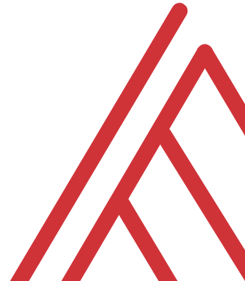
Questions?

Slide 8
Thank you

