Slide 1


First steps with Office Scripts

Slide 2
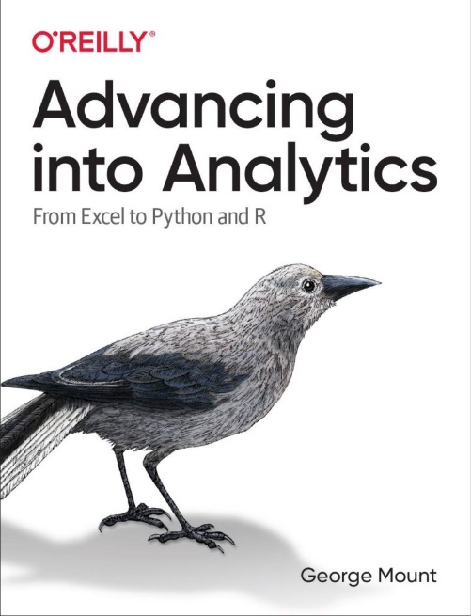
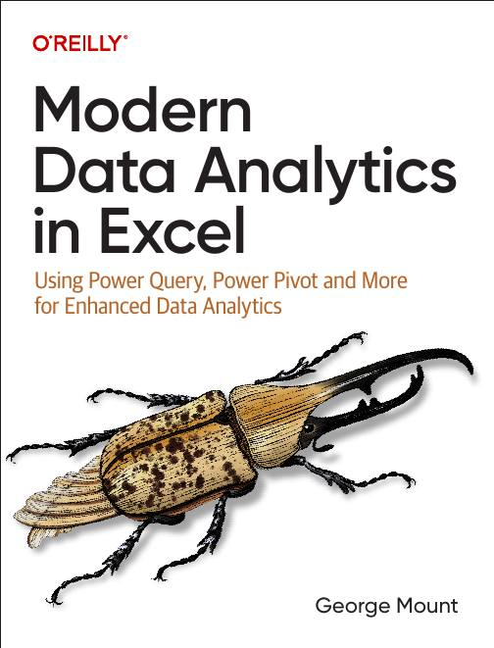



Hi, I’m George

Slide 3

Objectives for this session
Office Scripts for automation (vs VBA)
Using the Office Script recorder
Understanding core structure of Office Scripts
How to organize, share, execute scripts

Slide 4
Office Scripts availability
Please see https://learn.microsoft.com/en-us/office/dev/scripts/testing/platform-limits?tabs=business

Slide 5
Office Scripts vs VBA

Slide 6
Office Scripts vs VBA
Aspect | Office Scripts | VBA (Visual Basic for Applications)
Platform Compatibility | Primarily designed for Excel on the web. | Primarily used in Excel desktop applications.
Language | TypeScript/JavaScript. | VBA (a subset of Visual Basic).
Ease of Use | Requires familiarity with the JavaScript programming language, particularly the TypeScript superset. | Requires familiarity with the VBA programming language.
Integration | Can be integrated with Power Automate for automation across Microsoft 365. | Can interact with other Office applications through COM (Component Object Model).
Security | Runs in a more controlled environment, offering a higher level of security. | Macros can be a security risk if not properly managed.
Accessibility | Accessible primarily through Excel on the web. | Accessible through Excel desktop applications.

Slide 7
Office Scripts vs VBA (contd)
Recording Capability | Offers a macro recorder to generate scripts. | Offers a macro recorder to generate VBA code.
Deployment | Scripts can be shared across an organization through OneDrive and SharePoint. | Macros are typically shared through the distribution of Excel files.
Performance | Optimized for cloud-based spreadsheets and collaboration. | Optimized for desktop applications, can handle complex tasks efficiently.
Development Environment | Integrated development environment (IDE) in Excel. | VBA Editor (VBE) – a separate environment within Excel.
Learning Resources | Limited compared to VBA, but growing as Office Scripts is newer. | Extensive, given VBA’s long history and wide usage.
Automation Capabilities | Suited for lightweight to medium complexity automation tasks. | Capable of handling complex automation tasks, including interaction with Windows API and other external libraries.
https://stringfestanalytics.com/how-to-compare-office-scripts-and-vba-for-excel/

Slide 8
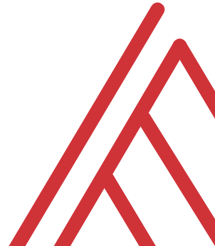
Questions?

Slide 9
Record Actions in Office Scripts

Slide 10
Record Actions in Office Scripts
Creating a script with Record Actions
Advantages and disadvantages of Record Actions
File: record-actions.xlsx
Resource: https://stringfestanalytics.com/how-to-understand-record-actions-in-office-scripts-for-excel/
Notes:
False!
Function, Formula, Function
Argument

Slide 11
Questions?

Slide 12
Understanding the structure of Office Scripts

Slide 13
function main() in Office Scripts
function main() as the heart of Office Scripts
‘Hello, world!’ in Office Scripts
Customizing function main()’s parameters
File: Open a blank workbook to proceed
Resource: https://stringfestanalytics.com/how-to-understand-function-main-in-office-scripts-for-excel/
Notes:
False!
Function, Formula, Function
Argument

Slide 14
Debugging with console.log()
Print to console with console.log()
How to use this for debugging, particularly in loops
File: Open a blank workbook to proceed
Resource: https://stringfestanalytics.com/how-to-understand-console-log-in-office-scripts-for-excel/
Notes:
False!
Function, Formula, Function
Argument

Slide 15
Sharing Office Scripts

Slide 16
Sharing your Office Scripts
Sharing within a workbook
Sharing with other users in an organization
Sharing outside your organization
File: sharing-office-scripts.xlsx
Resource: https://stringfestanalytics.com/office-scripts-for-excel-how-to-share-your-scripts/
Notes:
False!
Function, Formula, Function
Argument

Slide 17
Resource: stringfestanalytics.com
Subscribe for updates & access to my data analytics learning resource library
Notes:
False!
Function, Formula, Function
Argument

Slide 18
Thank you

