Slide 1
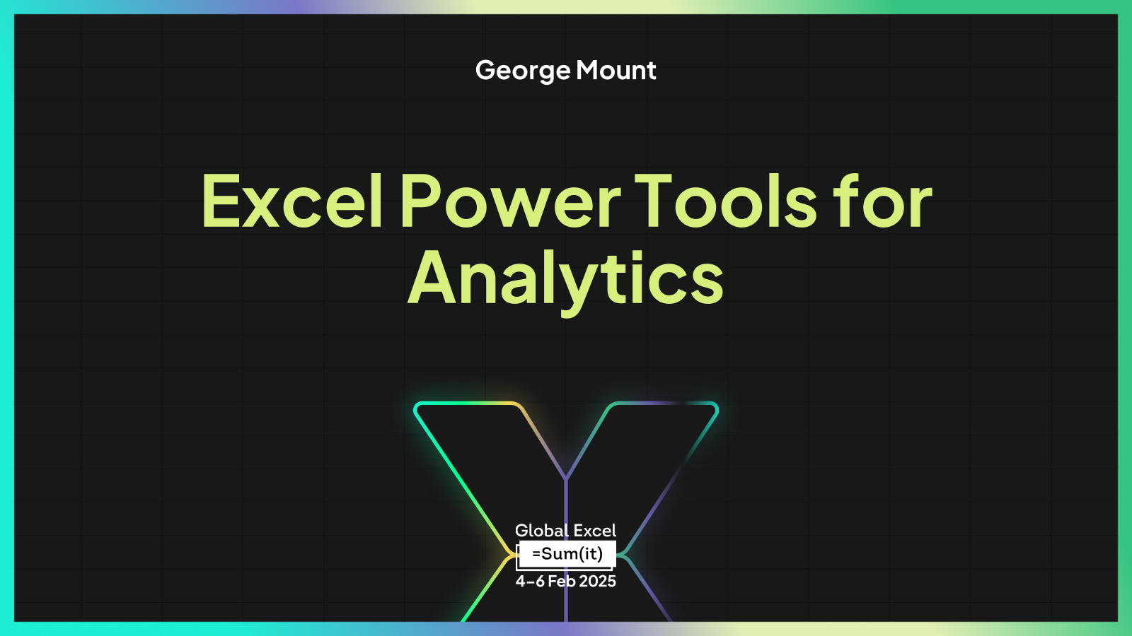

Slide 2
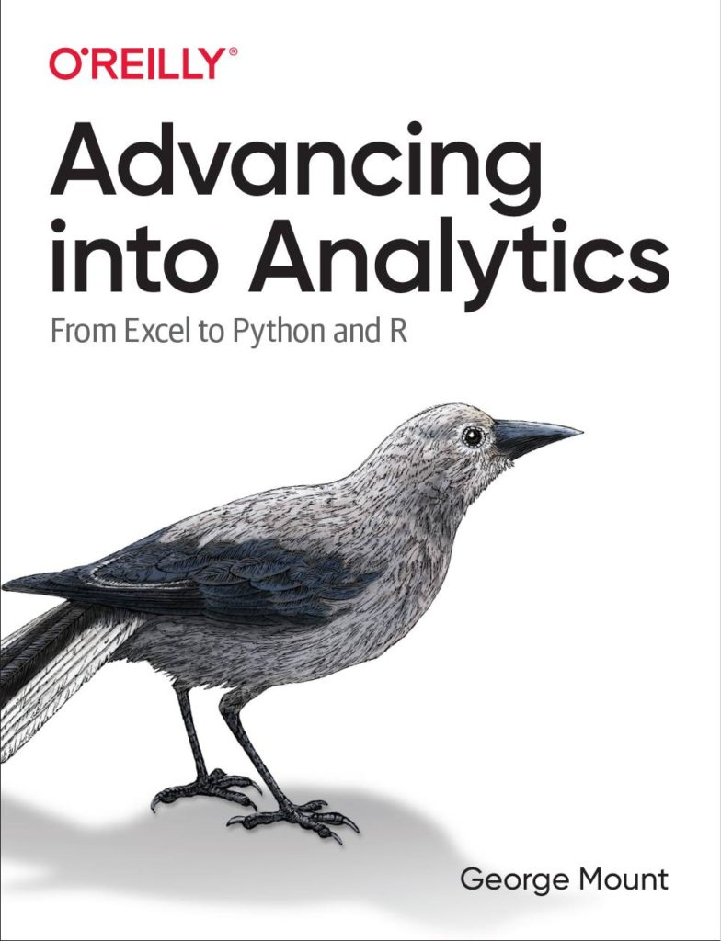

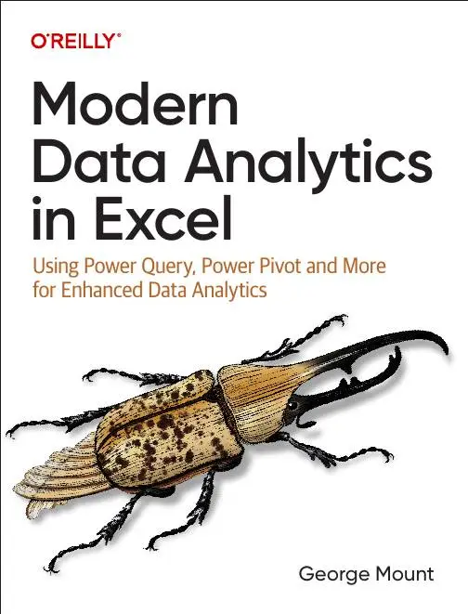



Hi, I’m George

Slide 3

Objectives for this session
Use current AI-powered features in Excel for data entry, analysis and automation
Augment and automate Excel analysis, visualization and reporting with Python and Python in Excel
Take Excel automation to new levels with Power Automate and Office Scripts

Slide 4
Following along
Download the resources: https://swiy.co/gxls25

Slide 5
Agenda
Copilot for Excel
Data manipulation
Data management
Data analysis & visualization
Python in Excel
First steps
Quick wins
Advanced Analysis with Copilot
Office Scripts
Office Scripts vs VBA
Record Actions
Understanding Office Scripts Structure
Sharing Office Scripts
Power Automate
Building a first flow
Customizing Excel outputs with Power Fx
Building flows with Copilot assistance
10am – 5pm
Expect ~10 min breaks every hour or so
1 hour lunch ~12:30-1pm?

Slide 6
I. Copilot for Excel

Slide 7
1. Data manipulation with Copilot

Slide 8
Data manipulation with Copilot
Getting data into Copilot
A tour of the Copilot editor
Table formatting with Copilot
File: copilot-data-manipulation.xlsx
Notes:
False!
Function, Formula, Function
Argument

Slide 9
Data manipulation with Copilot EXERCISE
Set up the data for Copilot
Format the date column in mm/dd/yyyy format
Format price and sales columns as currency
Add footer to display total sales
Set table’s font size to 30
File: copilot-data-manipulation-challenge.xlsx
Notes:
False!
Function, Formula, Function
Argument

Slide 10

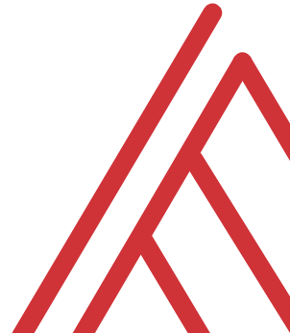

Questions?

Slide 11
2. Data management with Copilot

Slide 12
Data management with Copilot
Working with formulas and functions
Data profiling
Sorting and filtering
File: ai-powered-data-entry-forecasting.xlsx
Notes:
False!
Function, Formula, Function
Argument

Slide 13
Data management with Copilot EXERCISE
Add total_sales column: price * quantity
Hide price and quantity columns
Count the number of products in each category
Arrange dataset by total_sales, descending
File: copilot-data-management-challenge.xlsx
Notes:
False!
Function, Formula, Function
Argument

Slide 14
Questions?

Slide 15
3. Data analysis & visualization with Copilot

Slide 16
Data analysis & visualization with Copilot
Conditional formatting
Data analysis
Data visualization
File: copilot-analysis-visualization.xlsx
Notes:
False!
Function, Formula, Function
Argument

Slide 17
Data analysis & visualization with Copilot EXERCISE
Add data bar conditional format to avg_review column
Visualize relationship between avg_review and return_percentage
Chart total revenue over time
Find the leading product category based on revenue
File: copilot-analysis-visualization-exercise.xlsx
Notes:
False!
Function, Formula, Function
Argument

Slide 18
Questions?

Slide 19
Copilot for Excel RECAP
Copilot in Excel as AI agent – it tries to do things for you
Best for beginners… but also most confusing for beginners?
The “power” might lie in Python + Copilot + Excel
Notes:
False!
Function, Formula, Function
Argument

Slide 20
II. Python in Excel

Slide 21
1. Python in Excel: First Steps

Slide 22
Python in Excel: First steps
Understanding the Python in Excel environment
Loading Excel data into Python
Converting Python objects to Excel values
File: python-excel-first-steps.xlsx
Notes:
False!
Function, Formula, Function
Argument

Slide 23
Python in Excel: First steps EXERCISE
Load the penguins dataset into a DataFrame called penguins_df
Check the resulting dataset’s columns: run penguins_df.columns. Swith the output to display in Excel
Visualize relationship b/w bill length and body mass: run sns.scatterplot(x='bill_length_mm', y='body_mass_g', data=penguins_df). Practice resizing this plot.
File: python-excel-first-steps-exercise.xlsx
Notes:
False!
Function, Formula, Function
Argument

Slide 24
Questions?

Slide 25
2. From “that’s hard in Excel” to “that’s easy in Python”

Slide 26
From “that’s hard in Excel” to “that’s easy in Python” analysis
Data profiling: What is the shape, size, completeness?
Time series: pandas for panel data
Descriptive statistics/EDA: What stories might be told in this data?
File: hard-excel-easy-python-analysis.xlsx
Notes:
False!
Function, Formula, Function
Argument

Slide 27
From “that’s hard in Excel” to “that’s easy in Python” analysis EXERCISE
Explore relationship between sales, temperature, customer count over time
Fill in the blanks to complete the code
File: hard-excel-easy-python-analysis-exercise.xlsx
Notes:
False!
Function, Formula, Function
Argument

Slide 28
From “that’s hard in Excel” to “that’s easy in Python” visualization
Inserting and resizing Python plots in the workbook
Building plots in Python that would be difficult in Excel
Customizing the results of seaborn plots
File: hard-excel-easy-python-viz.xlsx
Notes:
False!
Function, Formula, Function
Argument

Slide 29
From “that’s hard in Excel” to “that’s easy in Python” visualization EXERCISE
Visualize this data to analyze sales, customer ratings, and more
Fill in the blanks to complete the code
File: hard-excel-easy-python-viz-exercise.xlsx
Notes:
False!
Function, Formula, Function
Argument

Slide 30
Questions?

Slide 31
3. Advanced Analysis with Copilot

Slide 32
Advanced Analysis with Copilot
How can Copilot help us with advanced analysis tasks like data visualization, time series, text analysis?
File: advanced-analysis-demos.xlsx
Notes:
False!
Function, Formula, Function
Argument

Slide 33
Advanced Analysis with Copilot EXERCISES
Try Advanced Analysis with Copilot to derive your own insights!
File: advanced-analysis-exercises.xlsx
Notes:
False!
Function, Formula, Function
Argument

Slide 34
Questions?

Slide 35
Python in Excel RECAP
Python can do some things easier – there’s a reason it’s in Excel now!
Consider Excel for front-end formatting, data entry and validation, Python for back-end data analysis and visualization
Notes:
False!
Function, Formula, Function
Argument

Slide 36
III. Office Scripts for Excel

Slide 37
1. Office Scripts vs VBA

Slide 38
Office Scripts vs VBA
Aspect | Office Scripts | VBA (Visual Basic for Applications)
Platform Compatibility | Primarily designed for Excel on the web. | Primarily used in Excel desktop applications.
Language | TypeScript/JavaScript. | VBA (a subset of Visual Basic).
Ease of Use | Requires familiarity with the JavaScript programming language, particularly the TypeScript superset. | Requires familiarity with the VBA programming language.
Integration | Can be integrated with Power Automate for automation across Microsoft 365. | Can interact with other Office applications through COM (Component Object Model).
Security | Runs in a more controlled environment, offering a higher level of security. | Macros can be a security risk if not properly managed.
Accessibility | Accessible primarily through Excel on the web. | Accessible through Excel desktop applications.

Slide 39
Office Scripts vs VBA (contd)
Recording Capability | Offers a macro recorder to generate scripts. | Offers a macro recorder to generate VBA code.
Deployment | Scripts can be shared across an organization through OneDrive and SharePoint. | Macros are typically shared through the distribution of Excel files.
Performance | Optimized for cloud-based spreadsheets and collaboration. | Optimized for desktop applications, can handle complex tasks efficiently.
Development Environment | Integrated development environment (IDE) in Excel. | VBA Editor (VBE) – a separate environment within Excel.
Learning Resources | Limited compared to VBA, but growing as Office Scripts is newer. | Extensive, given VBA’s long history and wide usage.
Automation Capabilities | Suited for lightweight to medium complexity automation tasks. | Capable of handling complex automation tasks, including interaction with Windows API and other external libraries.
https://stringfestanalytics.com/how-to-compare-office-scripts-and-vba-for-excel/

Slide 40
Questions?

Slide 41
2. Record Actions in Office Scripts

Slide 42
Record Actions in Office Scripts
Creating a script with Record Actions
Advantages and disadvantages of Record Actions
File: record-actions.xlsx
Resource: https://stringfestanalytics.com/how-to-understand-record-actions-in-office-scripts-for-excel/
Notes:
False!
Function, Formula, Function
Argument

Slide 43
Questions?

Slide 44
3. Understanding the structure of Office Scripts

Slide 45
function main() in Office Scripts
function main() as the heart of Office Scripts
‘Hello, world!’ in Office Scripts
Customizing function main()’s parameters
File: Open a blank workbook to proceed
Resource: https://stringfestanalytics.com/how-to-understand-function-main-in-office-scripts-for-excel/
Notes:
False!
Function, Formula, Function
Argument

Slide 46
Debugging with console.log()
Print to console with console.log()
How to use this for debugging, particularly in loops
File: Open a blank workbook to proceed
Resource: https://stringfestanalytics.com/how-to-understand-console-log-in-office-scripts-for-excel/
Notes:
False!
Function, Formula, Function
Argument

Slide 47
4. Sharing Office Scripts

Slide 48
Sharing your Office Scripts
Sharing within a workbook
Sharing with other users in an organization
Sharing outside your organization
File: sharing-office-scripts.xlsx
Resource: https://stringfestanalytics.com/office-scripts-for-excel-how-to-share-your-scripts/
Notes:
False!
Function, Formula, Function
Argument

Slide 49
Questions?

Slide 50
Office Scripts RECAP
Steep learning curve, limited resources
JavaScript/TypeScript as a web-friendly add-in/development tool for Excel?
Another great place to lean on Gen AI…
Notes:
False!
Function, Formula, Function
Argument

Slide 51
IV. Power Automate for Excel

Slide 52
First flow with Power Automate
Use Power Automate templates for Excel
Create clock in/clock out workflow
File: first-flow.xlsx
Notes:
False!
Function, Formula, Function
Argument

Slide 53
Customizing outputs with Power Fx
Continue with the previous example
How can we improve appearance of outputs in Excel?
Resource: https://stringfestanalytics.com/power-automate-for-excel-how-to-understand-the-power-fx-programming-language/
Notes:
False!
Function, Formula, Function
Argument

Slide 54
Building flows with Copilot
Get AI assistance to build a flow
Create a monthly email/post to Teams based on data in a workbook
File: power-automate-copilot.xlsx
Resource: https://stringfestanalytics.com/power-automate-for-excel-how-to-build-flows-with-copilot/
Notes:
False!
Function, Formula, Function
Argument

Slide 55
Questions?

Slide 56
Power Automate RECAP
Consider the Power Platform for further “citizen development”
Retrieve/move data at regular schedules (compared to ad-hoc with Power Query)
Power Automate & Office Scripts… better together
Notes:
False!
Function, Formula, Function
Argument

Slide 57


