Slide 1



Excel Power Tools for Analytics
George Mount

Slide 2
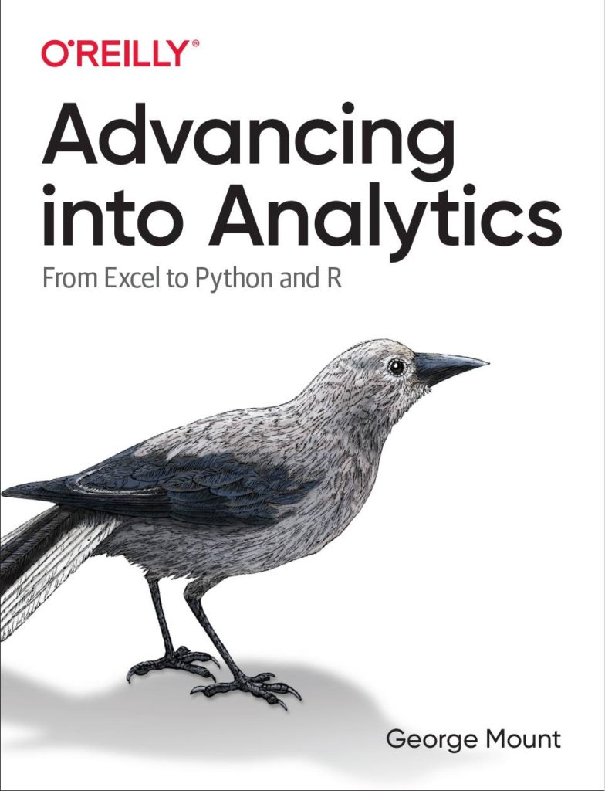

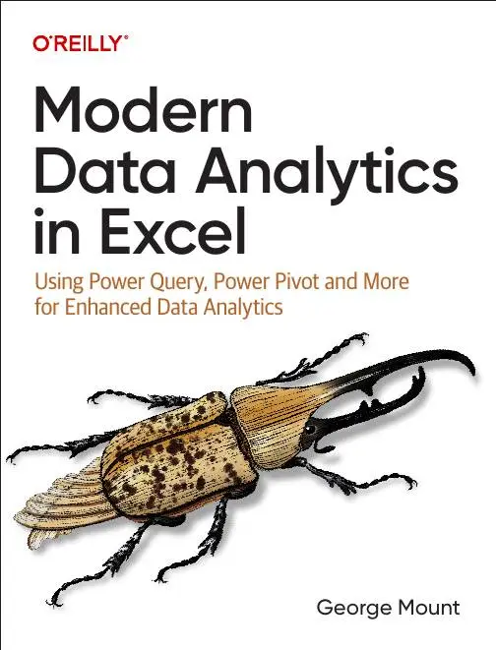


Hi, I’m George

Slide 3

Objectives for this session
Integrate Excel, Python, Copilot for data analysis.
Become a citizen data scientist!
Explore the future of Excel…

Slide 4

Following along
Download the resources: https://swiy.co/gxls2025

Slide 5



The most ambitious crossover event in history

Slide 6
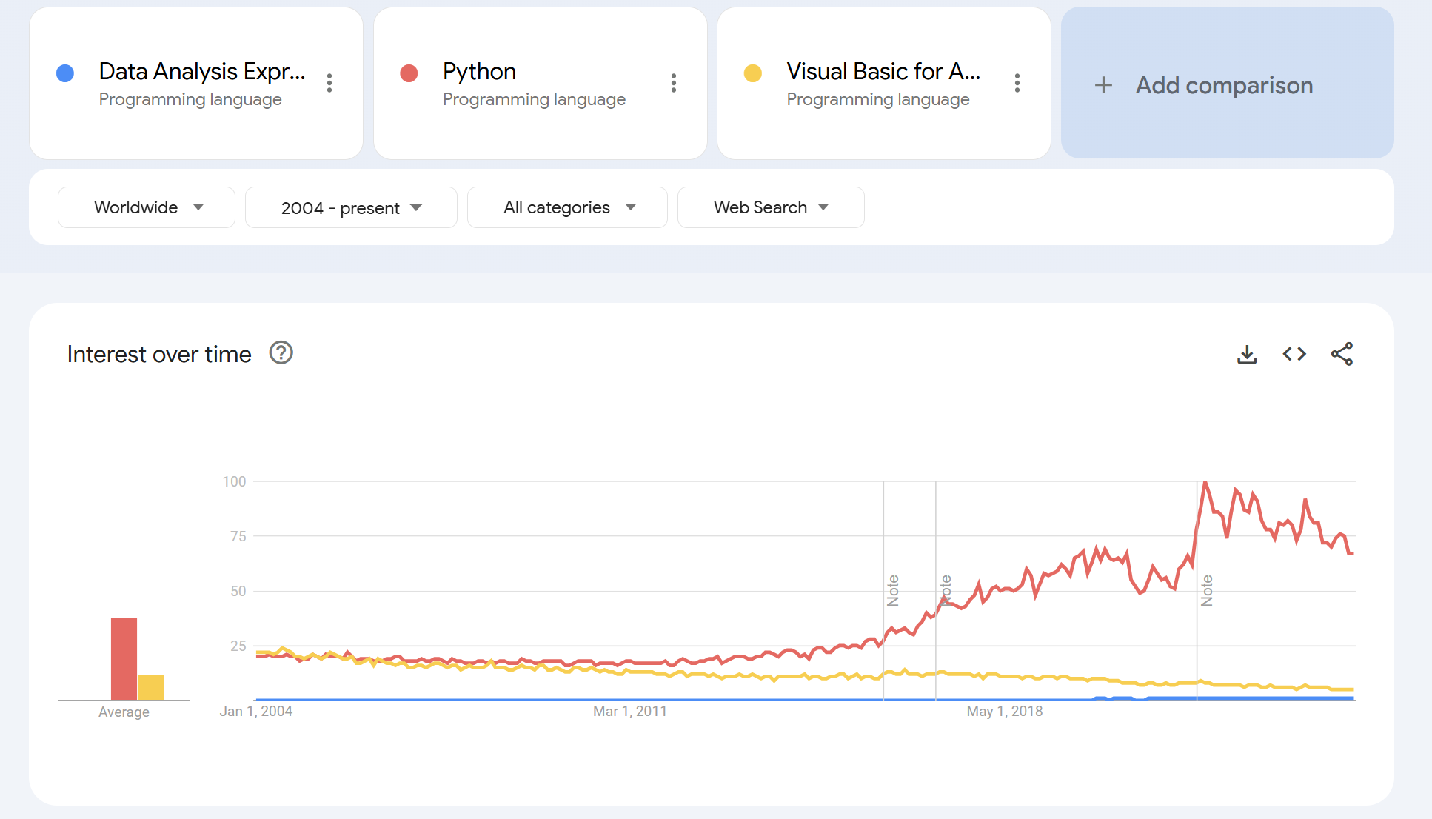
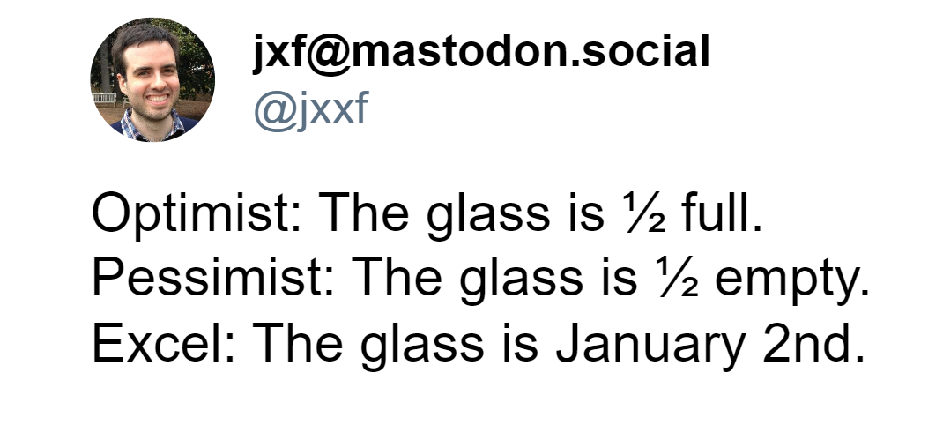
Why Python + Copilot + Excel?
Notes:
https://stringfestanalytics.com/the-end-of-dax-and-m-how-ai-and-python-are-transforming-excel/

Slide 7
1. Data manipulation with Copilot

Slide 8
Data manipulation with Copilot
Getting data into Copilot
A tour of the Copilot editor
Table formatting with Copilot
File: copilot-data-manipulation.xlsx
Notes:
False!
Function, Formula, Function
Argument

Slide 9
AI-powered data manipulation EXERCISE
Set up the data for Copilot
Format the date column in mm/dd/yyyy format
Format price and sales columns as currency
Add footer to display total sales
Set table’s font size to 30
File: copilot-data-manipulation-challenge.xlsx
Notes:
False!
Function, Formula, Function
Argument

Slide 10

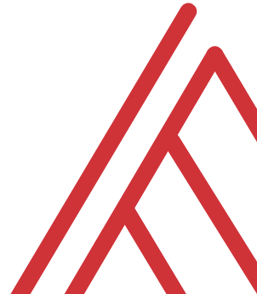

Questions?

Slide 11
2. Data management with Copilot

Slide 12
Data management with Copilot
Working with formulas and functions
Data profiling
Sorting and filtering
File: ai-powered-data-entry-forecasting.xlsx
Notes:
False!
Function, Formula, Function
Argument

Slide 13
Data management with Copilot EXERCISE
Add total_sales column: price * quantity
Hide price and quantity columns
Count the number of products in each category
Arrange dataset by total_sales, descending
File: copilot-data-management-challenge.xlsx
Notes:
False!
Function, Formula, Function
Argument

Slide 14
Questions?

Slide 15
3. Data analysis & visualization with Copilot

Slide 16
Data analysis & visualization with Copilot
Conditional formatting
Data analysis
Data visualization
File: copilot-analysis-visualization.xlsx
Notes:
False!
Function, Formula, Function
Argument

Slide 17
Data analysis & visualization with Copilot EXERCISE
Add data bar conditional format to avg_review column
Visualize relationship between avg_review and return_percentage
Chart total revenue over time
Find the leading product category based on revenue
File: copilot-analysis-visualization-exercise.xlsx
Notes:
False!
Function, Formula, Function
Argument

Slide 18
Questions?

Slide 19
AI-Powered Excel RECAP
AI in Excel learns over time – try adding more data
When one algorithm doesn’t work, try another
AI isn’t worth much without normalized, “tidy” datasets
Notes:
False!
Function, Formula, Function
Argument

Slide 20
Python in Excel

Slide 21
1. Python in Excel: First Steps

Slide 22
Python in Excel: First steps
Understanding the Python in Excel environment
Loading Excel data into Python
Converting Python objects to Excel values
File: python-excel-first-steps.xlsx
Notes:
False!
Function, Formula, Function
Argument

Slide 23
Python in Excel: First steps EXERCISE
Load the penguins dataset into a DataFrame called penguins_df
Check the resulting dataset’s columns: run penguins_df.columns. Swith the output to display in Excel
Visualize relationship b/w bill length and body mass: run sns.scatterplot(x='bill_length_mm', y='body_mass_g', data=penguins_df). Practice resizing this plot.
File: python-excel-first-steps-exercise.xlsx
Notes:
False!
Function, Formula, Function
Argument

Slide 24
Questions?

Slide 25
2. From “that’s hard in Excel” to “that’s easy in Python”

Slide 26
From “that’s hard in Excel” to “that’s easy in Python” analysis
Data profiling: What is the shape, size, completeness?
Time series: pandas for panel data
Descriptive statistics/EDA: What stories might be told in this data?
File: hard-excel-easy-python-analysis.xlsx
Notes:
False!
Function, Formula, Function
Argument

Slide 27
From “that’s hard in Excel” to “that’s easy in Python” analysis EXERCISE
Explore relationship between sales, temperature, customer count over time
Fill in the blanks to complete the code
File: hard-excel-easy-python-analysis-exercise.xlsx
Notes:
False!
Function, Formula, Function
Argument

Slide 28
Questions?

Slide 29
3. There’s more to Python and Excel than Python in Excel

Slide 30
There’s more to Python and Excel than Python in Excel
Python in Excel is all about data analysis, visualization, statistics & ML
It lacks Excel automation capabilities
Let’s automate an entire Excel workbook from Python… without opening Excel!
File: pae-pie.ipynb
Notes:
False!
Function, Formula, Function
Argument

Slide 31
There’s more to Python and Excel than Python in Excel EXERCISE
Automate production of a workbook comparing website visitors versus rating
Fill in the blanks to create the script
File: pae-pie-exercise.ipynb
Notes:
False!
Function, Formula, Function
Argument

Slide 32
Questions?

Slide 33


Slide 35


