Slide 1



Excel Power Tools for Analytics
George Mount

Slide 2
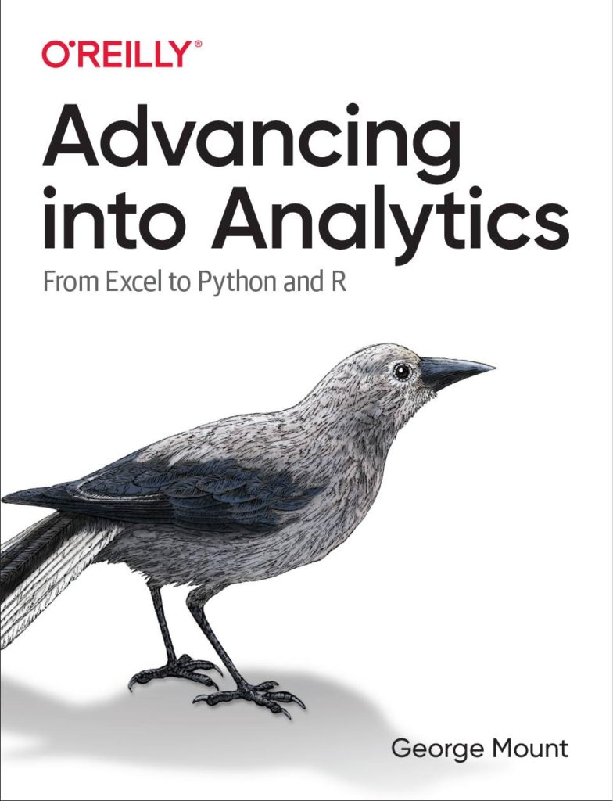

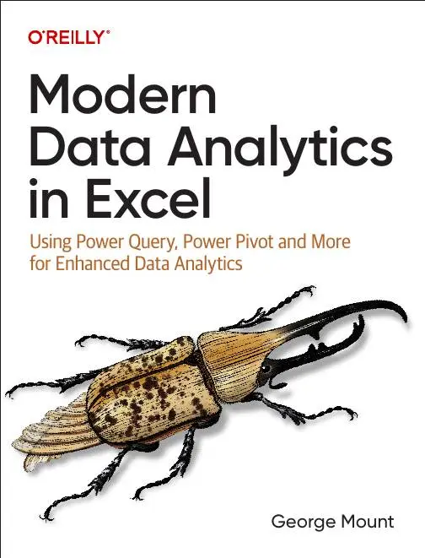



Hi, I’m George

Slide 3


Following along
Download the resources: https://swiy.co/gxls2025

Slide 4
Objectives for this session
Integrate Excel, Python, Copilot for data analysis.
Become a citizen data scientist!
Explore the future of Excel…

Slide 5
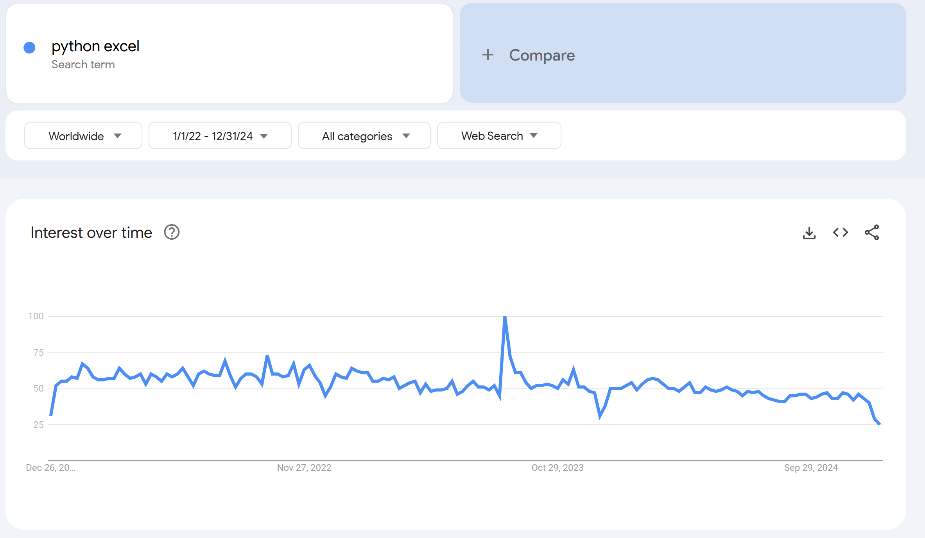
Python in Excel… not enough?
Python in Excel public preview 8/22/23
Notes:
Google Trends since beginning of 2022 through end of 2024
https://trends.google.com/trends/explore/TIMESERIES/1738242600?hl=en-US&tz=300&date=2022-01-01+2024-12-31&hl=en&q=python+excel,copilot+excel&sni=3
Date sources
Python in Excel: https://techcommunity.microsoft.com/blog/excelblog/announcing-python-in-excel-combining-the-power-of-python-and-the-flexibility-of-/3893439/replies/3906074
Copilot: https://www.microsoft.com/en-us/microsoft-365/blog/2024/09/16/microsoft-365-copilot-wave-2-pages-python-in-excel-and-agents/

Slide 6
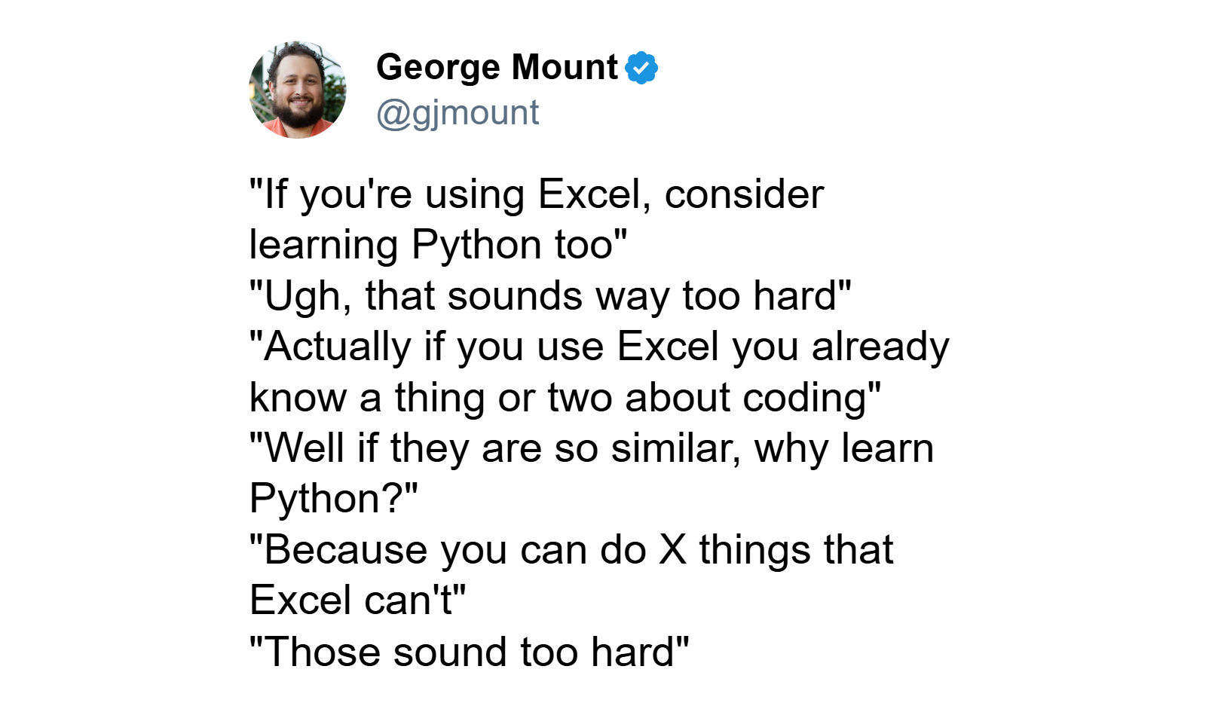
Python in Excel… not enough?
Notes:
A lot of hostility, but some interest…

Slide 7
Copilot in Excel… not enough?
Python in Excel public preview 8/22/23
Microsoft 365 Copilot commercially available 11/01/23
Notes:
Was it AI that made people lose even more interest? I don’t know. Most people hated Copilot in Excel BUT there was a prevailing narrative that AI meant you didn’t need to learn how to code anymore. But again , did I mention that people REALLY hated Copilot?!
Google Trends since beginning of 2022 through end of 2024
https://trends.google.com/trends/explore/TIMESERIES/1738242600?hl=en-US&tz=300&date=2022-01-01+2024-12-31&hl=en&q=python+excel,copilot+excel&sni=3
Date sources
Python in Excel: https://techcommunity.microsoft.com/blog/excelblog/announcing-python-in-excel-combining-the-power-of-python-and-the-flexibility-of-/3893439/replies/3906074
Copilot: https://www.microsoft.com/en-us/microsoft-365/blog/2024/09/16/microsoft-365-copilot-wave-2-pages-python-in-excel-and-agents/

Slide 8

Copilot in Excel… not enough?
Notes:
Not singling Wyn out, I think most people thought that!

Slide 9
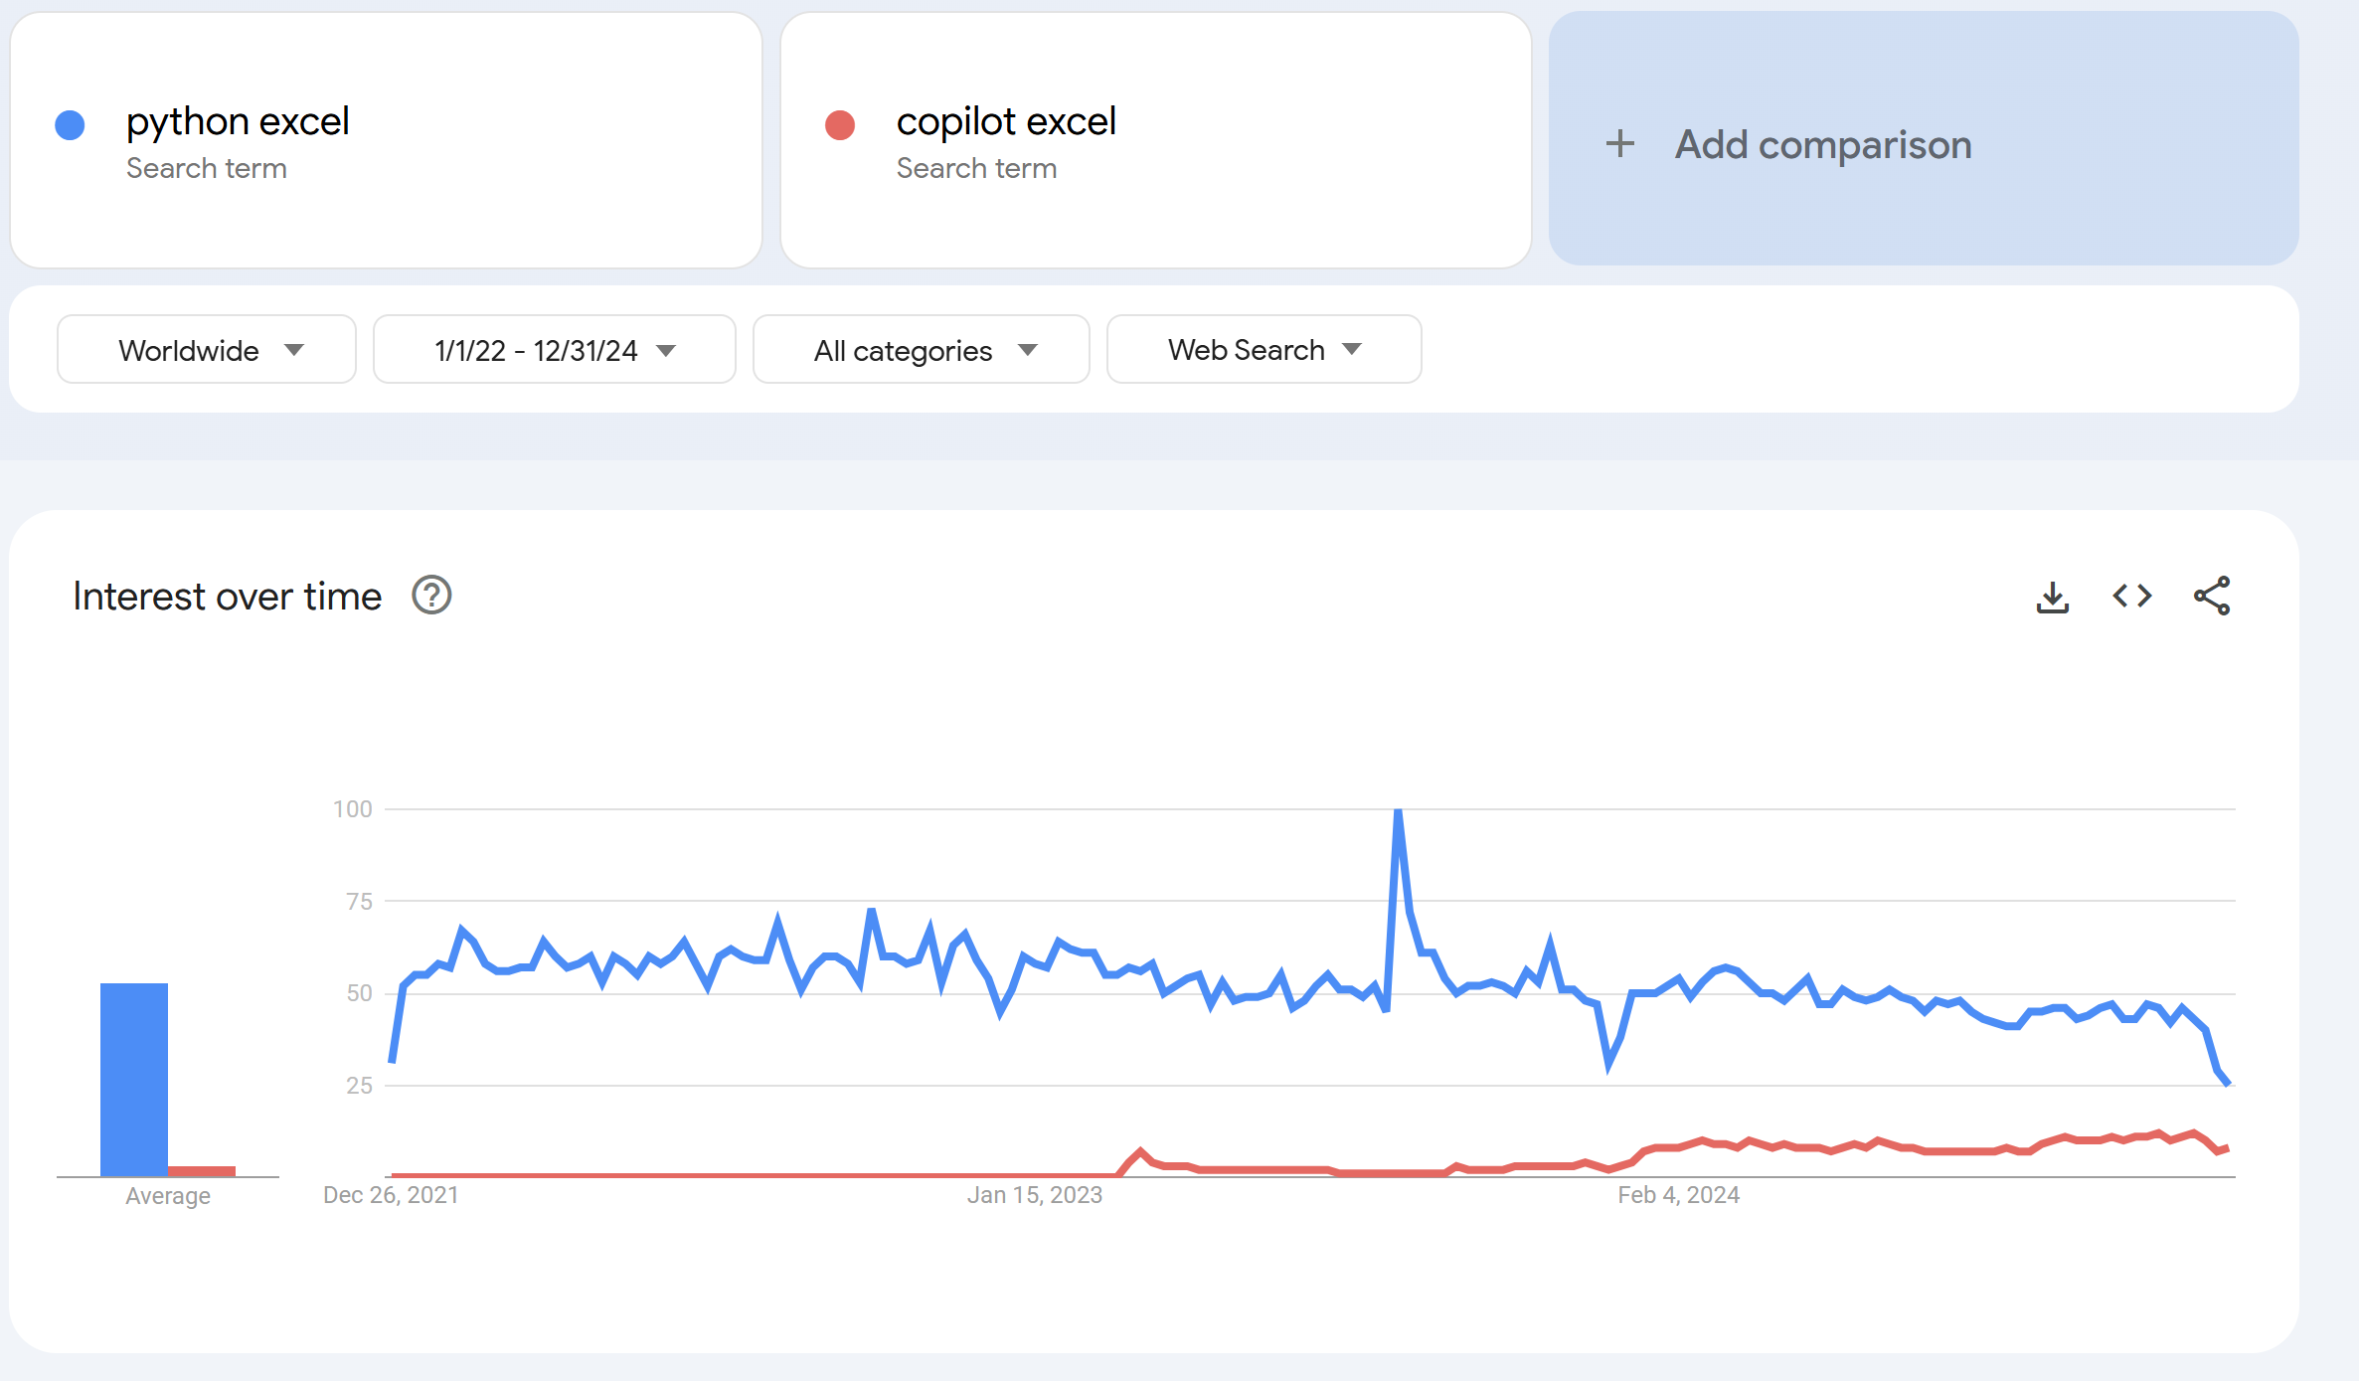
Copilot + Python + Excel… maybe enough?
Python in Excel public preview 8/22/23
Microsoft 365 Copilot commercially available 11/1/23
Advanced Analysis in Copilot public preview 9/16/24
Notes:
Google Trends since beginning of 2022 through end of 2024
https://trends.google.com/trends/explore/TIMESERIES/1738242600?hl=en-US&tz=300&date=2022-01-01+2024-12-31&hl=en&q=python+excel,copilot+excel&sni=3
Date sources
Python in Excel: https://techcommunity.microsoft.com/blog/excelblog/announcing-python-in-excel-combining-the-power-of-python-and-the-flexibility-of-/3893439/replies/3906074
Copilot: https://www.microsoft.com/en-us/microsoft-365/blog/2024/09/16/microsoft-365-copilot-wave-2-pages-python-in-excel-and-agents/

Slide 10



The most ambitious crossover event in history

Slide 11
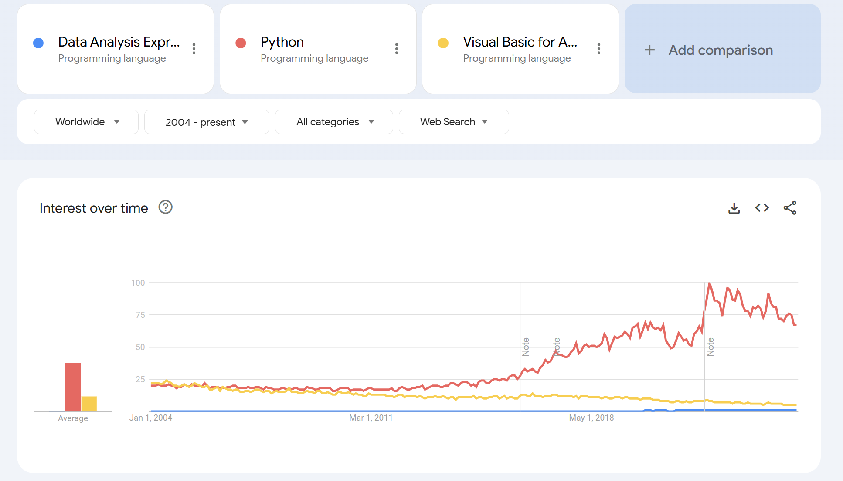
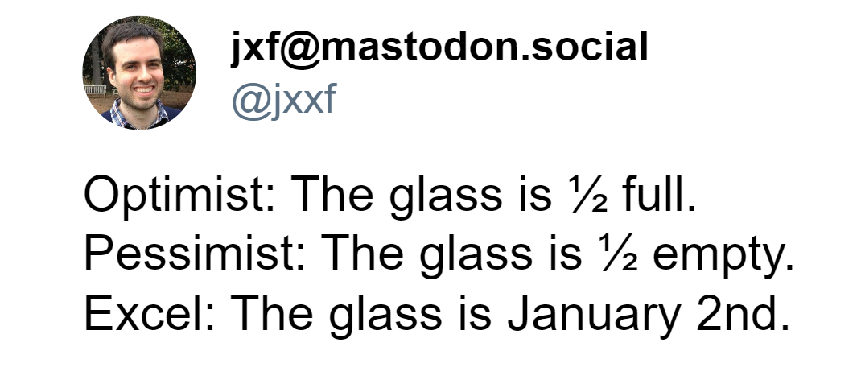
Why Python + Copilot + Excel?
Notes:
https://stringfestanalytics.com/the-end-of-dax-and-m-how-ai-and-python-are-transforming-excel/
To get started, I want to discuss why the combination of Python, Copilot, and Excel creates such a powerful synergy in data analysis and automation. Python is renowned for its simplicity and readability, making it an excellent 'glue' language. Unlike Excel's complex architecture, Python offers a smooth, snag-free experience for developers. Its syntax is clean and intuitive, which reduces errors and makes code maintenance easier. This simplicity is crucial when integrating different tools and workflows.
Copilot excels at working with Python code because of Python's extensive and well-documented codebase. This vast repository provides a rich learning ground for Copilot's machine learning model. As an AI pair programmer, Copilot leverages this knowledge to suggest code completions, write entire functions, and even help debug Python scripts in real-time, enhancing productivity significantly.
Excel, while powerful, has been the subject of many jokes regarding its data integrity issues. The humor in the slide points out Excel's tendency to misinterpret data, like turning dates into numbers or mixing up different data types. Additionally, Excel's architecture with separate components like Power Query for data transformation, Power Pivot for data modeling, and VBA for automation, creates silos which can be challenging to integrate seamlessly.
Integrating Python with Excel through tools like Python's pandas library or Excel's Python add-ins allows us to leverage Excel's user-friendly interface while overcoming its limitations with Python's robust data handling capabilities. Copilot acts as the bridge, providing intelligent coding assistance in Python, which can then interact with Excel data, making data manipulation, analysis, and visualization more efficient and less error-prone.
Given the trend towards more open, flexible, and integrated tools, the future seems less promising for proprietary languages like Excel's VBA. Python's open-source nature, coupled with AI assistance from tools like Copilot, offers a scalable and future-proof solution. This crossover not only enhances current workflows but also prepares us for future advancements in AI and data science, where Python will likely continue to play a leading role.
In summary, the combination of Python's simplicity, Copilot's AI-driven assistance, and Excel's widespread use creates a dynamic ecosystem. It addresses Excel's weaknesses while capitalizing on Python's strengths, making this trio a formidable force in data-driven environments.

Slide 12
Time for a demo….

Slide 13


Slide 14
The future of Excel?
Tool | Primary Functions | Strengths
Python | Backend data analysis, advanced charting, machine learning | Powerful data manipulation with libraries like pandas, extensive visualization options with libraries like matplotlib and seaborn
Excel | Frontend formatting, usability, interactive dashboards | User-friendly interface, widespread usage, well-suited for formatting and presentation

Slide 15
The future of Excel?
Tool | Primary Functions | Strengths
Python | Backend data analysis, advanced charting, machine learning | Powerful data manipulation with libraries like pandas, extensive visualization options with libraries like matplotlib and seaborn
Excel | Frontend formatting, usability, interactive dashboards | User-friendly interface, widespread usage, well-suited for formatting and presentation
JavaScript/TypeScript | Additional add-ins, enhanced interactivity, web integration | Building and integrating more complex functionalities, expanding Excel’s capabilities into web and app development
Notes:
In our discussion today about the future of Excel, we've focused on the integration of Python for backend data analysis, advanced charting, and machine learning, which offers powerful data manipulation capabilities through libraries like pandas and extensive visualization options with libraries like matplotlib and seaborn.
Excel itself continues to shine with its frontend formatting, usability, and interactive dashboards, providing a user-friendly interface that's well-suited for widespread usage, formatting, and presentation.
Now, although we haven't delved into JavaScript today, it's important to note that JavaScript, along with TypeScript, shares similar advantages to Python but in the realm of building applications, add-ins, and more for Excel. JavaScript and TypeScript enable additional add-ins, enhance interactivity, and facilitate web integration, allowing for the building and integration of more complex functionalities. This expands Excel's capabilities into web and app development, making it a versatile tool not just for data analysis but also for creating sophisticated user experiences within Excel's ecosystem.
This synergy between Python, Excel, and JavaScript/TypeScript paints a promising picture for Excel's future, where it can evolve into a more comprehensive platform for both data professionals and developers.

Slide 16
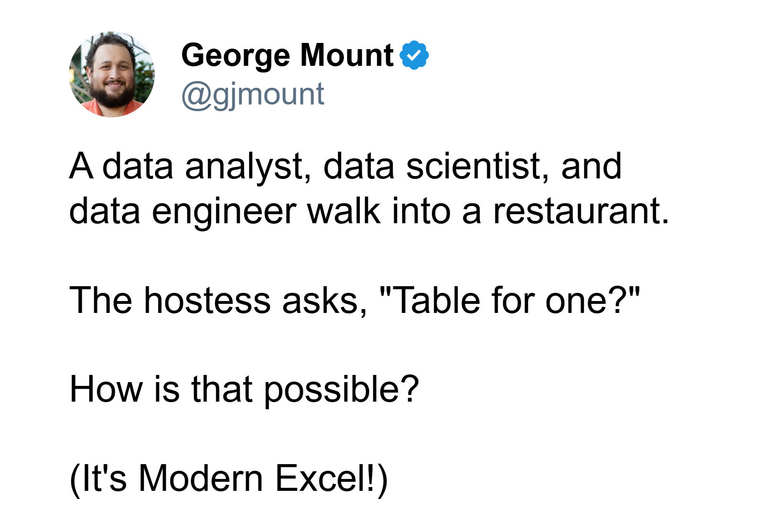

The future of Excel?
Notes:
Good afternoon, everyone. Today, we're exploring how Excel has become a powerful tool for transforming everyday professionals into citizen data analysts, scientists, and engineers, especially in the era of AI. Despite concerns about AI potentially rendering Excel skills obsolete, the reality is quite the opposite. Excel, with AI integration, serves as a gateway to advanced analytics, automated workflows, and machine learning, making it more relevant than ever.
First, let's define what a "citizen" data professional is. These are individuals who, without formal data roles, leverage Excel to build analytical models, automate processes, and even engage in predictive modeling from their own PCs. This democratization of data work allows them to bypass traditional IT bottlenecks, enhancing their productivity and agility.
For citizen data analysts, Excel has become a BI powerhouse through tools like Power Query, which automates data transformation from various sources, and Power Pivot, which enables complex data modeling and dynamic dashboard creation. Imagine receiving multiple CSV files each month; with Power Query, you can clean and transform these files effortlessly, then use Power Pivot to model the data, creating relationships and measures that power your interactive reports. This means decisions can be made instantly, without waiting for IT support or expensive BI tools.
Moving to citizen data scientists, Excel's integration with Python, facilitated by tools like LAMBDA(), transforms it into a robust platform for data science. Users can now perform tasks like setting random seeds, exploring statistical distributions, and splitting data for machine learning within Excel. This integration allows for advanced visualizations beyond Excel's native capabilities, making data analysis more intuitive. LAMBDA() further enhances this by allowing the creation of custom, complex formulas, essentially making Excel Turing complete for advanced calculations.
Finally, for citizen data engineers, Excel's capabilities are expanded through Power Automate and Office Scripts. Power Automate connects Excel with various workflows, automating data pipelines and ensuring data flows where it's needed, when it's needed. Office Scripts, a modern alternative to VBA, automates repetitive tasks like data formatting and report generation. For instance, a workflow might involve Power Automate detecting new CSV files in a SharePoint folder, appending them to an Excel workbook, with an Office Script then standardizing the data and updating dashboards, all without manual intervention.
The bridge that ties all these roles together is AI, particularly through Microsoft’s Copilot. For analysts, Copilot can construct complex PivotTables or dashboards from natural language commands, streamlining data interpretation. Data scientists can use Copilot for real-time Python code assistance within Excel, from model training to debugging. For engineers, Copilot simplifies setting up data workflows, making sophisticated automation accessible through simple descriptions.
In summary, Excel, powered by AI, enables a wide range of professionals to engage in data roles traditionally requiring specialized skills. This not only boosts productivity but also fosters a data-driven culture across organizations. As we conclude, I encourage you to think about which of these roles excites you the most, how AI integration can enhance your workflow, and what new skills you're eager to develop with Excel's evolving capabilities. Please share your thoughts and questions below.
https://gist.github.com/summerofgeorge/c8fff44d39519c56daf31a6176005034#file-citizen-da-ds-de-md

Slide 17
Python in Excel… not enough?
Notes:
A lot of hostility, but some interest…

Slide 18
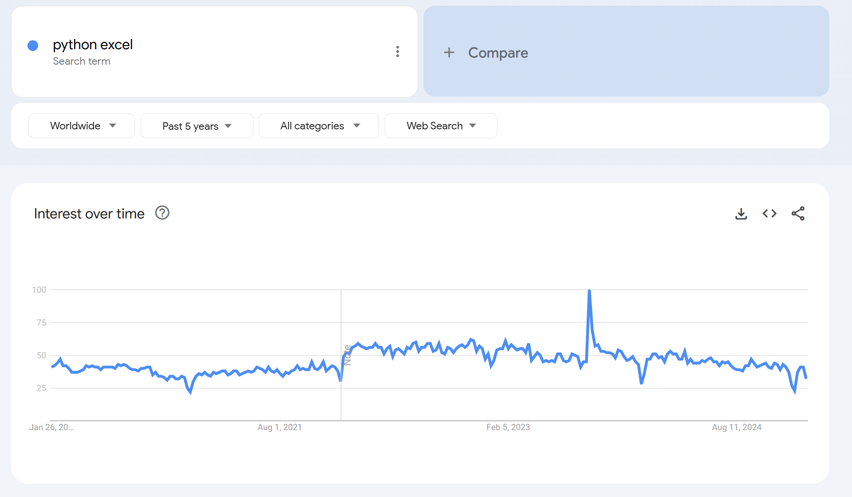
Python in Excel… not enough?
Python in Excel announcement
Notes:
A quick honeymoon period for Pytohn in Excel, what happened?

Slide 19
Copilot in Excel… not enough?
Python in Excel announcement
Copilot in Excel announcement
Notes:
Was it AI? I don’t know. Most people hated Copilot in Excel

Slide 20
Copilot in Excel… not enough?
Notes:
Not singling Wyn out, I think most people thought that!

Slide 21
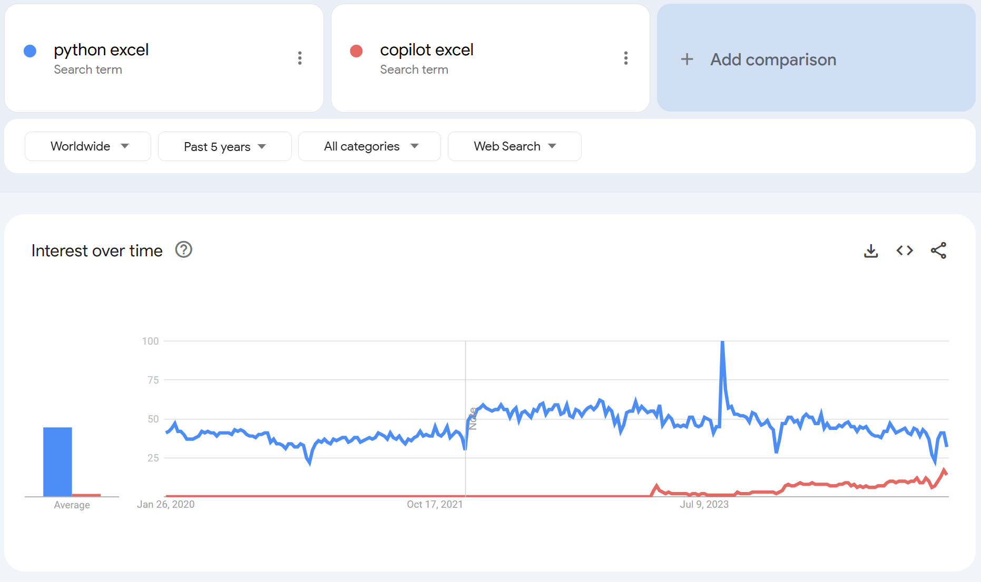
Copilot in Excel… not enough?
Python in Excel announcement
Copilot in Excel announcement
Notes:
So Copilot is slowly growing in interest

Slide 22
Copilot in Excel… not enough?
Python in Excel announcement
Copilot in Excel announcement
Notes:
So Copilot is slowly growing in interest

Slide 23
Copilot + Python + Excel… maybe enough?
Python in Excel announcement
Copilot in Excel announcement
Advanced Analysis with Copilot announcement
Notes:
So Copilot is slowly growing in interest

Slide 24
The most ambitious crossover event in history

Slide 25
Why Python + Copilot + Excel?
Notes:
https://stringfestanalytics.com/the-end-of-dax-and-m-how-ai-and-python-are-transforming-excel/
To get started, I want to discuss why the combination of Python, Copilot, and Excel creates such a powerful synergy in data analysis and automation. Python is renowned for its simplicity and readability, making it an excellent 'glue' language. Unlike Excel's complex architecture, Python offers a smooth, snag-free experience for developers. Its syntax is clean and intuitive, which reduces errors and makes code maintenance easier. This simplicity is crucial when integrating different tools and workflows.
Copilot excels at working with Python code because of Python's extensive and well-documented codebase. This vast repository provides a rich learning ground for Copilot's machine learning model. As an AI pair programmer, Copilot leverages this knowledge to suggest code completions, write entire functions, and even help debug Python scripts in real-time, enhancing productivity significantly.
Excel, while powerful, has been the subject of many jokes regarding its data integrity issues. The humor in the slide points out Excel's tendency to misinterpret data, like turning dates into numbers or mixing up different data types. Additionally, Excel's architecture with separate components like Power Query for data transformation, Power Pivot for data modeling, and VBA for automation, creates silos which can be challenging to integrate seamlessly.
Integrating Python with Excel through tools like Python's pandas library or Excel's Python add-ins allows us to leverage Excel's user-friendly interface while overcoming its limitations with Python's robust data handling capabilities. Copilot acts as the bridge, providing intelligent coding assistance in Python, which can then interact with Excel data, making data manipulation, analysis, and visualization more efficient and less error-prone.
Given the trend towards more open, flexible, and integrated tools, the future seems less promising for proprietary languages like Excel's VBA. Python's open-source nature, coupled with AI assistance from tools like Copilot, offers a scalable and future-proof solution. This crossover not only enhances current workflows but also prepares us for future advancements in AI and data science, where Python will likely continue to play a leading role.
In summary, the combination of Python's simplicity, Copilot's AI-driven assistance, and Excel's widespread use creates a dynamic ecosystem. It addresses Excel's weaknesses while capitalizing on Python's strengths, making this trio a formidable force in data-driven environments.

Slide 26
Time for a demo….

Slide 28
The future of Excel?
Tool | Primary Functions | Strengths
Python | Backend data analysis, advanced charting, machine learning | Powerful data manipulation with libraries like pandas, extensive visualization options with libraries like matplotlib and seaborn
Excel | Frontend formatting, usability, interactive dashboards | User-friendly interface, widespread usage, well-suited for formatting and presentation

Slide 29
The future of Excel?
Tool | Primary Functions | Strengths
Python | Backend data analysis, advanced charting, machine learning | Powerful data manipulation with libraries like pandas, extensive visualization options with libraries like matplotlib and seaborn
Excel | Frontend formatting, usability, interactive dashboards | User-friendly interface, widespread usage, well-suited for formatting and presentation
JavaScript/TypeScript | Additional add-ins, enhanced interactivity, web integration | Building and integrating more complex functionalities, expanding Excel’s capabilities into web and app development
Notes:
In our discussion today about the future of Excel, we've focused on the integration of Python for backend data analysis, advanced charting, and machine learning, which offers powerful data manipulation capabilities through libraries like pandas and extensive visualization options with libraries like matplotlib and seaborn.
Excel itself continues to shine with its frontend formatting, usability, and interactive dashboards, providing a user-friendly interface that's well-suited for widespread usage, formatting, and presentation.
Now, although we haven't delved into JavaScript today, it's important to note that JavaScript, along with TypeScript, shares similar advantages to Python but in the realm of building applications, add-ins, and more for Excel. JavaScript and TypeScript enable additional add-ins, enhance interactivity, and facilitate web integration, allowing for the building and integration of more complex functionalities. This expands Excel's capabilities into web and app development, making it a versatile tool not just for data analysis but also for creating sophisticated user experiences within Excel's ecosystem.
This synergy between Python, Excel, and JavaScript/TypeScript paints a promising picture for Excel's future, where it can evolve into a more comprehensive platform for both data professionals and developers.

Slide 30
The future of Excel?
Notes:
Good afternoon, everyone. Today, we're exploring how Excel has become a powerful tool for transforming everyday professionals into citizen data analysts, scientists, and engineers, especially in the era of AI. Despite concerns about AI potentially rendering Excel skills obsolete, the reality is quite the opposite. Excel, with AI integration, serves as a gateway to advanced analytics, automated workflows, and machine learning, making it more relevant than ever.
First, let's define what a "citizen" data professional is. These are individuals who, without formal data roles, leverage Excel to build analytical models, automate processes, and even engage in predictive modeling from their own PCs. This democratization of data work allows them to bypass traditional IT bottlenecks, enhancing their productivity and agility.
For citizen data analysts, Excel has become a BI powerhouse through tools like Power Query, which automates data transformation from various sources, and Power Pivot, which enables complex data modeling and dynamic dashboard creation. Imagine receiving multiple CSV files each month; with Power Query, you can clean and transform these files effortlessly, then use Power Pivot to model the data, creating relationships and measures that power your interactive reports. This means decisions can be made instantly, without waiting for IT support or expensive BI tools.
Moving to citizen data scientists, Excel's integration with Python, facilitated by tools like LAMBDA(), transforms it into a robust platform for data science. Users can now perform tasks like setting random seeds, exploring statistical distributions, and splitting data for machine learning within Excel. This integration allows for advanced visualizations beyond Excel's native capabilities, making data analysis more intuitive. LAMBDA() further enhances this by allowing the creation of custom, complex formulas, essentially making Excel Turing complete for advanced calculations.
Finally, for citizen data engineers, Excel's capabilities are expanded through Power Automate and Office Scripts. Power Automate connects Excel with various workflows, automating data pipelines and ensuring data flows where it's needed, when it's needed. Office Scripts, a modern alternative to VBA, automates repetitive tasks like data formatting and report generation. For instance, a workflow might involve Power Automate detecting new CSV files in a SharePoint folder, appending them to an Excel workbook, with an Office Script then standardizing the data and updating dashboards, all without manual intervention.
The bridge that ties all these roles together is AI, particularly through Microsoft’s Copilot. For analysts, Copilot can construct complex PivotTables or dashboards from natural language commands, streamlining data interpretation. Data scientists can use Copilot for real-time Python code assistance within Excel, from model training to debugging. For engineers, Copilot simplifies setting up data workflows, making sophisticated automation accessible through simple descriptions.
In summary, Excel, powered by AI, enables a wide range of professionals to engage in data roles traditionally requiring specialized skills. This not only boosts productivity but also fosters a data-driven culture across organizations. As we conclude, I encourage you to think about which of these roles excites you the most, how AI integration can enhance your workflow, and what new skills you're eager to develop with Excel's evolving capabilities. Please share your thoughts and questions below.
https://gist.github.com/summerofgeorge/c8fff44d39519c56daf31a6176005034#file-citizen-da-ds-de-md

Slide 31

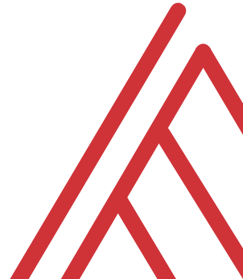

Questions?

Slide 32
