Slide 1
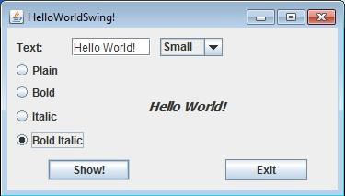
JRadioButtons
JTextField
Title
JComboBox for font size
JLabel
shows whatever typed in
at JTextField

