Slide 1
Generative Adversarial Networks and Training Using Limited Data
Joe Strinka

Slide 2
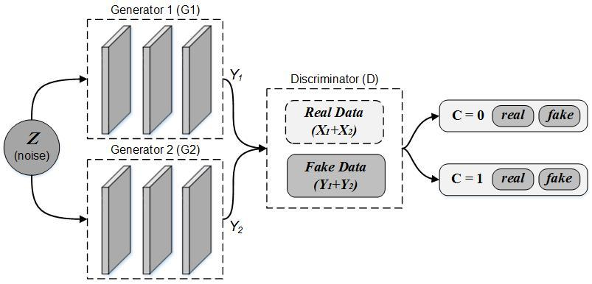
Generative Adversarial Networks (GANs)
GANs run off the concept of zero-sum framework
Mathematical representation of a situation in which each participant's gain or loss of utility is exactly balanced by the losses or gains of the utility of the other participants.
Generative
Generates new information
Adversarial
Generator and Discriminator
Network
Commonly complex neural nets

Slide 3
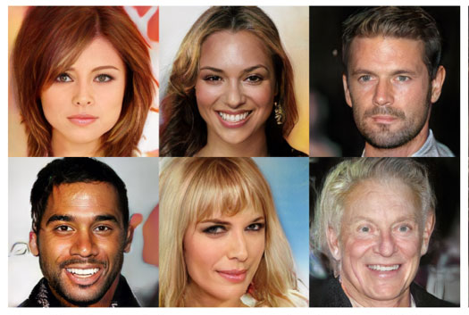
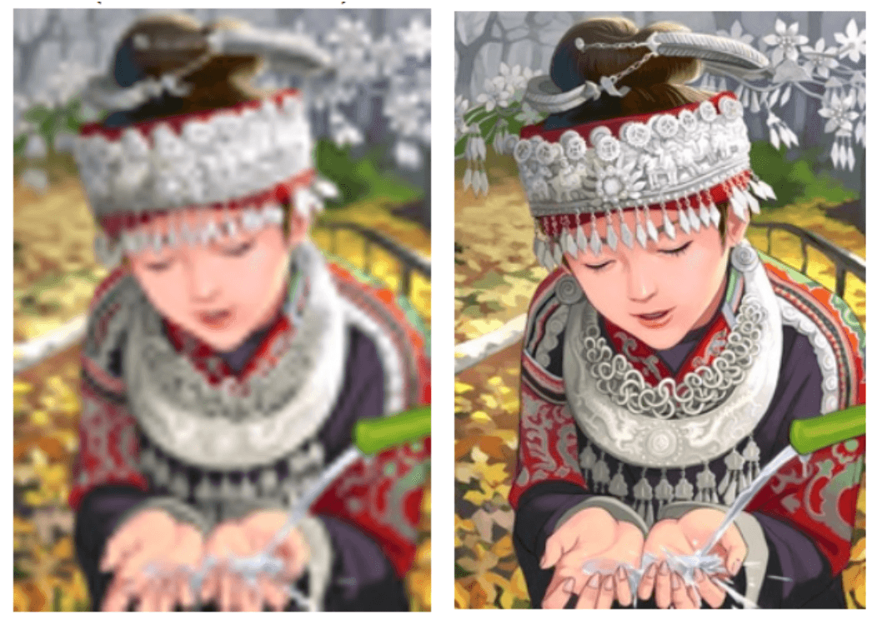
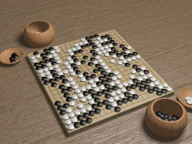
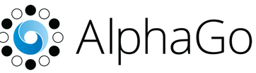
What Can they do
Image Generation
Resolution Enhancement
Go Champions
GANs can generate pictures indistinguishable from real pictures
GANs can be used to de-haze images and increase resolutions
Google’s AlphaGo implemented GANs in the mid-layers in order to beat world champion Go player Ke Jie

Slide 4
Challenges with GANs
Hyper parameter tuning cannot be done automatically (using skopt or similar)
If there is insufficient data to train the discriminator, then the generator will just copy the training data.
DeliGAN
Reparameterizes the latent generative space as a mixture model and learn the mixture model's parameters along with those of GAN.

Slide 5
Key Points
GANs are cool
The discriminator minimizes a cross-entropy, but the generator maximizes the same cross-entropy.
GANs have many uses such as language processing, image generation, resolution enhancement, and game learning
GANs don’t really fix the issue of insufficient data
If the training set is too small, the discriminator will learn to memorize the training data so the generator will just copy the training data

Slide 6
Questions?

