Slide 1
Project 1
Uber Rides in NYC
Sumita Trivedi
09/19/2020

Slide 2
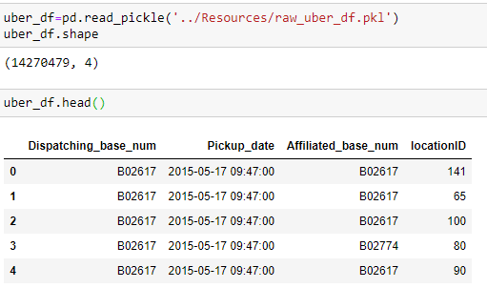
Uber Rides data
Data Source:
https://www.kaggle.com/fivethirtyeight/uber-pickups-in-new-york-city?select=Uber-Jan-Feb-FOIL.csv
14,270,479 Uber rides from January to June 2015 in New York City

Slide 3
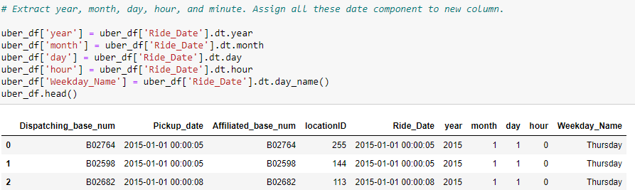
Extract Month, Date, Day of the Week, Hour

Slide 4
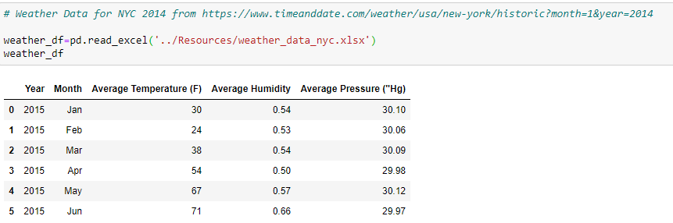
Weather Data
Get Weather data for NYC for Jan to June 2015

Slide 5
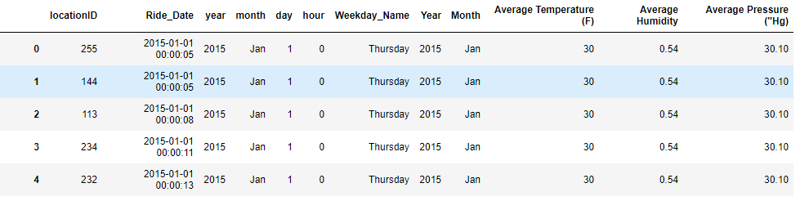
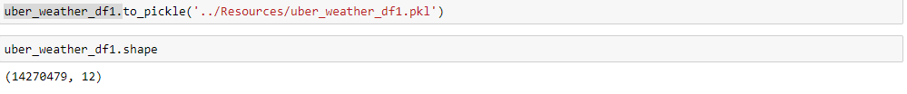
Creating Analysis Dataset
Join Uber ride and weather data on Month

Slide 6
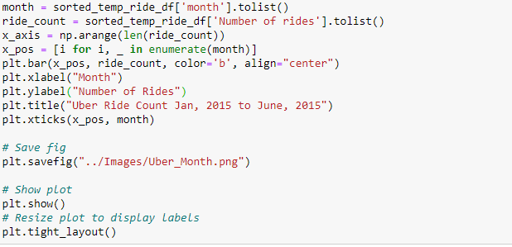
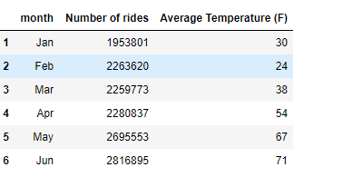
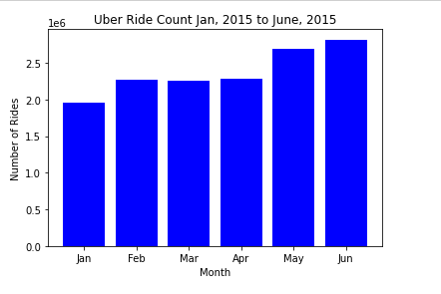
Do the number of Uber rides in NYC change with change in average Monthly Temperature

Slide 7
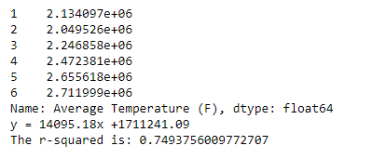
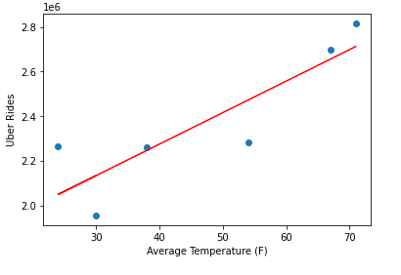
Do the number of Uber rides in NYC change with change in average Monthly Temperature
Perform a linear regression on temperature vs Number of Uber rides
Create line equation string , get regression values, r-square
Number of rides is positively co-related with temperature with r-square of 0.75
Reference: Uber_analysis.ipynb

Slide 8
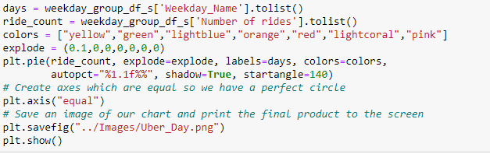
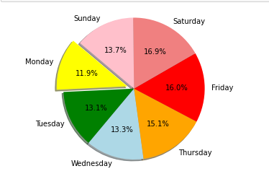
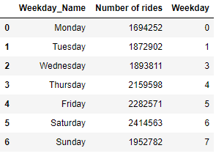
Are there more uber rides in weekdays or weekends?

Slide 9
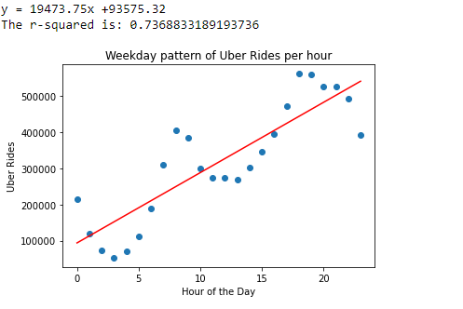
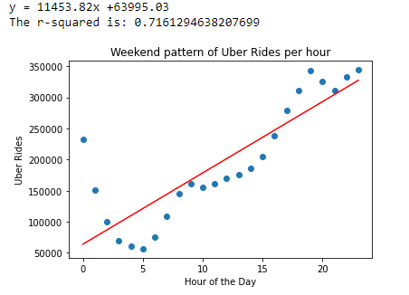
What time of the day is busiest for Uber drivers in NYC on Weekdays vs Weekend?
Create weekday indicator and subset weekday data. Similarly, create weekend indicator and subset weekend data.
Group each data by hour and count number of rides.
Perform a linear regression on hour vs Number of Uber rides. Create line equation string , get regression values, r-square
Weekday : Number of rides is positively co-related with hour with r-square of 0.75
Weekend : Number of rides is (less) positively co-related with hour with lower r-square of 0.72

