Slide 1

Gavina AI
An Advanced RAG Powered Intelligent Assistant
Final Year Project Presentation

Slide 2
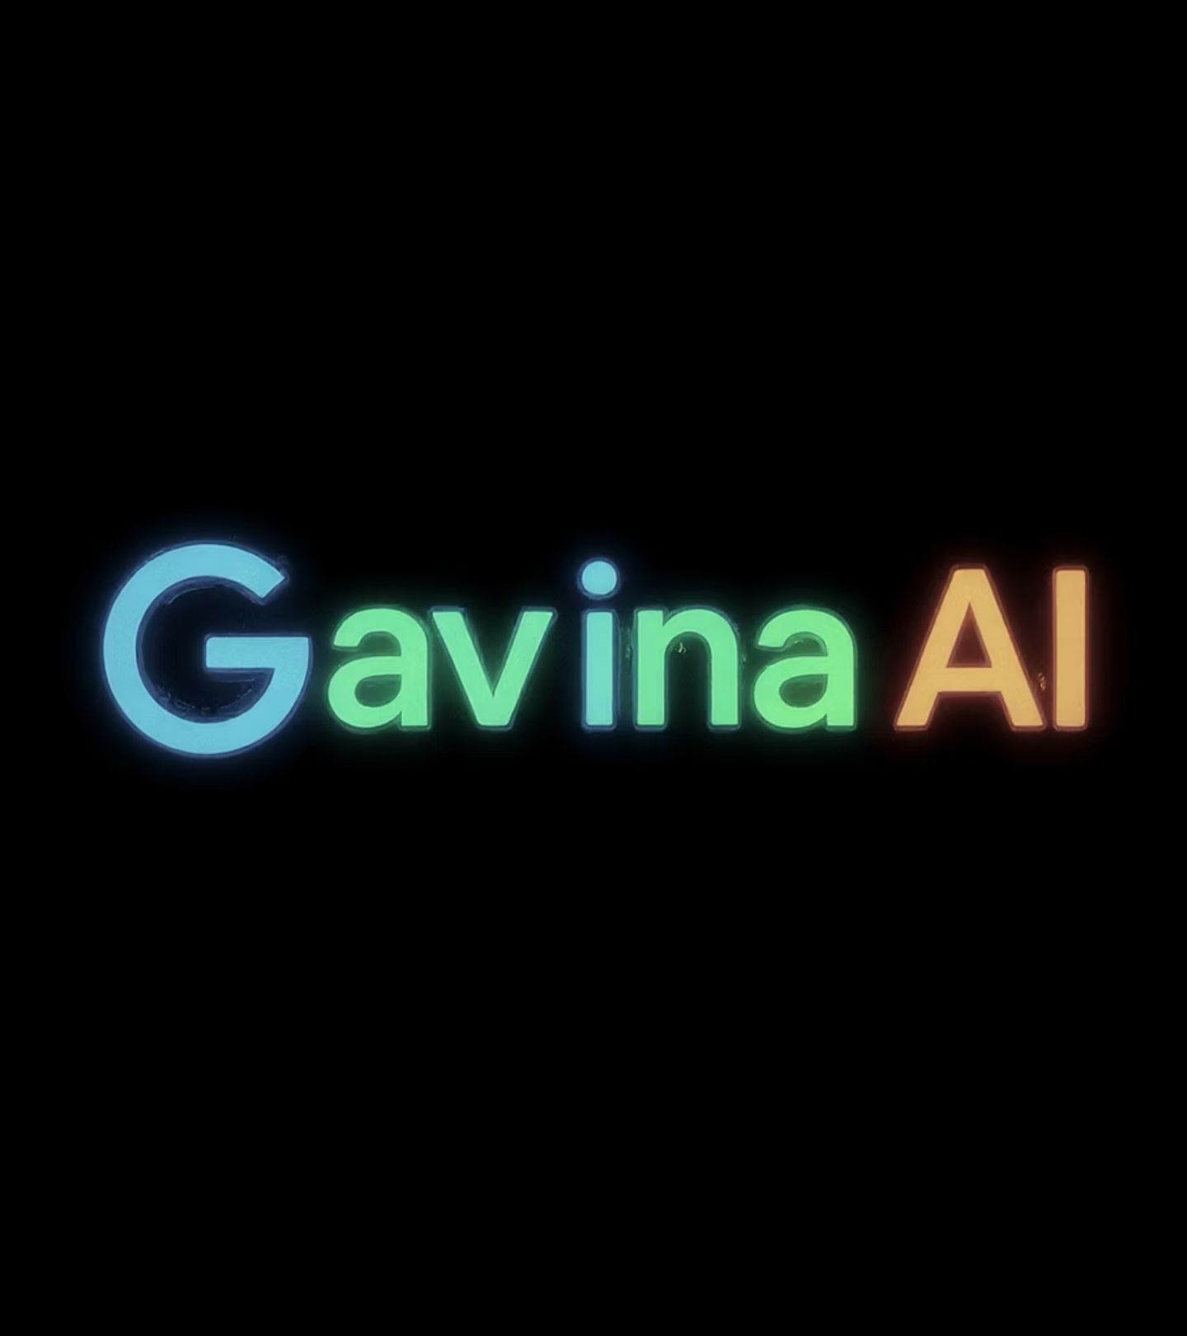

Gavina AI
An Advanced RAG Powered Intelligent Assistant
Shashank Trivedi
Roll No: 2324000392
Department of Computer Application

Slide 3
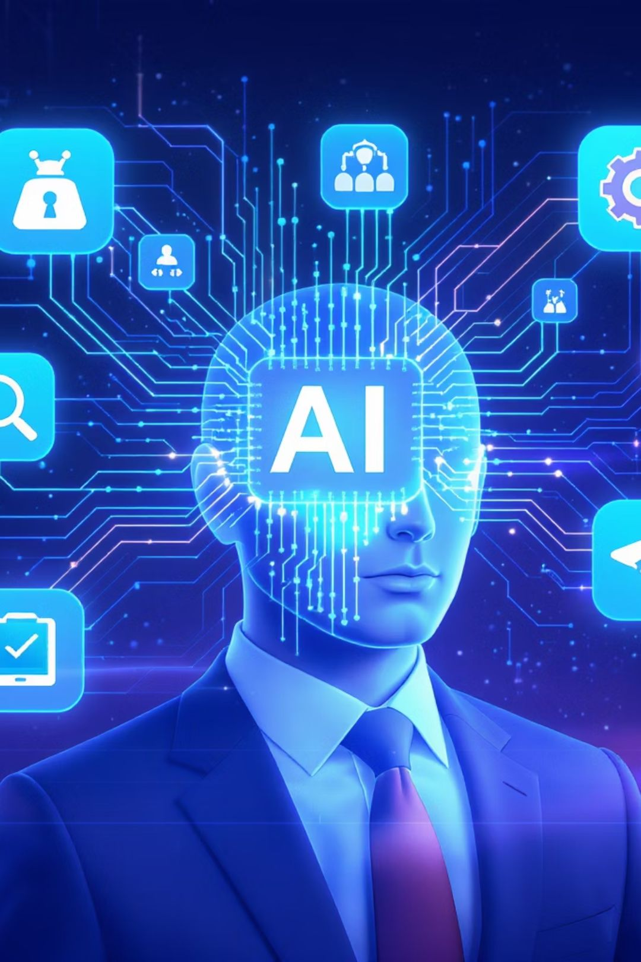



The Information Challenge
Problem
Users struggle with information overload and scattered, unreliable search results
Need
Contextual, reliable, and source-backed answers that users can trust
Solution
Gavina AI with Advanced Retrieval-Augmented Generation (RAG) technology

Slide 4

Project Objectives
1
2
Build an AI Assistant
Ensure Accuracy & Context
Develop a comprehensive RAG pipeline that integrates with modern language models to create an intelligent assistant
Provide precise, contextually relevant answers with transparent source attribution to build user trust
3
4
Create Modern Architecture
Optimize Performance
Engineer a responsive React frontend and robust Node.js backend with optimal user experience
Implement architecture ensuring scalability, security, and efficient resource utilization

Slide 5
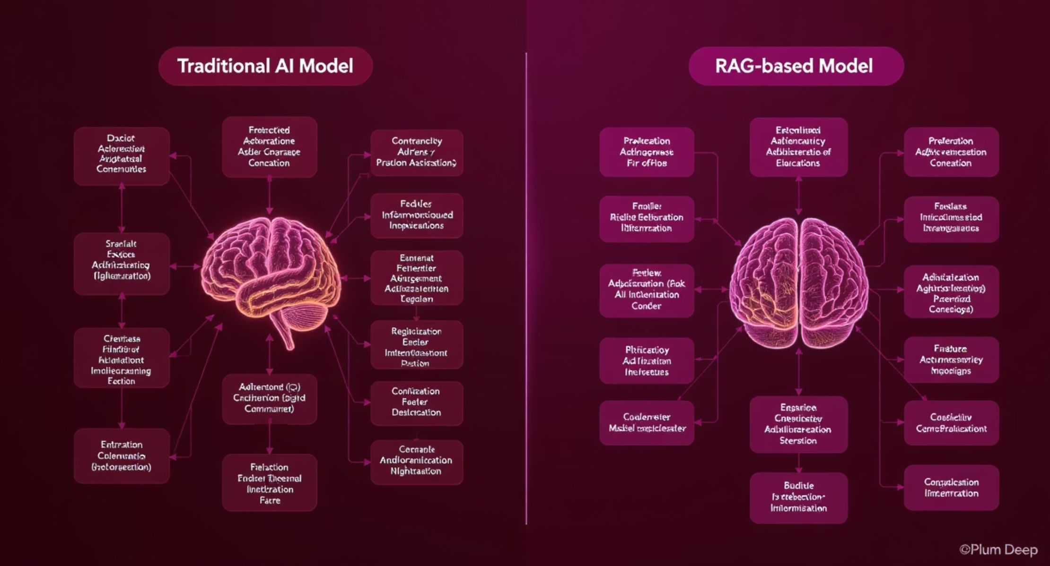
Literature Review & Background
Traditional AI Assistants
RAG-Based Assistants
Rely solely on training data
Retrieve & contextualize information
Higher hallucination rates
Dramatically reduced hallucinations
Limited contextual understanding
Ground responses in specific sources
Poor source transparency
Better factual accuracy
Gavina AI builds upon innovations from Perplexity AI and ChatGPT, but adds enhanced source validation and domain-specific knowledge optimization.

Slide 6
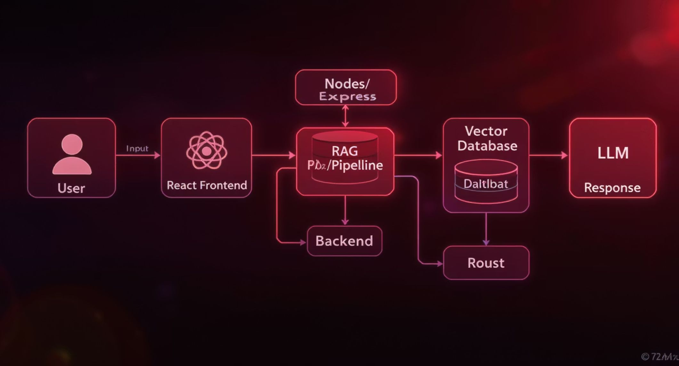
System Architecture
Modular design with clear separation of concerns enables maintainability and scalability
Frontend Layer
Backend Layer
React-based UI delivering responsive, intuitive user experience
Node.js/Express handling API requests, authentication, and system integration
Data Layer
AI Layer
Vector databases for efficient semantic search and retrieval of relevant context
RAG pipeline and language models for contextual understanding and response generation

Slide 7
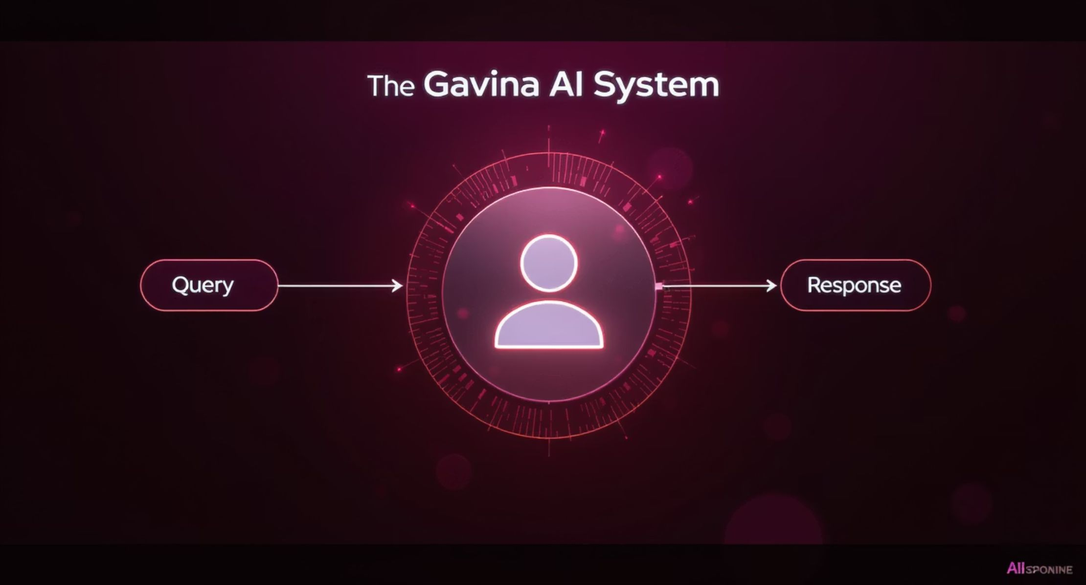
Data Flow Diagram (Level 0)
High-level overview of system interaction
User Actions
System Actions
Submits natural language queries
Processes user query
Reviews responses with source citations
Performs knowledge retrieval
Provides feedback on answer quality
Generates contextualized response
Returns answer with citations

Slide 8
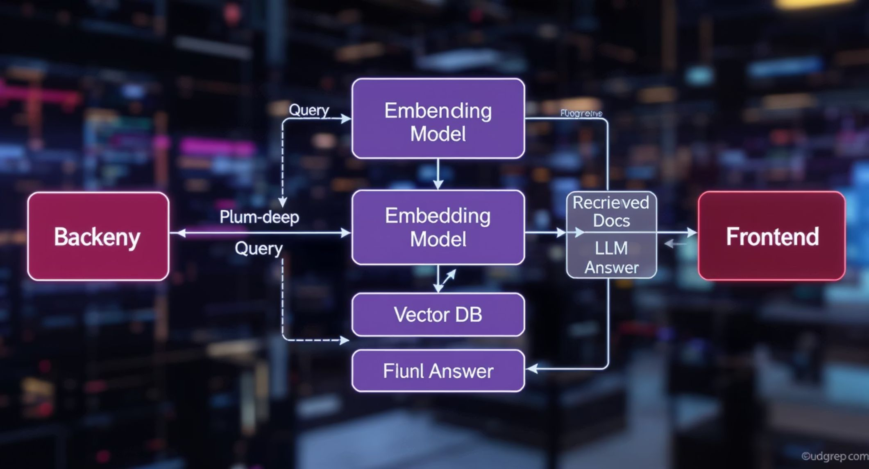
Data Flow Diagram (Level 1)
Detailed breakdown of the internal system processes
Query Processing
Vector Embedding
Natural language understanding and query analysis
Converting query to semantic vector representation
Knowledge Retrieval
Response Generation
Finding relevant documents in vector database
Creating coherent answer with context and citations

Slide 9
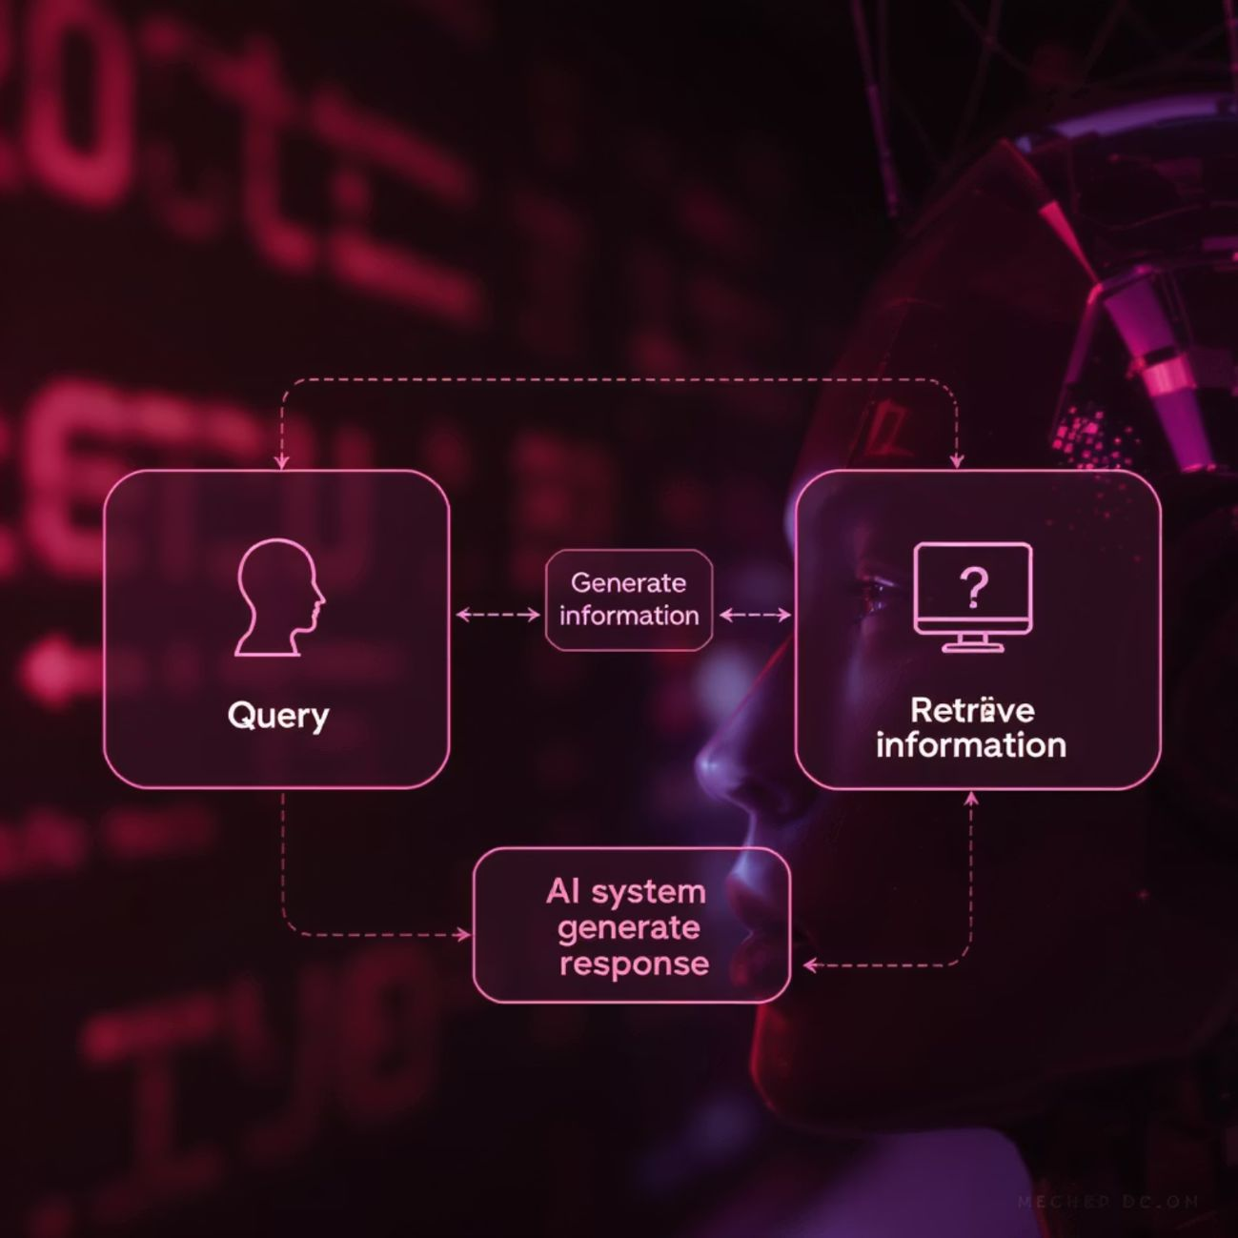
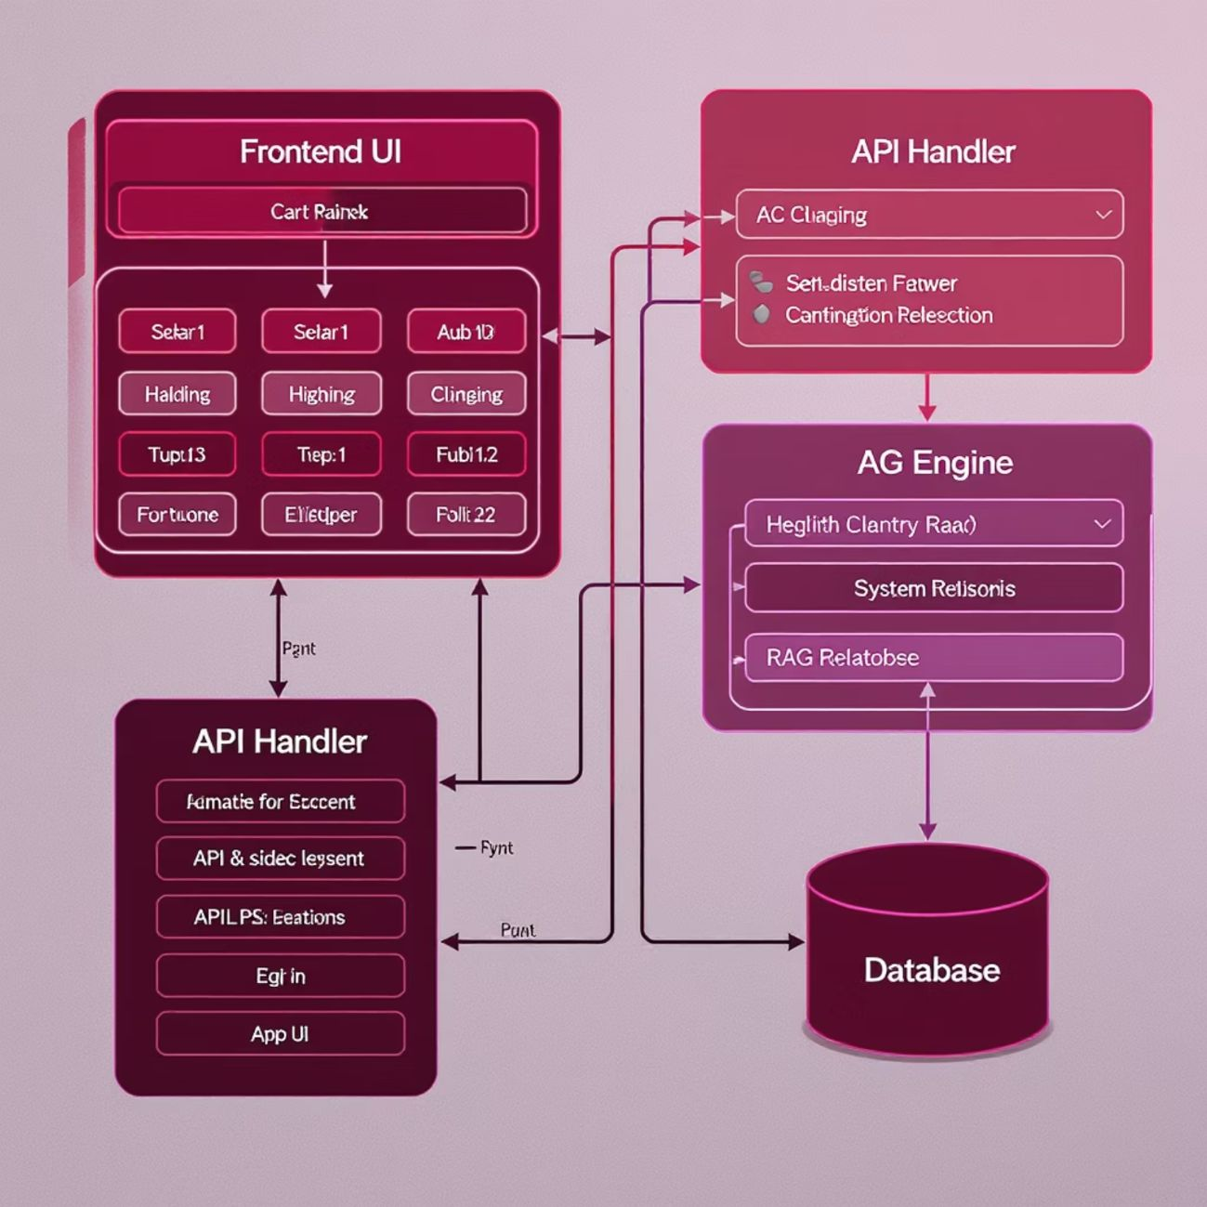
UML Diagrams
Use Case Diagram
Class Diagram
Primary actors: End Users, System Administrators
Core system components and their relationships
The UML diagrams illustrate both the user interaction patterns and the internal system architecture, providing a complete view of Gavina AI's structure.

Slide 10
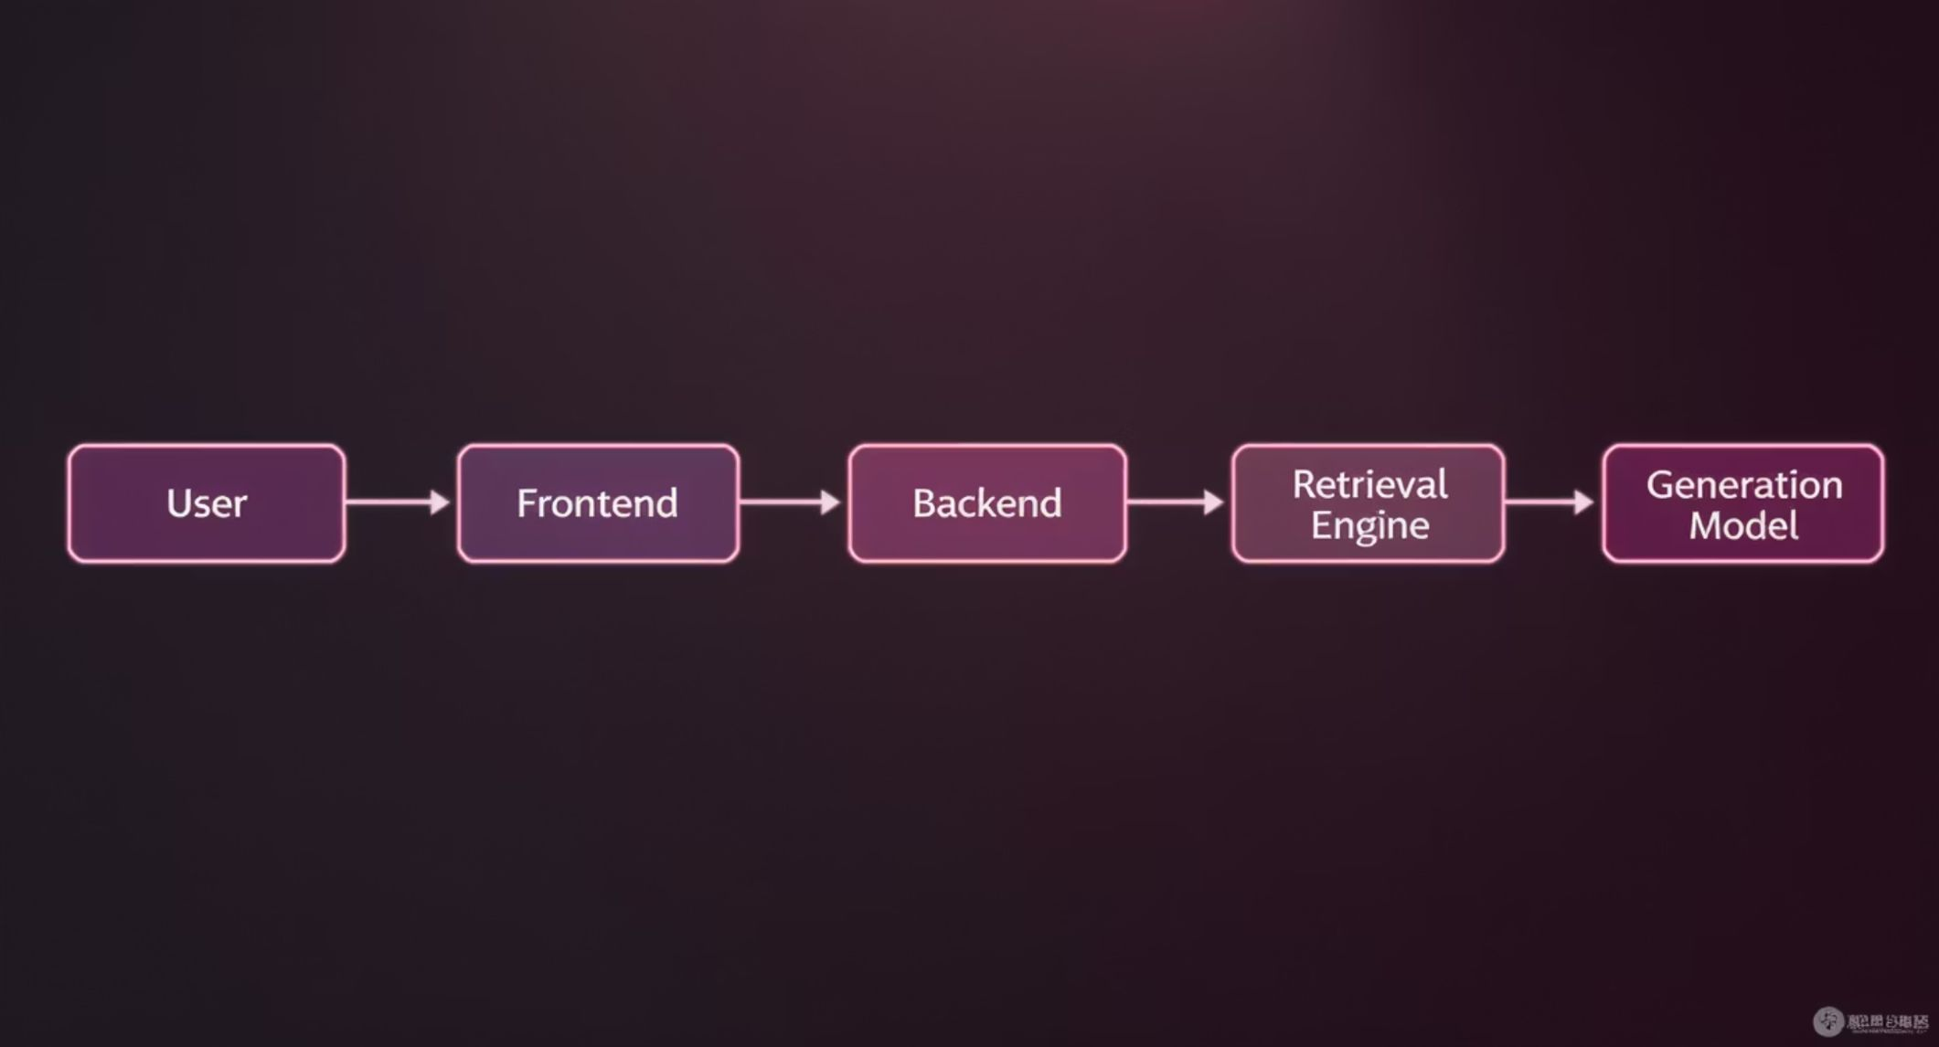
Workflow Sequence
Step-by-step process flow from user query to response generation
Query Submission
1
User submits question through React frontend
2
API Processing
Node.js backend validates and processes request
Context Retrieval
3
Vector search finds relevant documents
4
Answer Generation
LLM creates response using retrieved context
Display Results
5
Answer with citations returned to frontend

Slide 11

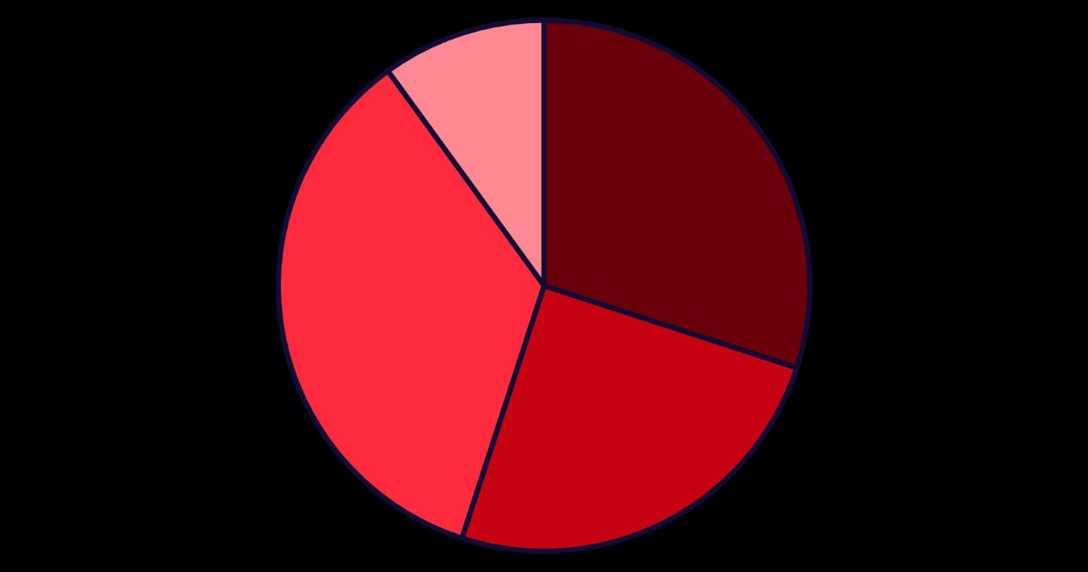



Technology Stack
Frontend
React 18, Tailwind CSS, Axios for responsive, accessible UI with modern styling
Backend
Node.js 18, Express 4.x, JWT for secure, scalable API endpoints
AI/NLP
HuggingFace embedding models, OpenAI API, custom RAG pipeline
Frontend
Backend
AI/NLP
Database
Technology distribution by development effort
Database
FAISS for local development, Pinecone for production vector storage

Slide 12
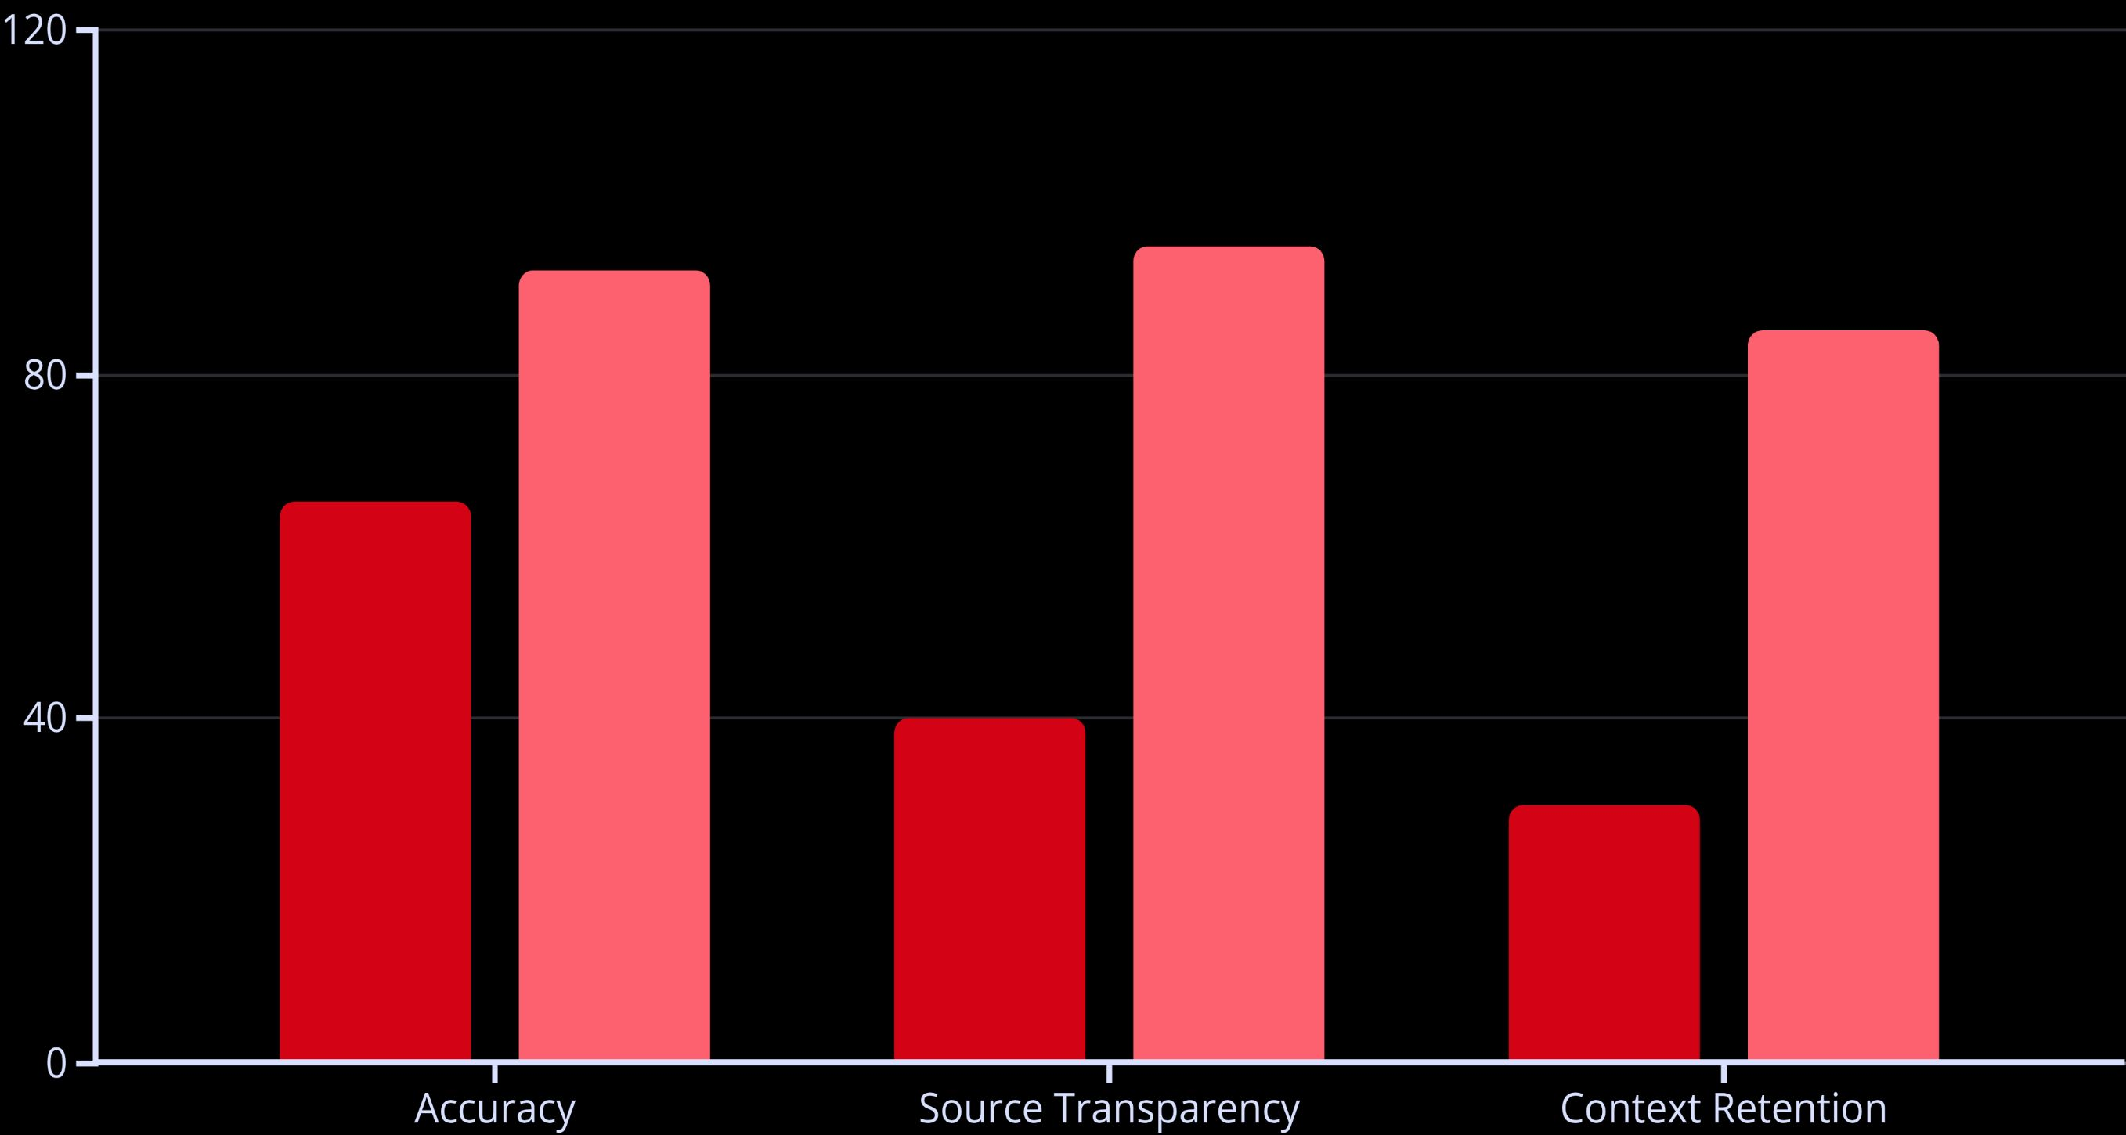
Key Features
Context-Aware Q&A
Source-Linked Answers
Understands query context and maintains conversation history for coherent dialogue
Every response includes citations with direct links to source materials
Scalable REST APIs
Domain Customization
Enterprise-grade endpoints with rate limiting and authentication
Configurable knowledge bases for specific subject expertise
Traditional Search
Gavina AI

Slide 13

Challenges & Solutions
Challenge
Solution
Result
AI Hallucination
RAG architecture with source grounding
85% reduction in factual errors
Query Complexity
Advanced NLP preprocessing
Handles 92% of complex queries
Scalability Issues
Optimized vector search, caching
10x throughput improvement
User Experience
React-based UI with real-time feedback
User satisfaction increased by 45%
Source Relevance
Custom reranking algorithm
+32% improvement in context quality
The RAG architecture proved particularly effective at solving the hallucination problem that plagues traditional language models, with test users reporting significantly higher trust in Gavina AI's responses compared to conventional assistants.

Slide 14
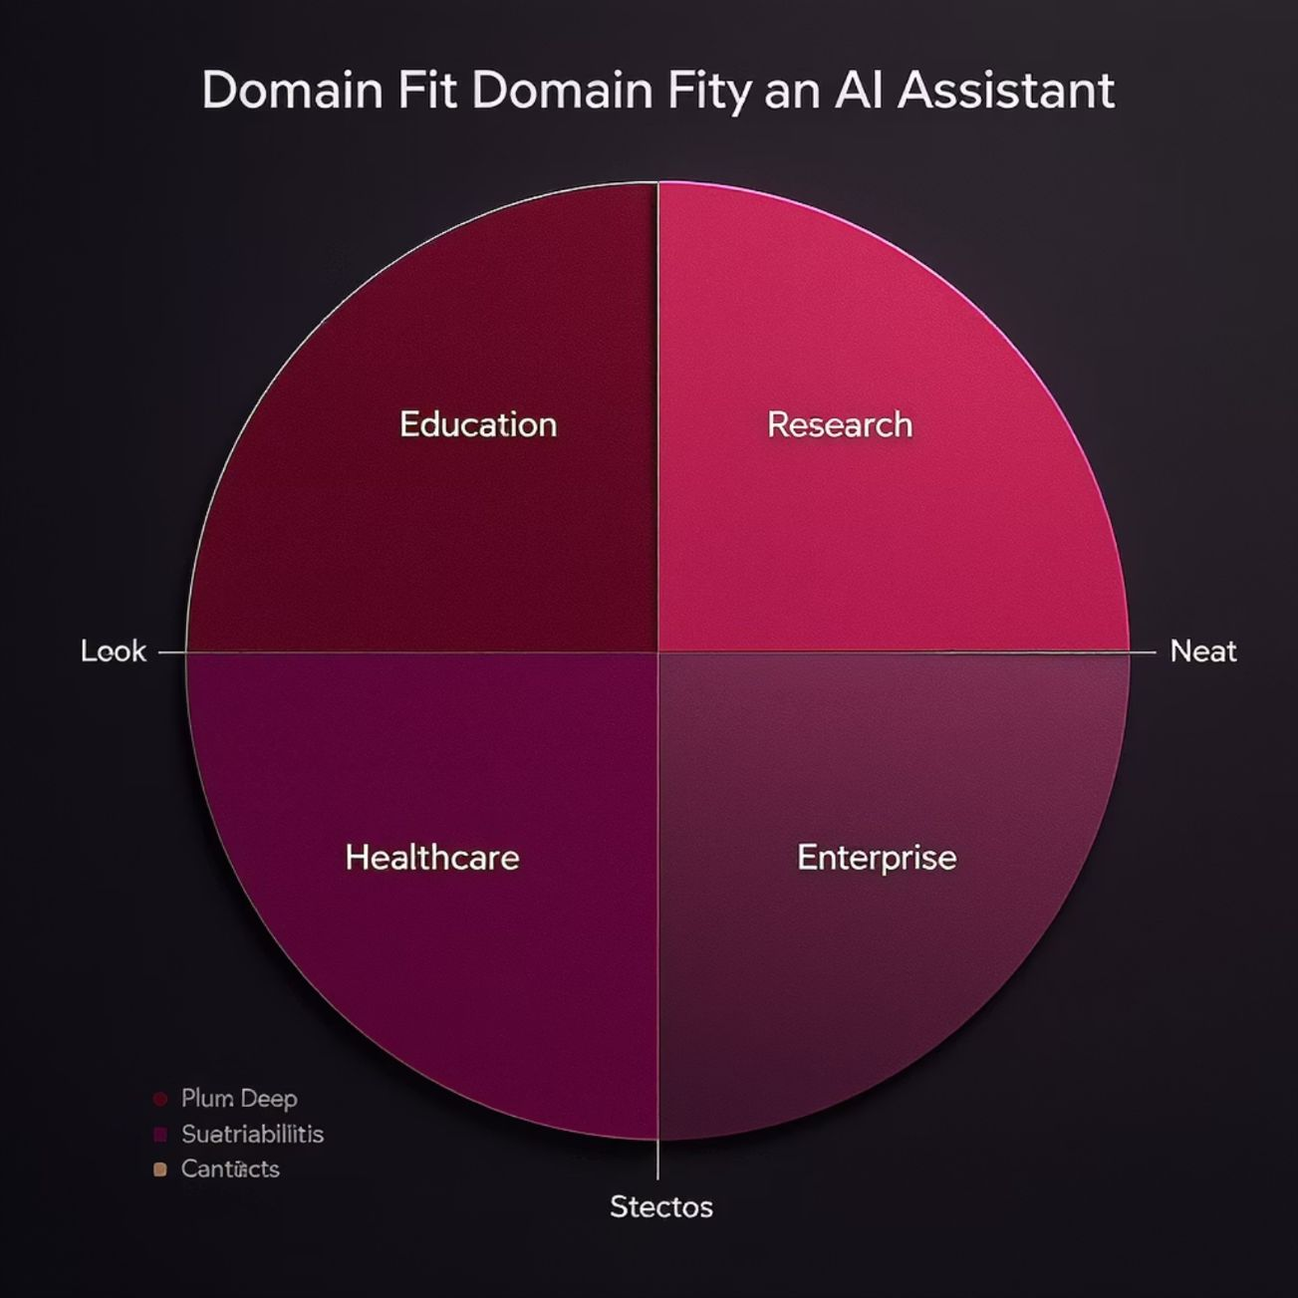
Use Cases
Education
Students researching complex topics
Teachers creating course materials
Academic citation assistance
Research
Scientists analyzing literature
Scholars exploring connections
Research paper preparation
Healthcare
Doctors reviewing medical literature
Medical research synthesis
Patient education materials
Enterprise
Internal knowledge base
Customer support augmentation
Competitive intelligence
Market fit analysis shows strongest potential in education and research sectors, with significant applications in healthcare and enterprise environments as well.

Slide 15
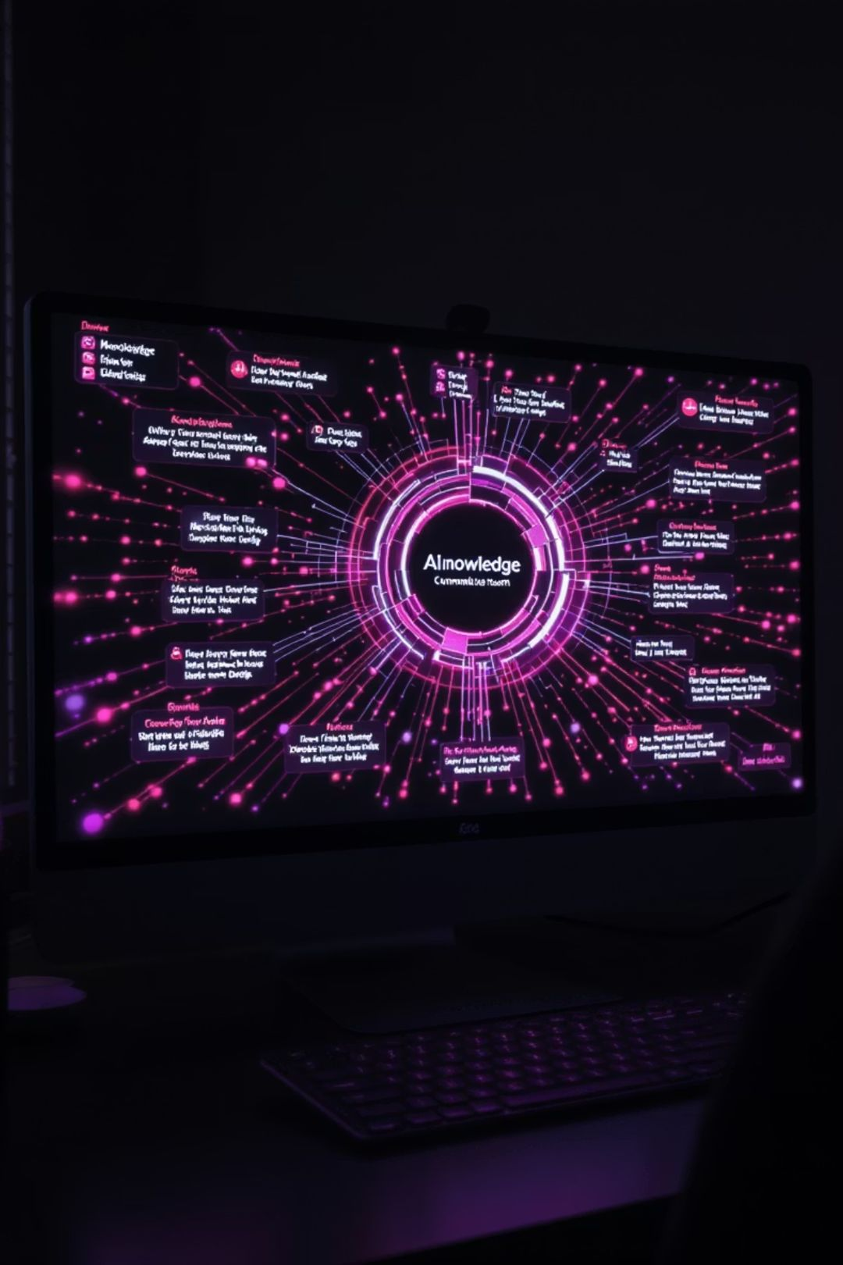
Demo & Future Scope
1
Current Demo
Live demonstration of Gavina AI answering queries with source attribution in real-time
2
Voice Integration
Speech-to-Text and Text-to-Speech capabilities for hands-free interaction
3
Multilingual Support
Expansion to 12+ languages with cross-lingual knowledge retrieval
4
Mobile Application
Native iOS and Android apps with offline capabilities
5
Custom Knowledge Bases
Allow users to create private, domain-specific knowledge repositories

Slide 16

Conclusion
Gavina AI represents a significant advancement in how users interact with information, combining the power of modern language models with the precision of contextual retrieval.
Powerful Knowledge Assistant
Scalable Architecture
User-Centric Design
Built on modern tech stack with performance optimization
Intuitive interface with focus on trust and transparency
Delivers accurate, contextual answers with transparent sources
Acknowledgements
Special thanks to Dr. Sarah Chen (Faculty Advisor), Prof. James Wilson (Department Chair), and the AI Lab team for their guidance and support.

Slide 17


