Slide 1
Wellness Companion
💚
Project Presentation
AI-Powered Agentic Assistant for Emotional & Mental Wellness
Survey-Driven Design | Python Automation | Prompt Engineering
WELLNESS COMPANION
SERENITY
AI-Powered Mental
Health Companion
March 2026 | Team Wellness | AI Tools & Prompt Engineering

Slide 2
01 | Problem Statement & Target Audience
🔍 The Problem
🎯 Target Audience
Rising mental health concerns among students & young adults (18-30)
Lack of accessible, affordable, 24/7 emotional support systems
Stigma around mental health prevents people from seeking help
Existing apps are generic — not personalized to individual needs
No tool that combines mood tracking + financial stress + sleep issues
Students (18-22)
Academic & exam stress
Young Adults (23-30)
Work pressure & burnout
Adults (31-40)
Financial & social stress
Anyone 40+
Sleep & lifestyle issues
💡 Assistant Name: "SERENITY" — Your 24/7 AI Wellness Companion

Slide 3
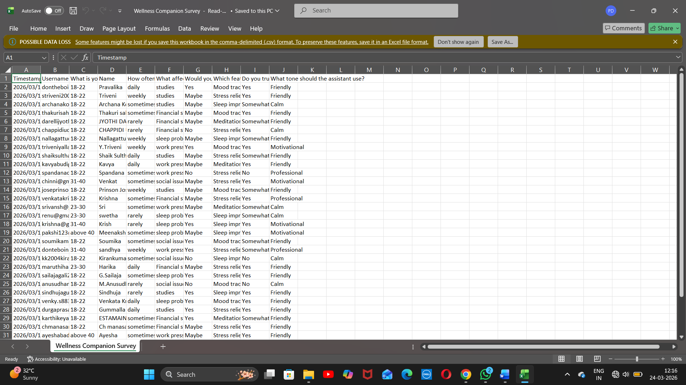

Slide 4
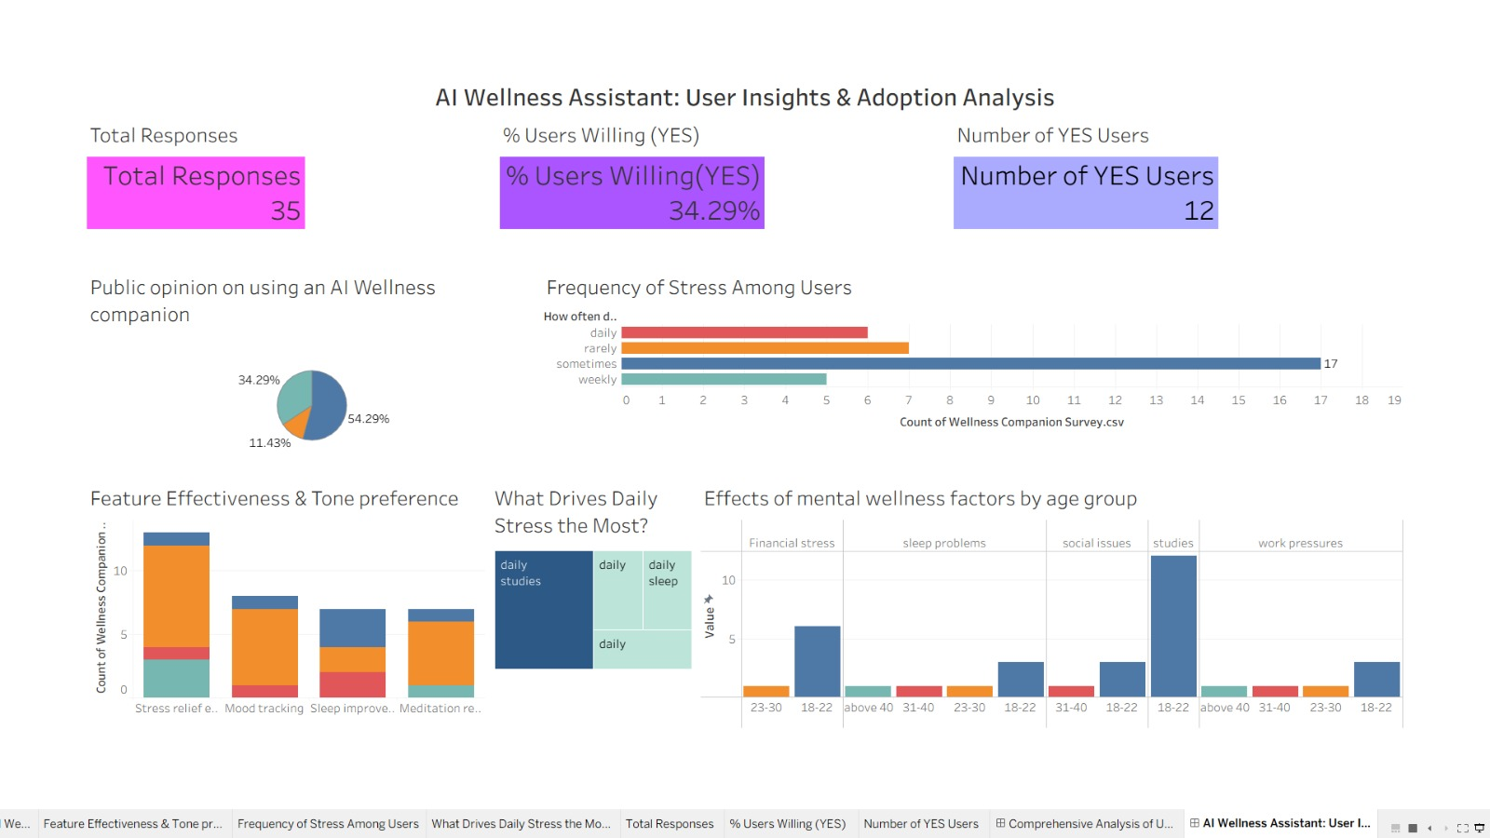

Slide 5
03 | Agentic Workflow — Think → Decide → Act
01
02
03
🧠
⚖️
⚡
THINK
DECIDE
ACT
Receive user input (mood, stress, symptoms)
NLP analysis of sentiment & intent
Context-aware understanding
Memory of past interactions
→
Classify stress type & severity
Match to knowledge base
Select appropriate response strategy
Personalize based on user profile
→
Generate empathetic response
Suggest coping techniques
Trigger automation (reminders, logs)
Escalate to professional if needed

Slide 6
04 | Python Decision Simulation
🐍 serenity_decision.py
📥
User Input
def serenity_respond(user_input, profile):
mood = analyze_sentiment(user_input)
stress_type = classify_stress(user_input)
if mood == "critical":
return escalate_to_professional()
if stress_type == "academic":
tips = get_study_tips(profile["age"])
return generate_response(tips, tone="calm")
elif stress_type == "financial":
return generate_response(
finance_coping_strategies(),
tone=profile["preferred_tone"]
)
elif stress_type == "sleep":
schedule_reminder(user=profile["id"])
return sleep_hygiene_advice()
return empathetic_response(mood, stress_type)
Text / voice message
↓
🧬
NLP Analysis
Sentiment + intent detection
↓
🔀
Decision Tree
Classify stress type & severity
↓
💬
Response Gen.
Tone-matched, empathetic reply
↓
🔁
Feedback Loop
Learn from user reactions

Slide 7
05 | Prompt Engineering Comparison
❌ Basic Prompt
📝 Prompt:
"I feel stressed. Help me."
★★☆☆☆
💬 Output:
Quality: 2/5
Generic stress tips without personalization. No tone adaptation. No follow-up questions. May feel robotic or dismissive.
✅ Engineered Prompt
📝 Prompt:
"You are SERENITY, a compassionate wellness companion. User is a 20-year-old student feeling overwhelmed by exams. Provide a calm, empathetic response with 2 actionable coping strategies, then ask a follow-up question."
★★★★★
💬 Output:
Quality: 5/5
Personalized, empathetic response. Age-appropriate advice. Action-oriented. Opens dialogue. Matches Friendly tone.
🔑 Key Techniques Used: Role Assignment | Few-Shot Examples | Chain-of-Thought | Persona Framing | Constraint Setting

Slide 8
06 | NotebookLM Research Insights
📚
WHO Reports
🔬 NotebookLM
Process
1 in 4 people globally affected by mental health disorders. Depression is leading cause of disability worldwide.
1
Uploaded 5+ research papers
on mental health & AI
🧪
AI in Mental Health
CBT-based chatbots show 30-40% improvement in mild-moderate anxiety. High engagement among 18-30 age group.
2
Generated audio overview
for quick understanding
📱
App Usage Patterns
3
Asked targeted questions
about CBT effectiveness
Users prefer daily micro-interactions (2-5 min) over weekly sessions. Notification reminders boost retention by 60%.
4
Extracted key statistics
for survey design
🔬
Key Finding
5
Validated SERENITY's
approach against research
Personalization + empathy + anonymity = highest user satisfaction. SERENITY addresses all three.

Slide 9
07 | Automation Flow
👤
💬
🧠
📊
💡
🔔
▶
▶
▶
▶
▶
User Opens
SERENITY
Enters Mood /
Stress Input
AI Analyzes
& Classifies
Logs to
Mood Tracker
Personalized
Response
Schedules
Reminders
Automation Stack:
Python Scripts
Google Forms
Tableau / Excel
NotebookLM
Scheduling API
Decision logic & response generation
Survey collection & data capture
Data visualization & insights
Research synthesis & knowledge base
Wellness reminders & push notifications

Slide 10
08 | Branding & Visual Identity
Color Palette
Voice & Tone
💚
✓ Empathetic
Validates feelings first
Deep Navy
Calm Teal
Soft Mint
Warm Gold
Growth Green
✓ Non-Judgmental
#0D1B2A
#00B4D8
#90E0EF
#F4A261
#2DC653
Safe, stigma-free space
Typography & UX Design
✓ Action-Oriented
🔤 Headlines: Calibri Bold — authoritative, clean
📝 Body: Calibri Light — readable, gentle
💻 Code: Consolas — technical precision
🎨 Rounded UI elements — approachable feel
📱 Mobile-first layout — thumb-friendly
♿ WCAG 2.1 AA accessible contrast ratios
Gives practical steps
SERENITY
✓ Hopeful
Wellness Companion
Future-focused language
Your 24/7 AI
Mental Health Ally
✓ Professional
When severity demands

Slide 11
09 | Ethical Considerations
🔐
⚕️
⚖️
🤝
Data Privacy & Security
Not a Medical Device
Fairness & Bias
Transparency & Trust
All conversations encrypted end-to-end
No personal data sold to third parties
GDPR & HIPAA compliance by design
User can delete all data anytime
Clear disclaimer: AI, not a therapist
Escalation protocol for crisis situations
Partnerships with licensed professionals
No diagnostic claims or prescriptions
Diverse training data across demographics
Regular bias audits & model testing
Culturally sensitive responses
Inclusive language guidelines
Users know they're talking to AI
Explainable AI decision pathways
Regular transparency reports published
Open feedback & reporting channels

Slide 12
10 | Conclusion & Future Scope
✅ What We Built
🚀 Future Scope
SERENITY — AI Wellness Companion for 18-40 age group
Survey-informed, data-driven design decisions
Python-based agentic decision simulation
Advanced prompt engineering for empathetic responses
NotebookLM-backed research foundation
Ethical framework prioritizing user safety & privacy
Voice interface integration for accessibility
Wearable device sync (heart rate, sleep data)
Multi-language support (Telugu, Hindi, English)
Group therapy & peer support features
Clinical partnership for crisis escalation
AR/VR guided meditation experiences
"SERENITY is not just an app — it's a movement toward accessible, empathetic, AI-powered mental healthcare for everyone."
🙏 Thank You | Questions Welcome

