Slide 1
PRODUCTION QUALITY
Production quality report
2025-01-01 to 2025-12-31
Defect rate
Inspection yield
5.56%
94.44%
Inspected units
Defective units
60,000
3,334
Oussama Elayeb public synthetic inspections (simulated)
01
Notes:
Dataset: Oussama Elayeb public synthetic inspections (simulated)
See DATASET_SOURCE.md for sample provenance.

Slide 2
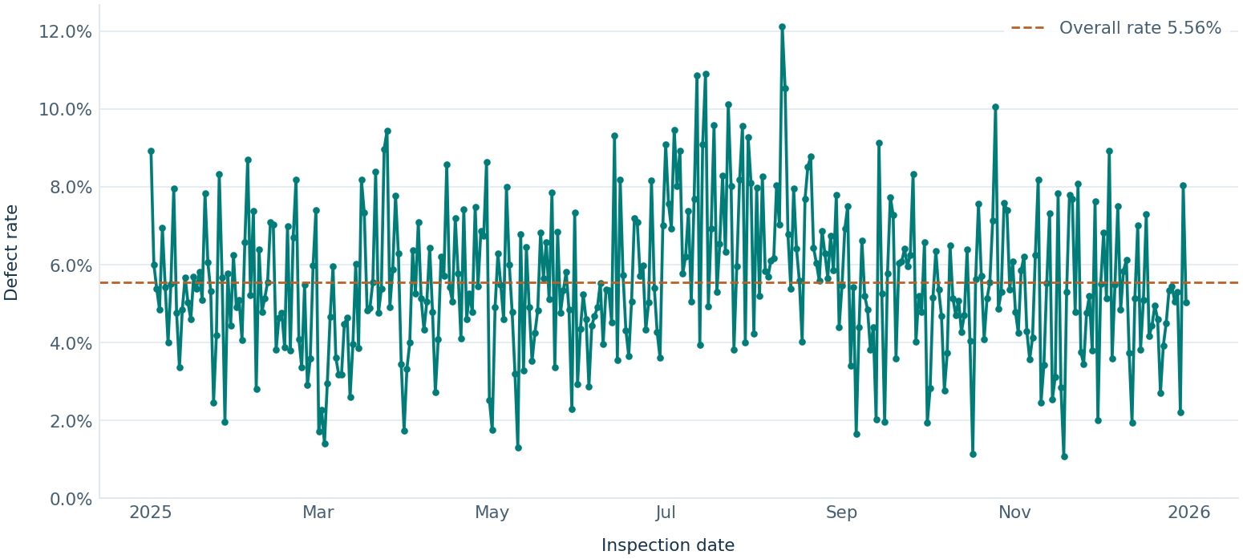
PRODUCTION QUALITY
Daily defect rate
DAILY PEAK
2025-08-11 had the highest observed daily rate at 12.12% (20 of 165 units).
Each point uses the units inspected on that date. Gaps indicate no defined rate.
Oussama Elayeb public synthetic inspections (simulated)
02
Notes:
Dataset: Oussama Elayeb public synthetic inspections (simulated)
See DATASET_SOURCE.md for sample provenance.

Slide 3
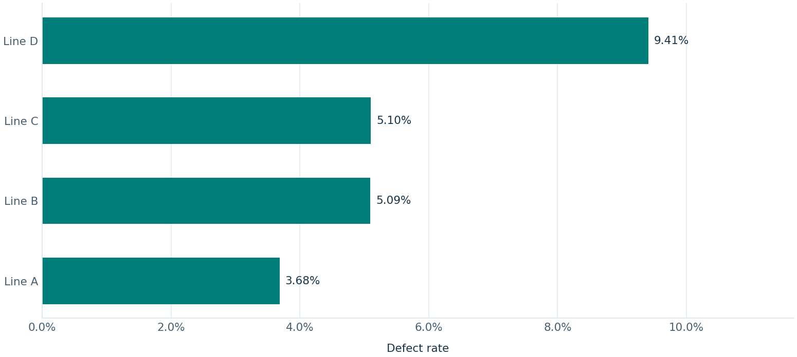
PRODUCTION QUALITY
Defect rate by line
HIGHEST OBSERVED RATE
Line D recorded 9.41% (1,119 of 11,895 units).
Line rates use each line's inspected units. Lines with zero volume have no rate.
Oussama Elayeb public synthetic inspections (simulated)
03
Notes:
Dataset: Oussama Elayeb public synthetic inspections (simulated)
See DATASET_SOURCE.md for sample provenance.

Slide 4
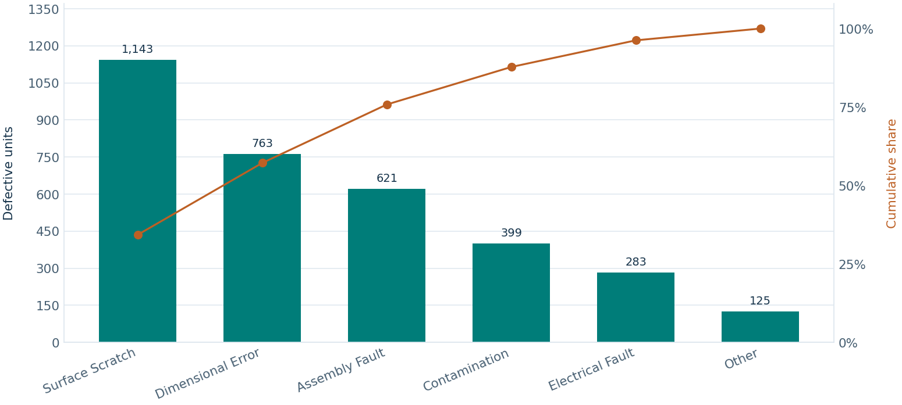
PRODUCTION QUALITY
Defect Pareto
LARGEST CATEGORY
Surface Scratch accounted for 1,143 defective units (34.28%).
Each defective unit counts once under its assigned defect type.
Oussama Elayeb public synthetic inspections (simulated)
04
Notes:
Dataset: Oussama Elayeb public synthetic inspections (simulated)
See DATASET_SOURCE.md for sample provenance.

Slide 5
PRODUCTION QUALITY
Observations and limits
Accepted data
60,000 rows kept and 0 rows excluded. See the Data Quality Log for details.
Rate interpretation
Rates assume distinct inspection cohorts. First-pass and rework history are unverified.
Defect categories
Each defective unit contributes to one verified category.
Oussama Elayeb public synthetic inspections (simulated)
05
Notes:
Dataset: Oussama Elayeb public synthetic inspections (simulated)
See DATASET_SOURCE.md for sample provenance.

