Slide 1
PRODUCTION QUALITY
Production quality report
2024-01-01 to 2024-01-31
Defect rate
Inspection yield
11.98%
88.02%
Inspected units
Defective units
42,259
5,062
User-supplied inspection records
01
Notes:
Dataset: User-supplied inspection records
See DATASET_SOURCE.md for sample provenance.

Slide 2
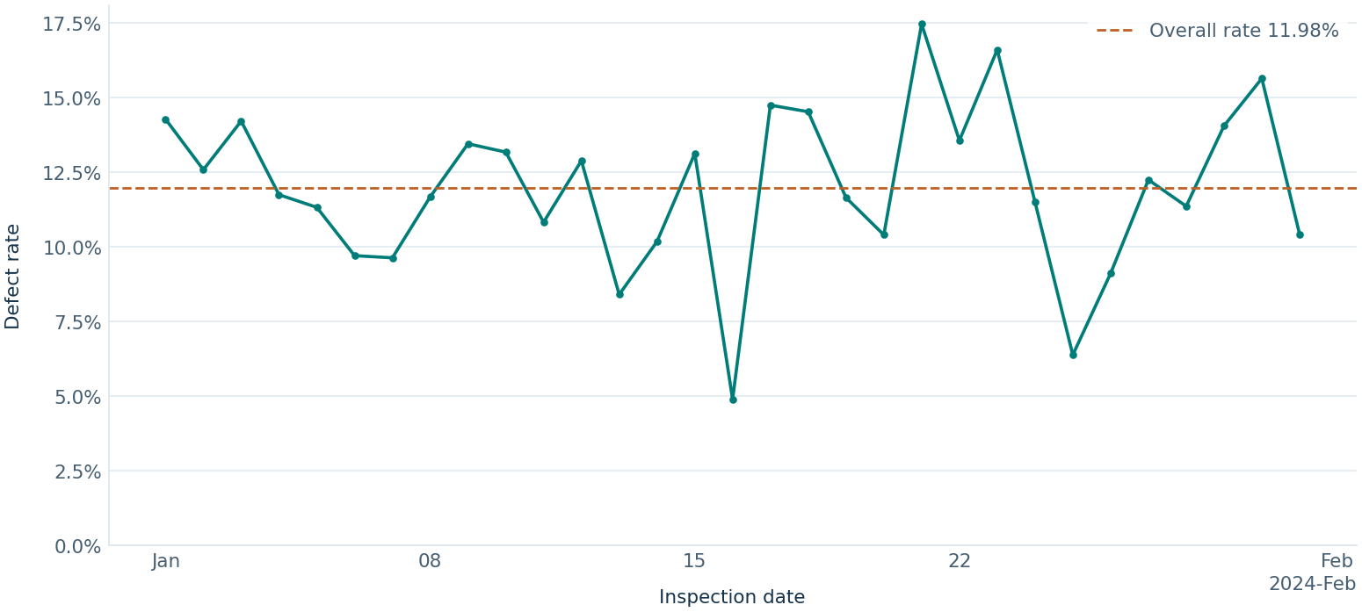
PRODUCTION QUALITY
Daily defect rate
DAILY PEAK
2024-01-21 had the highest observed daily rate at 17.47% (209 of 1,196 units).
Each point uses the units inspected on that date. Gaps indicate no defined rate.
User-supplied inspection records
02
Notes:
Dataset: User-supplied inspection records
See DATASET_SOURCE.md for sample provenance.

Slide 3
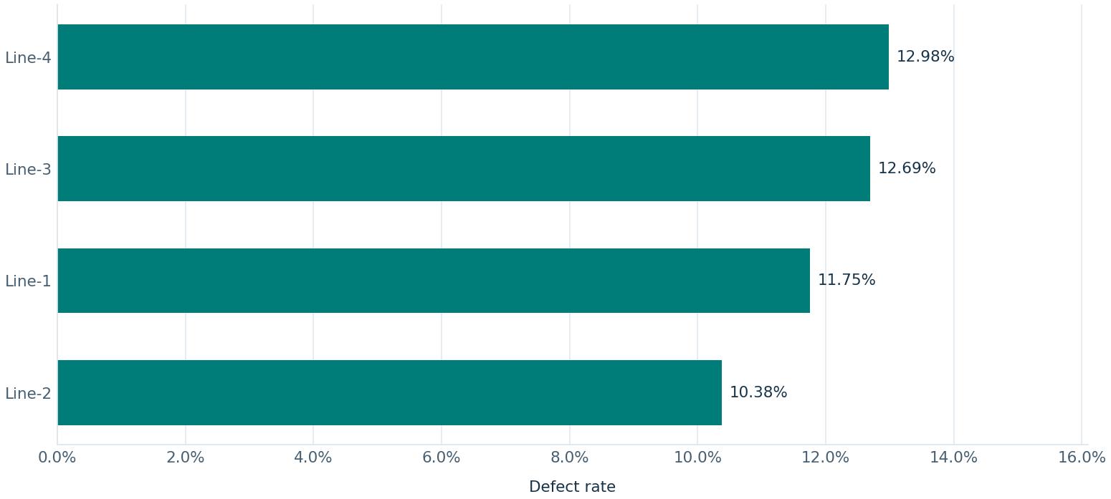
PRODUCTION QUALITY
Defect rate by line
HIGHEST OBSERVED RATE
Line-4 recorded 12.98% (1,477 of 11,378 units).
Line rates use each line's inspected units. Lines with zero volume have no rate.
User-supplied inspection records
03
Notes:
Dataset: User-supplied inspection records
See DATASET_SOURCE.md for sample provenance.

Slide 4
PRODUCTION QUALITY
Observations and limits
Accepted data
350 rows kept and 0 rows excluded. See the Data Quality Log for details.
Rate interpretation
Rates assume distinct inspection cohorts. First-pass and rework history are unverified.
Defect categories
Skipped. Per-unit allocation to a single defect type was not confirmed.
User-supplied inspection records
04
Notes:
Dataset: User-supplied inspection records
See DATASET_SOURCE.md for sample provenance.

