Slide 1
Hospital X SAMueL Analysis (Stroke Audit Machine Learning)
(Michael Allen, Kerry Pearn, Anna Laws, Martin James)

Slide 2
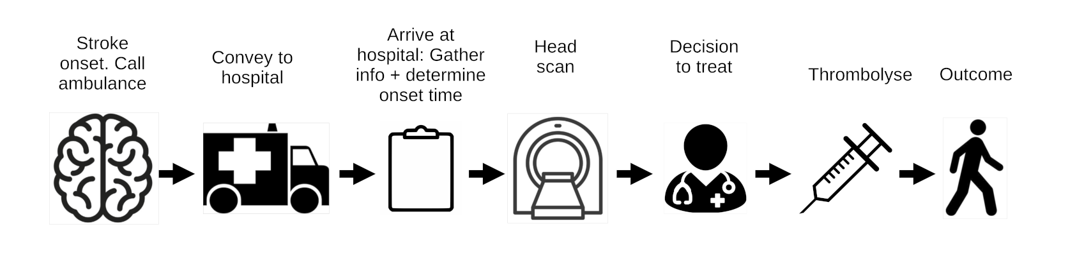
Breaking down the emergency stroke pathway into key steps
We can model key changes to pathway, such as:
What if the pathway were faster?
What if hospital determined the stroke onset time in more patients?
What if clinical decision-making was like that of benchmark hospitals?
Predict what treatment a patient would receive at other hospitals
We model these changes with a hospital’s own patient population, to allow for inter-hospital variation in patient population characteristics.

Slide 3
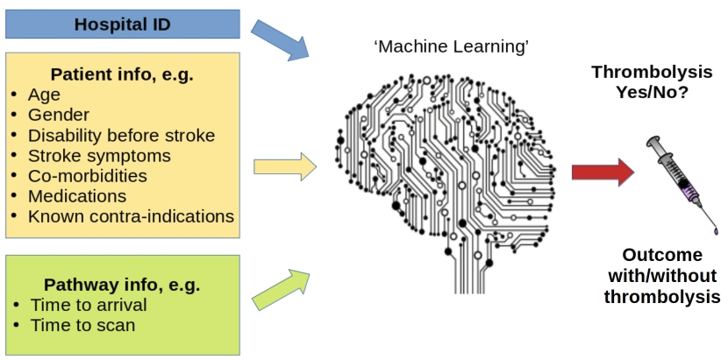
Machine learning overview
Machine learning is based on the simple principle of recognising similarity to what has been seen before
We accessed 246,676 emergency stroke admissions in England and Wales over three years. Our machine learning models use XGBoost classification, and are based on those 88,928 patients who arrive within 4 hours of known stroke onset. Accuracy = 85% (ROC AUC = 0.92).

Slide 4
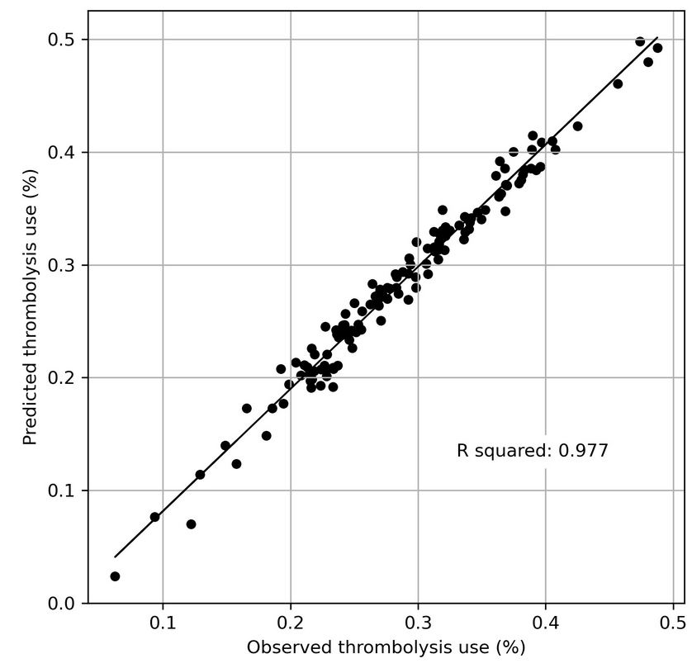
Predicting hospital thrombolysis use across 132 hospitals
Predicted thrombolysis use (for patients arriving within 4 hours of known stroke onset) was measured by combining 5 test sets from k-fold validation (where the model is tested on data not used to train the model).
The predicted vs. observed thrombolysis are highly correlated (r-squared 0.977).

Slide 5
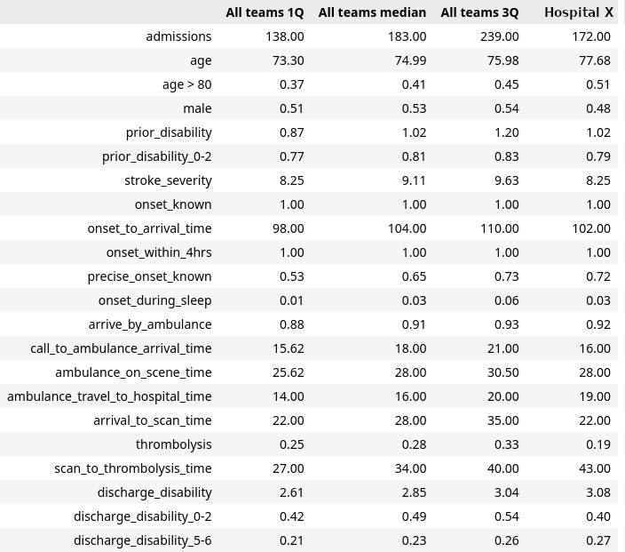
Descriptive stats
Statistics for patients arriving within 4 hours of known stroke onset
Stats are for 5 years (2017-2021)
Out of hospital admissions only
General observations:
60% of patients have stroke time determined (lower than national average)
For patients arriving within 4 hours of known stroke onset
Age is older than national average
Prior disability is similar to national average
Stroke severity is a little lower than national average
Ambulance response, on-scene, and travel times are similar to national average (2017-2021)
Arrival-to-scan time is faster than national average
Scan-to-thrombolysis time is slower than national average
Distances?
Time for decision-making?
Other

Slide 6
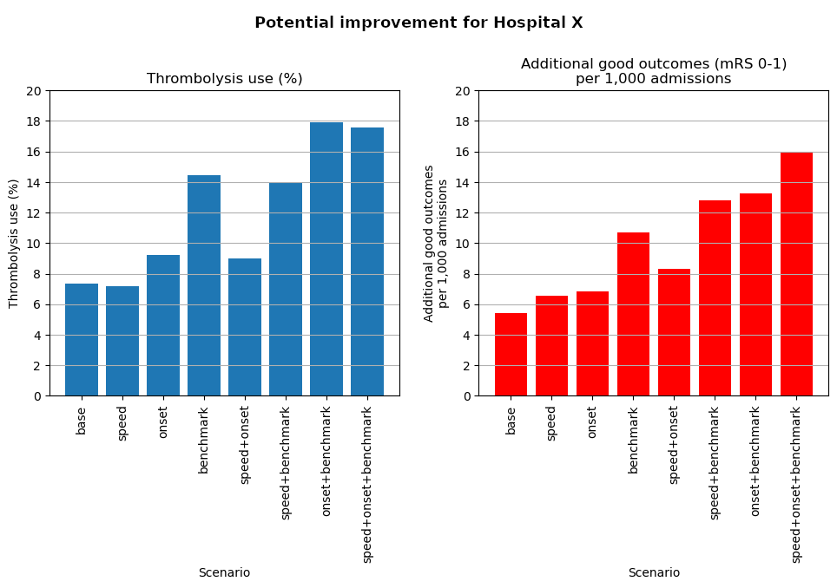
Improvement potential (modelled on own hospital's patients)
Improving speed to 30 minutes arrival-to-thrombolysis has only a small effect on thrombolysis use, but will improve net benefit (as majority of patients benefit).
Determination of more stroke onset times is likely to lead to some improvement in thrombolysis use
Decision to use thrombolysis in patients arriving within 4 hours of known stroke onset is significantly lower than benchmark hospitals (see next slides).

Slide 7
Comparing thrombolysis decision to 'benchmark' hospitals
Benchmark hospitals are the 25 hospitals in England and Wales who are most likely to use thrombolysis if all hospitals saw the same patients (through to time of scan)
An ideally thrombolysable patient:
Infarction
90 mins onset to arrival
Onset not during sleep
Precise onset time
NIHSS 15
No prior disability
No use of anticoagulants for atrial fibrillation
Age 72
Non-ideal changes:
Late: Arrival at 3hr 45 min after stroke
Mild stroke: NIHSS 3
Prior disability: mRS 3 before stroke
Imprecise: Imprecisely known stroke onset time
Age: Age 87

Slide 8
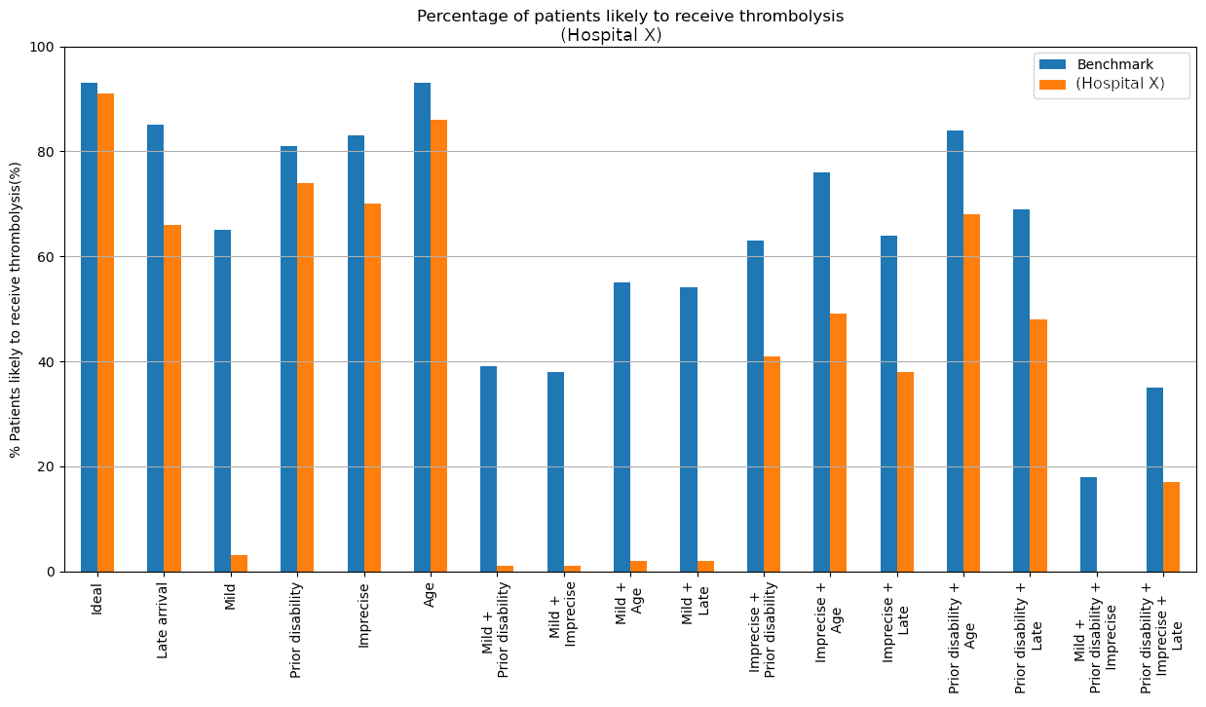

Slide 9
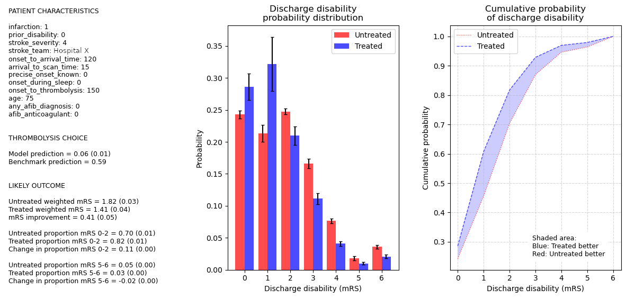
Predicted (learned) outcome for a mild stroke patient with or without thrombolysis

Slide 10
Key observations
Hospital X:
Determines stroke onset times in fewer patients than the national average
Has good arrival-to-scan times, but slower scan-to-thrombolysis times than the national average
Is particularly less likely to give thrombolysis to mild stroke patients compared to higher thrombolysing 'benchmark' hospitals.

