Slide 1
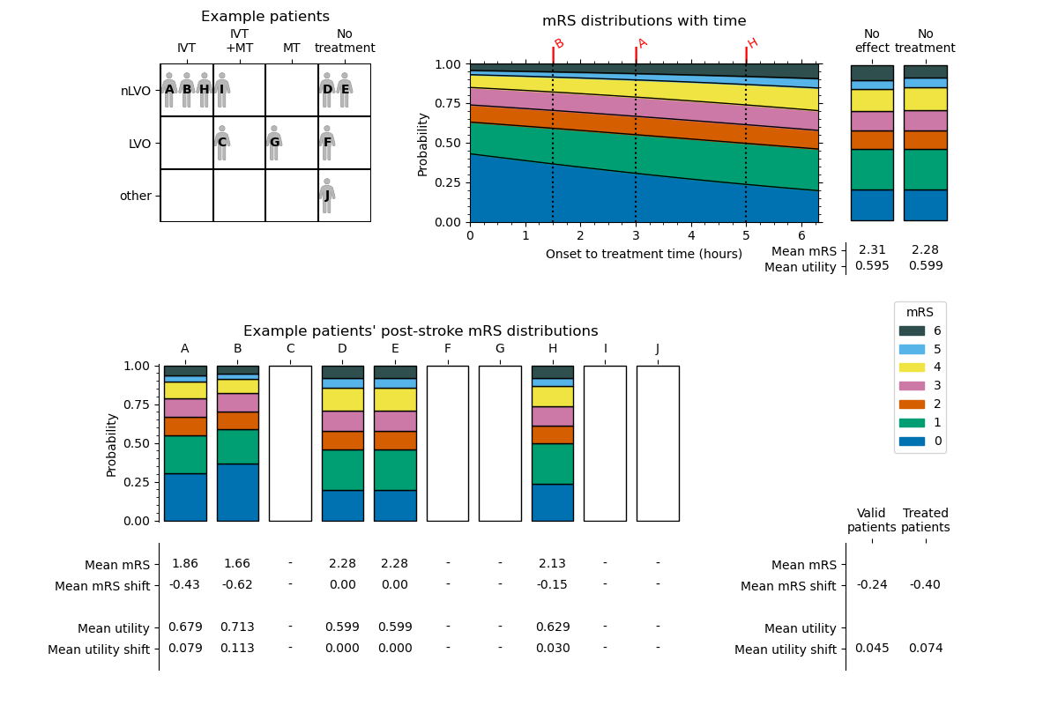
not_treated_mean_mrs
no_effect_mean_mrs
no_effect_mean_utility
not_treated_mean_utility
each_patient_post_stroke_mrs_dist
treated_population_mean_
valid_patients_mean_mrs_shift
mean_valid_patients_
mean_mrs_shift
each_patient_post_stroke_mean_mrs
each_patient_mean_mrs_shift
each_patient_post_stroke_mean_utility
treated_population_mean_
valid_patients_mean_added_utility
each_patient_mean_added_utility
mean_valid_patients_
mean_added_utility

