Slide 1
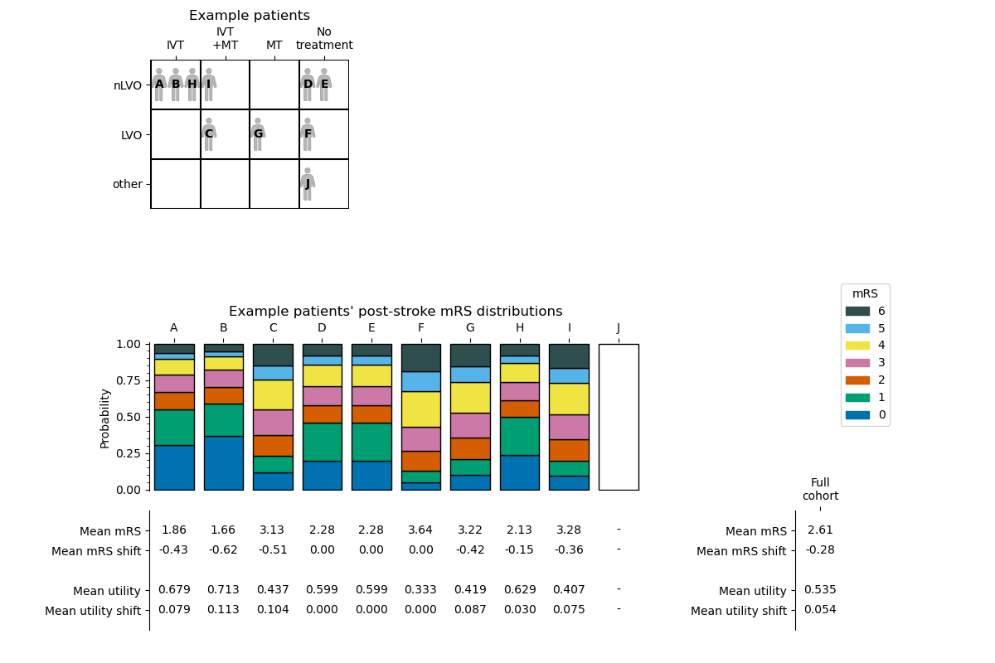
each_patient_post_stroke_mrs_dist
post_stroke_mean_mrs
each_patient_post_stroke_mean_mrs
each_patient_mean_mrs_shift
mean_mrs_shift
each_patient_post_stroke_mean_utility
mean_utility
each_patient_mean_added_utility
mean_added_utility

