Slide 1
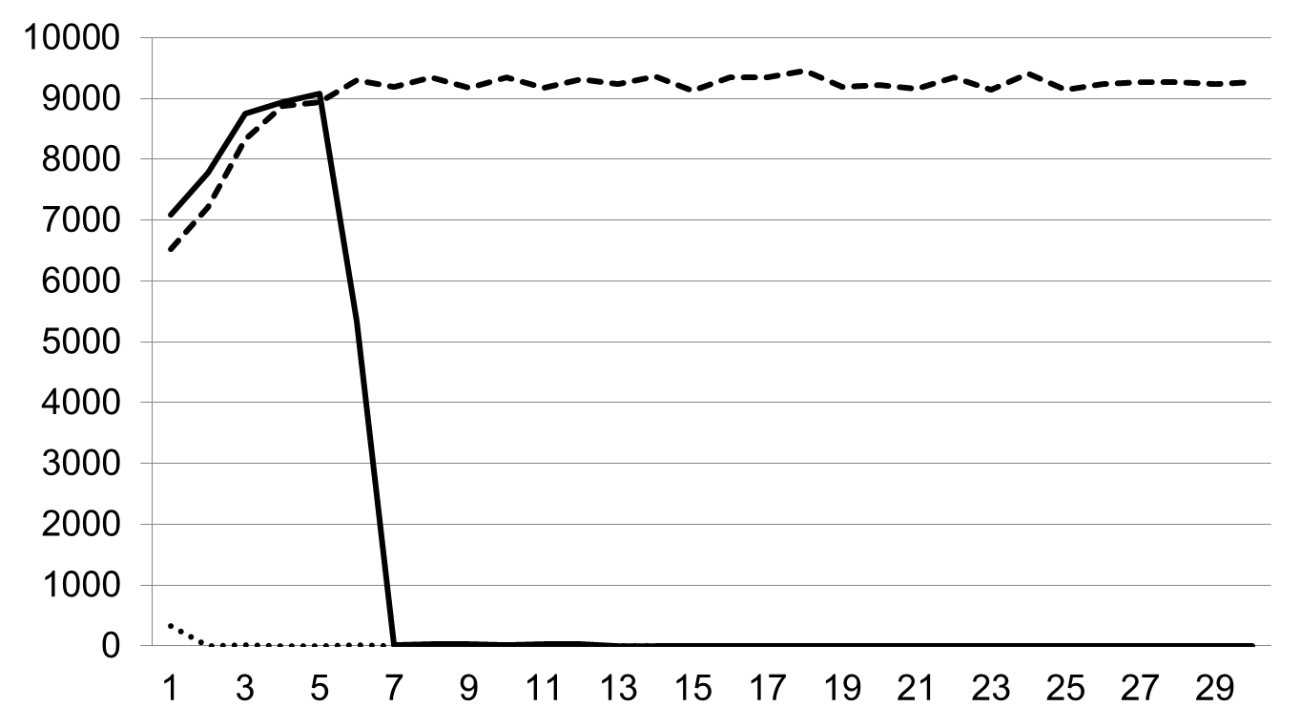
cache-dynamic-enabledd
cache-pre-enabledd
cache-disabledd
IOTLB-flush frequency
Time Interval (min)
Notes:
Since we know that whenever the function iotlb_flush_qi() is invoked, several IOTLB entries will be invalidated in a page granularity. As a result, y-axis in figure 1 represents the invocation times of that function per minute, which indicates the frequency of IOTLB-flush. From this figure, the frequency in control group remains quite stable and high after five minutes. By contrast, frequency in low-pressure group drops to zero in a very short time and remains stable from then on, while frequency in high-pressure group has very similar behavior with that of control group in the first five minutes, but is reduced to zero quickly due to the cache pool.
It can be concluded that once our proposed algorithm is enabled, the IOTLB frequency can be reduced at a maximum level.

Slide 2
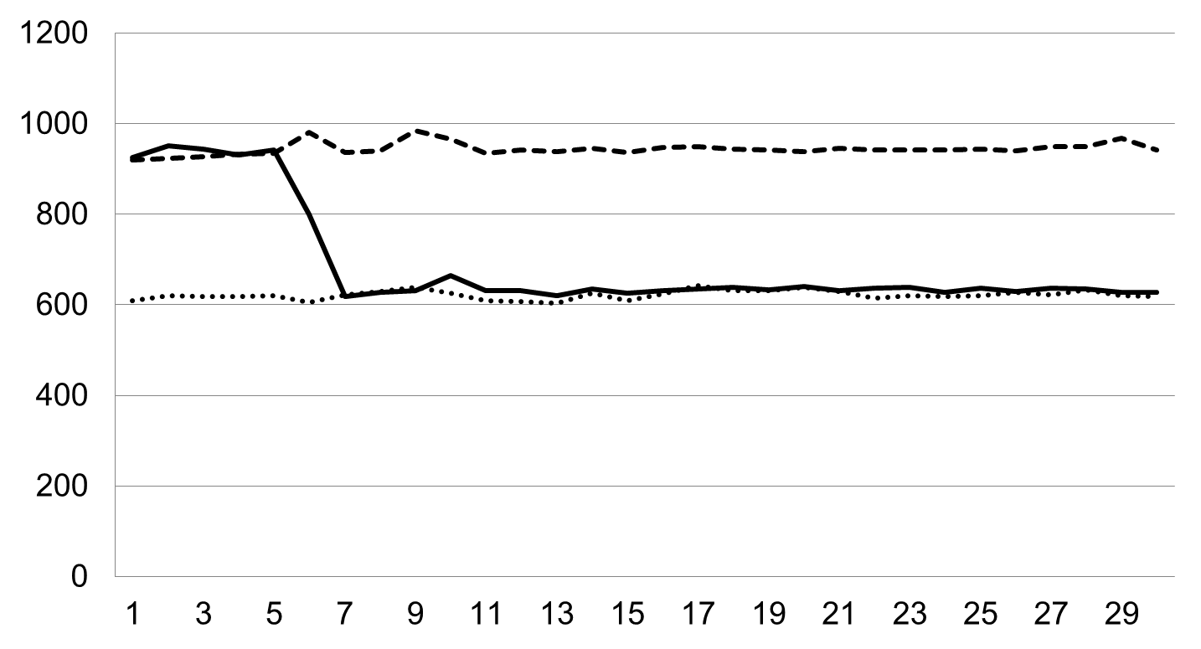
cache-dynamic-enabledd
cache-pre-enabledd
cache-disabledd
Average Cost (ns)
Time Interval (min)

Slide 3
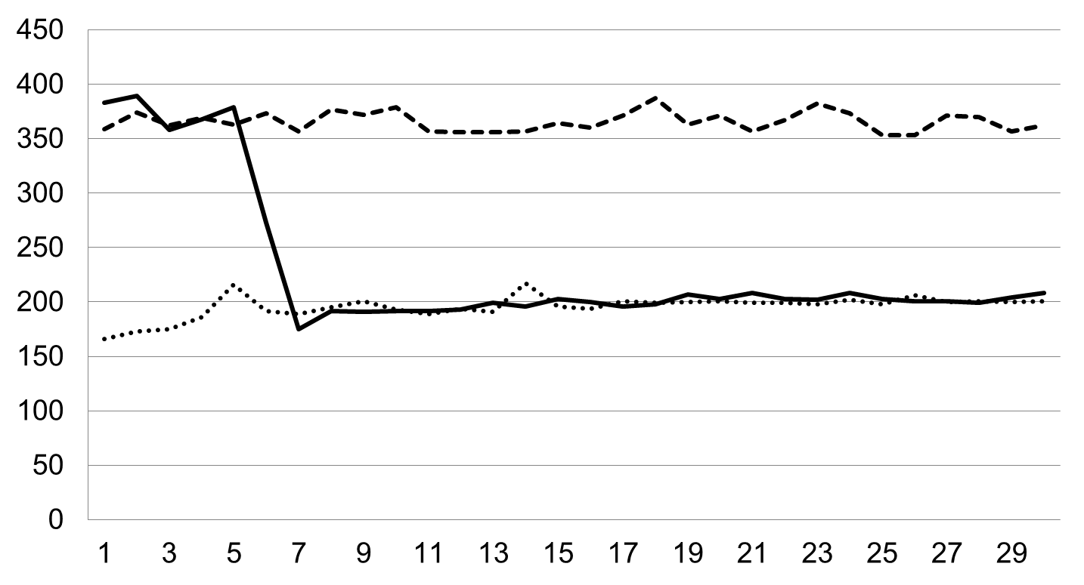
cache-dynamic-enabledd
cache-pre-enabledd
cache-disabledd
Average Cost (ns)
Time Interval (min)

Slide 4
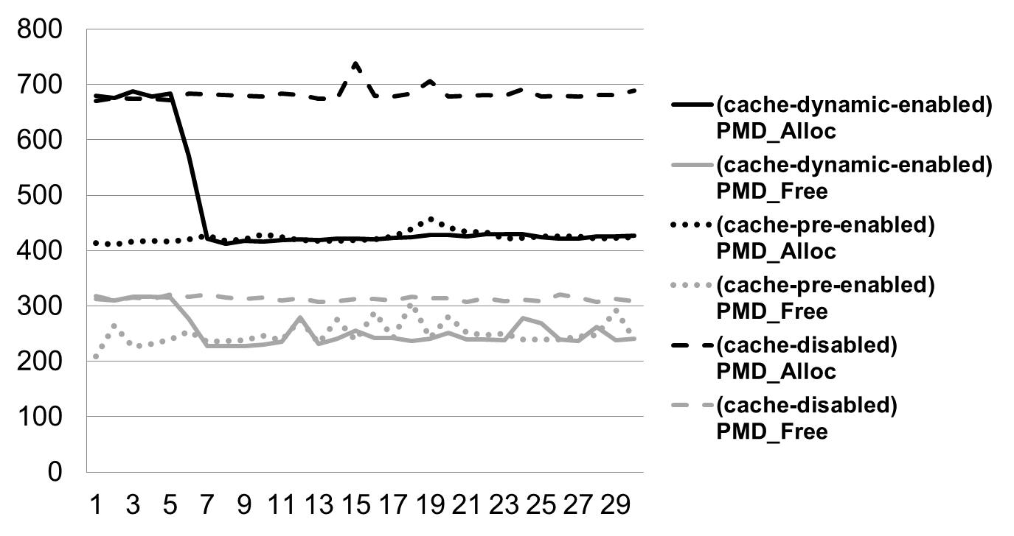
运行时，开启firefox程序
测试每分钟间隔下，PMD的分配和释放时间（优化前后）
Cost (ns)
Time Interval (min)

Slide 5
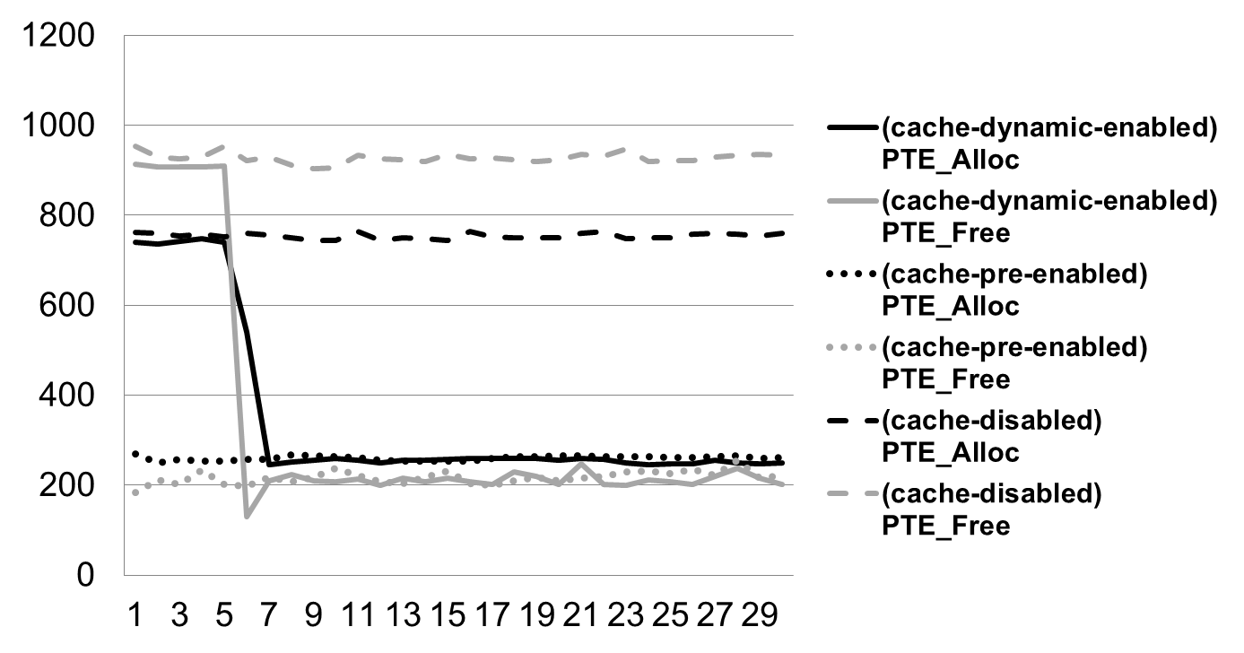
运行时，开启firefox程序
测试每分钟间隔下，PTE的分配和释放时间（优化前后）
Cost (ns)
Time Interval (min)

Slide 6
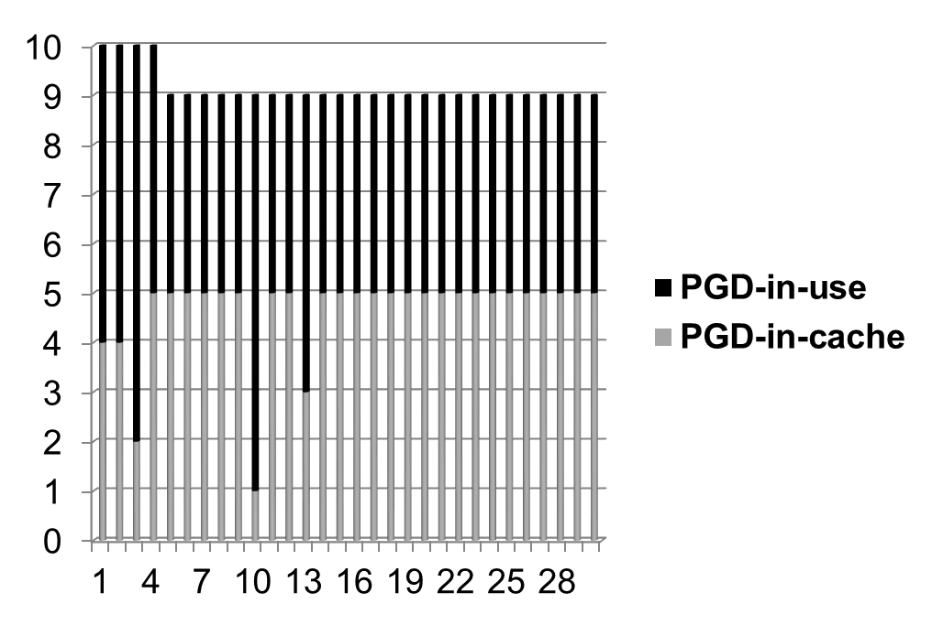
运行时，开启firefox程序
测试每分钟间隔下，PGD页表的缓存池（low-pressure）
Page (4K)
Time Interval (min)
Notes:
5pages in cache pool
Proportion among each level of page table
Pages in total
Proportion between each page table and its cache pool
When to free the pages to the buddy system, there are two conditions, 1) Proportion between each page table and its cache pool; 2) the total pages in pages in pool and pages in use.
Besides the I/O efficiency and CPU usage, the algorithm should also be evaluated in the aspect of memory usage since three levels of cache pools have been built to support a fast process creation/termination. We try to reach a satisfying balance between time and space. From figure 5 to 7, low-pressure group takes up to only 250 pages(i.e., 1000K < 1M) in the long time run while high-pressure group caches only 210 pages at most. It is reasonable that high-pressure group has less pages in the pool since a certain amount of page tables is freed to the buddy system right after the cache pool is put to use. And the proportion among the total pages of each level of page table including pages both in pool and in use matches kernel paging mechanism. On top of that, when to free the pages from the pool to the buddy system is based on the training study. Specifically, using PGD pool as an example, pages in pool will not be freed unless two conditions are true. 1) proportion between pages in pool and that in use is greater than 1:1; 2) total number of pages in pool and in use exceeds 10 pages. As for the page number to free, the difference number between them is set in order to adjust the proportion to 1:1. An equation below can clearly state this point: num_to_free = num_in_pool – num_in_use.
Note that the method to determine the proportion and total page number is based on an experiment when no pages are freed, which is the so-called training study. Further discussions about when to free will be talked about in the future work.

Slide 7
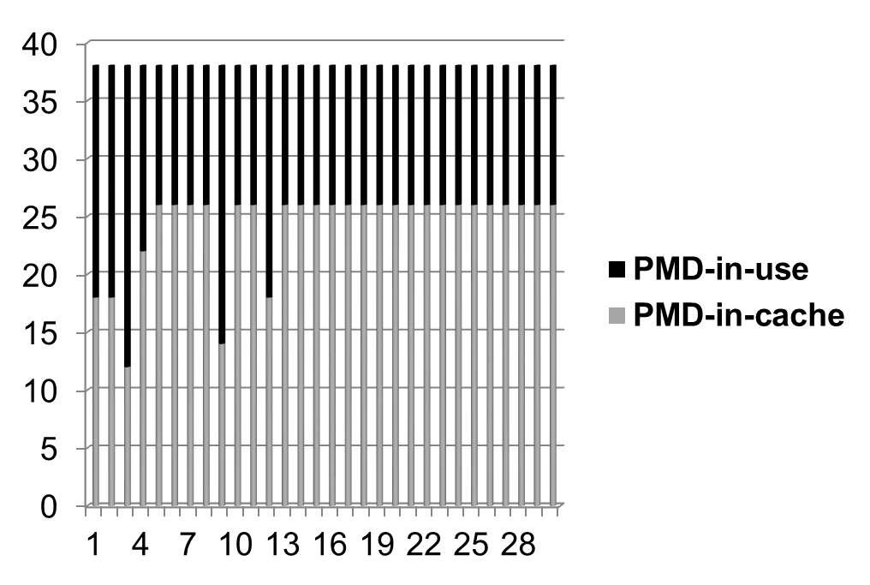
运行时，开启firefox程序
测试每分钟间隔下，PMD页表的缓存池（low-pressure）
Page (4K)
Time Interval (min)
Notes:
38 pages. cache(26pages): page table = 2:1

Slide 8
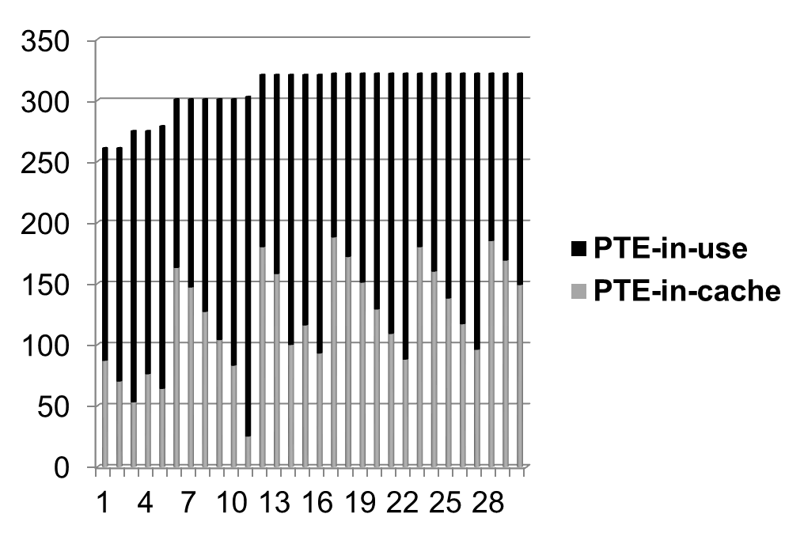
运行时，开启firefox程序
测试每分钟间隔下，PTE页表的缓存池（low-pressure）
Page (4K)
Time Interval (min)
Notes:
322 pages. PTE: cache(220pages) < 2:1

Slide 9
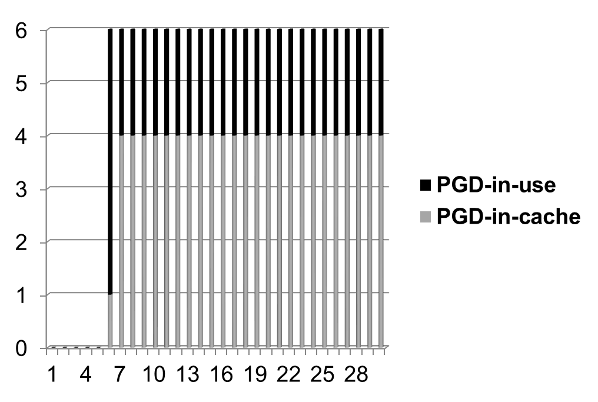
运行时，开启firefox程序
测试每分钟间隔下，PGD页表的缓存池（high-pressure）
Page (4K)
Time Interval (min)
Notes:
Cache (4pages) : PGD = 4 : 2 = 2:1

Slide 10
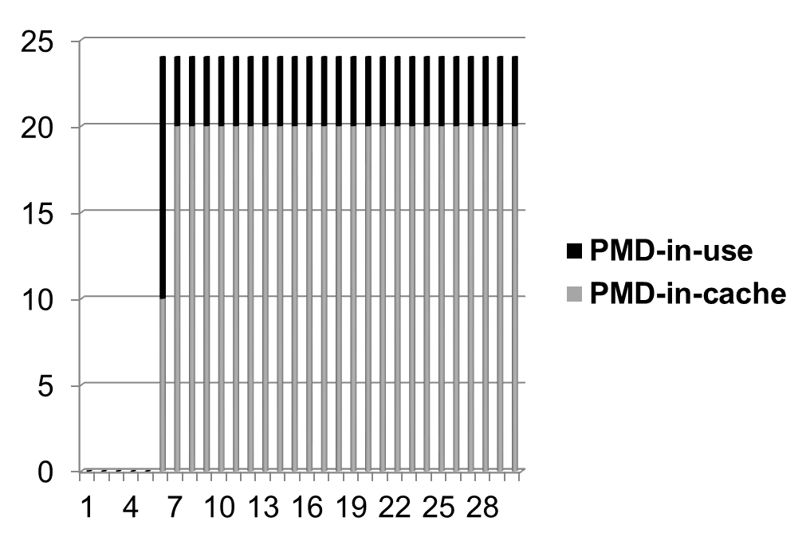
运行时，开启firefox程序
测试每分钟间隔下，PMD页表的缓存池（high-pressure）
Page (4K)
Time Interval (min)
Notes:
Cache (20 pages) : PMD (4 pages) = 5:1

Slide 11
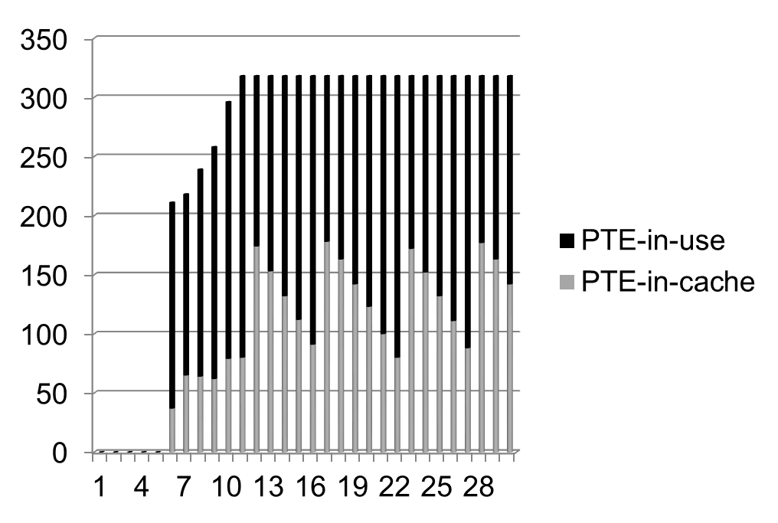
运行时，开启firefox程序
测试每分钟间隔下，PTE页表的缓存池（high-pressure）
Page (4K)
Time Interval (min)
Notes:
Cache (180 pages): PTE (240 pages) < 1:2

