Slide 1
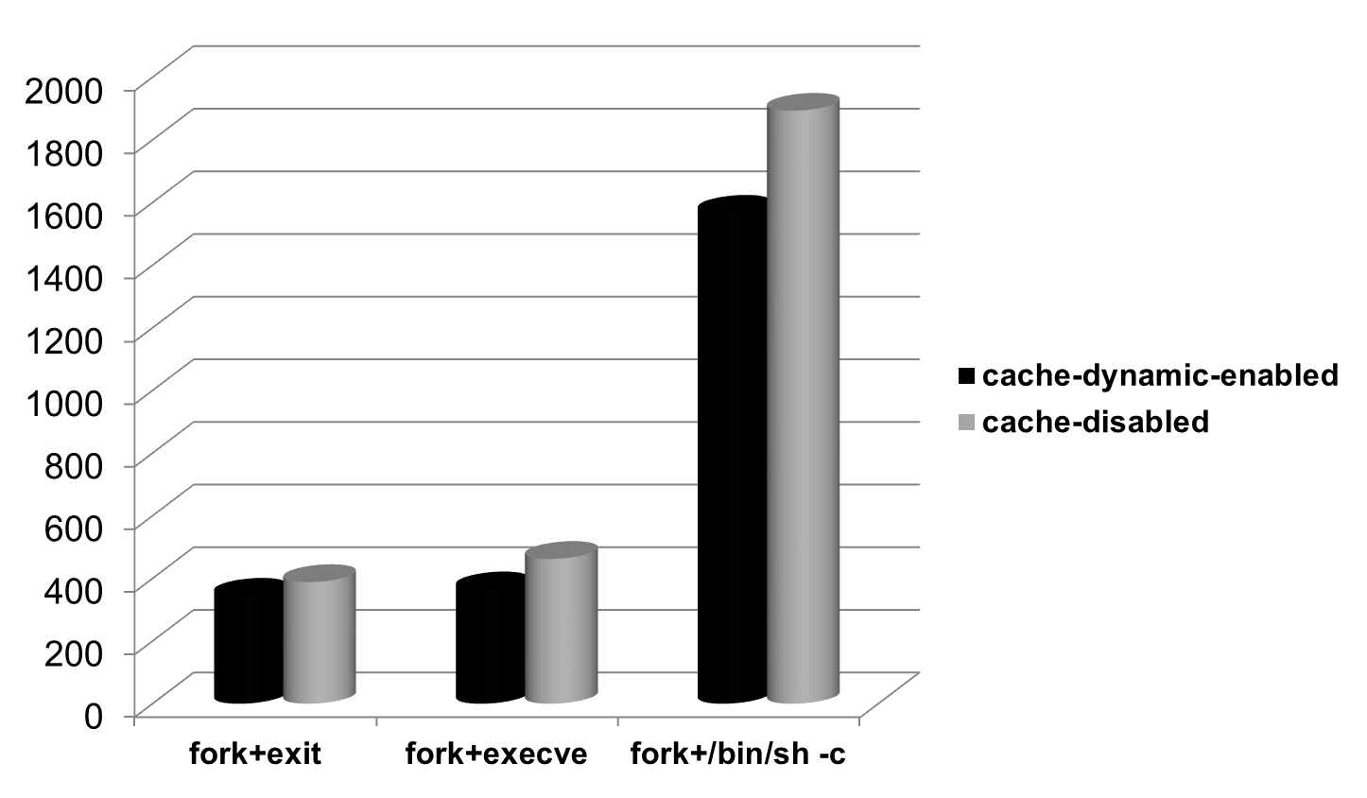
lmbench
time (μs)
process

