Slide 1
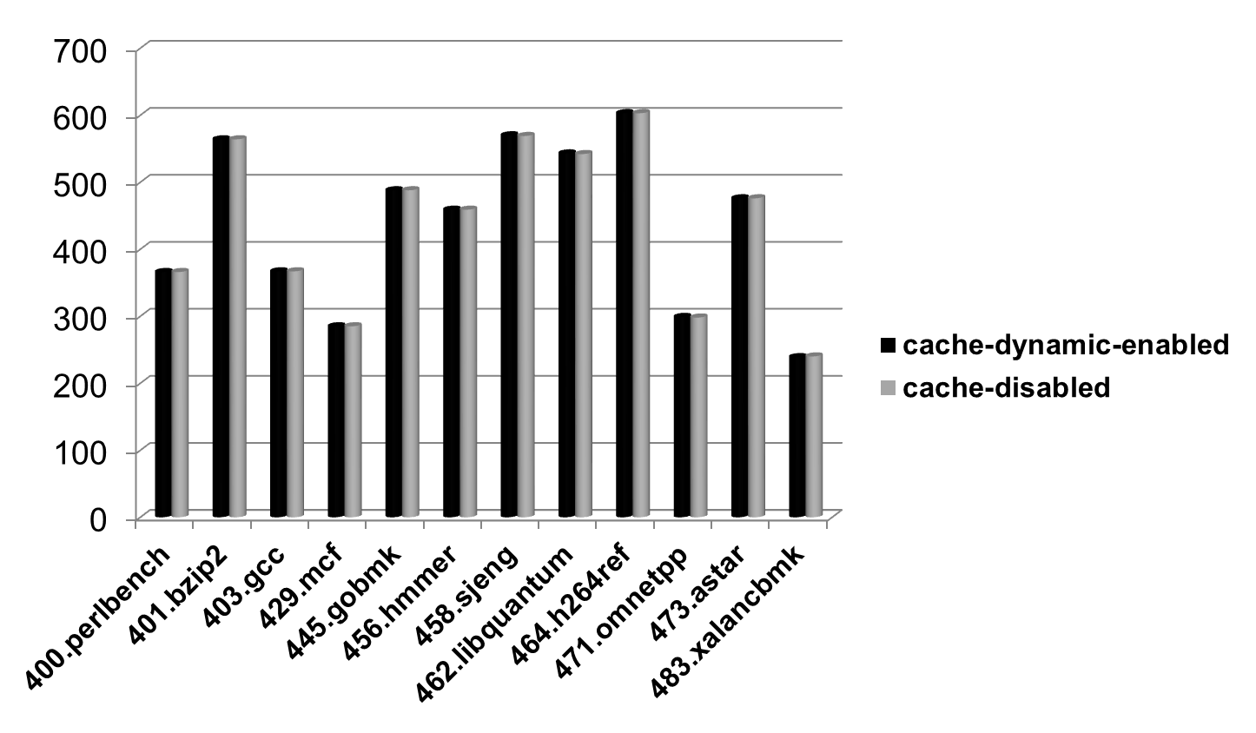
time (s)
benchmark

