Slide 1
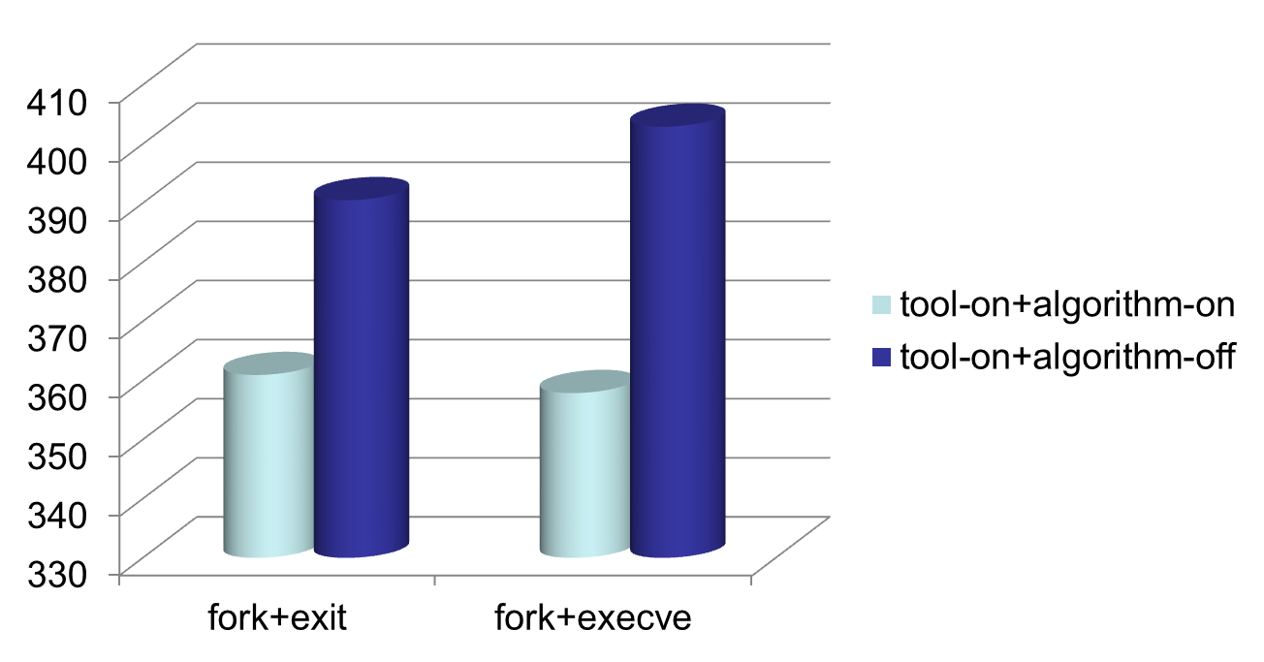
lmbench
time (μs)
benchmark

Slide 2
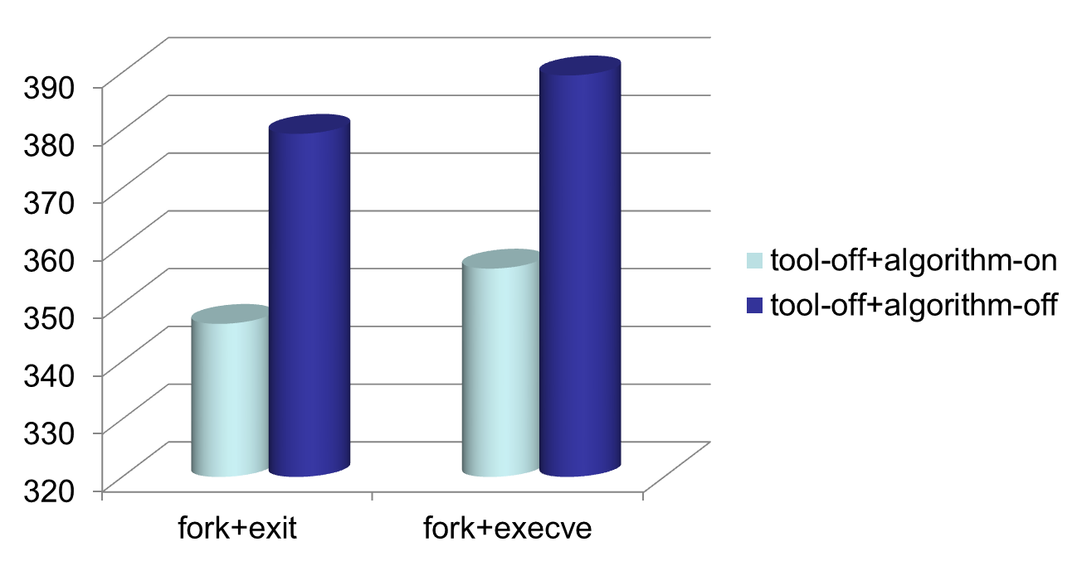
lmbench
time (μs)
benchmark

