Slide 1
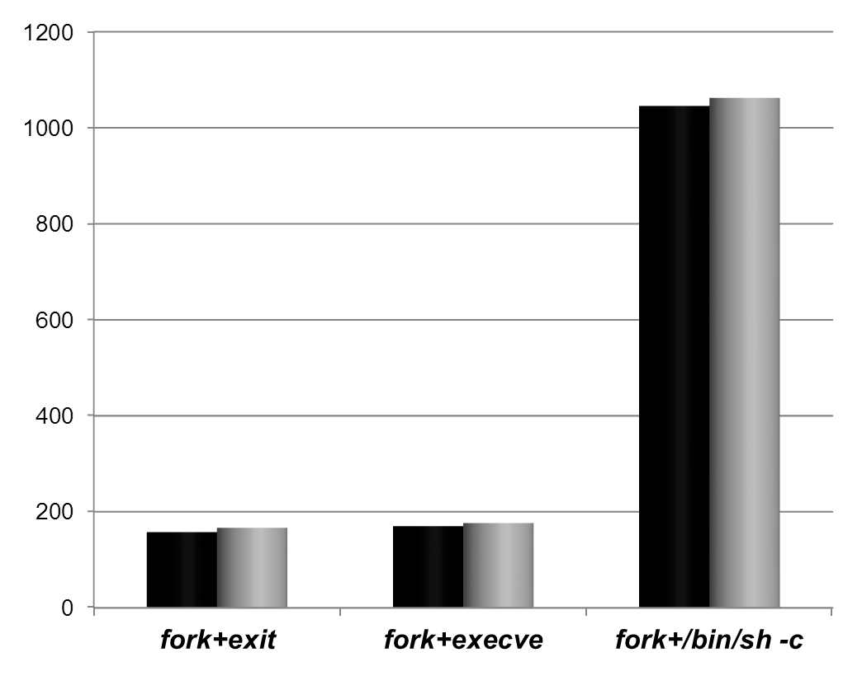
dynamic-enabled
disabled
time (μs)

