Slide 1
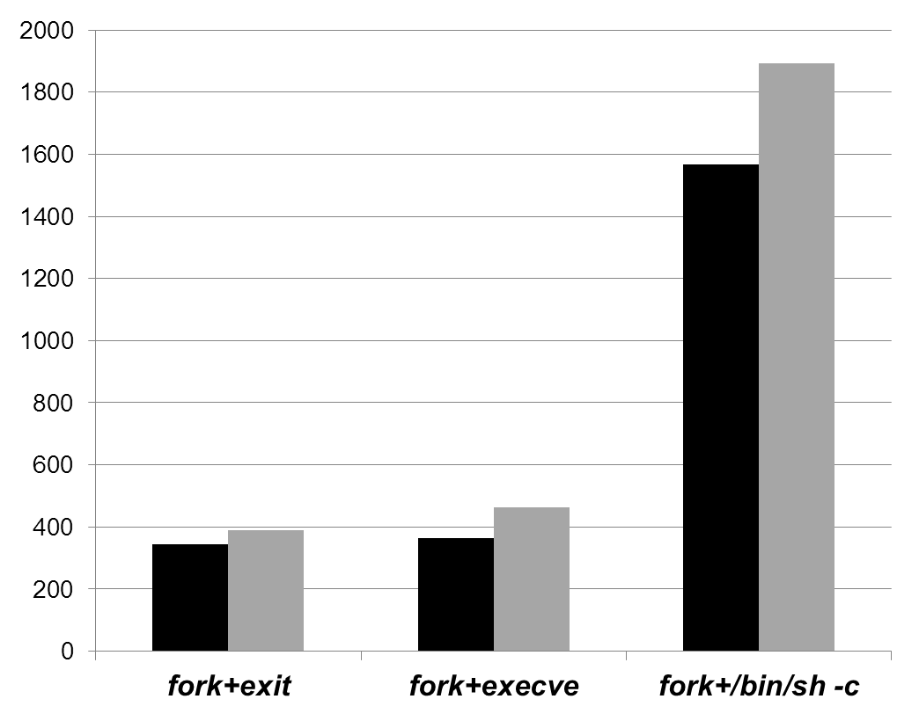
Dyn-PiBooster
Baseline
Time (μs)

