Slide 1
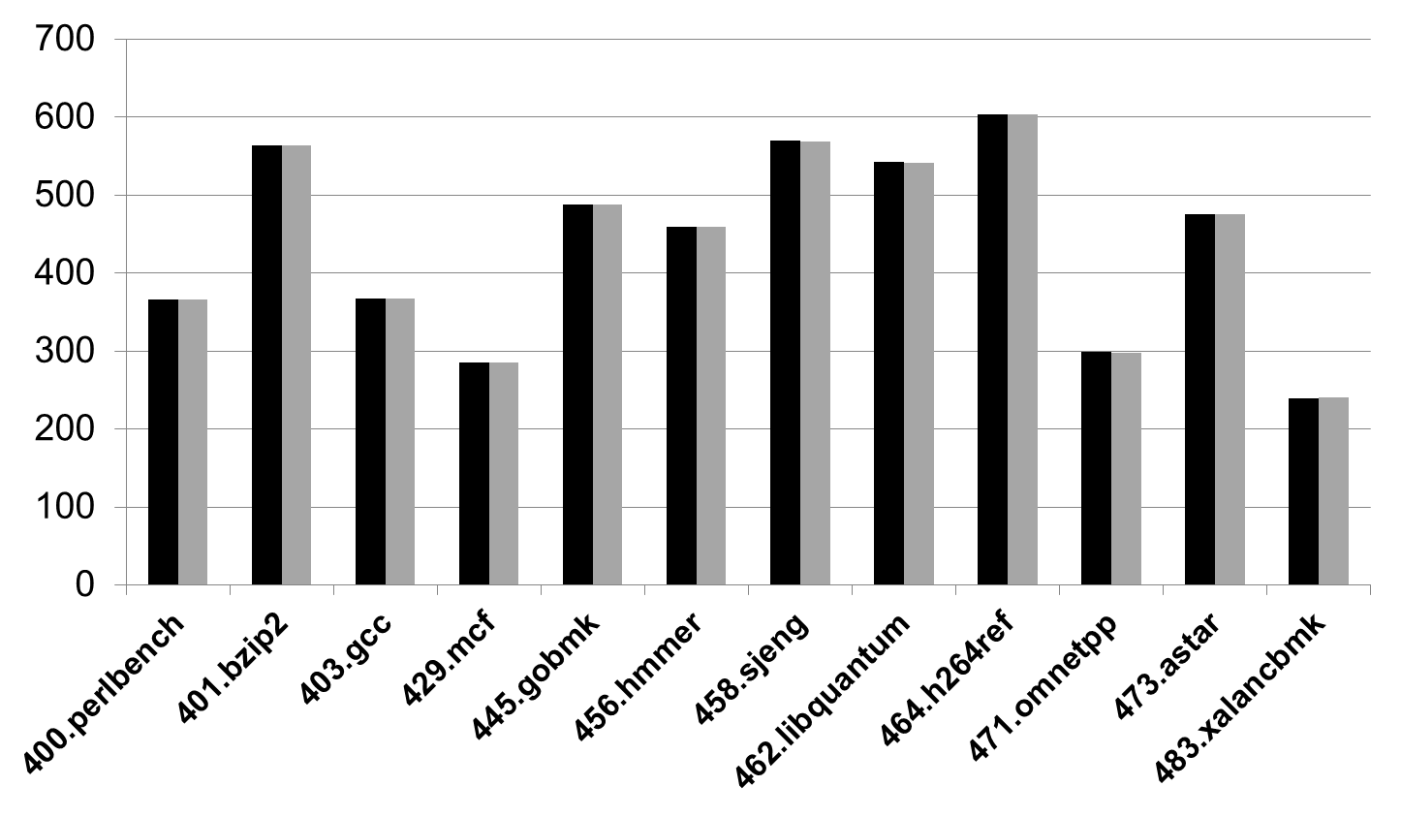
Dyn-PiBooster
Baseline
Time (s)

