Slide 1
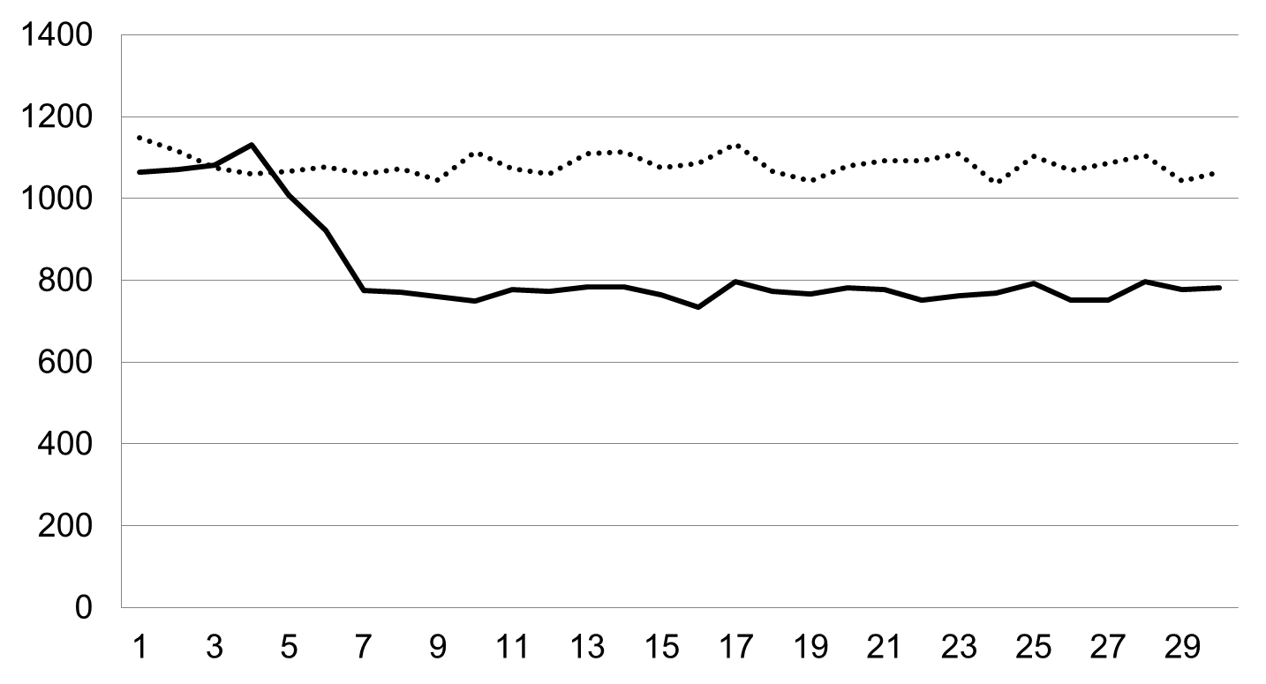
dynamic-enabled
pre-enabled
disabled
Average Cost (ns)
Time Interval (min)
Notes:
PGD ALLOC

Slide 2
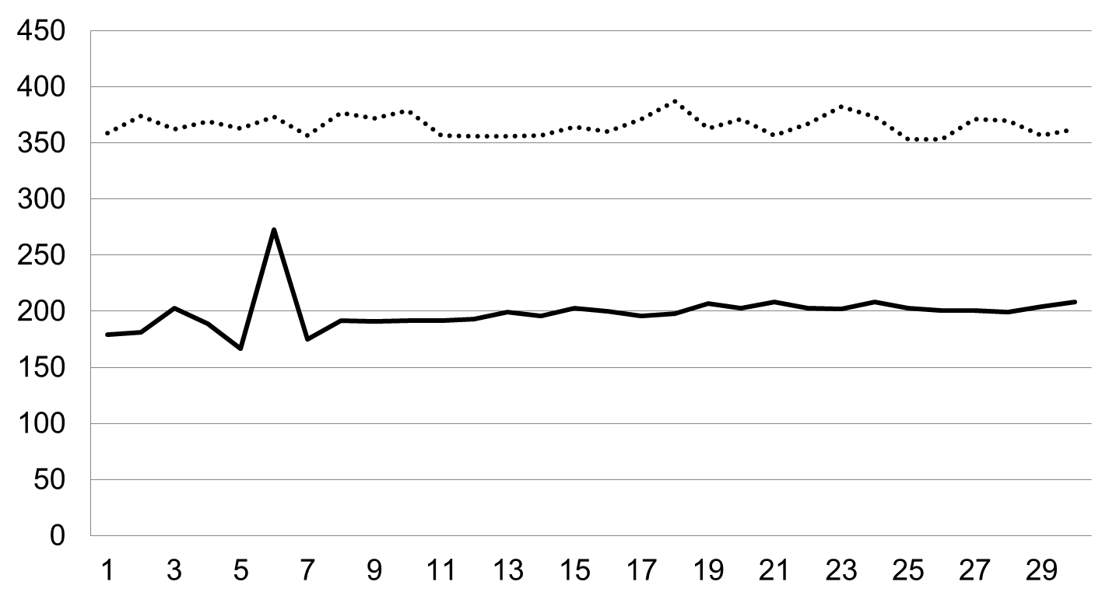
dynamic-enabled
pre-enabled
disabled
Average Cost (ns)
Time Interval (min)
Notes:
PGD FREE

Slide 3
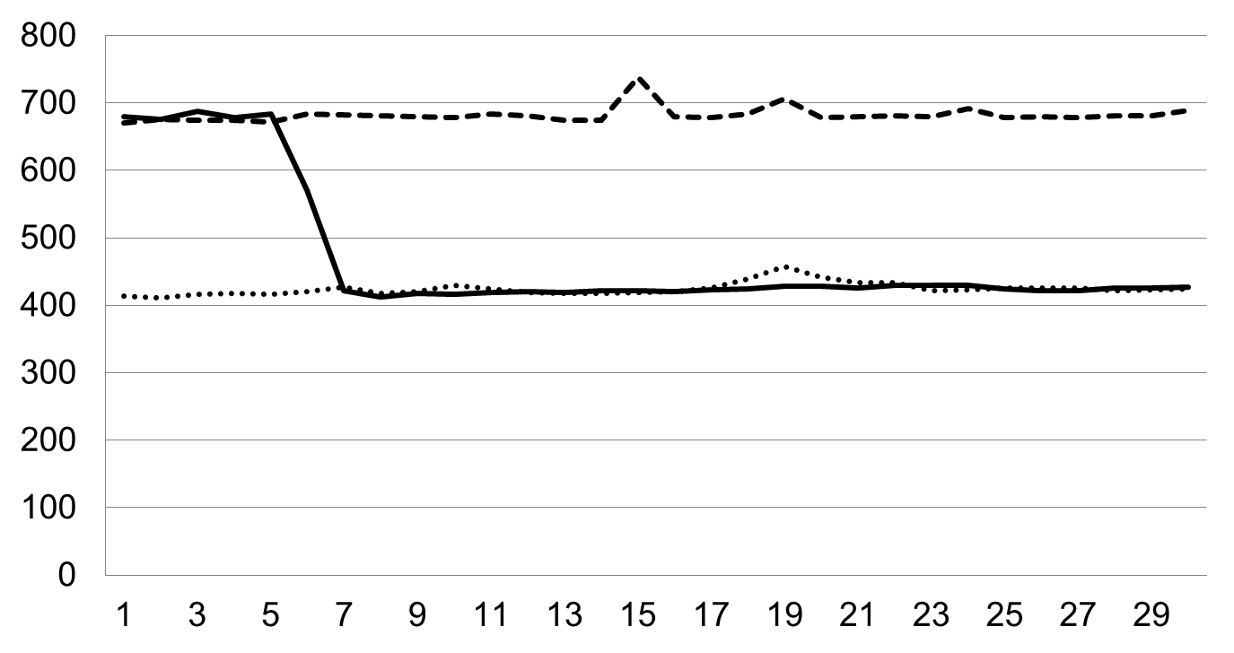
dynamic-enabled
pre-enabled
disabled
Average Cost (ns)
Time Interval (min)
Notes:
PMD ALLOC

Slide 4
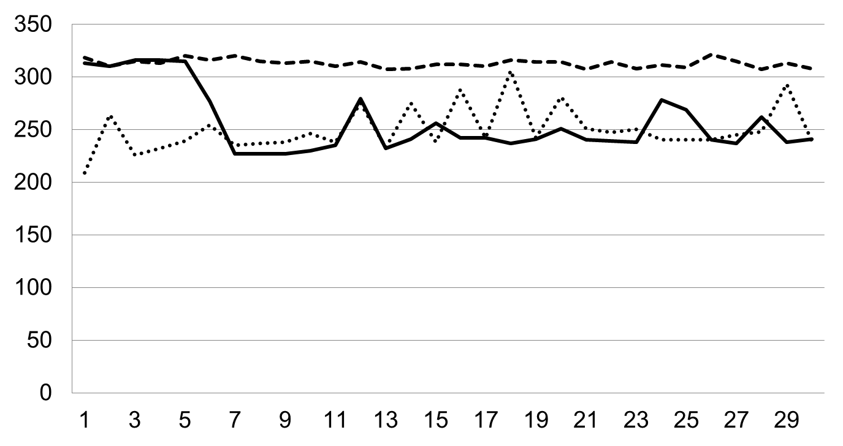
dynamic-enabled
pre-enabled
disabled
Average Cost (ns)
Time Interval (min)
Notes:
PMD FREE

Slide 5
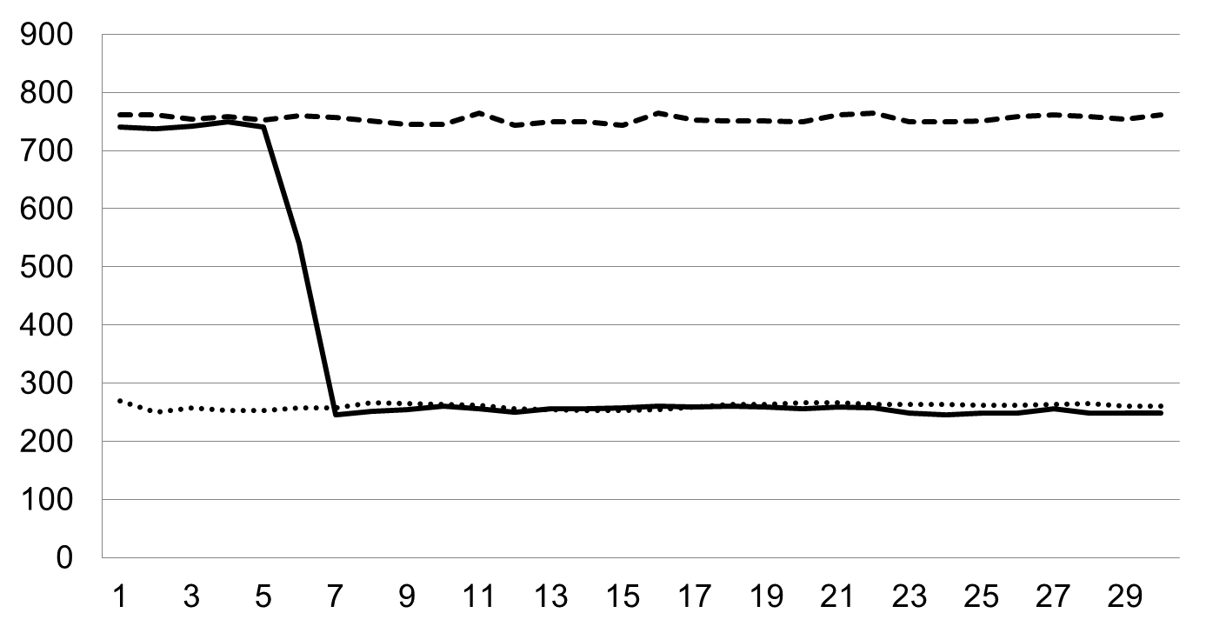
dynamic-enabled
pre-enabled
disabled
Average Cost (ns)
Time Interval (min)
Notes:
PTE ALLOC

Slide 6
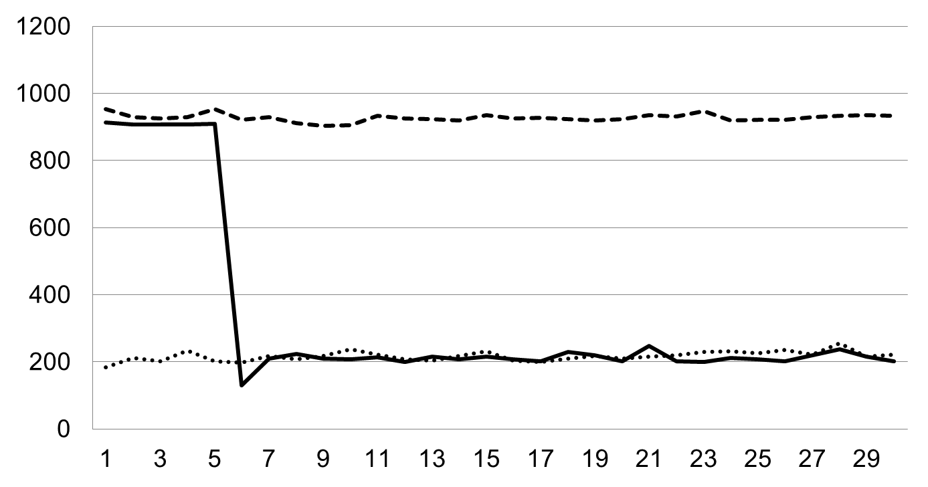
dynamic-enabled
pre-enabled
disabled
Average Cost (ns)
Time Interval (min)
Notes:
PTE FREE

