Slide 1



Forest Fire Detection Using Deep Learning
Vikram Pratap Singh
AICTE Student ID: STU65aa02e6074b91705640678

Slide 2

Learning Objectives
Learned about theoretical and practical aspects of ML,Deep Learning, Neural Networks and specifically about CNN(convolutional Neural Networks).
Understood the use of CNN for image classification and applied on Forest Fire detection.
Learned CNN layers and their purpose Conv2d, ReLu, Downsampling, Flattening and Final layers.
Build the stacked CNN model step by step for binary classification of fire and no-fire.
Visually analysed the accuracy of the model through plotting graphs.
GOAL
Source :
www.freepik.com/

Slide 3
Tools and Technology used
Language: Python.
Libraries : Numpy, matplotlib.
Frameworks : Keras, Tensorflow.
Model : CNN(sequentially stacked binary model).
Development Environment : Google Collab.
Dataset : Kaggle(The wildfire dataset).

Slide 4
Methodology
Data Collection : From kaggle(Forest Fire Detection).
Data Preprocessing : Rescaling(1./255), Resizing(150,150) of images, setting batch_size of 32 and class_mode as binary.
Model Selection : Sequentially stacked binary CNN model with Conv2d, MaxPooling2d, Dense, Flatten and output as CNN layers.
Model Training : Trained the the model on training set, epochs set as 12, accuracy is used as evaluation metrics.
Evaluation Metrics : Accuracy is used for evaluation with Test Accuracy of 82.81%.
Visualization : By plotting graphs of training and validation accuracy and loss for comprehensive understanding.
Validation and prediction : Finally the model is tested on the test_set against various images.

Slide 5
Problem Statement:
Forests are the lungs of planet earth as they checks global warming, provide resources, fresh air and keeps our survival intact. Each year a vast forest-cover is lost due to forest fires all over the world.
Manual methods takes time due to poor information exchange and lack of early prediction due to remoteness and poor connectivity.
By automating this process of forest fire prediction using Deep Learning methods(CNN models), deploying the model on cloud and getting real time imagery with satellite/drone connectivity can instantly generate the alarm and pinpoint the location.
This AI based automated process will help in stopping fires early on and can save vast amount of valuable resources getting wasted.

Slide 6
Solution:
Used the CNN model to predict the two classes i.e., fire and no-fire.
Based on the image input given to the prediction function of the model, the model uses the sigmoid function to calculate probability and assigns the given image as fire or no-fire.
The model is trained successfully with test accuracy of 82.81% which is fair for this simple model.
The model is generalised to all regions of different forests as the dataset chosen was diverse with images from around the globe.
Once deployed the model can be used for real-time and real-world application.
Further it can be fully automated with satellite connectivity and will profoundly help in disaster management.

Slide 7
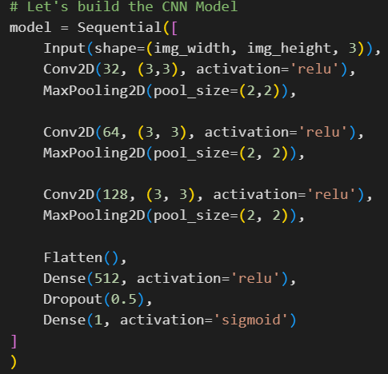
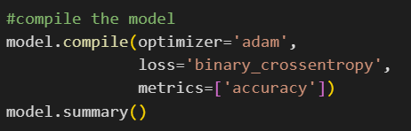
Screenshot of Output:

Slide 8
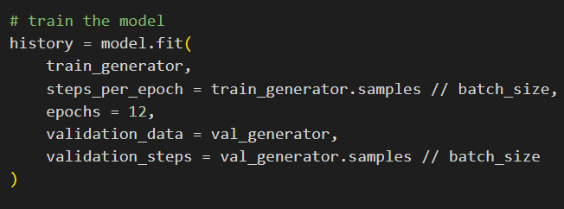
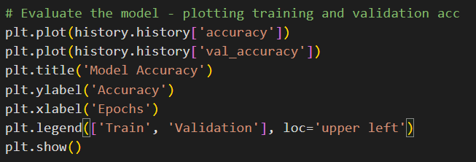
Screenshot of Output:

Slide 9
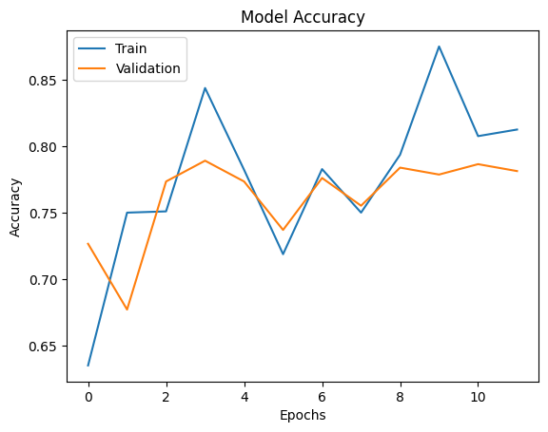
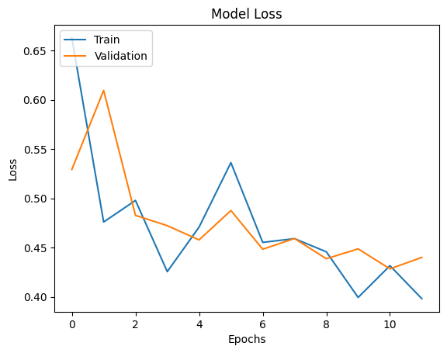
Screenshot of Output:

Slide 10
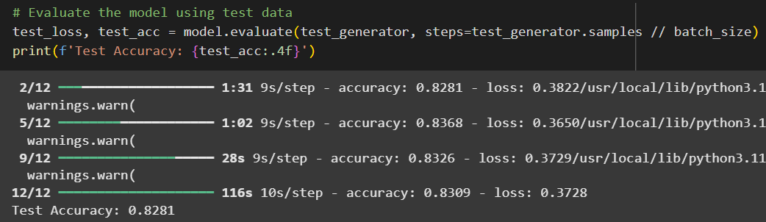
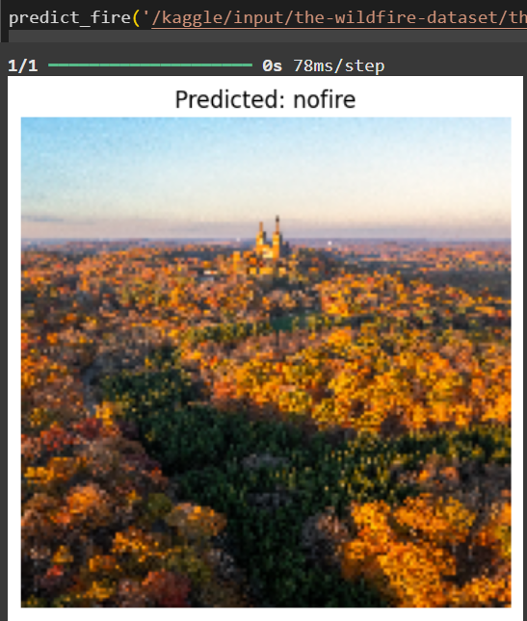
Screenshot of Output:

Slide 11
Conclusion:
For this Forest-Fire-Detection project I took the dataset from kaggle having two classes of images as fire and no-fire.
Then trained the binary CNN model on the dataset to make prediction if there is fire or no-fire in the input images.
Got the test-accuracy of 82.81%.
Future Scope : The accuracy can be further increased with some tweaks like regularization,etc.
Some already trained powerful models like MobileNetV2, etc can be used for further robustness.
The fully functional model can be deployed on the cloud and start the real time service.
It can further be connected to satellite imagery for real time real world prediction with exact location of fire.
Further a fully automated system for prediction, awareness, stakeholder involvement, disaster management authorities involvement will help stop the forest fires and loss of resources at the earliest.
GitHub Repo Link : https://github.com/stroopstrata/AICTE_Weeks.git

