Slide 1
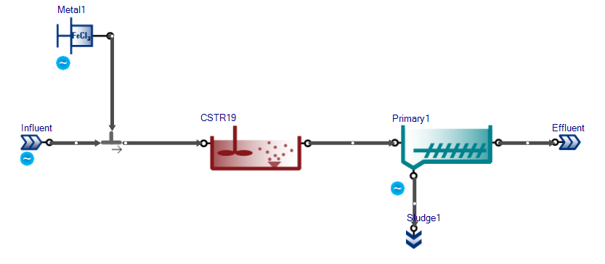

Slide 2
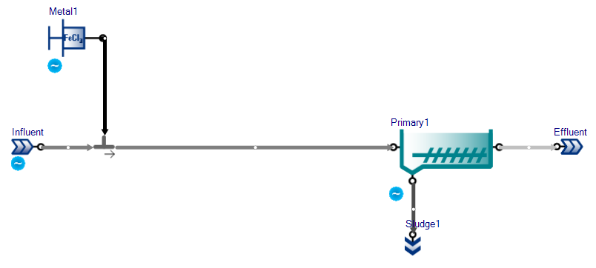

Slide 3
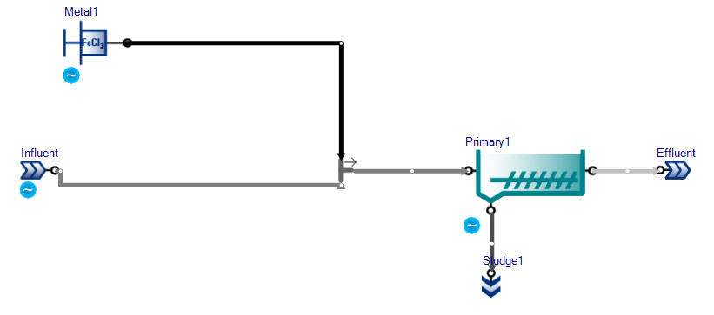

Slide 4
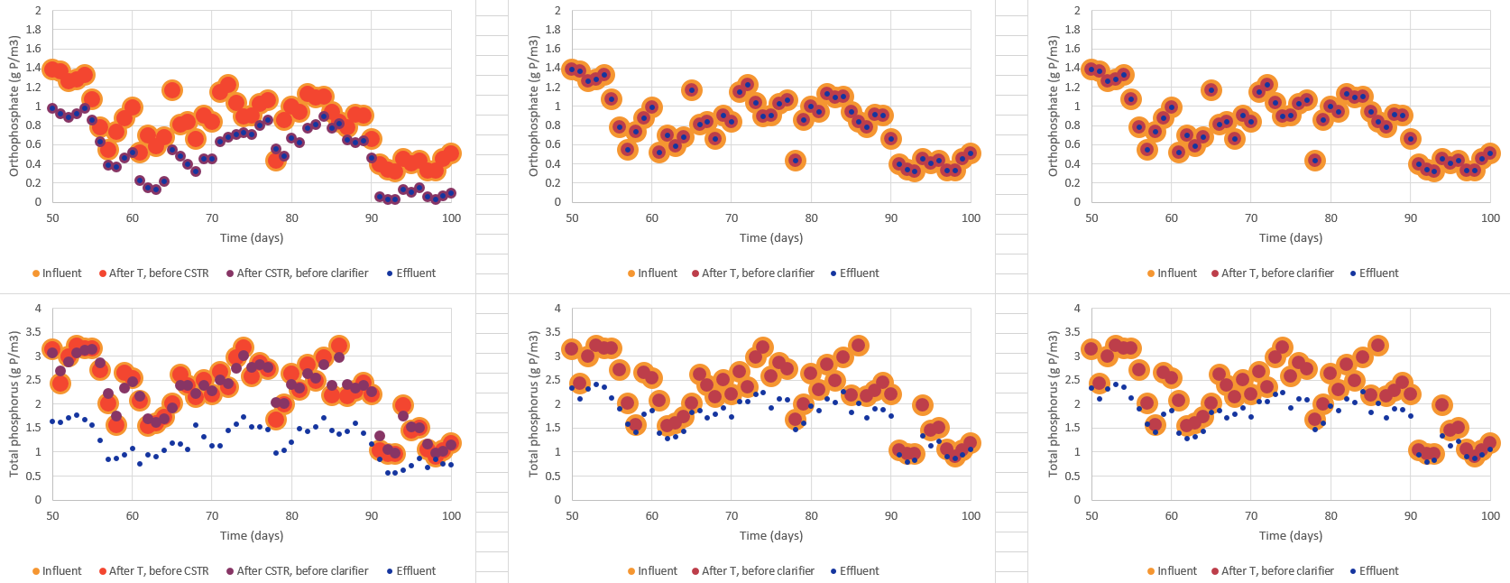
CSTR
Sideflow combiner
No CSTR
Sideflow combiner
No CSTR
Tflow combiner
Orthophosphate (g P/m3)
Orthophosphate (g P/m3)
Total phosphorus (g P/m3)

Slide 5
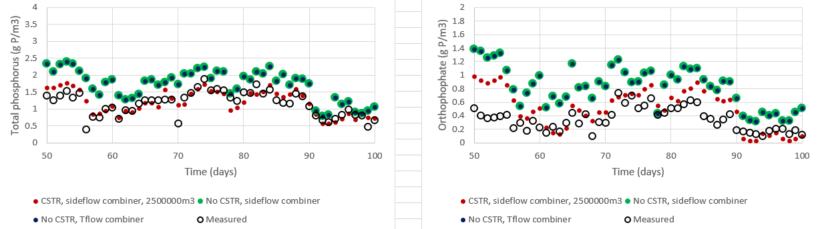
CSTR
Sideflow combiner
No CSTR
Sideflow combiner
No CSTR
Tflow combiner

Slide 6
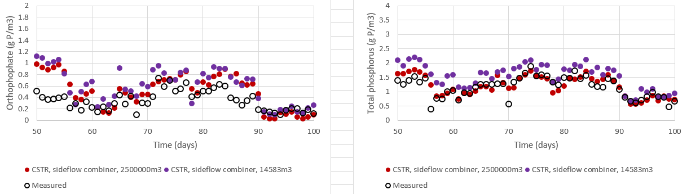
CSTR
2,500,000 m³
1.19 d HRT
CSTR
14,583 m³
10 min HRT
PO4 NSE = 0.494
TP NSE = 0.244
PO4 NSE = 0.561
TP NSE = 0.531

Slide 7
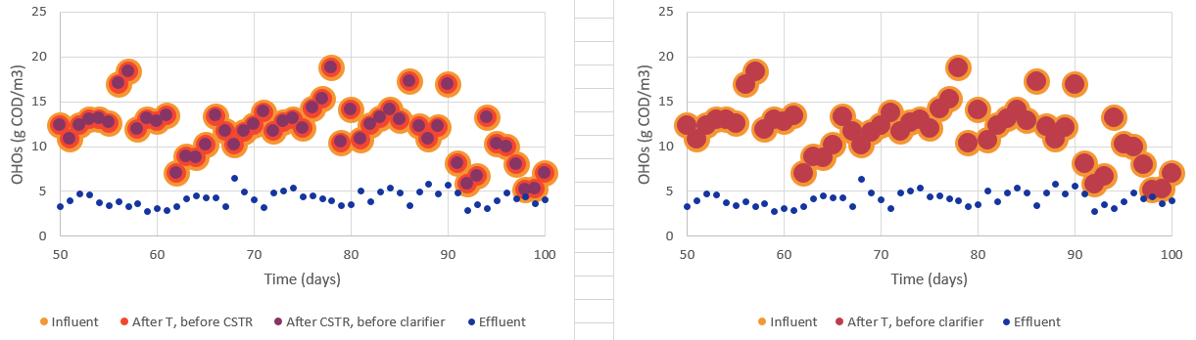
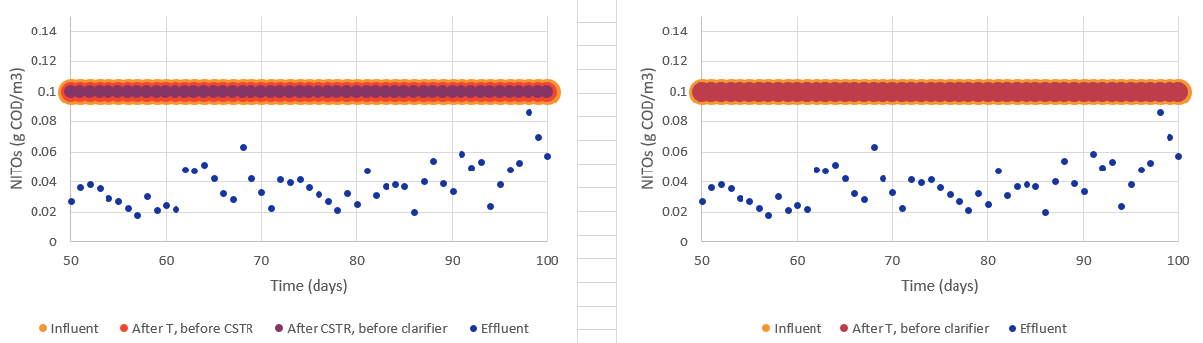
CSTR
14,583 m3 (10 min HRT)
No CSTR
Sideflow combiner
OHOs (g COD/m3)
NITOs (g COD/m3)

