Slide 1
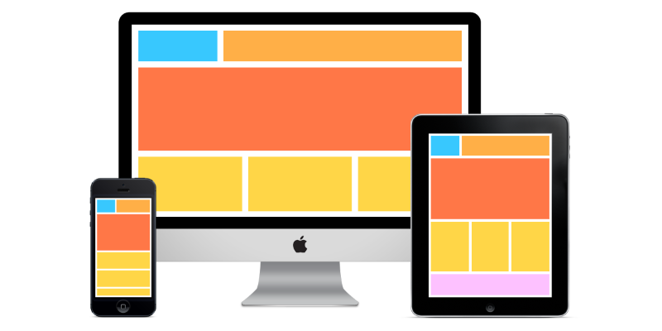
User Interfaces

Slide 2
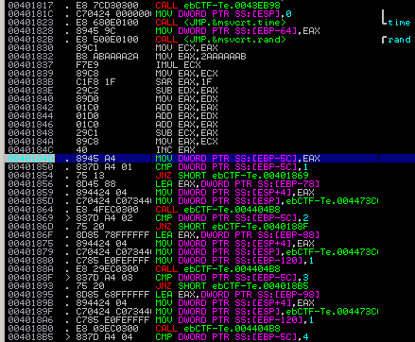

Schnittstelle in die welt der software

Slide 3

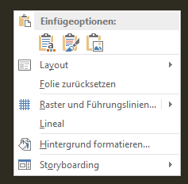
ACTIOn – object | object - action

Slide 4
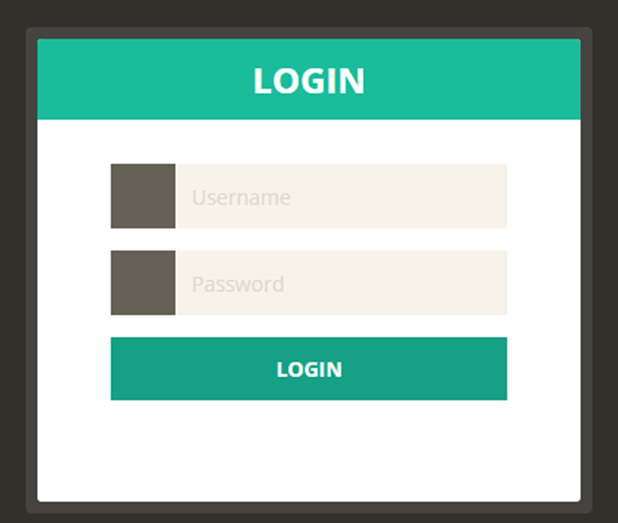
forms

Slide 5
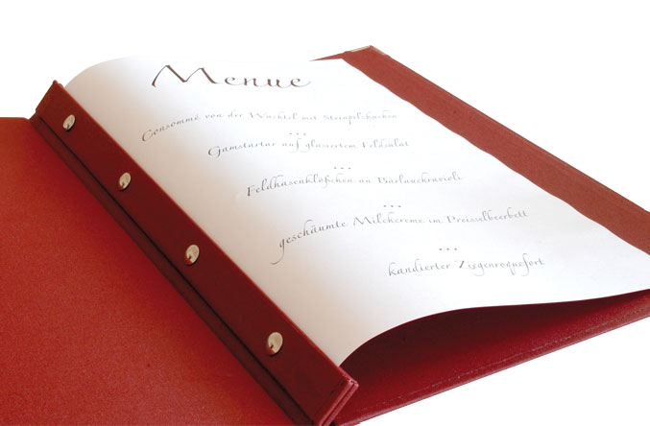
Menüs

Slide 6
User Interfaces

