Slide 1



Slide 2


Slide 3




Slide 4


Slide 5
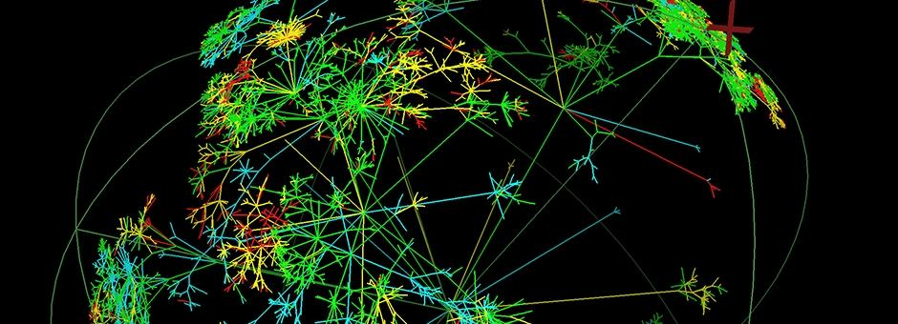
“We are experts in complex networks
Our expertise in the challenges presented by complex networks began in 2004. Pandora FMS has been designed with the sole purpose of obtaining information, no matter how hard to get.”

Slide 6



