Slide 1

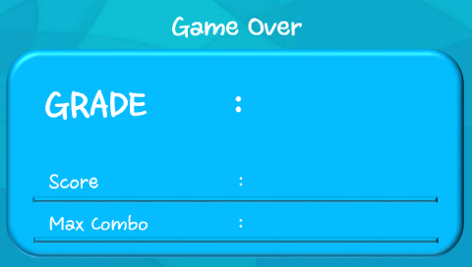
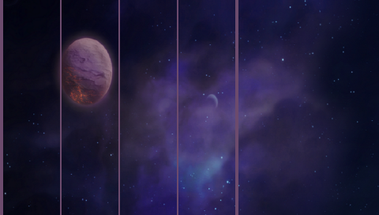
Title :
Speed
4 6 8 10 12 14 16
Play
Cancel
Score
Hit
Yes
Buzzer Mode
No
MP3 Mode
Give Up
Back

