Slide 1

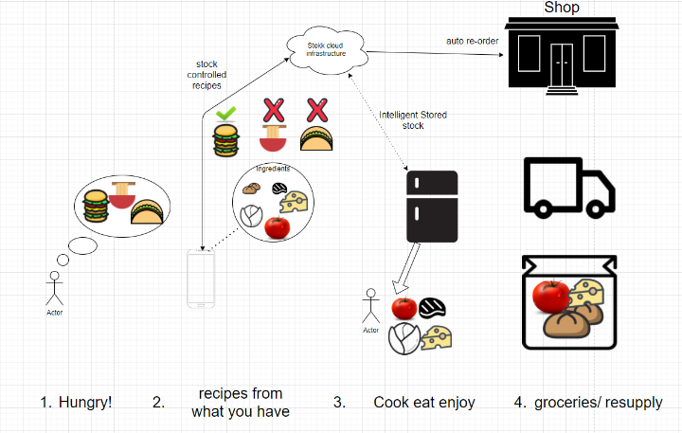
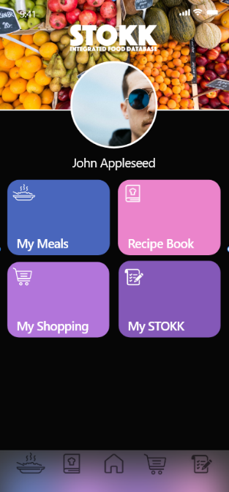
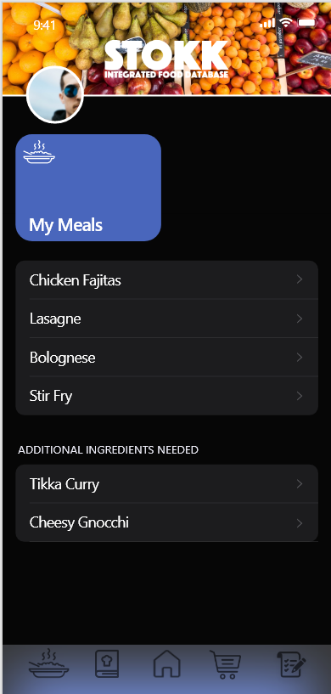
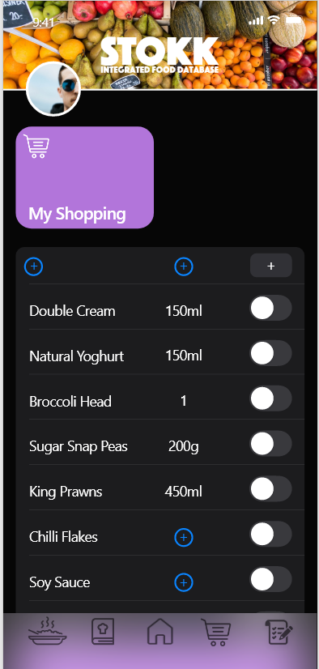
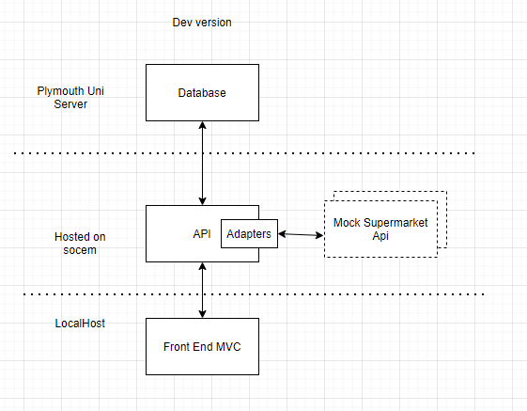
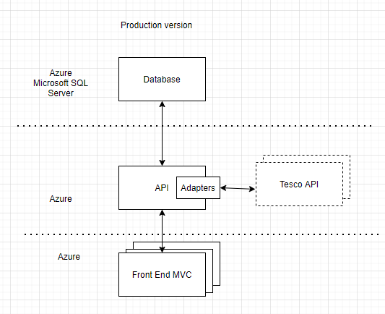
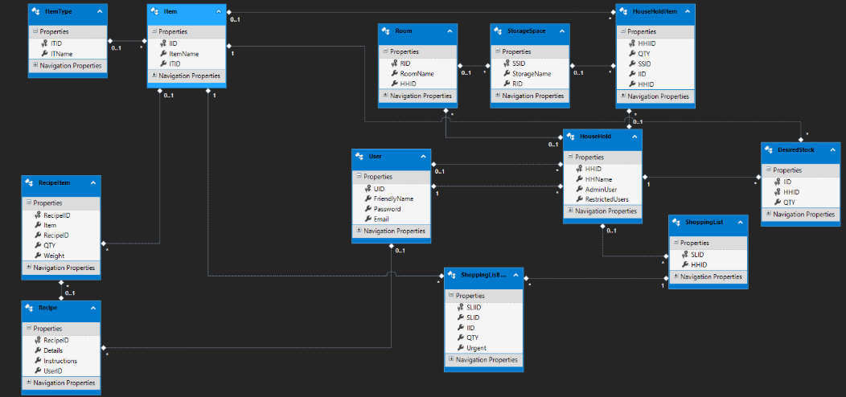
Candidate Number: 10560031
Stokk assists users with shopping, stock control and recipe handling
using automation to help make the kitchen a smart environment.
Intelligentially selects recipes from a database of user supplied and community generate recipes based on what the user has in their fridge.
User friendly stock management system that takes into account the actual use of Stokk.
Automated shopping list with the ability to connect to external API via a unified adapter model.
Adobe XD UI development workflow,
created to be user friendly and accessible to make successful smart system
Development architecture using mock adapter
to simulate external API connection,
local development environment
Production architecture hosted on azure
With decoupled connections to external API via adapters
ERD of database system which utilizes trigger-based automation for functionality

