Slide 1

CHEMBL Structure Curation

Slide 2
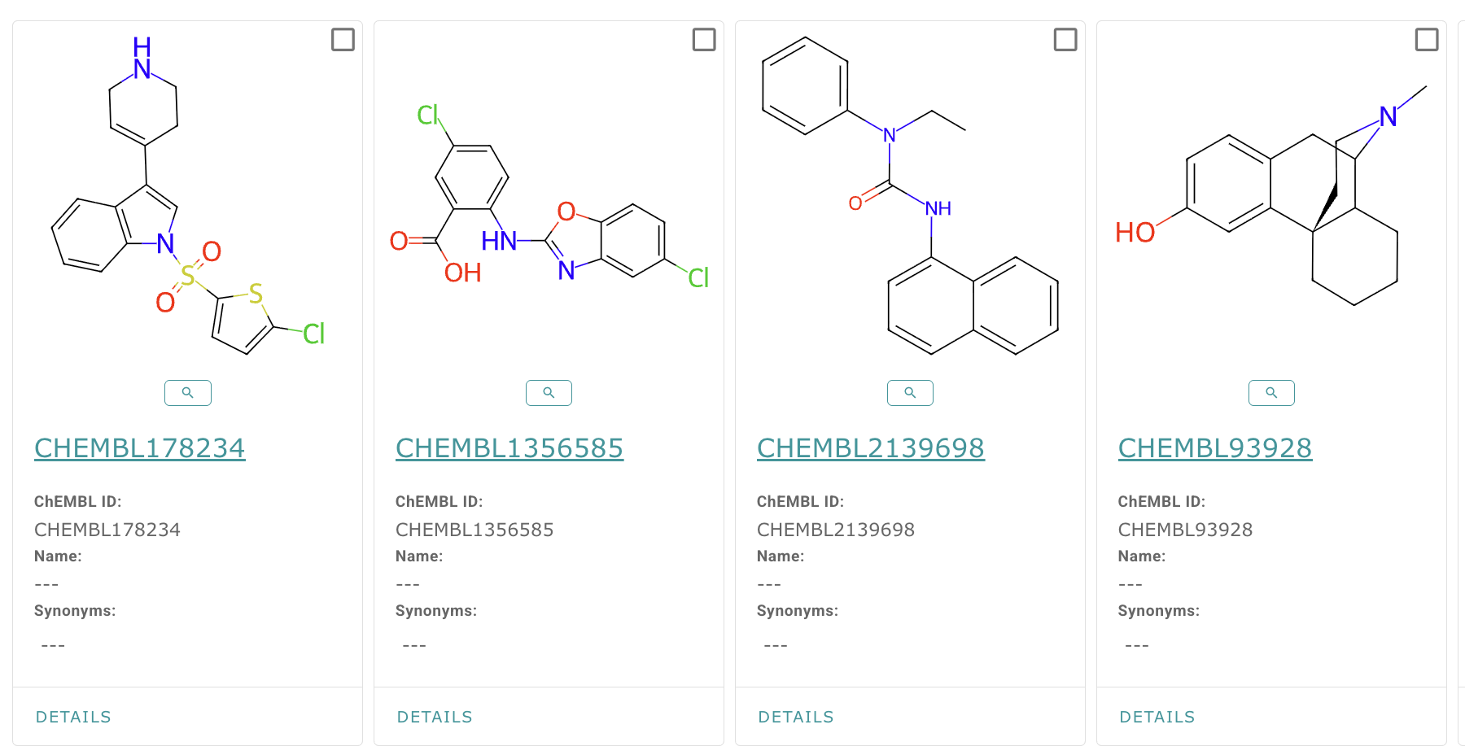
Example Structures

Slide 3
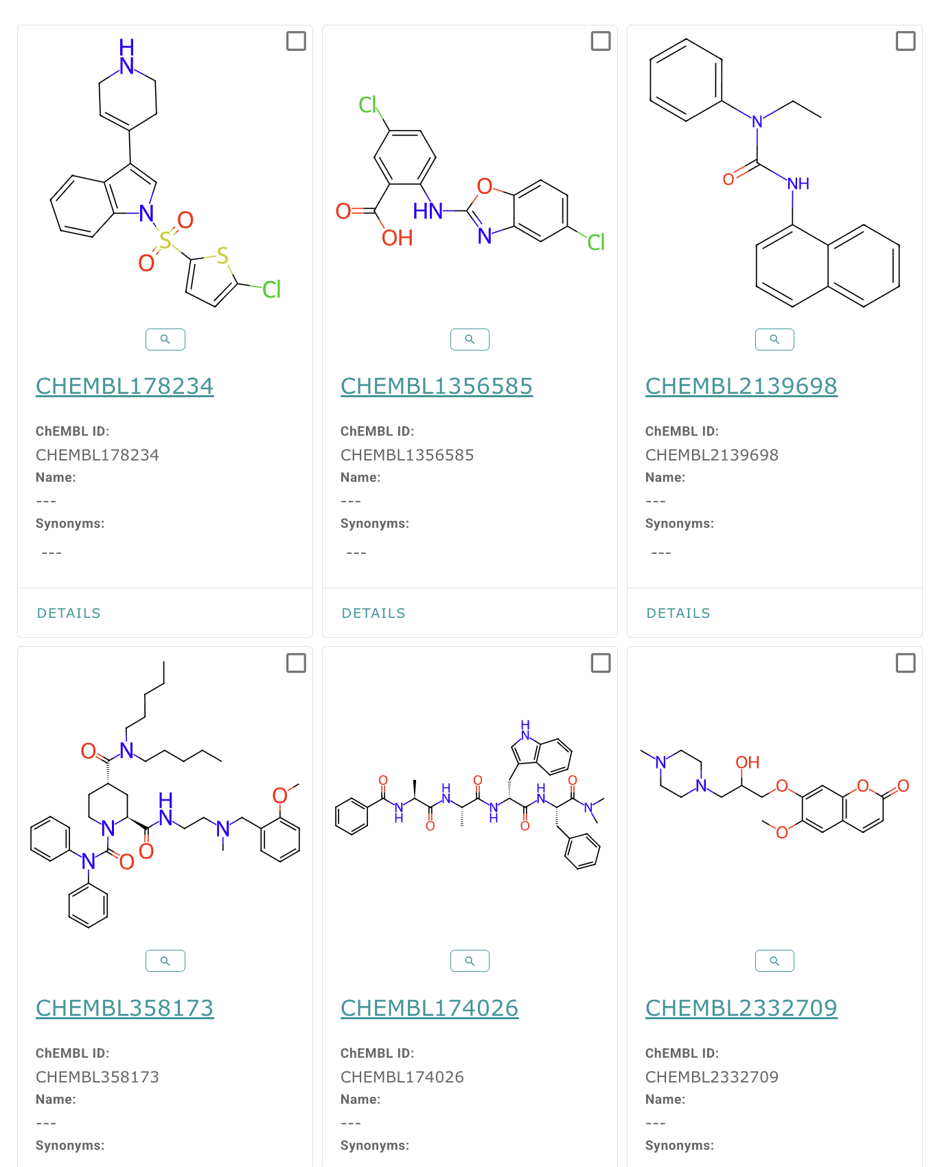
SMALL MOLECULES

