Slide 1
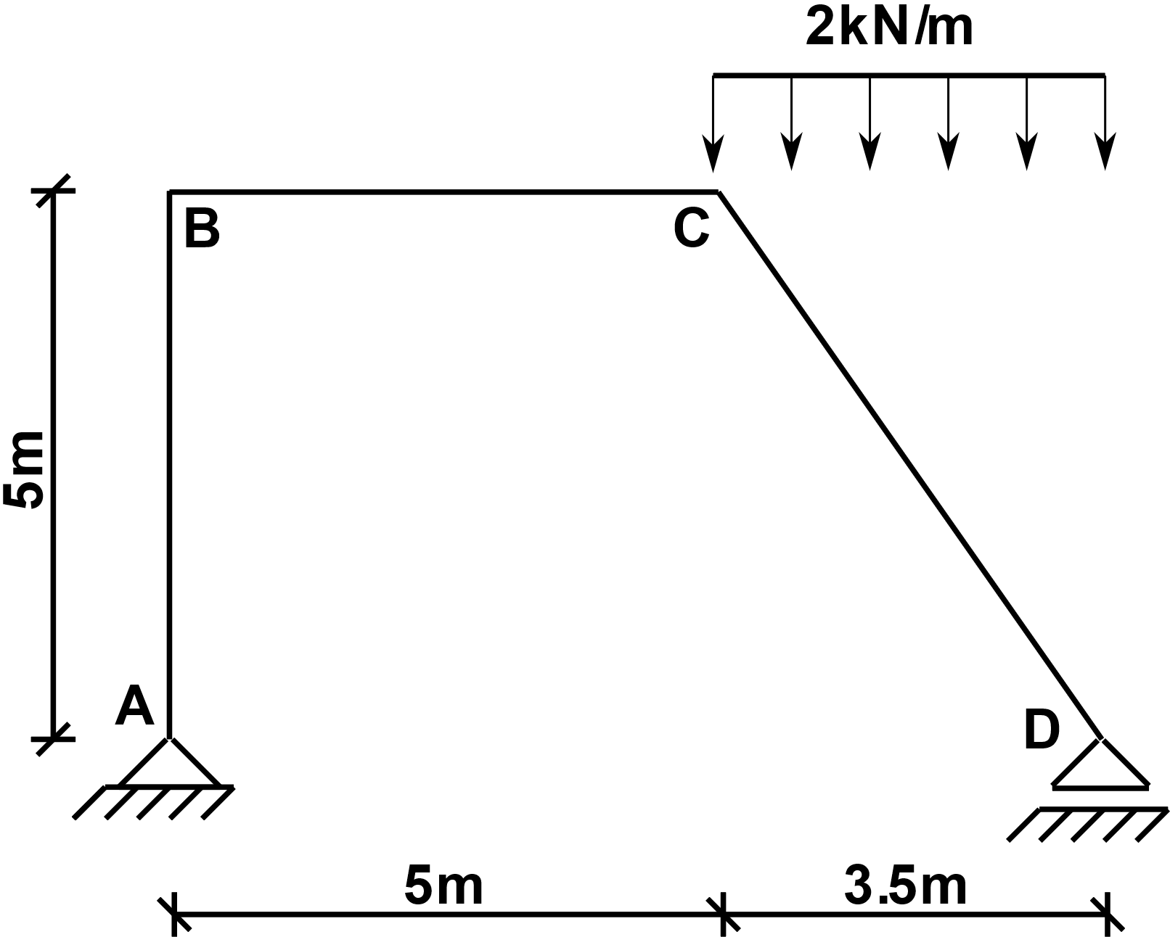
Statically determinate frame under distributed loading
We are looking for the bending moment (M), shear force (V) and axial force (N) diagrams

Slide 2
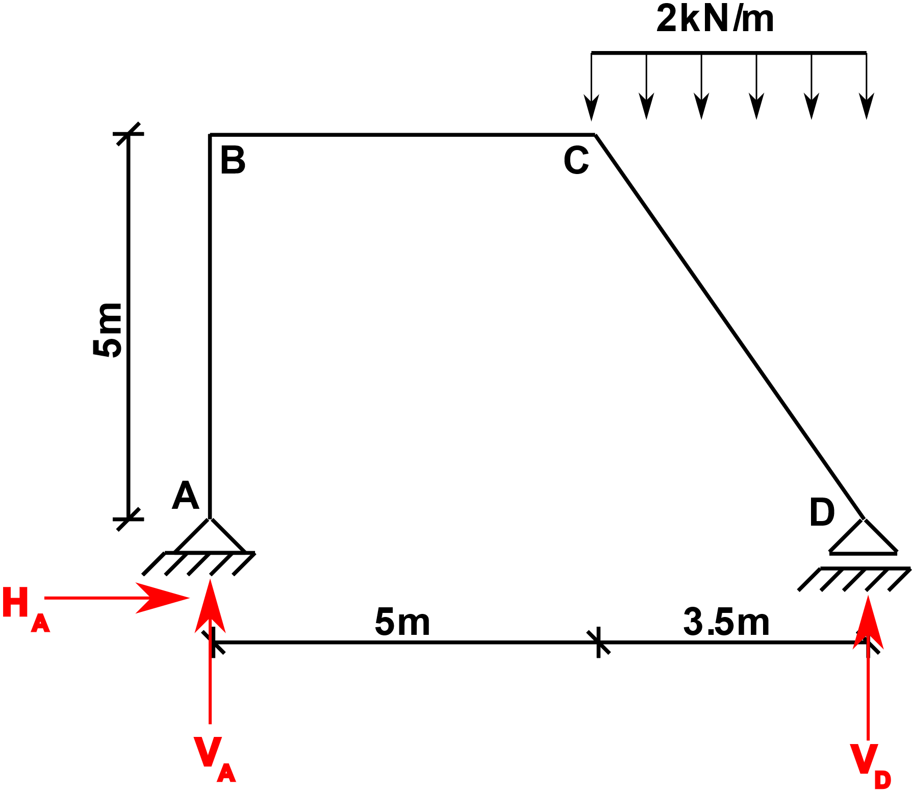
Step 1: Calculate the support reactions

Slide 3
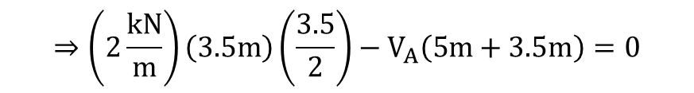

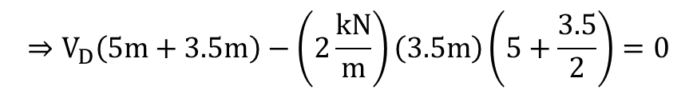


Step 1: Calculate the support reactions
$$\sum{M_{A}=0}$$
$$⇒V_{D}\left(5m+3.5m\right)−\left(2\frac{kN}{m}\right)\left(3.5m\right)\left(5+\frac{3.5}{2}\right)=0$$
$$⇒V_{D}=5.559kN$$
$$\sum{M_{D}=0}$$
$$⇒\left(2\frac{kN}{m}\right)\left(3.5m\right)\left(\frac{3.5}{2}\right)−V_{A}\left(5m+3.5m\right)=0$$
$$⇒V_{A}=1.441kN$$
$$\sum{H=0⇒H_{A}=0}$$

Slide 4
Step 2: Decompose the distributed load
We need to find the magnitudes of the distributed loads acting in directions along the member length and perpendicular to the member length for the member CD

Slide 5
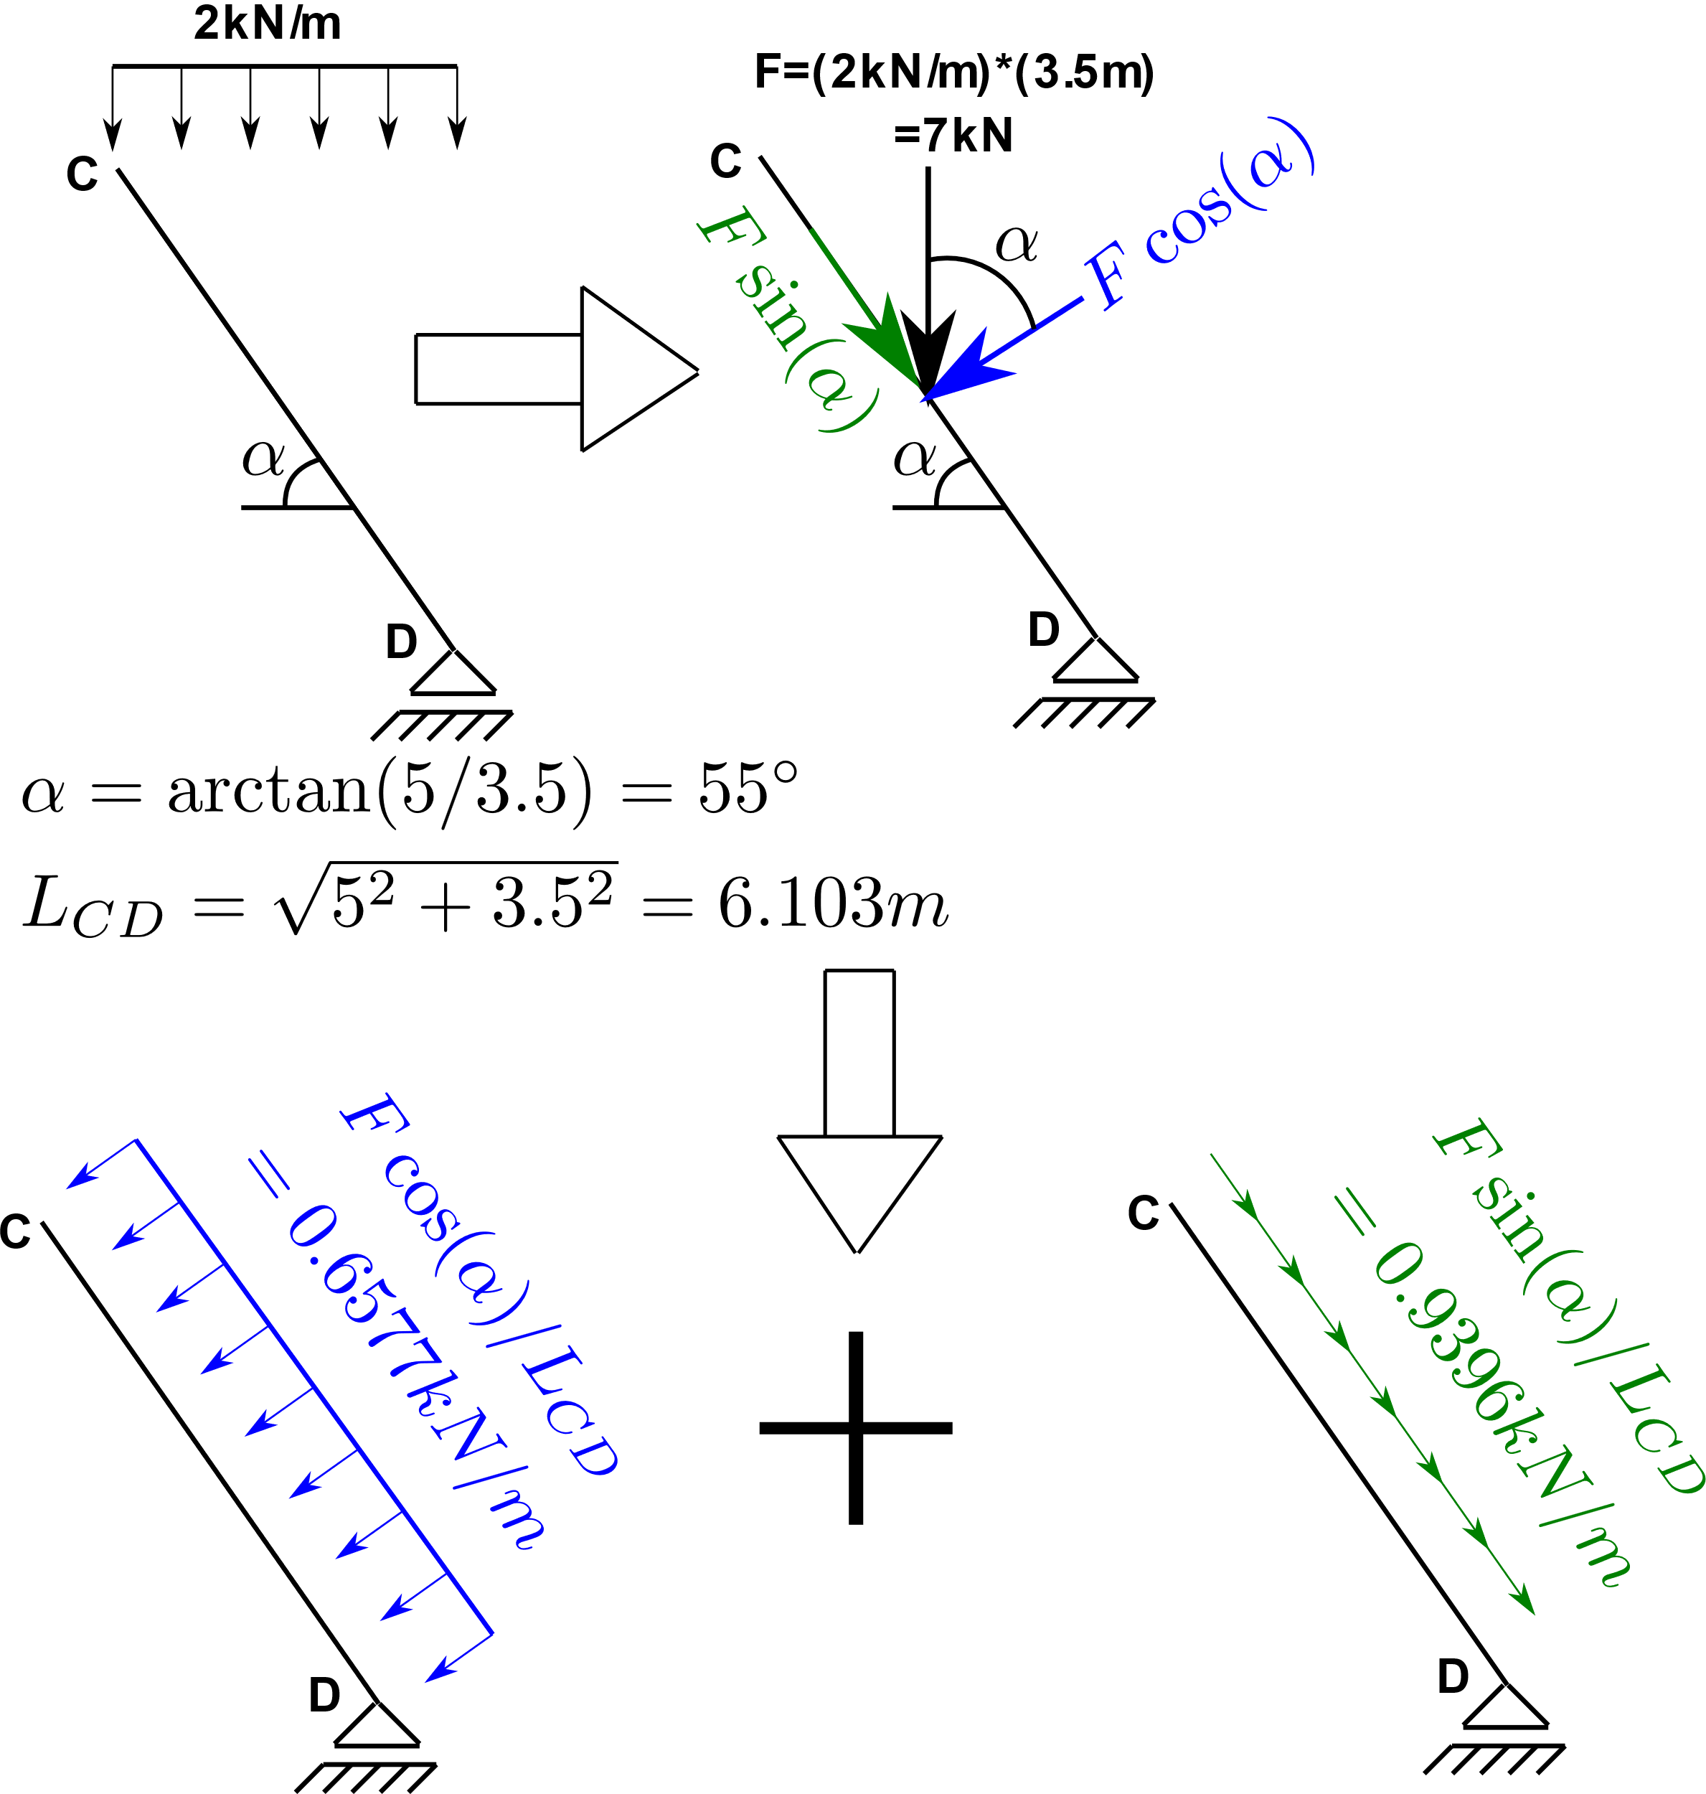
Step 2: Decompose the distributed load
We need to find the magnitudes of the distributed loads acting in directions along the member length and perpendicular to the member length for the member CD

Slide 6
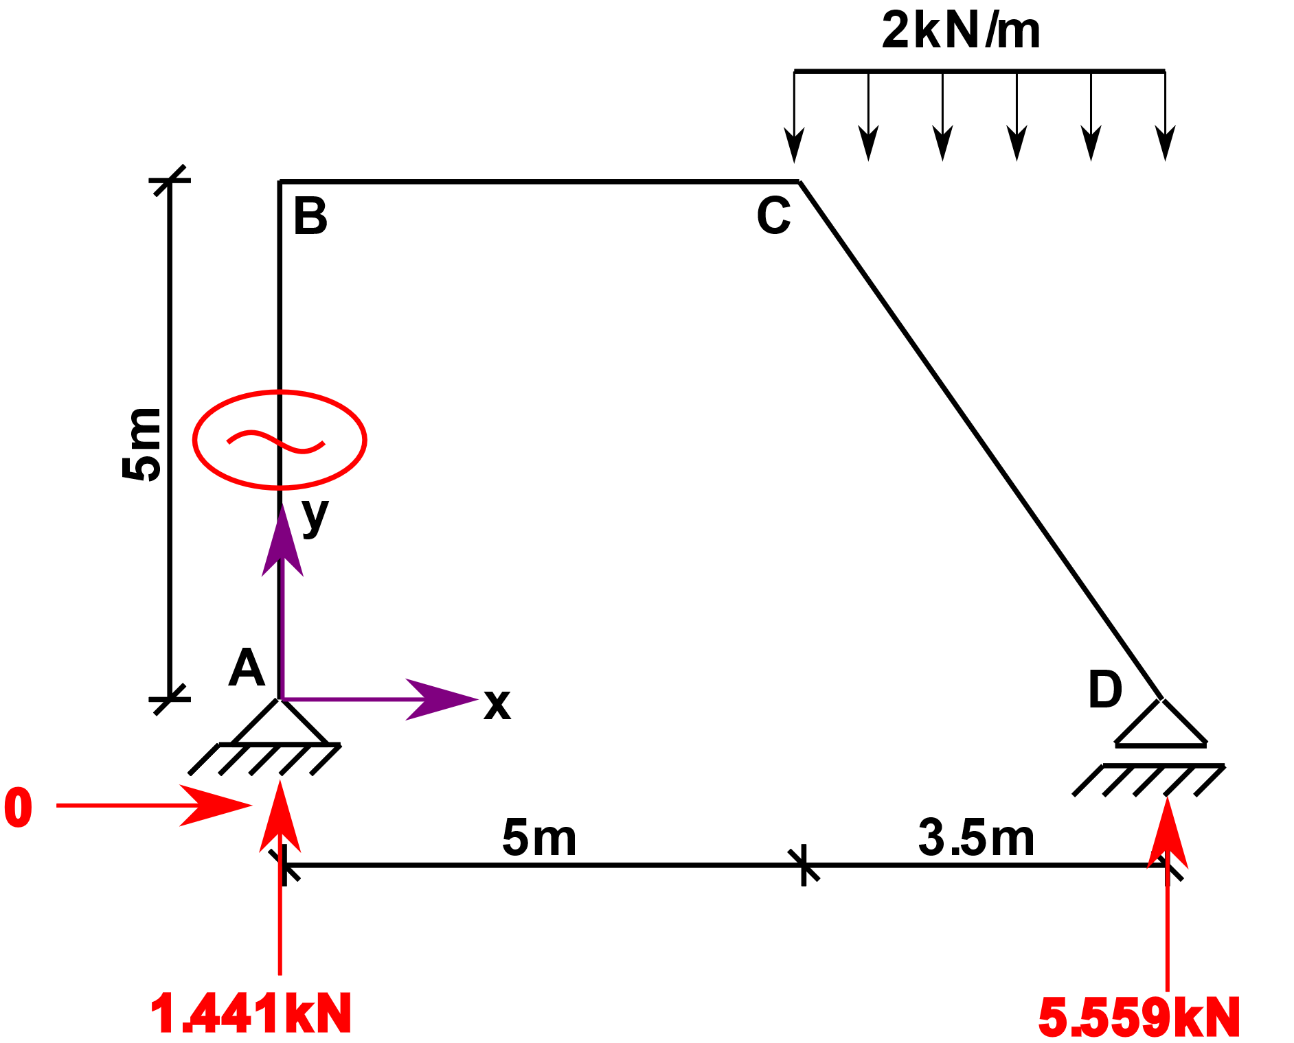
Step 3: N, V, M equations
Member AB:

Slide 7
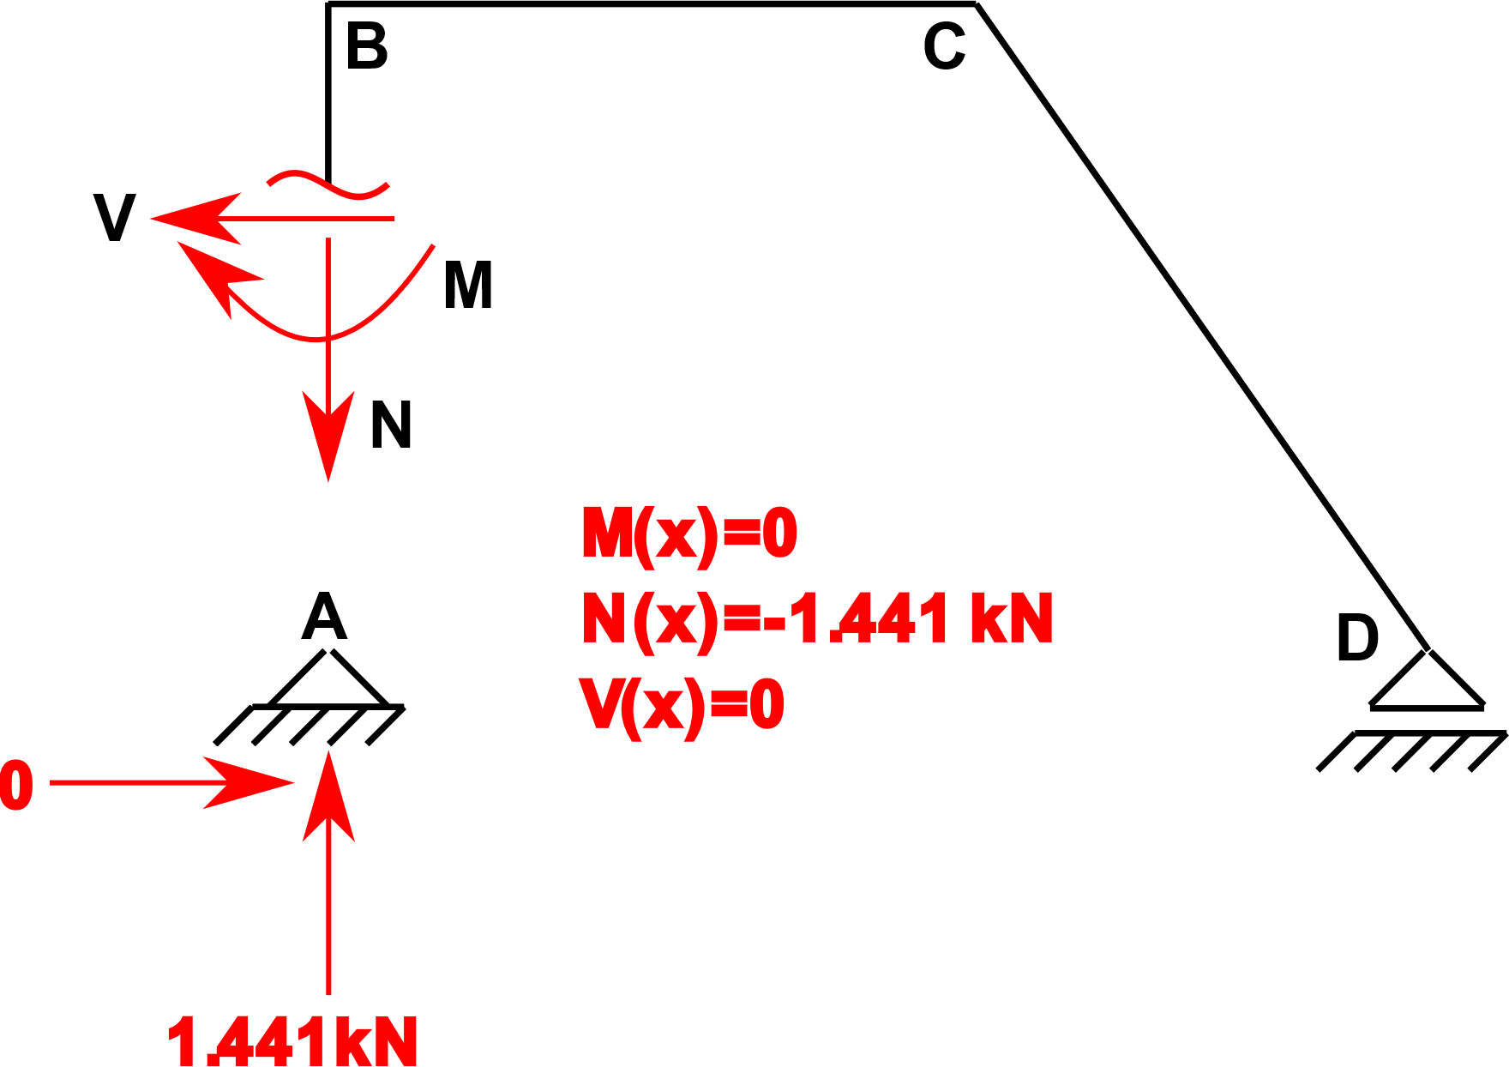
Step 3: N, V, M equations
Member AB:

Slide 8
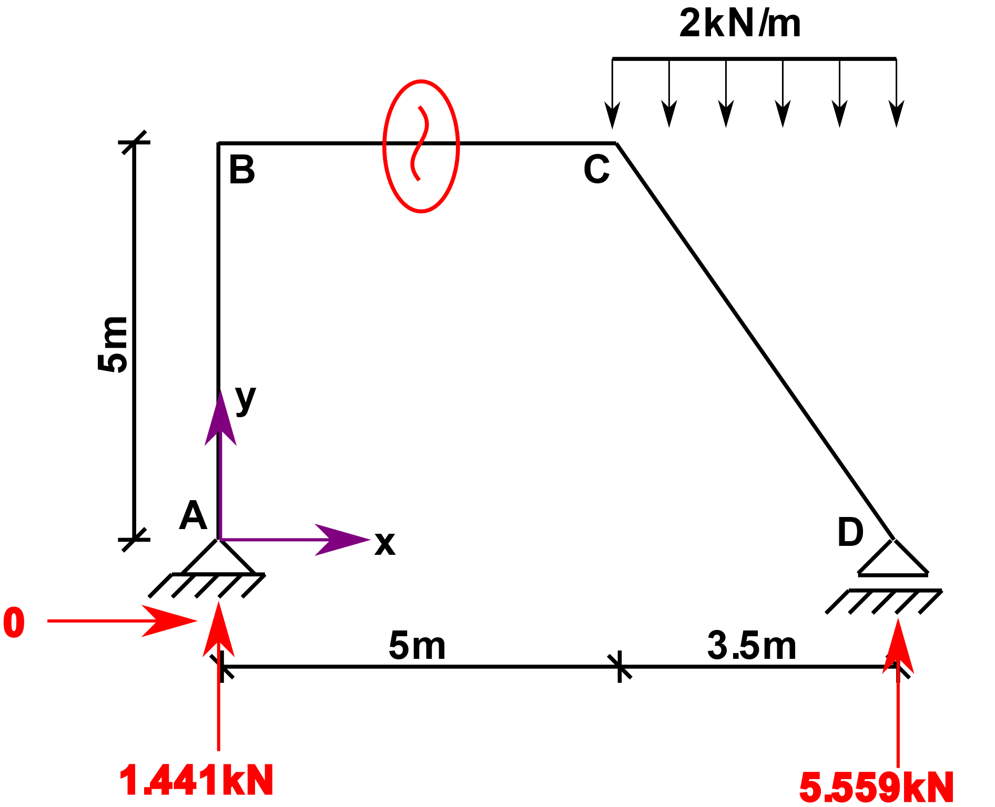
Step 3: N, V, M equations
Member AB:
Member BC:

Slide 9
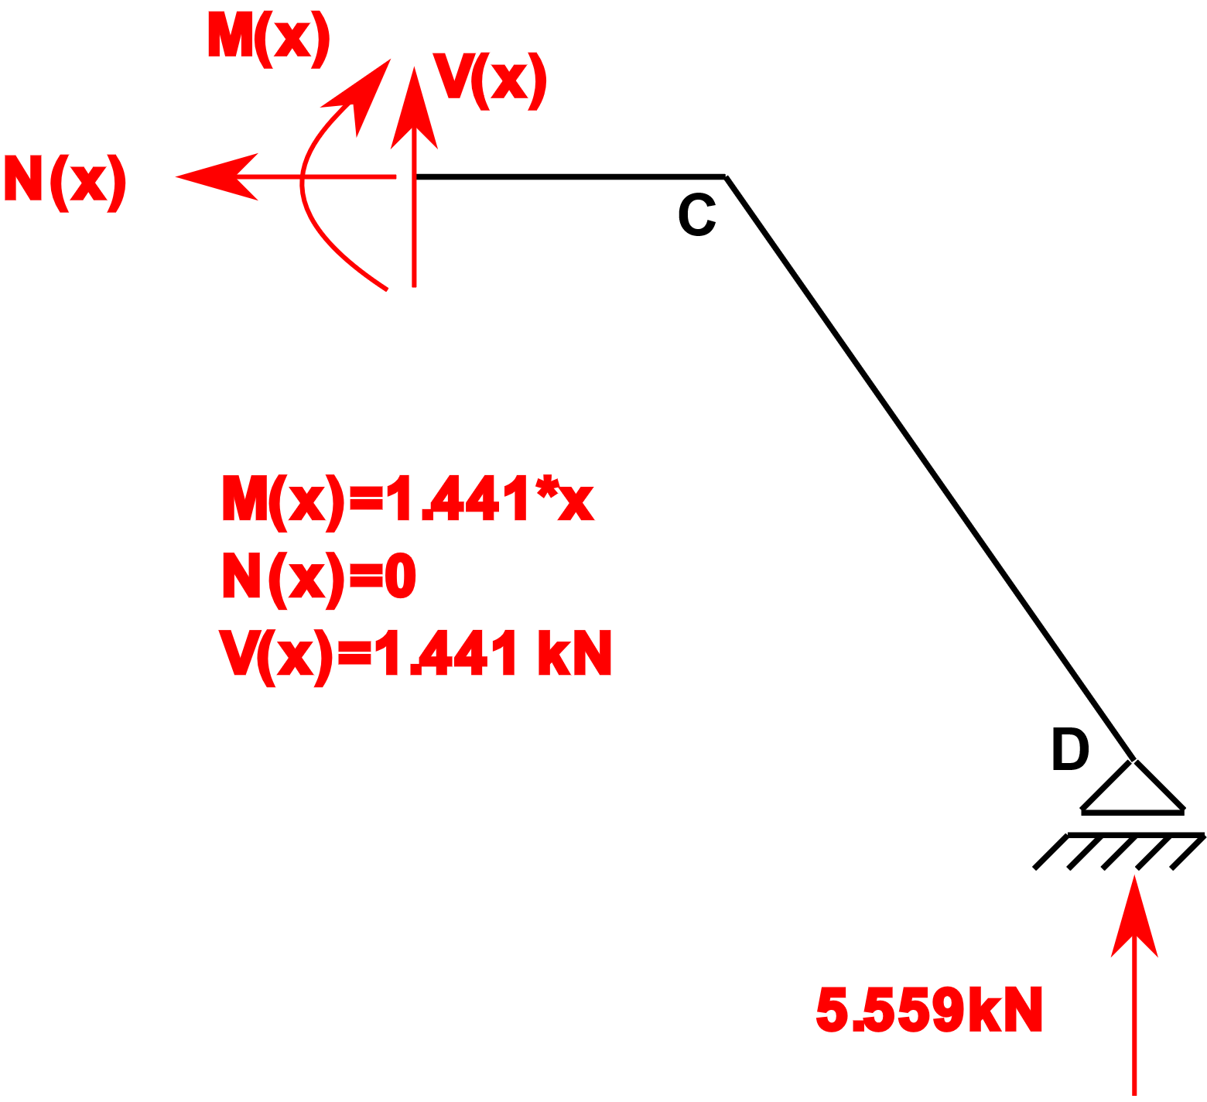
Step 3: N, V, M equations
Member AB:
Member BC:

Slide 10
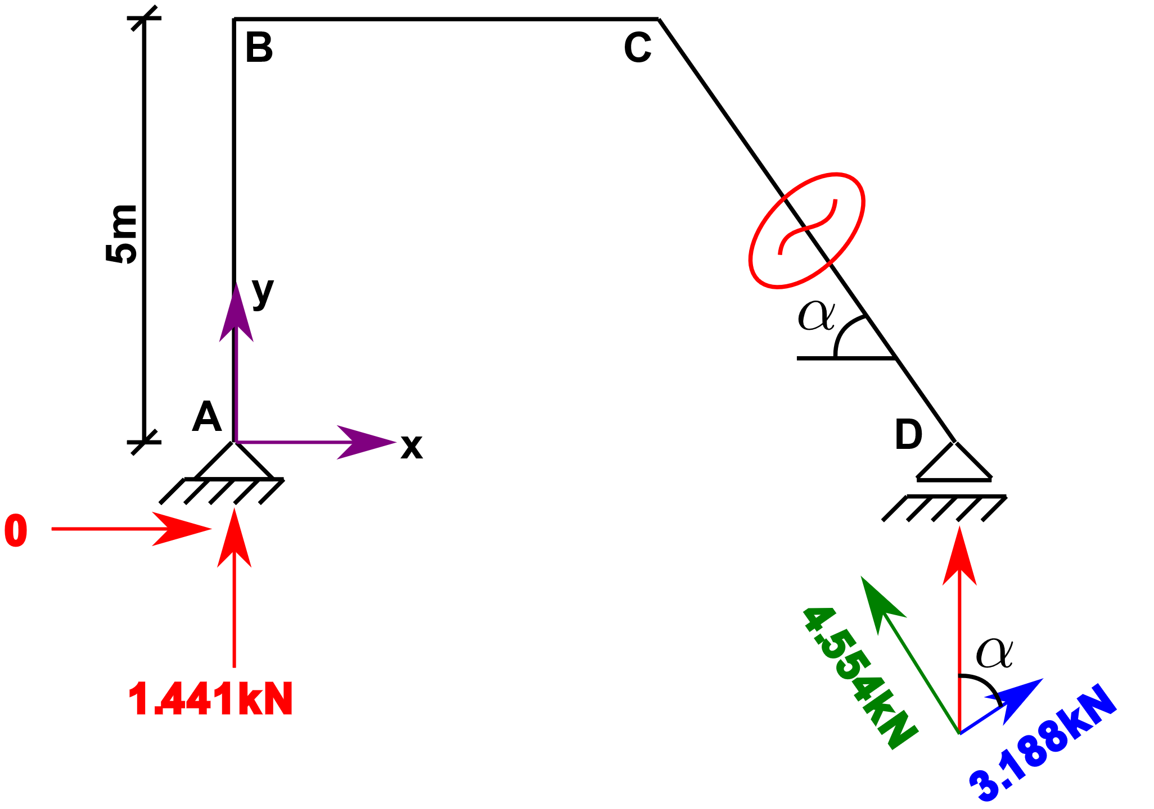
Step 3: N, V, M equations
Member AB:
Member BC:
Member CD:

Slide 11
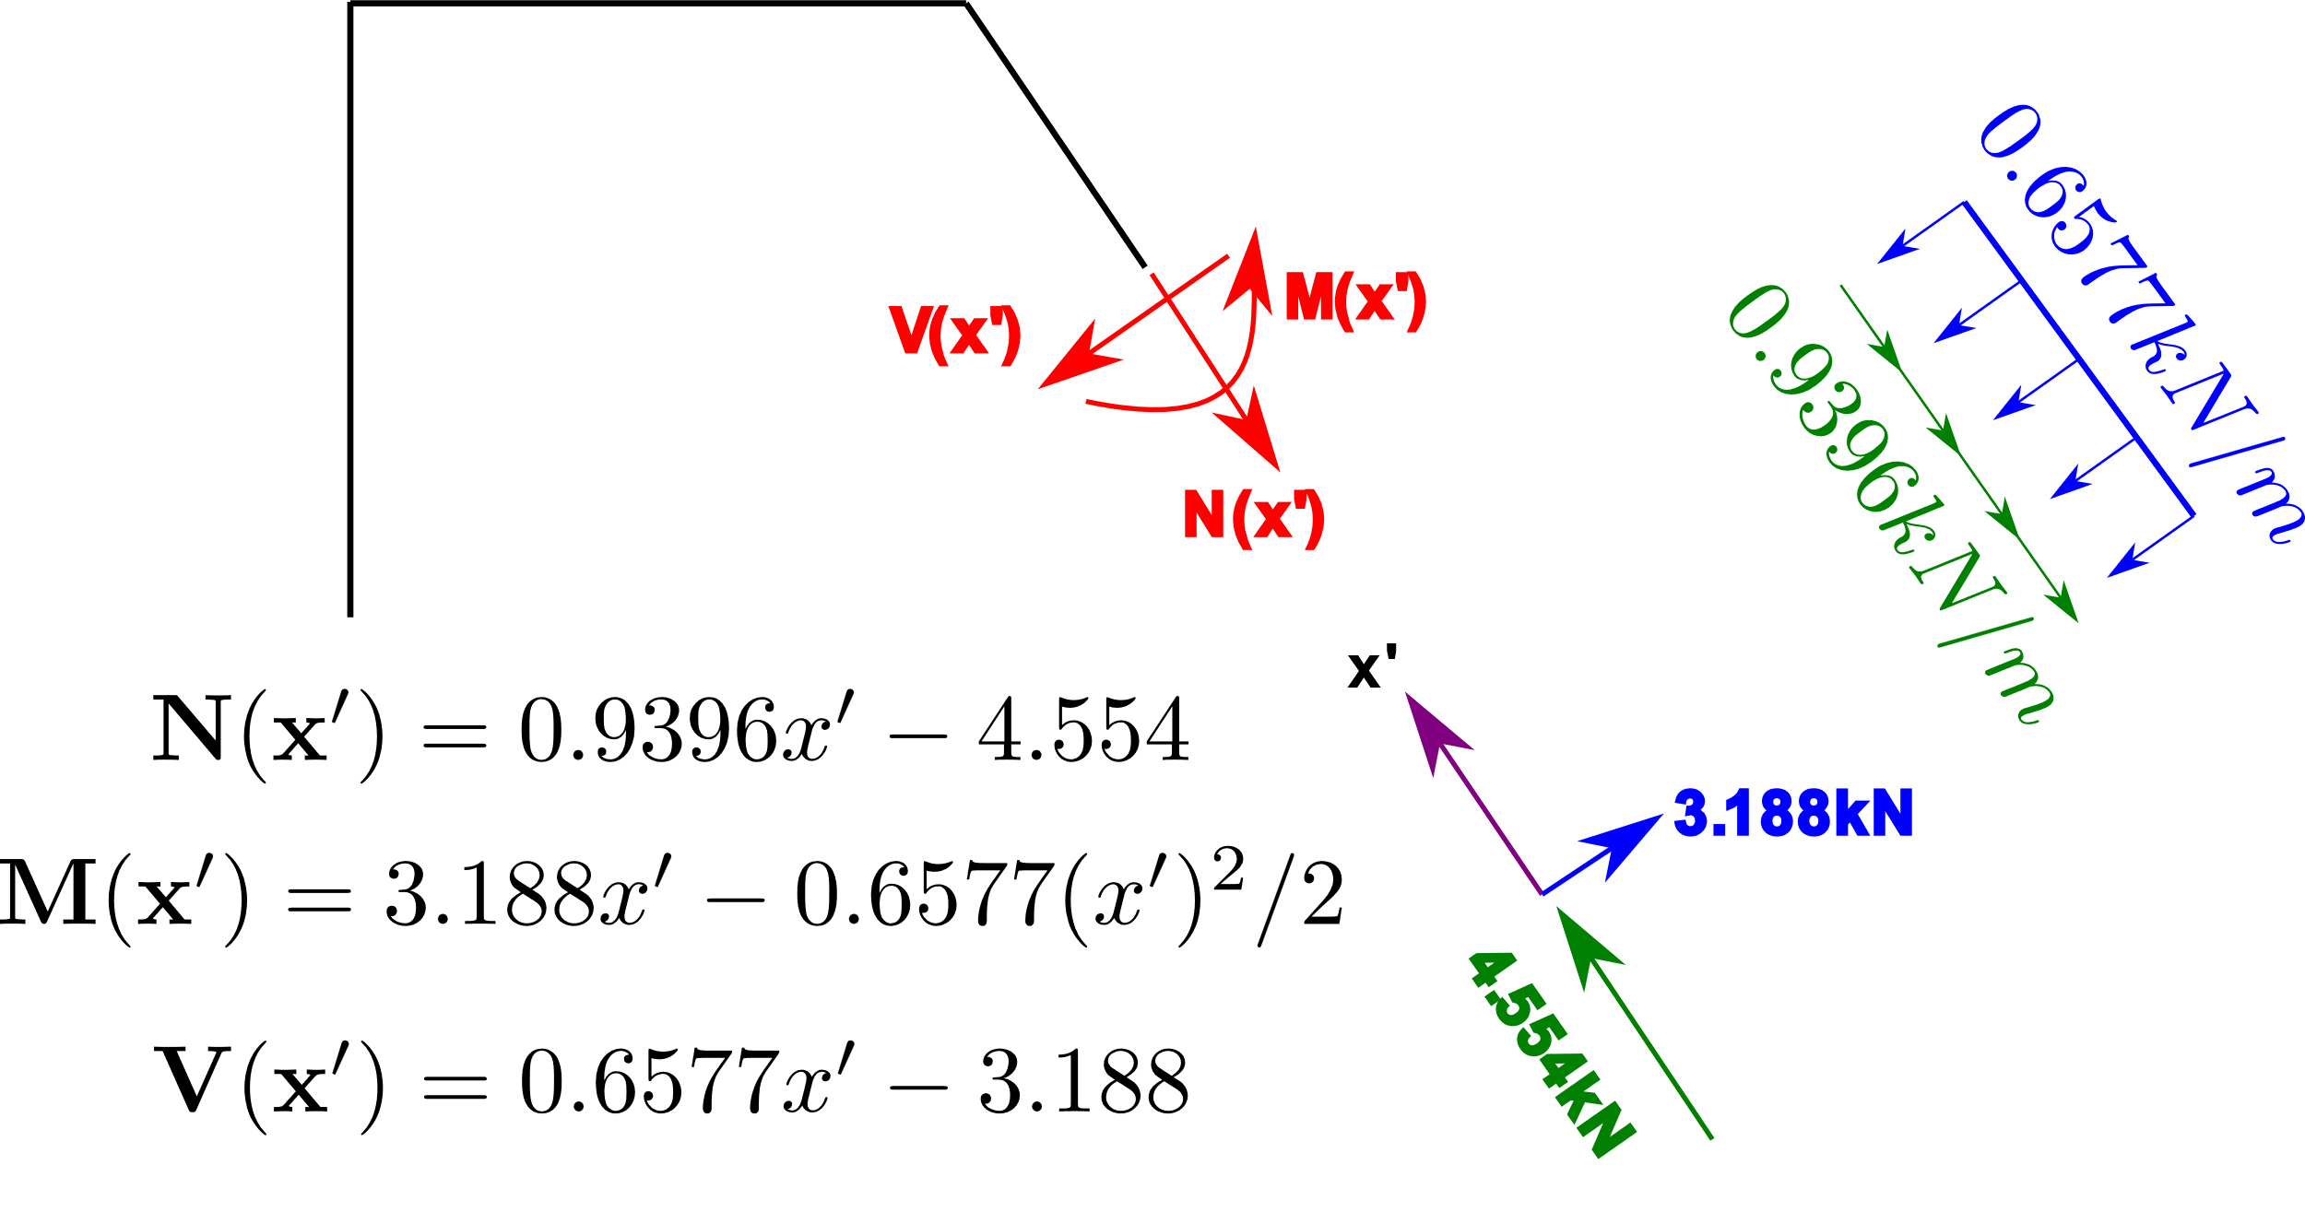
Step 3: N, V, M equations
Member AB:
Member BC:
Member CD:

Slide 12
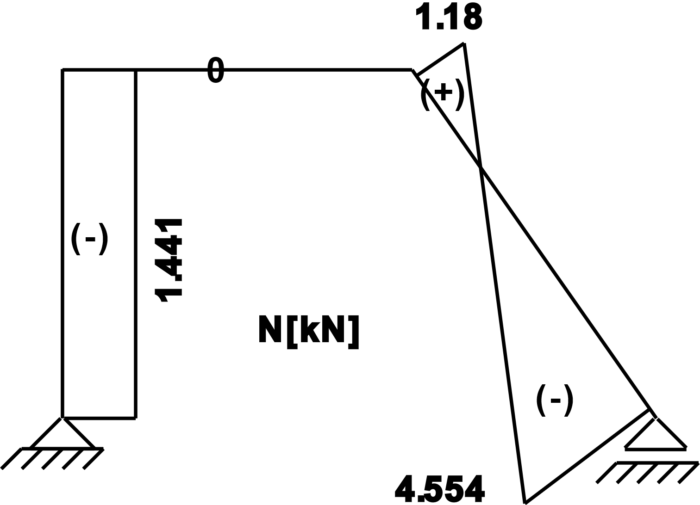
Step 4: N, V, M diagrams

Slide 13
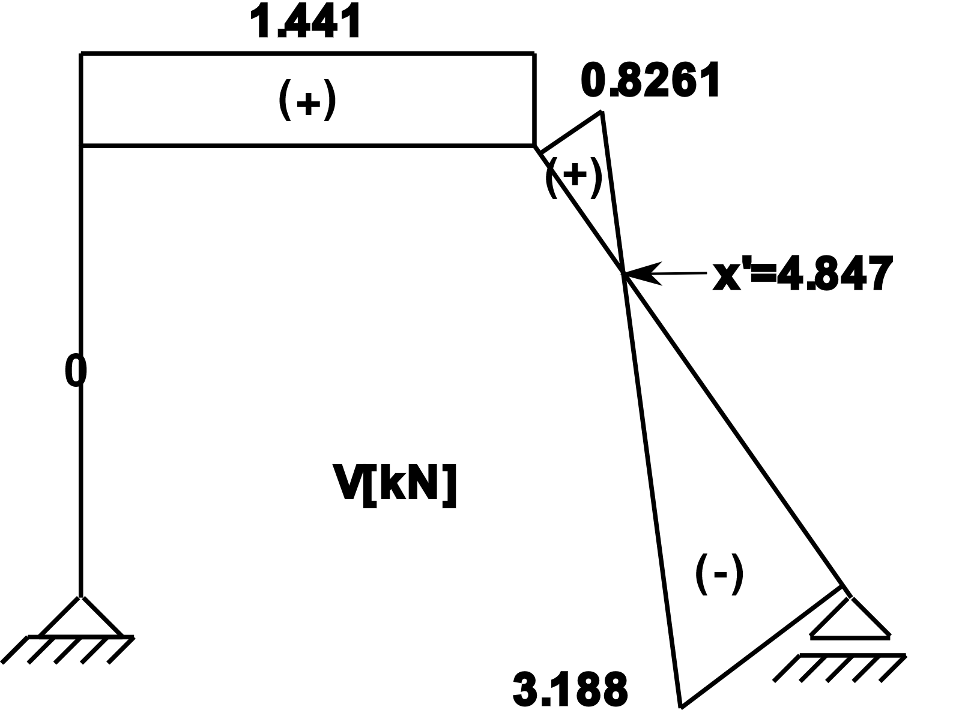
Step 4: N, V, M diagrams

Slide 14
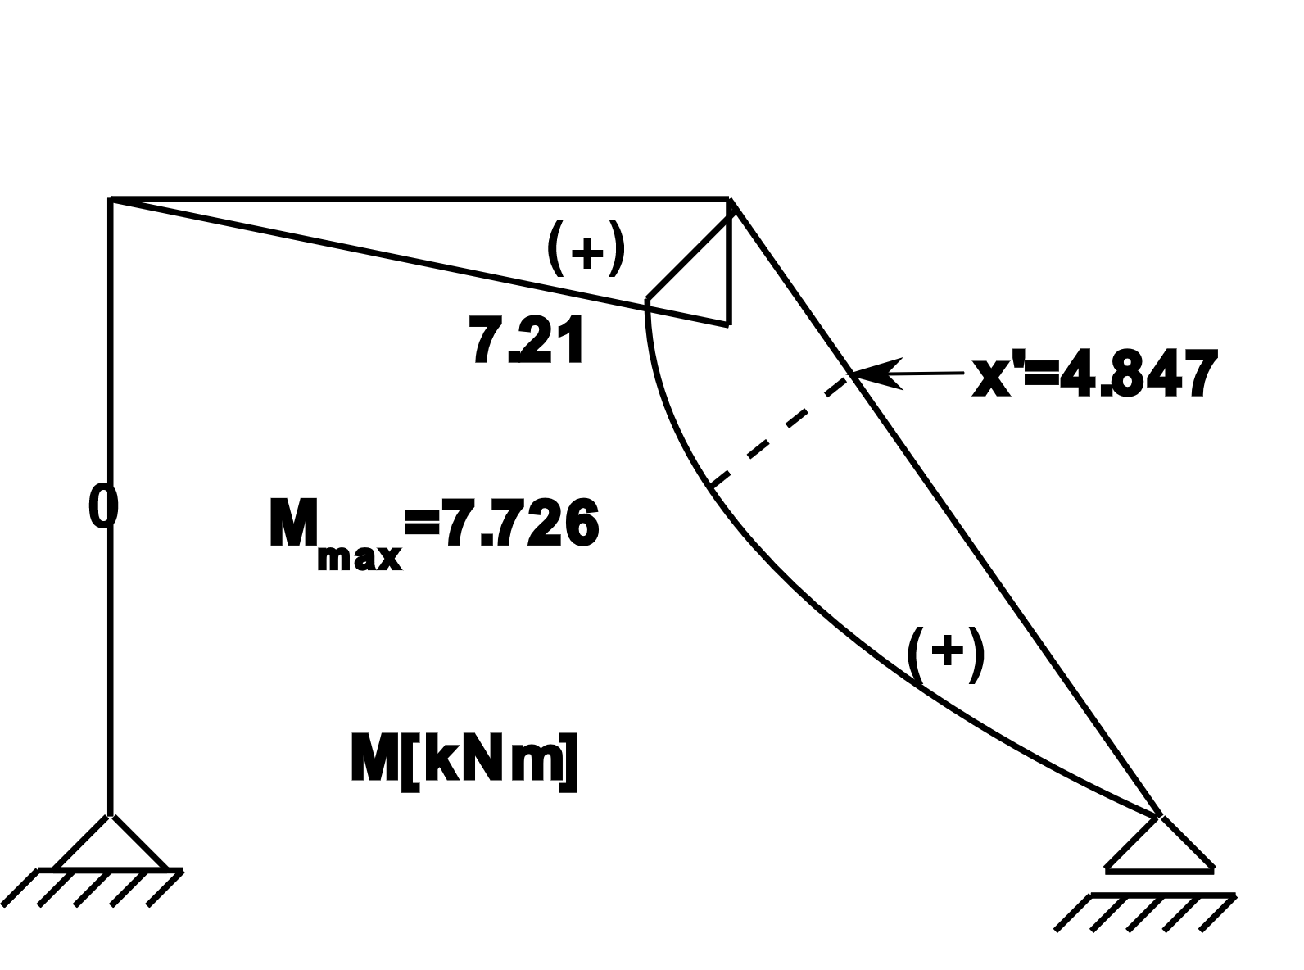
Step 4: N, V, M diagrams

