Slide 1
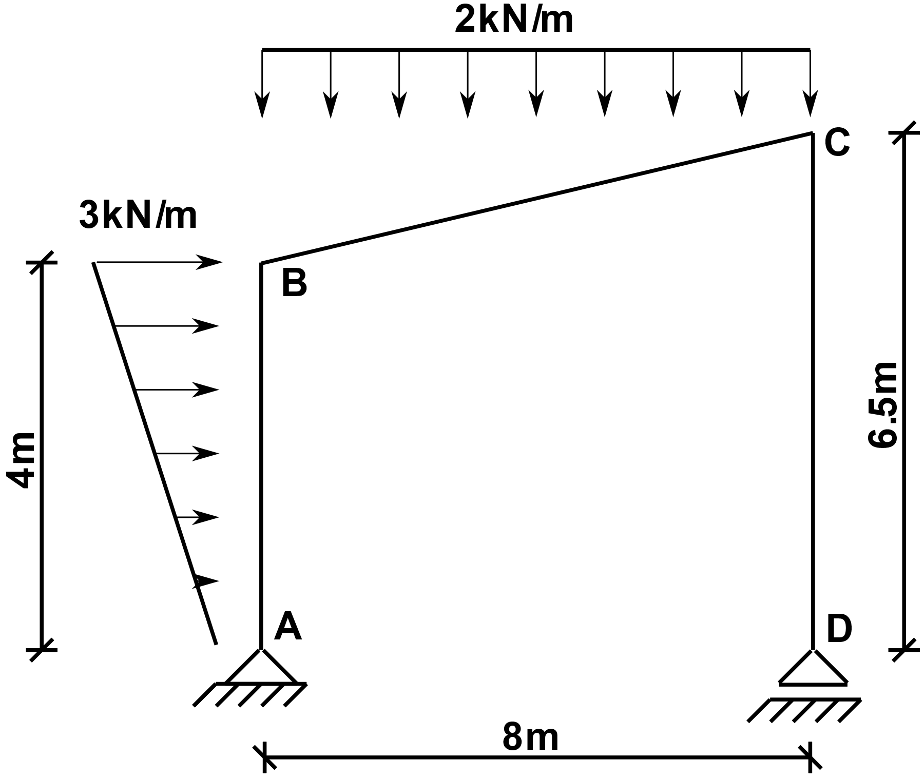
Statically determinate frame under distributed loading
We are looking for the bending moment (M), shear force (V) and axial force (N) diagrams

Slide 2
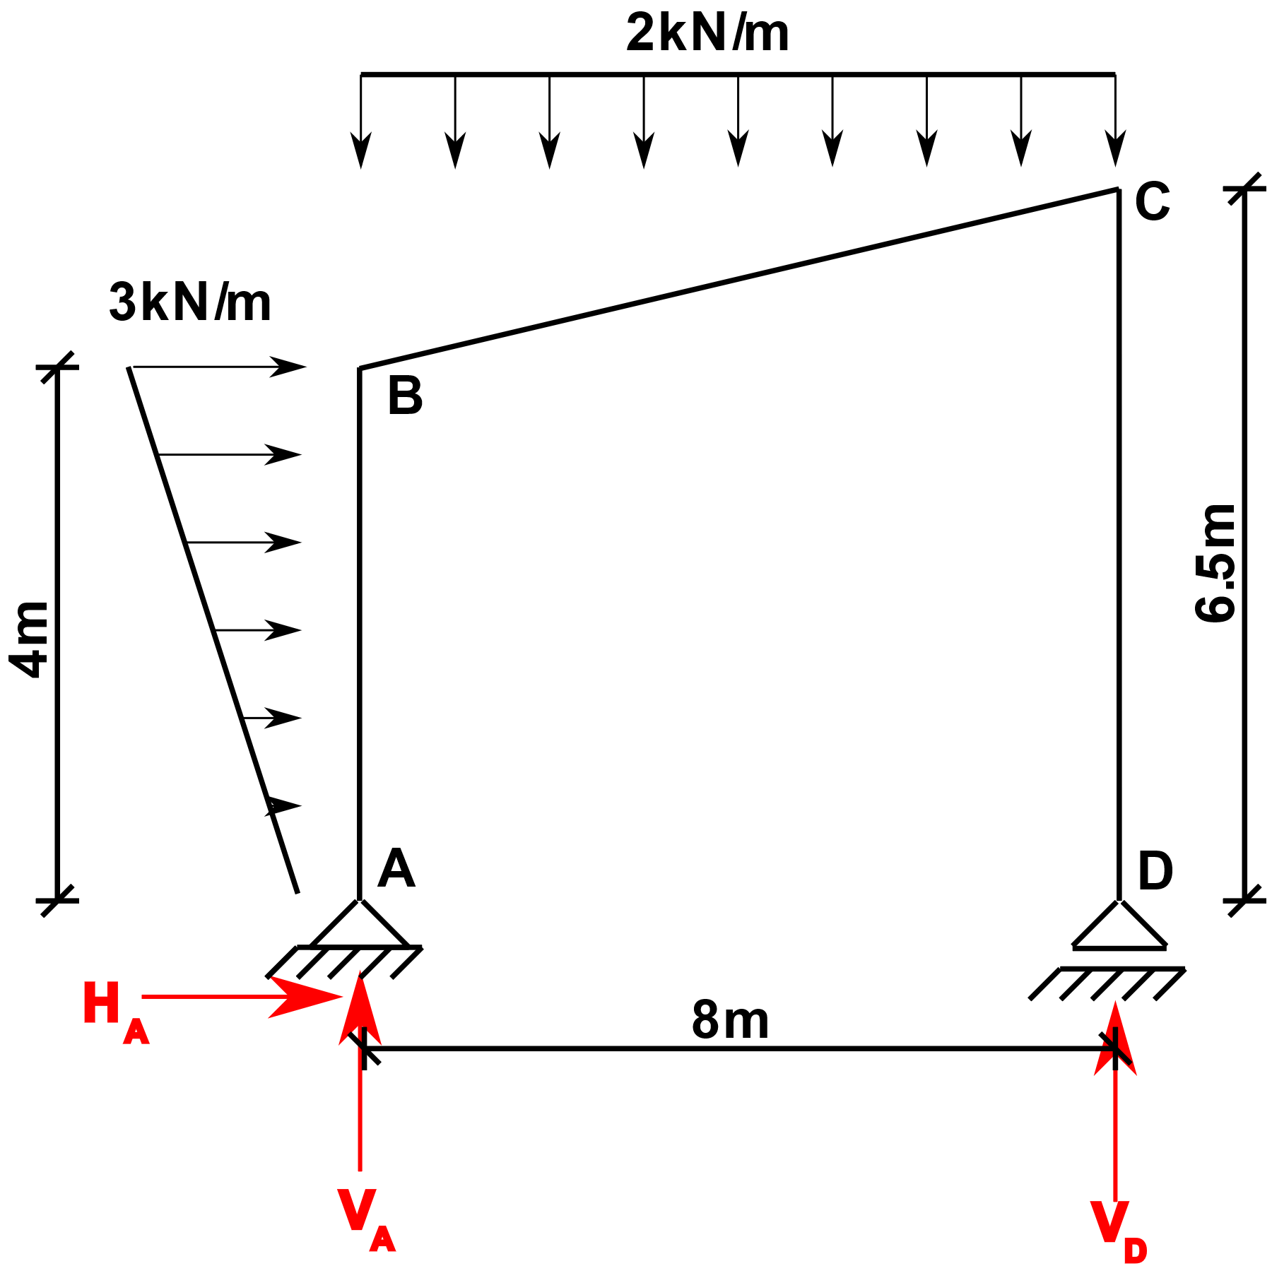
Step 1: Calculate the support reactions

Slide 3
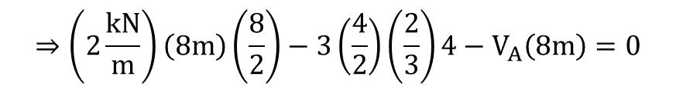

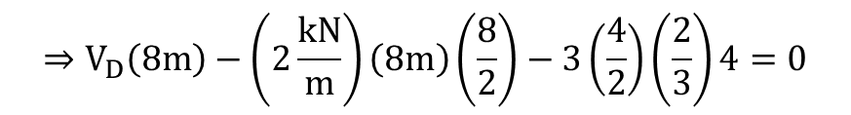
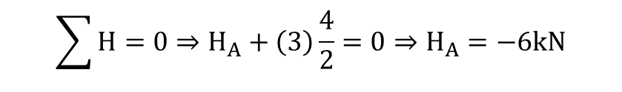

Step 1: Calculate the support reactions
$$\sum{M_{A}=0}$$
$$⇒V_{D}\left(8m\right)−\left(2\frac{kN}{m}\right)\left(8m\right)\left(\frac{8}{2}\right)−3\left(\frac{4}{2}\right)\left(\frac{2}{3}\right)4=0$$
$$⇒V_{D}=10kN$$
$$\sum{M_{D}=0}$$
$$⇒\left(2\frac{kN}{m}\right)\left(8m\right)\left(\frac{8}{2}\right)−3\left(\frac{4}{2}\right)\left(\frac{2}{3}\right)4−V_{A}\left(8m\right)=0$$
$$⇒V_{A}=6 kN$$
$$\sum{H=0⇒H_{A}+\left(3\right)\frac{4}{2}=0⇒H_{A}=−6kN}$$

Slide 4
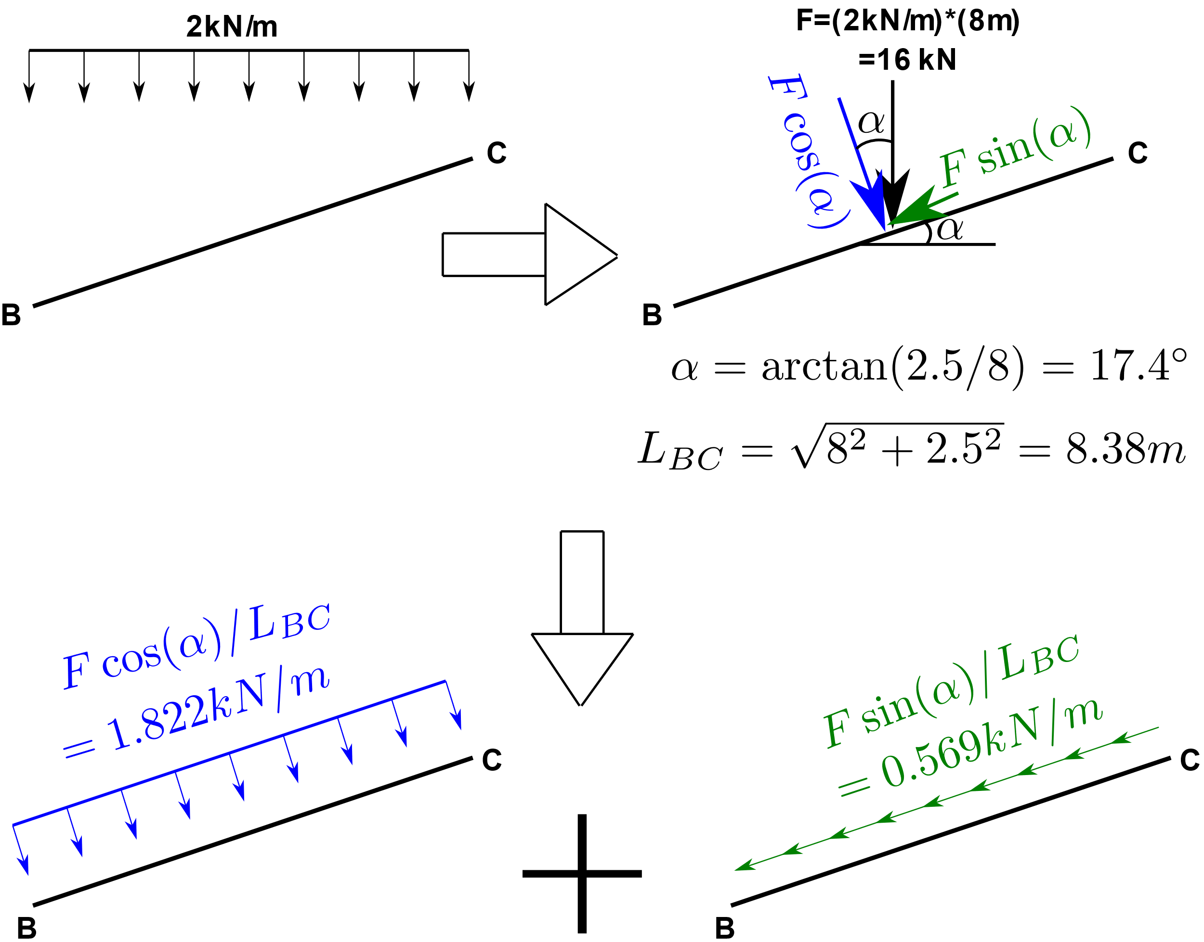
Step 2: Decompose the distributed load
We need to find the magnitudes of the distributed loads acting in direction along the member length and perpendicular to the direction of member length for the member BC

Slide 5
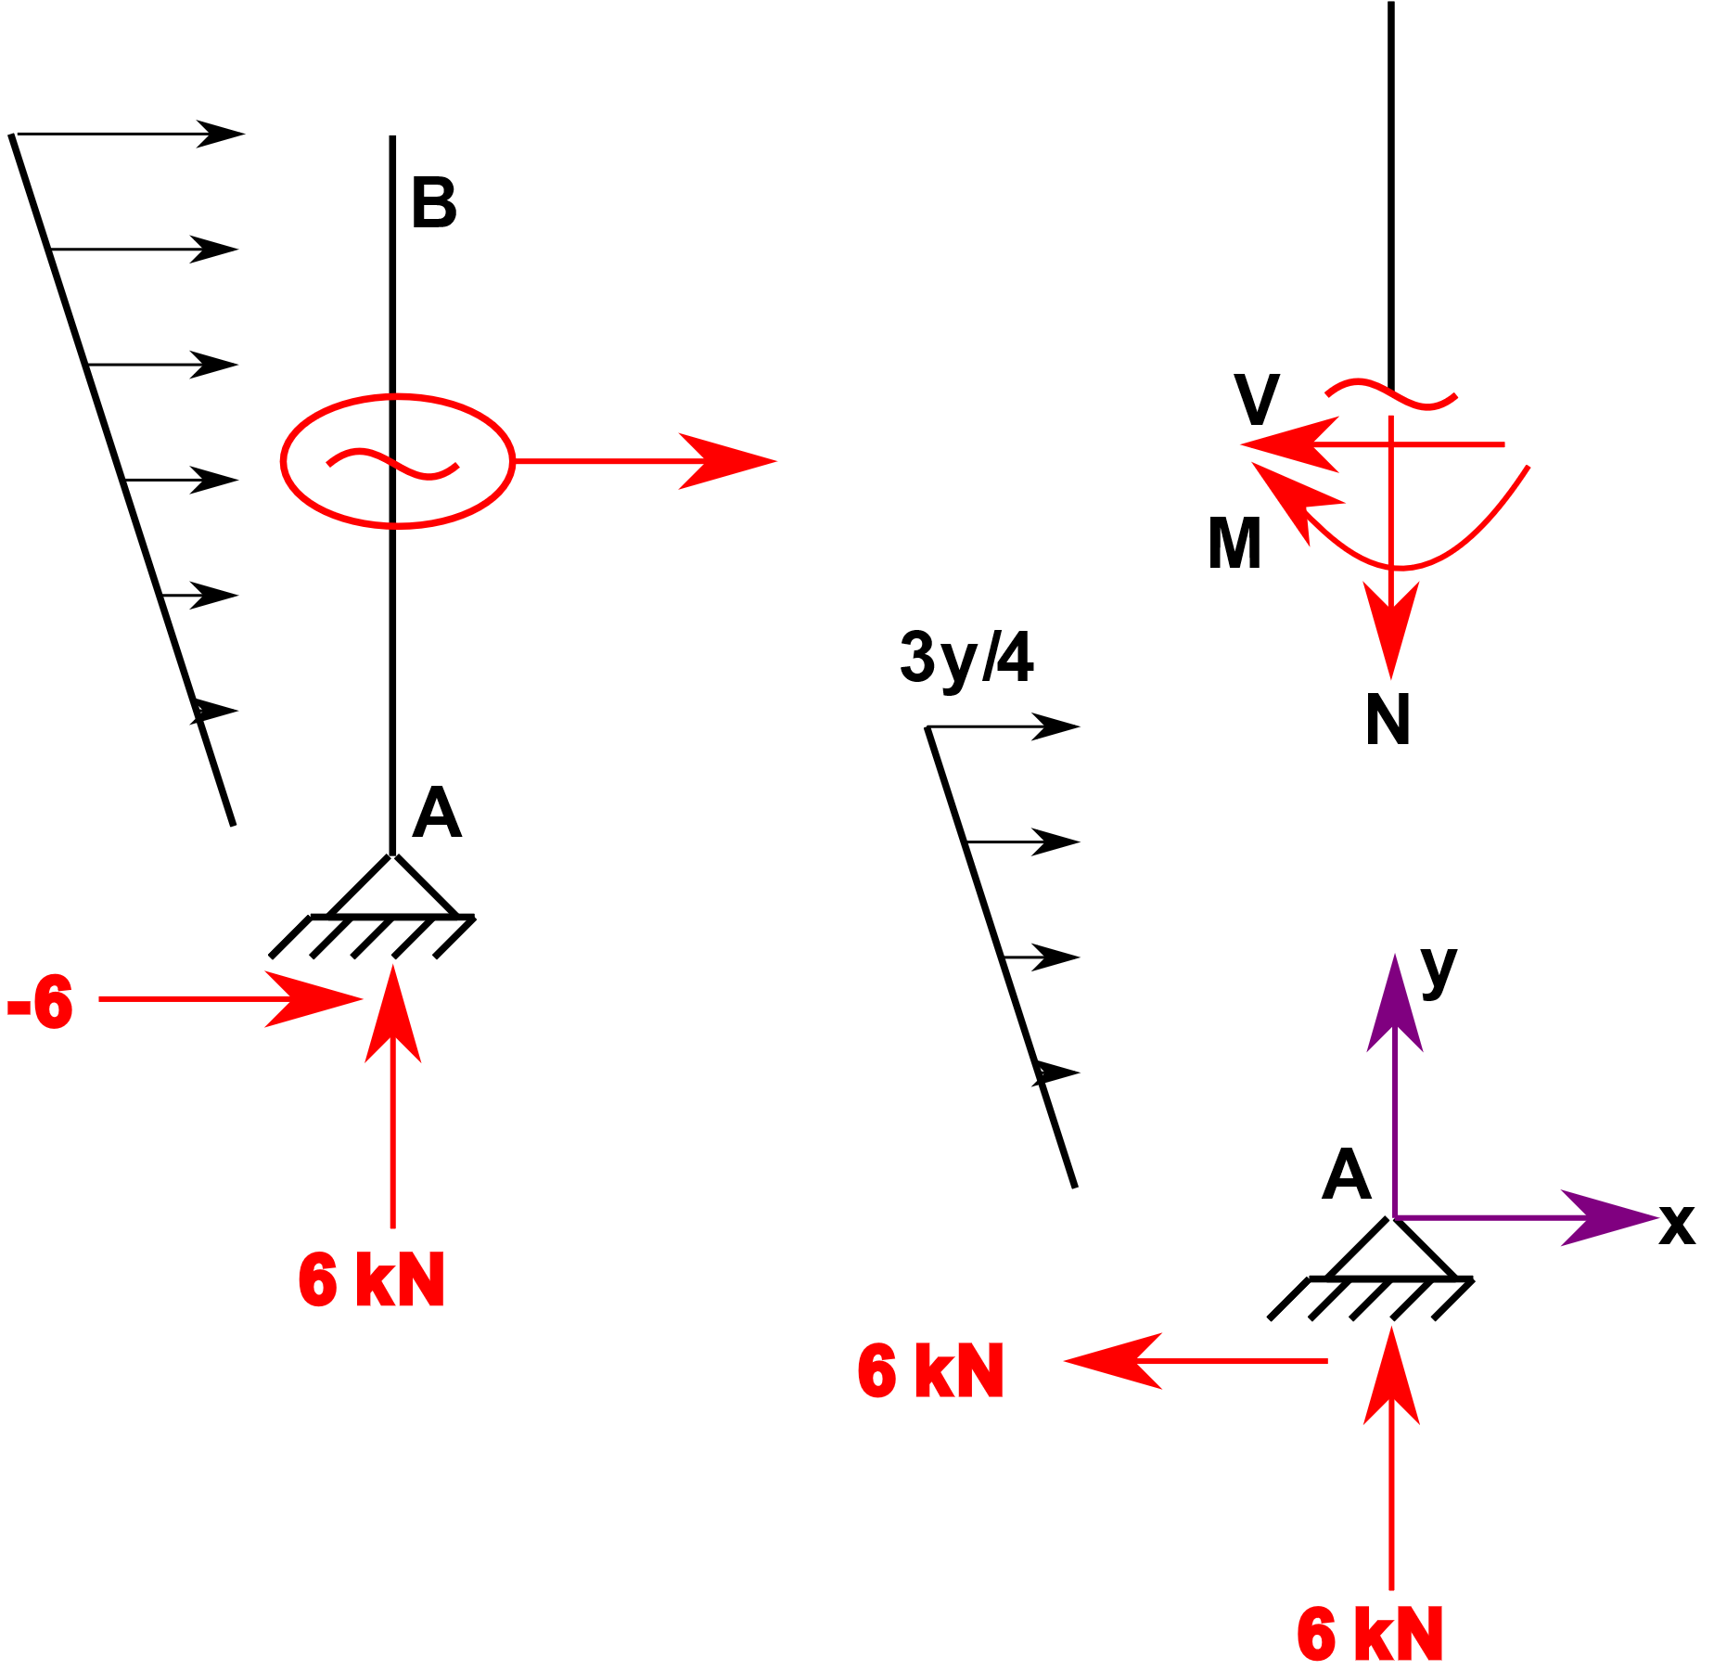
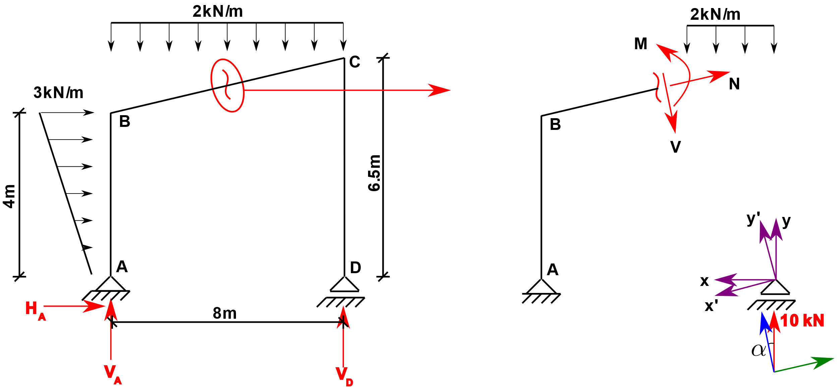
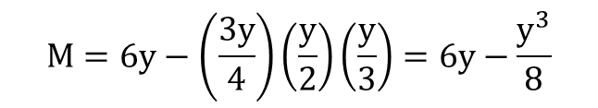
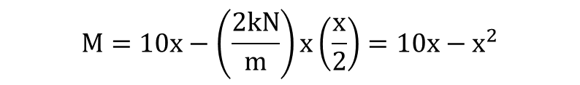
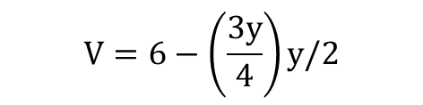

Step 3: N, V, M diagrams
Member AB:
Member BC:
$$N=−6 kN \text{(}\text{compression}\text{)}$$
$$N=10sinα −\left(0.569\right)x^{′}=2.98−0.569x′$$
$$V=6−\left(\frac{3y}{4}\right)y/2$$
$$V=−10cosα+\left(1.822\right)x^{′}=−9.55+1.822x′$$
$$M=10x−\left(\frac{2kN}{m}\right)x\left(\frac{x}{2}\right)=10x−x^{2}$$
$$M=6y−\left(\frac{3y}{4}\right)\left(\frac{y}{2}\right)\left(\frac{y}{3}\right)=6y−\frac{y^{3}}{8}$$

Slide 6
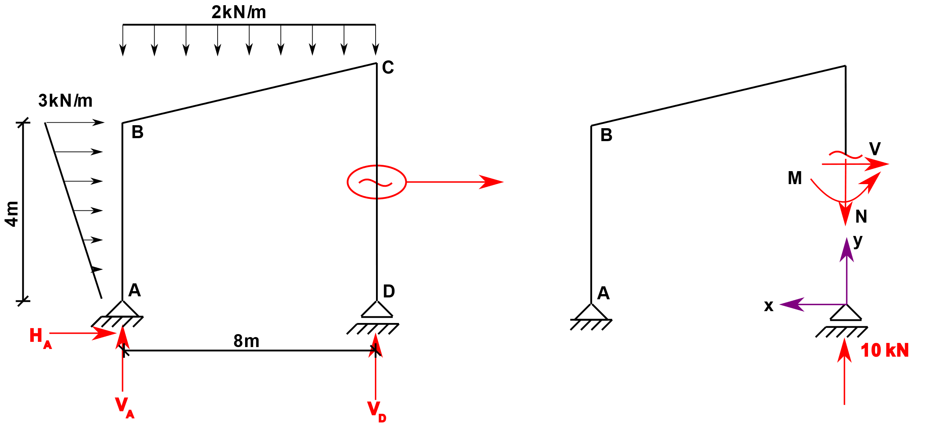
Step 3: N, V, M diagrams
Member CD:
$$N=−10kN$$
$$V=0$$
$$M=0$$

Slide 7
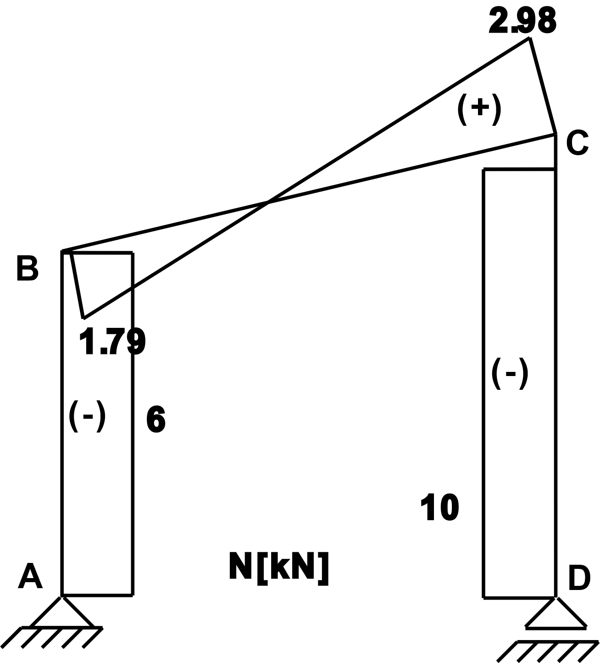
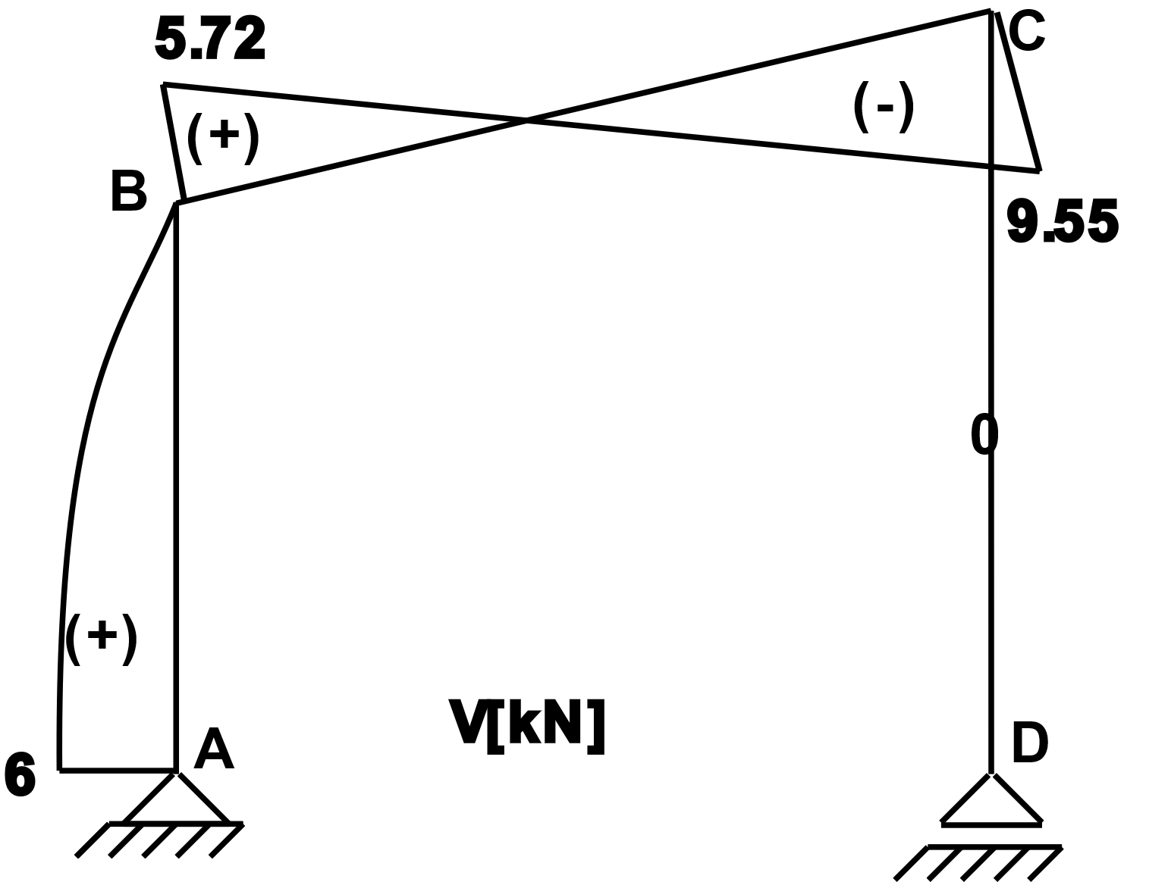
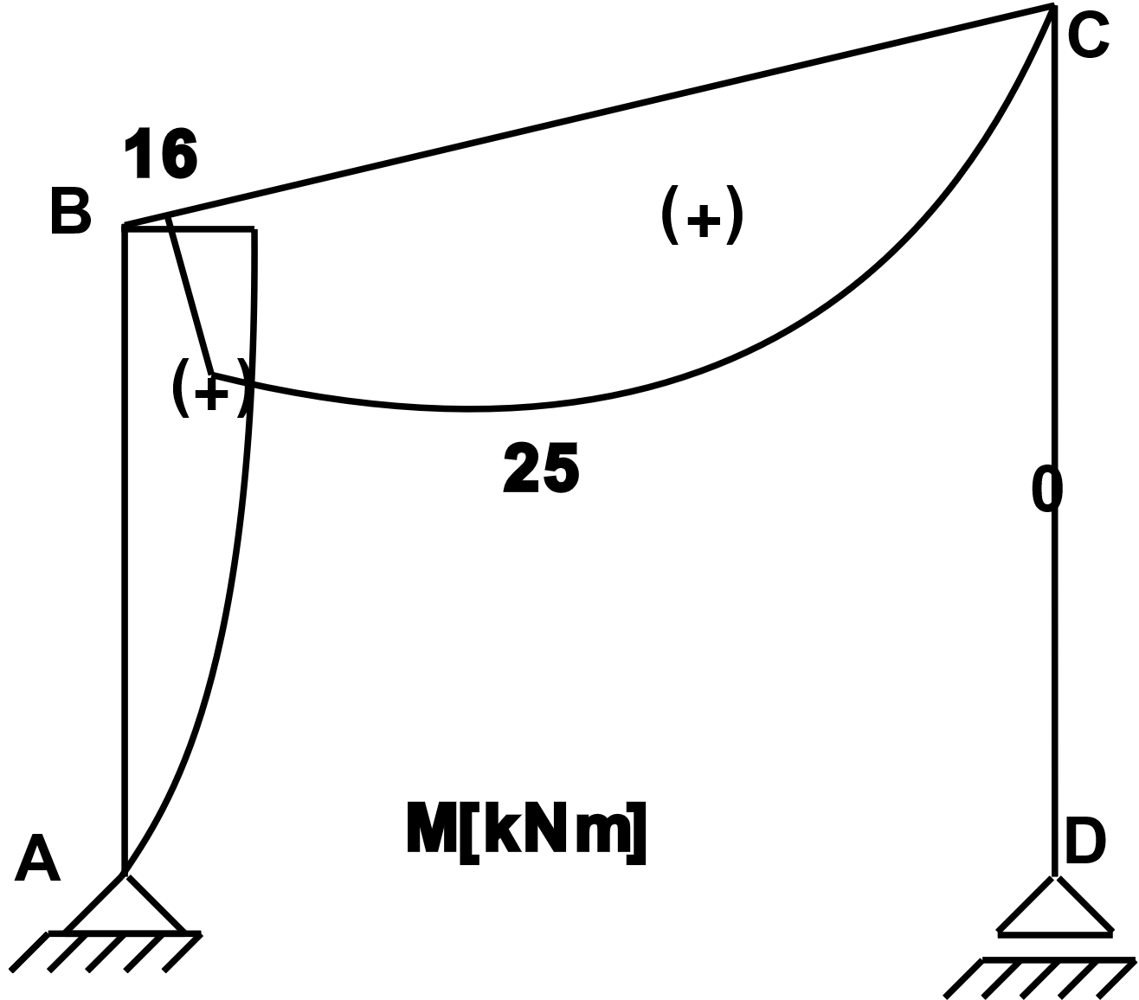
Step 3: N, V, M diagrams

