Slide 1
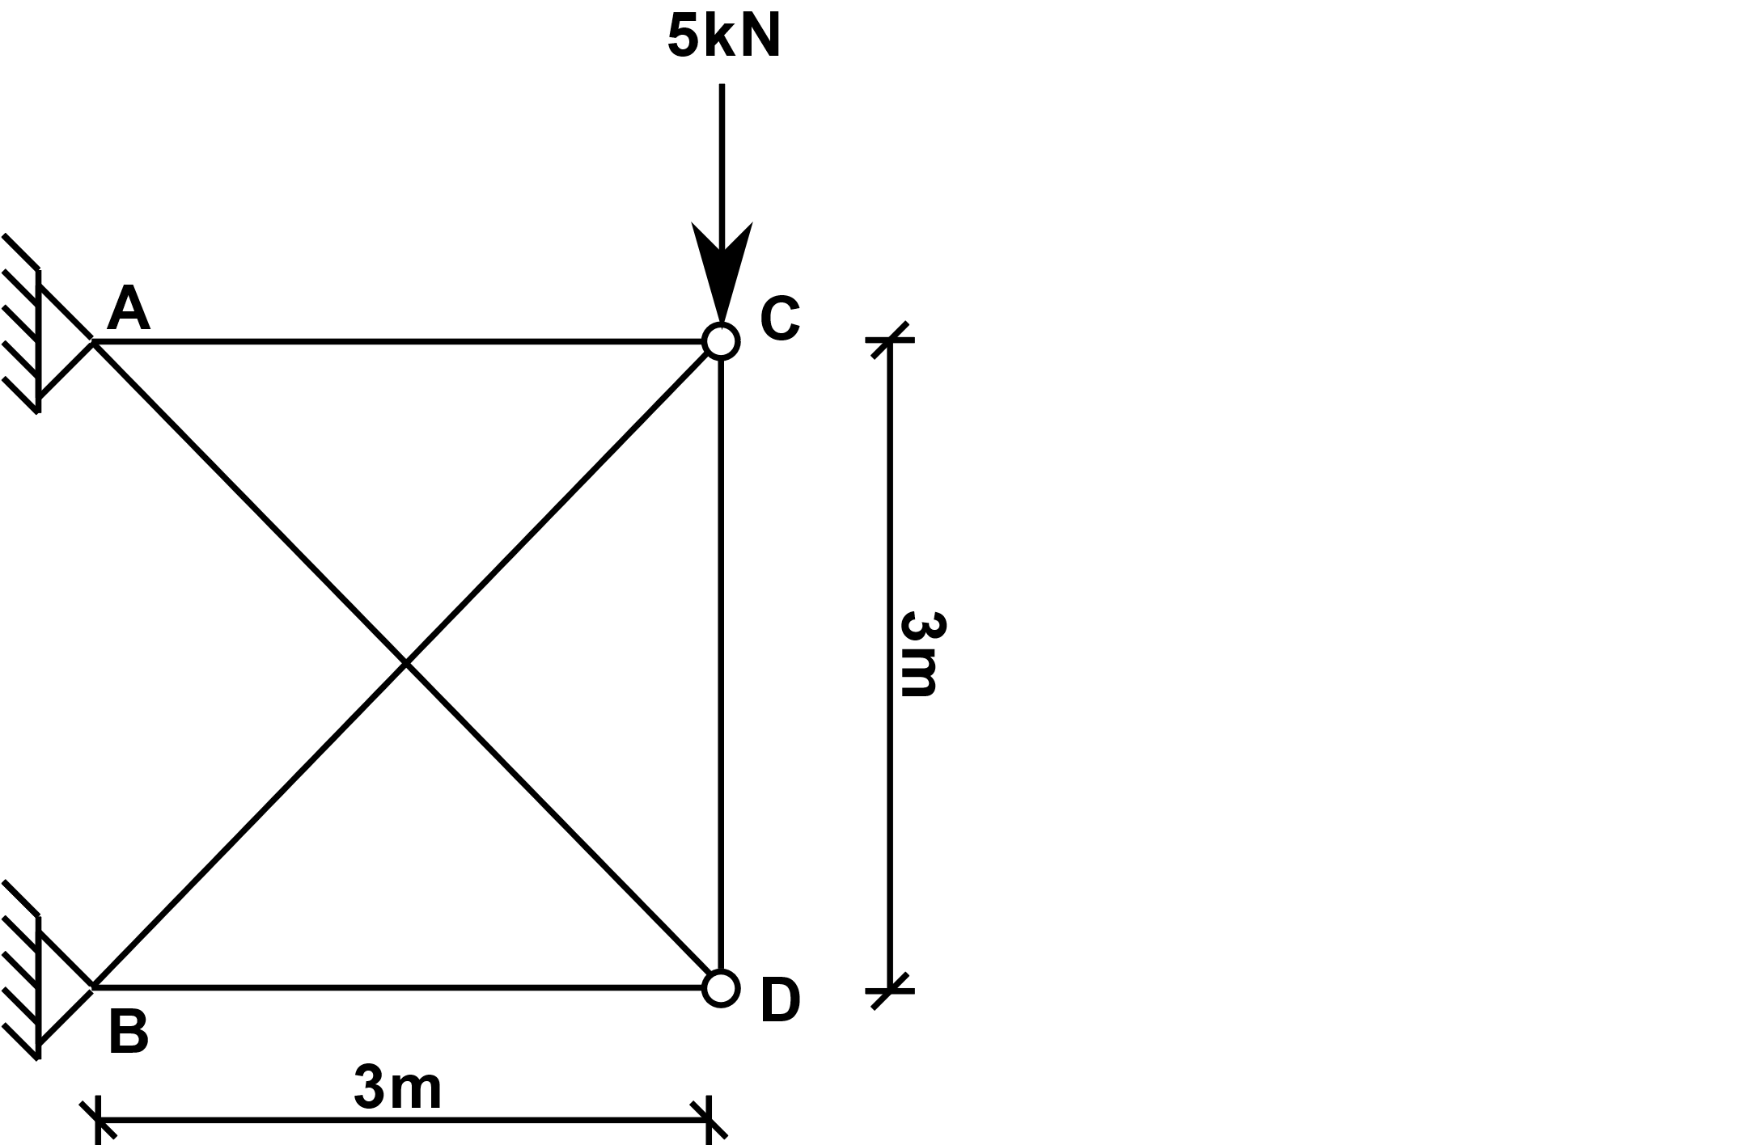
Displacement of a point in a five-bar planar truss with the virtual work method
For all members:
A=4500 mm²
E=200000 N/mm²
We are looking for the vertical displacement of the node D

Slide 2
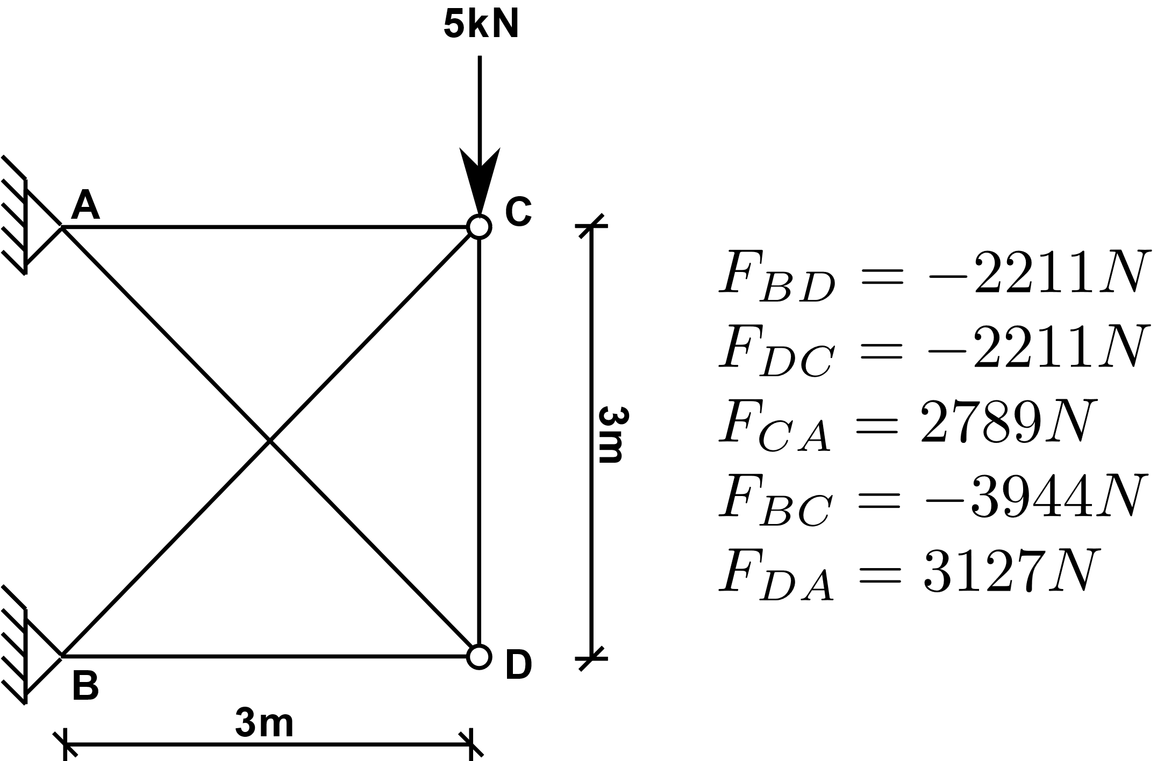
Element forces under external load
We are looking for the vertical displacement of the node D
→ We apply unit force in the direction of the displacement

Slide 3
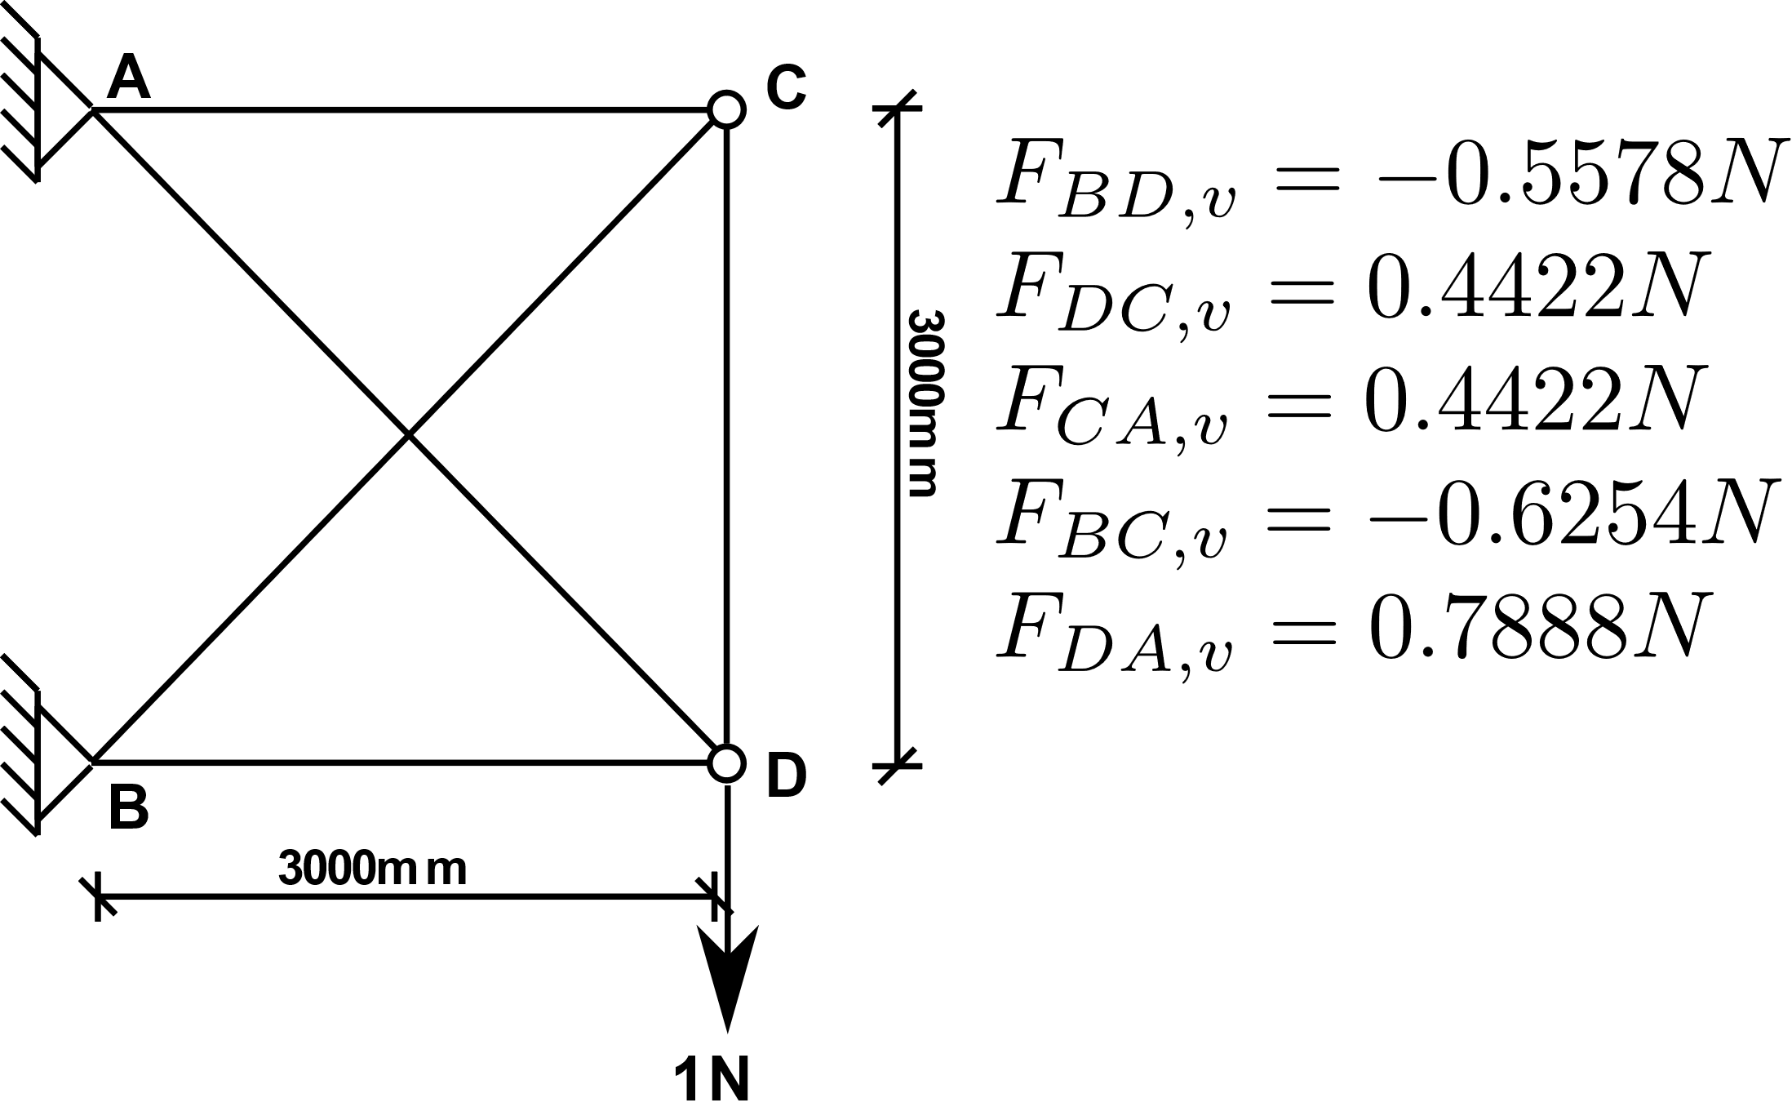
Element Forces under unit virtual force
We are looking for the vertical displacement of the node D
→ We apply unit force in the direction of the displacement

Slide 4
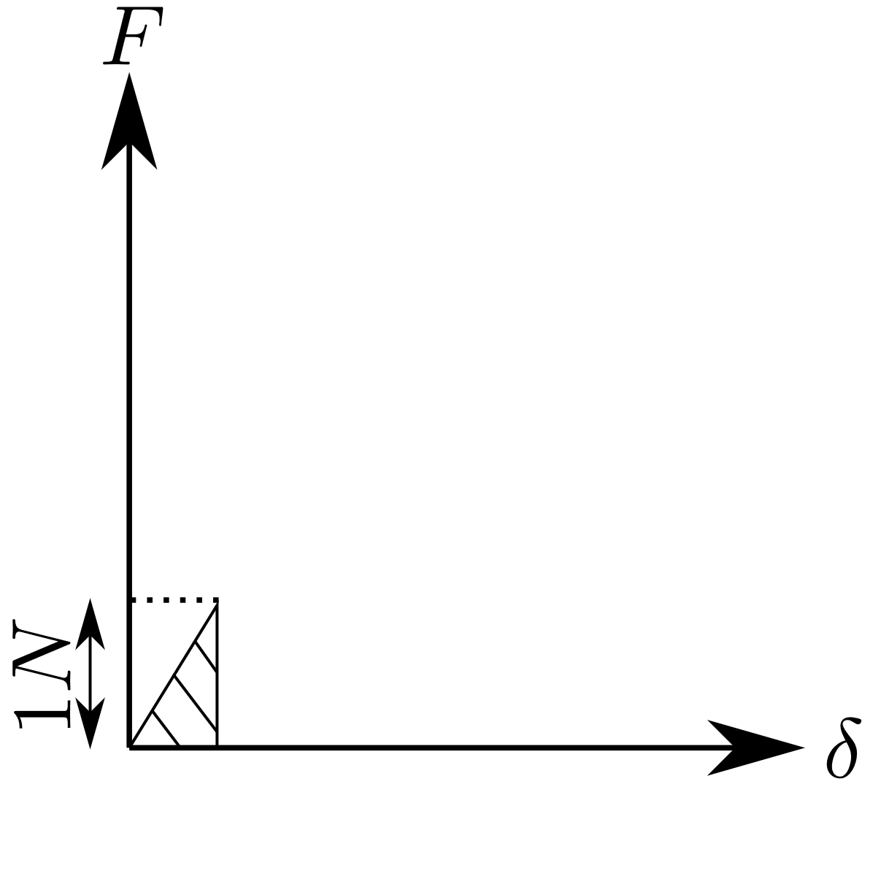
Virtual work done by the unit external force
* The unit force is applied in the same direction as the displacement at the location of the displacement.

Slide 5
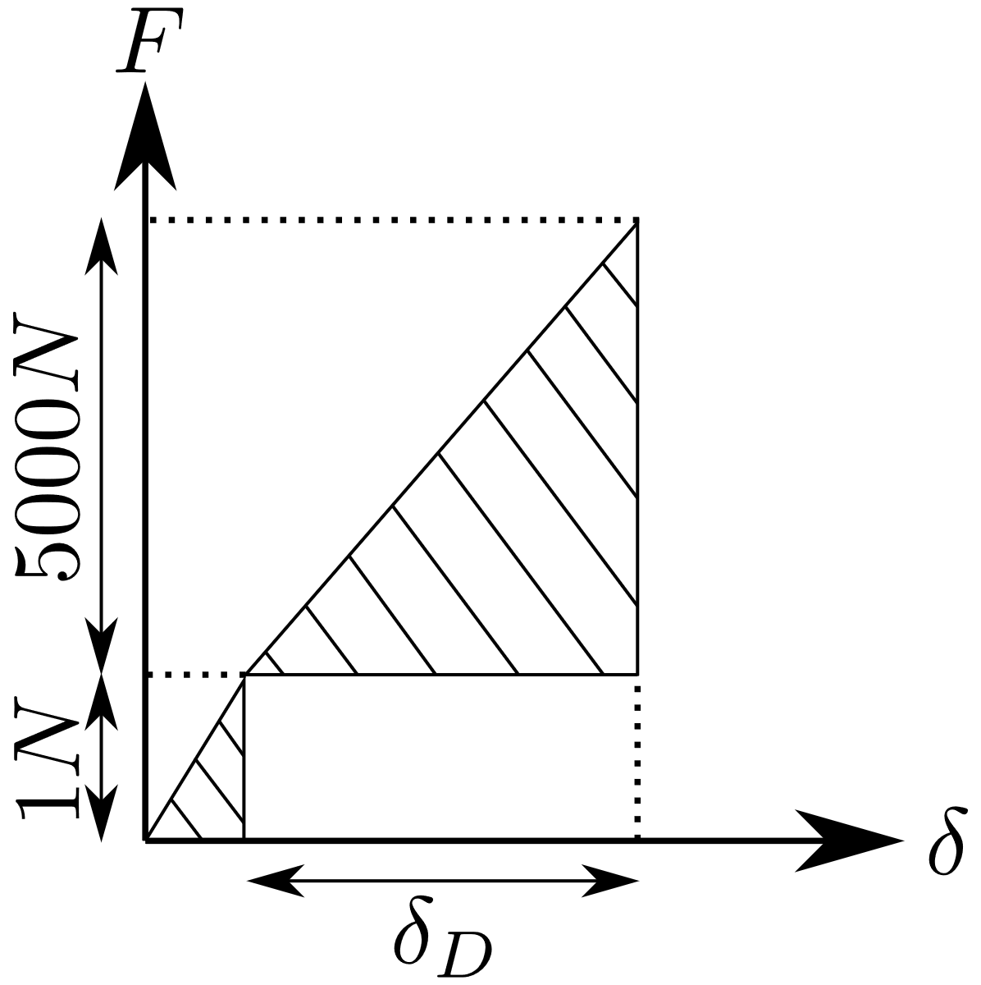
Virtual work done by the unit external force
* The unit force is applied in the same direction as the displacement at the location of the displacement.
* Once the virtual unit force is fully applied, the 5kN external load is applied. During that stage the virtual unit force stays constant.

Slide 6
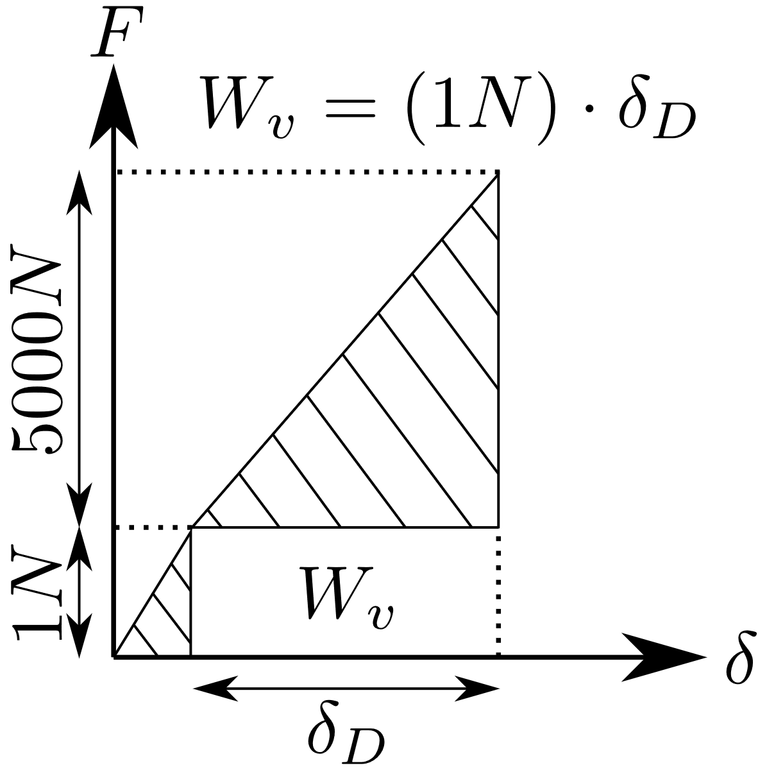
Virtual work done by the unit external force
* The unit force is applied in the same direction as the displacement at the location of the displacement.
* Once the virtual unit force is fully applied, the 5kN external load is applied. During that stage the virtual unit force stays constant.
* As the node D goes through displacement due to 5kN external load, work is being done by the virtual unit force in the direction of the displacement. This virtual work gives to the method its name and is equal to the area of the rectangle shown with W_{v} in the figure.

Slide 7
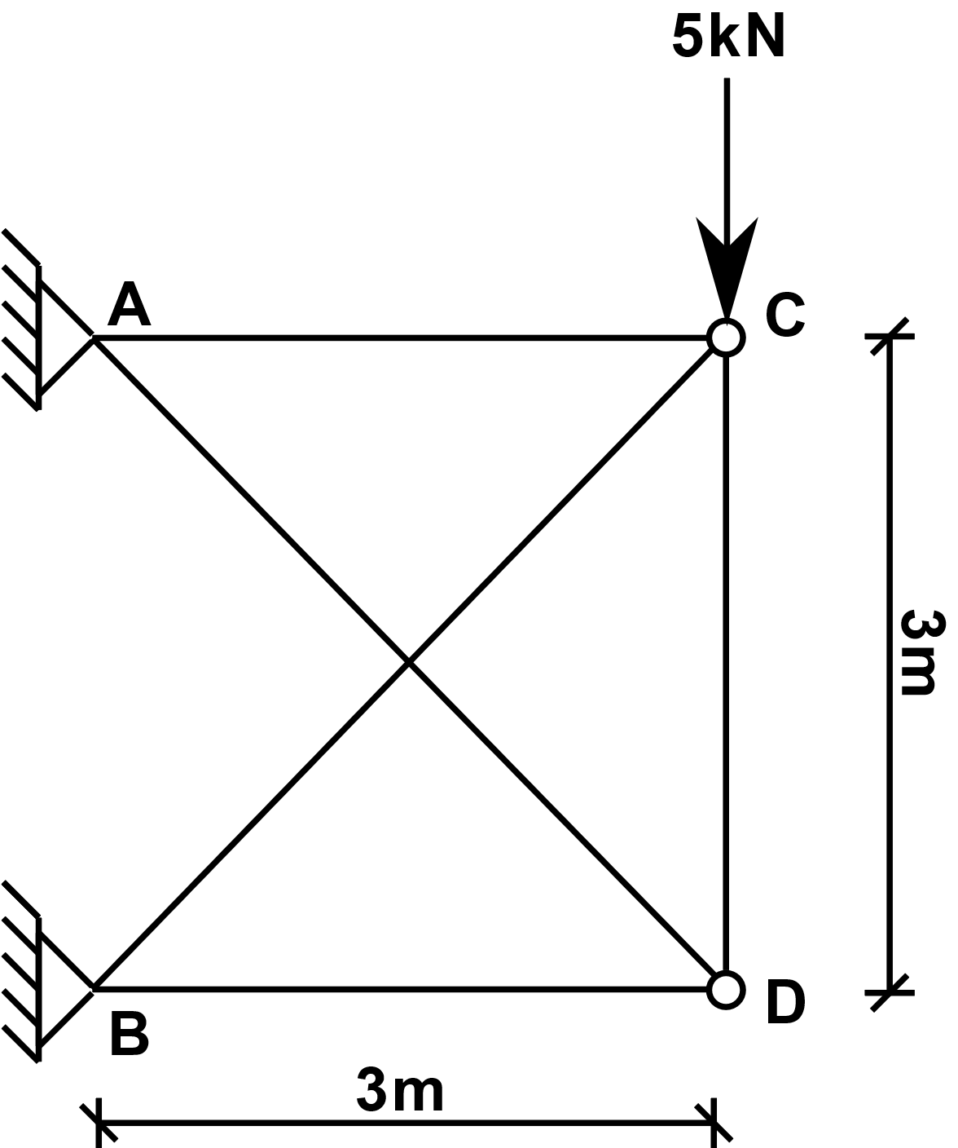
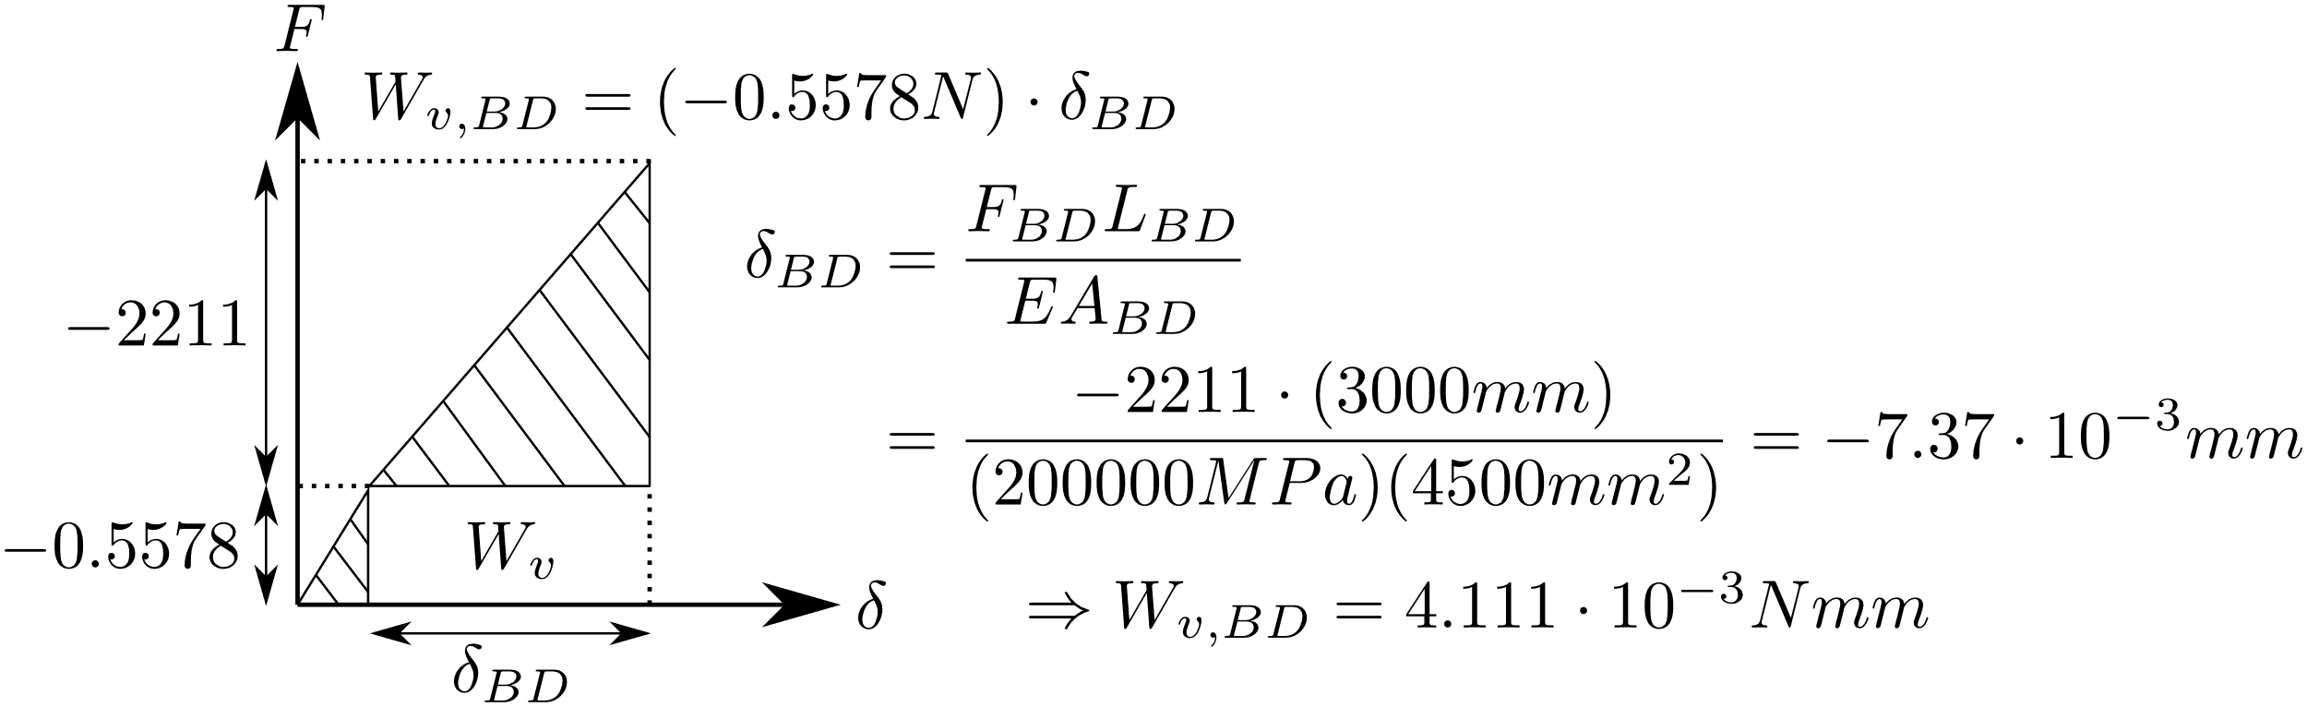
The virtual work done by the external virtual unit force is equal to the sum of the virtual works done by all the virtual element forces.
Virtual work in element BD:

Slide 8
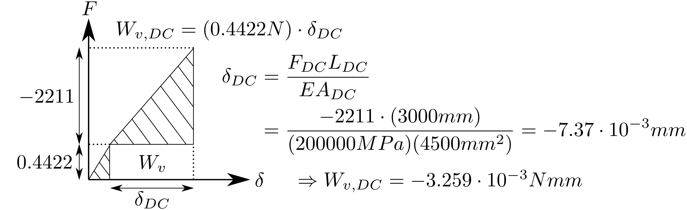
The virtual work done by the external virtual unit force is equal to the sum of the virtual work done by all the virtual element forces.
Virtual work in element DC:

Slide 9
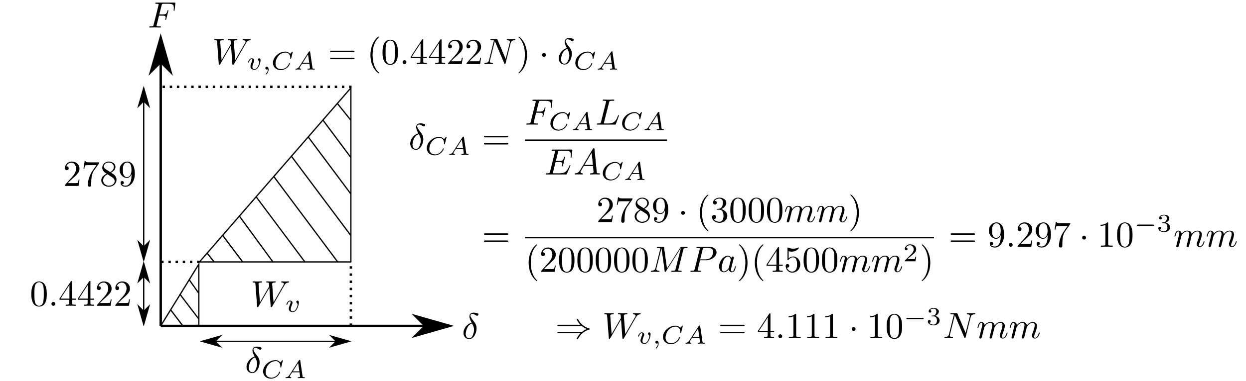
The virtual work done by the external virtual unit force is equal to the sum of the virtual work done by all the virtual element forces.
Virtual work in element CA:

Slide 10
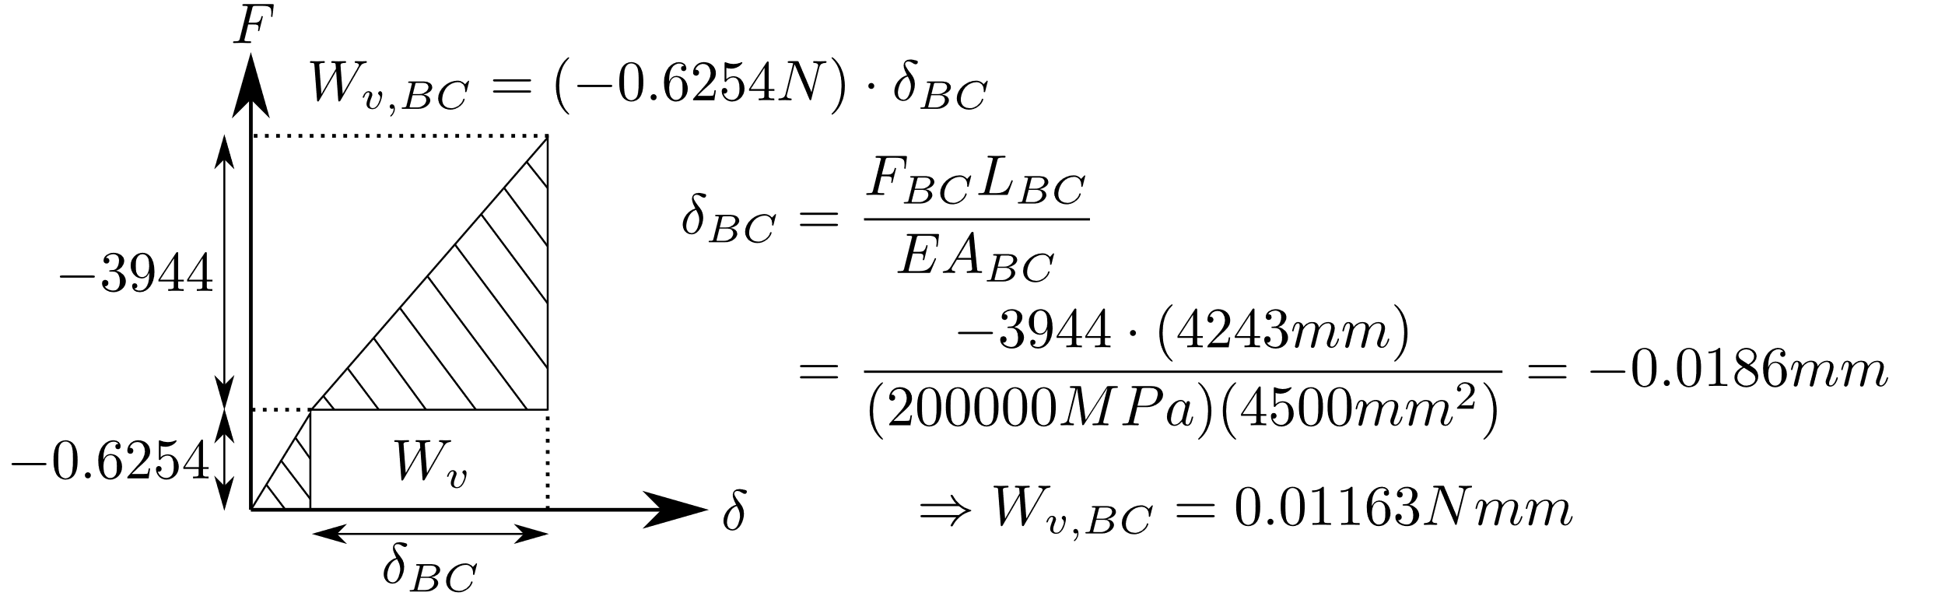
The virtual work done by the external virtual unit force is equal to the sum of the virtual work done by all the virtual element forces.
Virtual work in element BC:

Slide 11
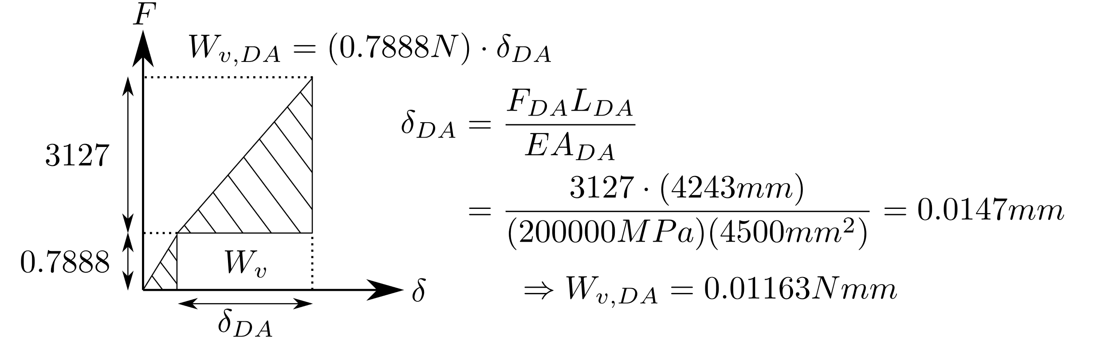
The virtual work done by the external virtual unit force is equal to the sum of the virtual work done by all the virtual element forces.
Virtual work in element DA:

Slide 12
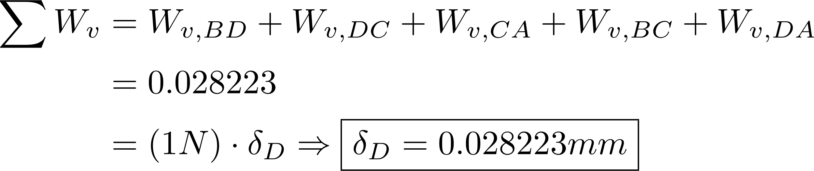
The total virtual work done by all the virtual element forces = virtual work done by the external virtual unit force

