Slide 1
Approaches to Inference
inference
exact
variable elimination
approximate
MCMC
deterministic
loopy belief propagation
LP relaxations
randomized
importance sampling
variational
ILP
randomized search
local search
mean field
Gibbs
dual decomp.
beam search
simulated annealing
dynamic programs
red = hard inference
blue = soft inference
purple = both

Slide 2
“Parts”
Assume that feature function g breaks down into local parts.
Each part has an alphabet of possible values.
Decoding is choosing values for all parts, with consistency constraints.
(In the graphical models view, a part is a clique.)

Slide 3
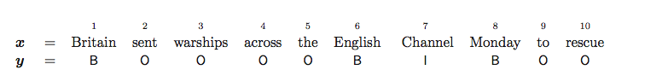
Example
One part per word, each is in {B, I, O}
No features look at multiple parts
Fast inference
Not very expressive

Slide 4
Example
One part per bigram, each is in {BB, BI, BO, IB, II, IO, OB, OO}
Features and constraints can look at pairs
Slower inference
A bit more expressive

Slide 5
Geometric View
Let z_{i,π} be 1 if part i takes value π and 0 otherwise.
z is a vector in {0, 1}^{N}
N = total number of localized part values
Each z is a vertex of the unit cube

Slide 6
Score is Linear in z
not really equal; need to transform back to get y

Slide 7
Polyhedra
Not all vertices of the N-dimensional unit cube satisfy the constraints.
E.g., can’t have z_{1,BI} = 1 and z_{2,BI} = 1
Sometimes we can write down a small (polynomial number) of linear constraints on z.
Result: linear objective, linear constraints, integer constraints …

Slide 8
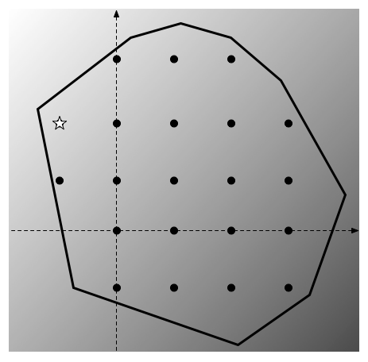

Slide 9
Integer Linear Programming
Very easy to add new constraints and non-local features.
Many decoding problems have been mapped to ILP (sequence labeling, parsing, …), but it’s not always trivial.
NP-hard in general.
But there are packages that often work well in practice (e.g., CPLEX)
Specialized algorithms in some cases
LP relaxation for approximate solutions

Slide 10
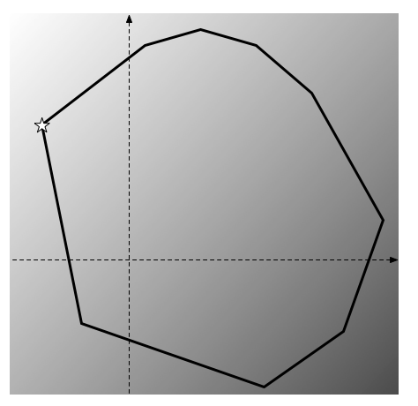

Slide 11
Remark
Graphical models assumed a probabilistic interpretation
Though they are not always learned using a probabilistic interpretation!
The polytope view is agnostic about how you interpret the weights.
It only says that the decoding problem is an ILP.

Slide 12
3. Weighted Parsing

Slide 13
Grammars
Grammars are often associated with natural language parsing, but they are extremely powerful for imposing constraints.
We can add weights to them.
HMMs are a kind of weighted regular grammar (closely connected to WFSAs)
PCFGs are a kind of weighted CFG
Many, many more.
Weighted parsing: find the maximum-weighted derivation for a string x.

Slide 14
Decoding as Weighted Parsing
Every valid y is a grammatical derivation (parse) for x.
HMM: sequence of “grammatical” states is one allowed by the transition table.
Augment parsing algorithms with weights and find the best parse.
The Viterbi algorithm is an instance of recognition by a weighted grammar!

Slide 15
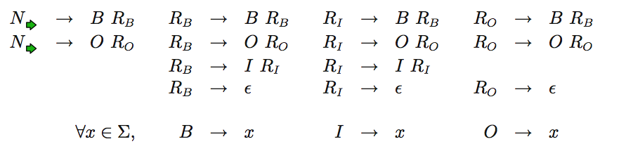
BIO Tagging as a CFG
Weighted (or probabilistic) CKY is a dynamic programming algorithm very similar in structure to classical CKY.

Slide 16
4. Paths and Hyperpaths

Slide 17
Best Path
General idea: take x and build a graph.
Score of a path factors into the edges.
Decoding is finding the best path.
The Viterbi algorithm is an instance of finding a best path!

Slide 18
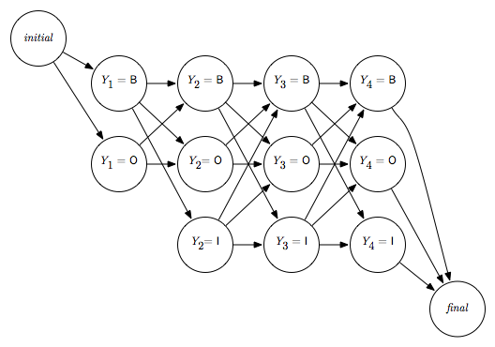
“Lattice” View of Viterbi

Slide 19
A Generic Best Path Algorithm
Input: directed graph G = (V, E), cost : E → ℝ, start vertex v₀
Output: d : V → ℝ (shortest path function) and back pointers b : V → V
for all v ∈ V \ {v₀}, d(v) := ∞ and b(v) := ∅
set d(v₀) = 0
while d has not converged:
pick an arbitrary edge (u, v)
if d(u) + cost(u, v) < d(v):
d(v) := d(u) + cost(u, v)
b(v) := u

Slide 20
Ordering Updates
Naïve ways of choosing edges will lead to cyclic updating and gross inefficiency!
Before considering various ways of doing it, let's consider how the Viterbi algorithm is essentially solving the same problem.

Slide 21
Viterbi Algorithm (In the Style of A Best Path Algorithm)
Input:
directed graph G = (V, E) where each vertex v = (q, t), q ∈ Q ∪ {∅}, t ∈ {-1, 0, 1, …, n} and each edge (u, v) = ((q, t), (q', t + 1))
cost : E → ℝ, defined by cost((q, t), (q', t + 1)) = – log γ(q' | q) – log η(s_{t+1} | q) – log (1 - ξ(q)) cost((q, n - 1), (q', n)) = – log γ(q' | q) – log η(s_{t+1} | q) – log ξ(q') cost((∅, -1), (q, 0)) = – log π(q)
fixed start vertex v₀ = (∅, -1)
Output: d : V → ℝ (shortest path function) and back pointers b : V → V
for all v ∈ V \ {v₀}, d(v) := ∞ and b(v) := ∅
set d(v₀) = 0
perform a topological sort on V
while d has not converged: for each v in top-sort order:
pick an arbitrary edge (u, v)
for each (u, v) ∈ E:
if d(u) + cost(u, v) < d(v):
d(v) := d(u) + cost(u, v)
b(v) := u
// d(v) and b(v) are now known

Slide 22
The Viterbi Trick
From a “best path” perspective, Viterbi is:
defining the vertices and edges to have special structure (state/time step)
assigning costs based on HMM weights and the specific input string s₁ … s_{n}
ordering the edges cleverly to make things efficient
Note also: Viterbi's graph has no cycles.

Slide 23
Another Variant: “Forward” Updating
After topological sort, can also choose all edges going out of current node.
for all v ∈ V \ {v₀}, d(v) := ∞ and b(v) := ∅
set d(v₀) = 0
perform a topological sort on V
for each u in top-sort order:
for each (u, v) ∈ E:
if d(u) + cost(u, v) < d(v):
d(v) := d(u) + cost(u, v)
b(v) := u

Slide 24
Memoized Recursion
Input: directed graph G = (V, E), cost : E → ℝ, start vertex v₀, target vertex v_{t}
Output: d : V → ℝ (shortest path function) and back pointers b : V → V
for all v ∈ V \ {v₀}, d(v) := ∅ and b(v) := ∅
set d(v₀) = 0
memoize(v_{t})
memoize(v):
// guaranteed to return best-cost path score for v
if d(v) = ∅:
d(v) := ∞
for each (u, v) ∈ E:
if memoize(u) + cost(u, v) < d(v):
d(v) := d(u) + cost(u, v)
b(v) := u
return d(v)

Slide 25
A Generic Best Path Algorithm
Input: directed graph G = (V, E), cost : E → ℝ, start vertex v₀
Output: d : V → ℝ (shortest path function) and back pointers b : V → V
for all v ∈ V \ {v₀}, d(v) := ∞ and b(v) := ∅
set d(v₀) = 0
while d has not converged:
pick an arbitrary edge (u, v)
if d(u) + cost(u, v) < d(v):
d(v) := d(u) + cost(u, v)
b(v) := u

Slide 26
Dijkstra's Algorithm
Input: directed graph G = (V, E), cost : E → ℝ_{≥0} (important!), start vertex v₀
Output: d : V → ℝ (shortest path function) and back pointers b : V → V
for all v ∈ V \ {v₀}, d(v) := ∞ and b(v) := ∅
set d(v₀) = 0
Q := priority queue on V ordered by d (lower cost = higher priority)
while d has not converged: while Q is not empty:
pick an arbitrary edge (u, v)
u := extract-min(Q)
for each (u, v) ∈ E:
if d(u) + cost(u, v) < d(v):
d(v) := d(u) + cost(u, v)
b(v) := u
update v's priority in Q

Slide 27
A* Algorithm
Input: directed graph G = (V, E), cost : E → ℝ_{≥0}, start vertex v₀, target vertex v_{t}, heuristic h : V → ℝ_{≥0} such that h(v) ≤ best-cost(v, v_{t})
Output: d : V → ℝ (shortest path function) and back pointers b : V → V
for all v ∈ V \ {v₀}, d(v) := ∞ and b(v) := ∅
set d(v₀) = 0
Q := priority queue on V ordered by d + h (lower cost = higher priority)
while Q is not empty:
u := extract-min(Q)
for each (u, v) ∈ E:
if d(u) + cost(u, v) < d(v):
d(v) := d(u) + cost(u, v)
b(v) := u
update v's priority in Q

Slide 28
Minimum Cost Hyperpath
General idea: take x and build a hypergraph.
Score of a hyperpath factors into the hyperedges.
Decoding is finding the best hyperpath.
This connection was elucidated by Klein and Manning (2002).

Slide 29
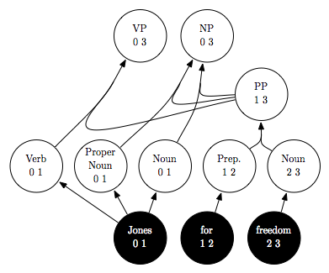
Parsing as a Hypergraph

Slide 30
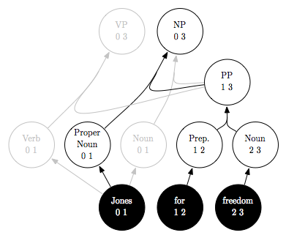
Parsing as a Hypergraph
cf. “Dean for democracy”

Slide 31
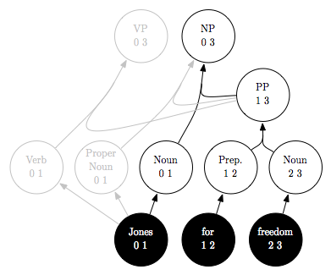
Parsing as a Hypergraph
Forced to work on his thesis, sunshine streaming in the window, Mike experienced a …

Slide 32
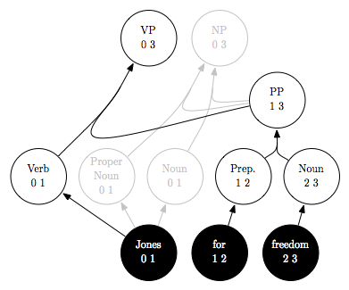
Parsing as a Hypergraph
Forced to work on his thesis, sunshine streaming in the window, Mike began to …

Slide 33
Why Hypergraphs?
Useful, compact encoding of the hypothesis space.
Build hypothesis space using local features, maybe do some filtering.
Pass it off to another module for more fine-grained scoring with richer or more expensive features.

Slide 34
5. Weighted Logic Programming

Slide 35
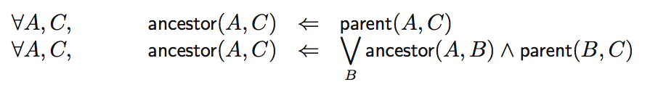
Logic Programming
Start with a set of axioms and a set of inference rules.
The goal is to prove a specific theorem, goal.
Many approaches, but we assume a deductive approach.
Start with axioms, iteratively produce more theorems.

Slide 36
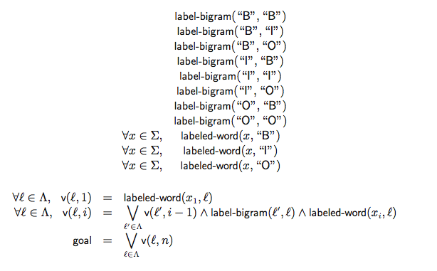

Slide 37
Weighted Logic Programming
Twist: axioms have weights.
Want the proof of goal with the best score:
Note that axioms can be used more than once in a proof (y).

Slide 38
Whence WLP?
Shieber, Schabes, and Pereira (1995): many parsing algorithms can be understood in the same deductive logic framework.
Goodman (1999): add weights in a semiring, get many useful NLP algorithms.
Eisner, Goldlust, and Smith (2004, 2005): semiring-generic algorithms, Dyna.

Slide 39
Dynamic Programming
Most views (exception is polytopes) can be understood as DP algorithms.
The low-level procedures we use are often DP.
Even DP is too high-level to know the best way to implement.
Break a problem into slightly smaller problems with optimal substructure.
Best path to v depends on best paths to all u such that (u,v) ∈ E.
Overlapping subproblems: each subproblem gets used repeatedly, and there aren’t too many of them.

Slide 40
Dynamic Programming
Three main strategies for DP:
Viterbi, Levenshtein edit distance, CKY: predefined, “clever” ordering.
Memoization
Agenda (Dijkstra’s algorithm, A*)
Things to remember in general:
The hypergraph may too big to represent explicitly; exhaustive calculation may be too expensive.
The hypergraph may or may not have properties that make “clever” orderings possible.
DP does not imply polynomial time and space! Most common approximations when the desired state space is too big: beam search, cube pruning, agendas with early stopping, ...

Slide 41
Summary
Decoding is the general problem of choosing a complex structure.
Linguistic analysis, machine translation, speech recognition, …
Statistical models are usually involved (not necessarily probabilistic).
No perfect general view, but much can be gained through a combination of views.
First question: can I solve it exactly with DP?

