Slide 1
spring framework overview
By Vijay Kumar Keshri

Slide 2
With Spring,
your business needs drive the technology,
the technology doesn’t drive you!
---------------------------------------------------
Spring applies OO best practices and integrates best-of-breed technologies to provide a “one-stop-shop” for building high-quality enterprise applications quickly.

Slide 3
Agenda
    Declaring beans
    Injecting constructors and setters
    Wiring beans
    Automatic bean wiring
    Controlling bean creation and destruction

Slide 4
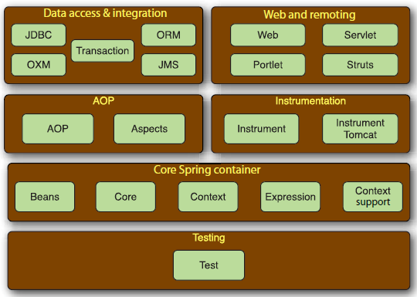
The Spring Framework is made up of six well-defined modules

Slide 5
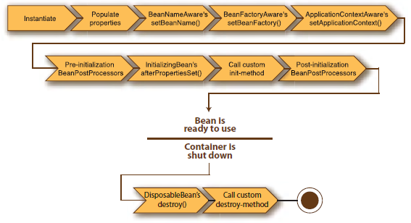
A bean goes through several steps between creation and destruction in the Spring container. Each step is an opportunity to customize how the bean is managed in Spring.

Slide 6
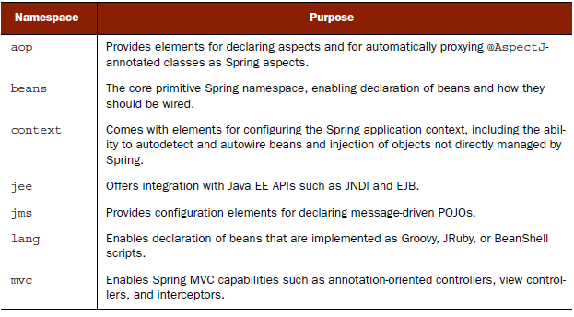
Spring comes with several XML namespaces through which you can configure the Spring container

Slide 7
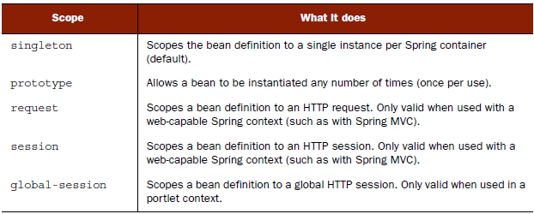
Spring’s bean scopes let you declare the scope under which beans are created without hard-
coding the scoping rules in the bean class itself.

Slide 8
Spring Core: The Bean Factory
The most complete IoC container
  Setter Dependency Injection
    Configuration via JavaBean properties
  Constructor Dependency Injection
    Like PicoContainer: configuration via constructor arguments
  Dependency Lookup
    Avalon/EJB-style call-backs

Slide 9
Spring: Dependency Injection
Setter Injection
  Configuration XML
  <bean id=“hibernateClinic" class=“samples.HibernatePetClinic">
  <property name="sessionFactory">
  <ref bean=“sessionFactory"/>
  </property>
  </bean>
  Java Code
  public class HibernatePetClinic implements PetClinic {
  public void setSessionFactory(SessionFactory factory) {
  this.sessionFactory = factory;
  }
  }

Slide 10
Spring: Dependency Injection
Constructor Injection
  Configuration XML
  <bean id=“hibernateClinic" class=“samples.HibernatePetClinic">
  <constructor-arg index=“0”>
  <ref bean=“sessionFactory"/>
  </constructor-arg>
  </bean>
  Java Code
  public class HibernatePetClinic implements PetClinic {
  public HibernatePetClinic(SessionFactory factory) {
  this.sessionFactory = factory;
  }
  }

Slide 11
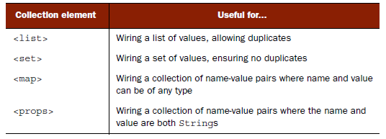
Just as Java has several kinds of collections, Spring allows for injecting several kinds of collections

Slide 12
Thank you

