Slide 1
ctai – compile time assembly interpreter
Mateusz Janek | 29.11.2017 | Wro.cpp

Slide 2
Agenda
*this
Assumptions
Flow
Architecture
Live coding
Summary
Links
Questions/discussion

Slide 3
Assumtions
YAGNI
unit_t
No floating points
Tokens separated by ONE space
:label & .label

Slide 4
Flow

Slide 5
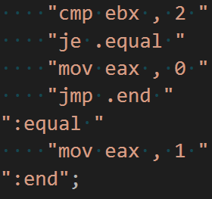
Flow – Step 1: Code

Slide 6
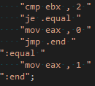
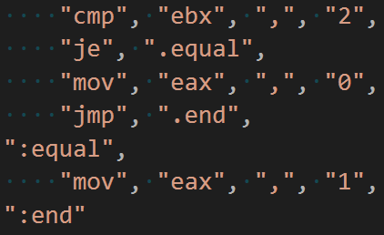
Flow – Step 2: Tokens

Slide 7
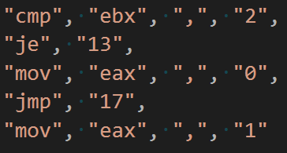
Flow – Step 3: Labels

Slide 8
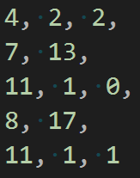
Flow – Step 4: Opcodes

Slide 9
Flow – Step 5: Assemble and execute
RAM
4 | 2 | 2 | 7 | 13 | 11 | 1 | 0 | 8 | 17 | 11 | 1 | 1 | …
eip
esp

Slide 10
Architecture

Slide 11
Wstawki z kodzenia

Slide 12
Podsumowanie

Slide 13
Linki

Slide 14
Thank you!

