Slide 1
ctai – compile time assembly interpreter
Mateusz Janek <mateusz.janek6@gmail.com> | Wro.cpp| 29.11.2017

Slide 2
Agenda
*this
ctai overview
Protips
Summary
Links
Questions/discussion

Slide 3
ctai

Slide 4
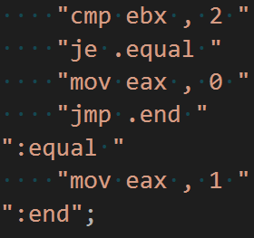
Step 1: Code

Slide 5
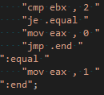
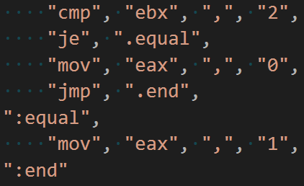
Step 2: Tokens

Slide 6
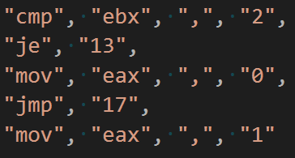
Step 3: Labels

Slide 7
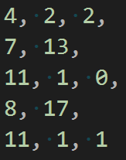
Step 4: Opcodes

Slide 8
Step 5: Assemble and execute
RAM
4 | 2 | 2 | 7 | 13 | 11 | 1 | 0 | 8 | 17 | 11 | 1 | 1 | …
eip
esp

Slide 9
Architecture
MACHINE
RAM
ZF
REGISTERS
eax
ebx
ecx
edx
ebp
esp
eip

Slide 10
ctai code
Helpers
vector, string
Tokenize
Labels
Assemble
Execute

Slide 11
Protips
Helpers
vector, string
Tokenize
Labels
Assemble
Execute

Slide 12
The Code

Slide 13
Links
decltype(auto) - https://stackoverflow.com/a/24109800/4175394
user defined literals - http://en.cppreference.com/w/cpp/language/user_literal
deduction guides - http://en.cppreference.com/w/cpp/language/class_template_argument_deduction
two-phase lookup - http://blog.llvm.org/2009/12/dreaded-two-phase-name-lookup.html
… and more. Check the code (:

Slide 14

Code & presentation
github.com/stryku/workshops/tree/master/ctai

Slide 15
Questions/discussion

Slide 16
Thank you!

