Slide 1
ctai – compile time assembly interpreter
Mateusz Janek | 29.11.2017 | Wro.cpp

Slide 2
Agenda
*this
Assumptions
Steps
Architecture
Live coding
Summary
Links
Questions/discussion

Slide 3
Assumtions
YAGNI
unit_t
No floating points
Tokens separated by ONE space
:label & .label

Slide 4
Steps

Slide 5
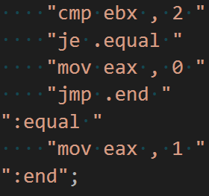
Step 1: Code

Slide 6
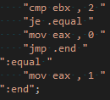
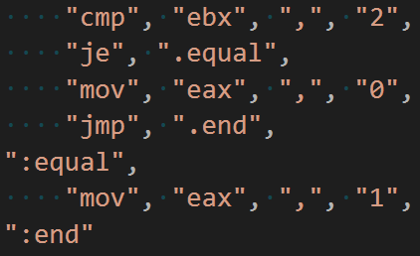
Step 2: Tokens

Slide 7
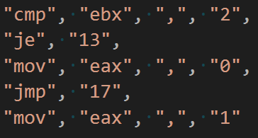
Step 3: Labels

Slide 8
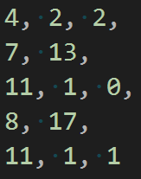
Step 4: Opcodes

Slide 9
Step 5: Assemble and execute
RAM
4 | 2 | 2 | 7 | 13 | 11 | 1 | 0 | 8 | 17 | 11 | 1 | 1 | …
eip
esp

Slide 10
Architecture
MACHINE
RAM
ZF
REGISTERS
eax
ebx
ecx
edx
ebp
esp
eip

Slide 11
The Code

Slide 12
Links
decltype(auto) - https://stackoverflow.com/a/24109800/4175394
user defined literals - http://en.cppreference.com/w/cpp/language/user_literal
deduction guides - http://en.cppreference.com/w/cpp/language/class_template_argument_deduction
two-phase lookup - http://blog.llvm.org/2009/12/dreaded-two-phase-name-lookup.html
if with initializer - https://skebanga.github.io/if-with-initializer/
… and more. Check the code (:

Slide 13
Questions

Slide 14
Code & presentation
https://github.com/stryku/workshops/tree/master/ctai_wro_cpp

Slide 15
Thank you!

