Slide 1
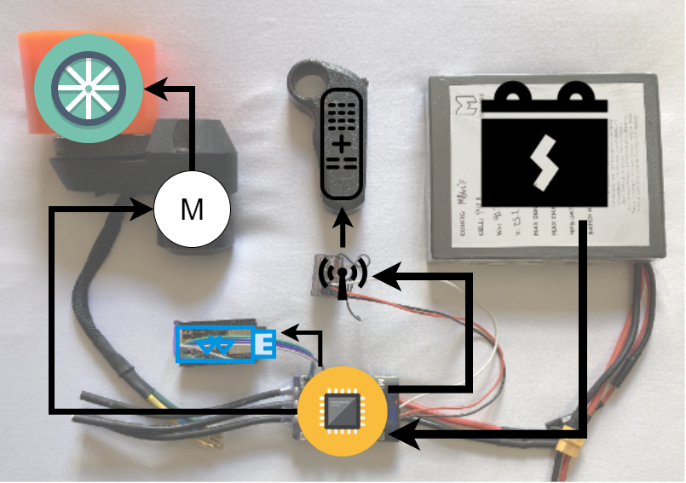
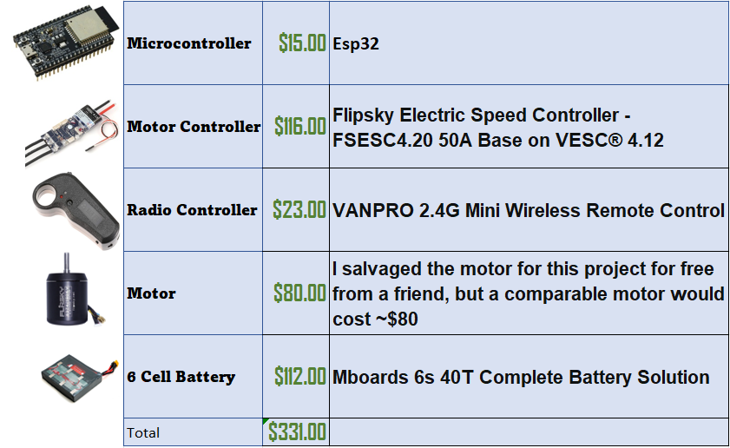
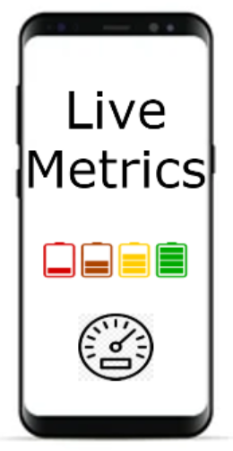
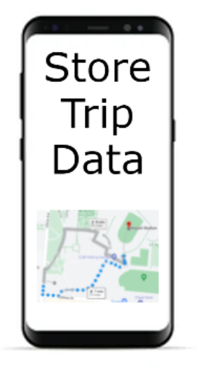
eeZPower
Bringing the convenience of electric power to every board
Abstract
Physical Layout
The goal is to create a device along with a companion app that can be quickly attached to any type of board (skateboard, longboard, etc.) that provides the convenience of a motorized one while being just as quick to remove. Current solutions are either expensive or require tools to attach. Our device aims to solve those issues while allowing your board’s original hardware to stay intact.
Design Diagram
challenges, obstacles and design decisions
Original design planned to make use of an inexpensive HC-05 Bluetooth module, but proved to be incompatible with the fsesc motor controller
Gantt Chart
all student pictures should be on the poster labeled with names
• project advisor should be clearly documented (photo optional)

