Slide 2
Don't Deploy and Forget: Managing your models across the entire analytic lifecycle
Stephen Sparano
Principal Product Manager
SAS Decision Management

Slide 3
Abstract – keyword analysis
The analytic lifecycle does not end once the model is created, rather it's just the beginning of the important phases related to analytical deployment, monitoring and model updates. Businesses are looking for more flexible ways to deploy their models for real time, streaming, and batch processes, as well as ways to monitor their model performance. And this need extends to SAS models as well as open source and PMML models. In this demonstration, you'll see how SAS Model Manager integrates with critical SAS model scoring technologies for real time, batch and streaming environments.

Slide 4


The Analytics Model Lifecycle
Process Data
Integrate (business process)
Data Science
Operations
Explorative
Automated
Innovation
Robust
New Data
Investigate
Deploy
Execute
Actions
Ask
Experiment
Decisions
Discover
Data Scientist, Model Developer
IT, Business Analyst, Executives
Model
Validate
DATA
Stream / Data Warehouse / Data Lake / Hadoop

Slide 5

SAS Analytics Ecosystem
Dev – Test – Publish – Monitor - Improve
Off Line Analytic Development
SAS Visual Analytics
SAS VDMML
Analytic Execution
Analytical output
SAS Visual Statistics
SAS Visual Text Analytics
SAS Real time (MAS)
Results
Performance Data
Batch
In Database
In Hadoop
Performance results
SAS Cloud Analytic Server(CAS)
SAS Model Manager
Model Management and Monitoring
Publishing
Services
Analytical Models
Streaming

Slide 6
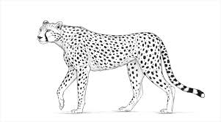
Section 1 of 3: Create a model
What is a model
How do I make one
How do I share it with other teams in the business.

Slide 7
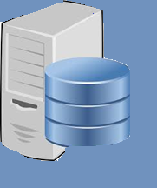
Ok fine, what exactly is a model
_7OR6RJSERJ6CUFEBZ7DLGD4QN.setvars(allvars);
_7OR6RJSERJ6CUFEBZ7DLGD4QN.setkey(n'98FC3C9FF5F64A9F7E5B711CB5957999CA9656DC');
_7OR6RJSERJ6CUFEBZ7DLGD4QN.setOption('_destroyFirstInstLast_', 0);
_7P0F7BS6MNJJVI9FF82BP8YP4();
_7OR6RJSERJ6CUFEBZ7DLGD4QN.scoreRecord();
if "P_MAINTENANCE_FLAG0" = . then "P_MAINTENANCE_FLAG0" = 0.7730829421;
if "P_MAINTENANCE_FLAG1" = . then "P_MAINTENANCE_FLAG1" = 0.2269170579;
if MISSING("I_MAINTENANCE_FLAG") then do ;
_P_ = 0.0;
if "P_MAINTENANCE_FLAG1" > _P_ then do ;
_P_ = "P_MAINTENANCE_FLAG1";
"I_MAINTENANCE_FLAG" = '1';
end;
if "P_MAINTENANCE_FLAG0" > _P_ then do ;
_P_ = "P_MAINTENANCE_FLAG0";
"I_MAINTENANCE_FLAG" = '0';
end;
end;
EM_EVENTPROBABILITY = "P_MAINTENANCE_FLAG1";
EM_CLASSIFICATION = "I_MAINTENANCE_FLAG";
EM_PROBABILITY = MAX("P_MAINTENANCE_FLAG1", "P_MAINTENANCE_FLAG0");
The code is the model.
This model score code was created by running a VDMML function on a CAS server.
The code can be run in many environments.
This is what we deploy.

Slide 8
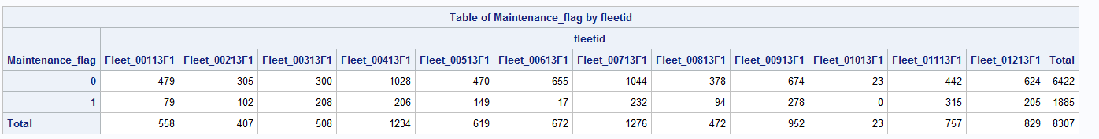
Scenario
Truck Fleet data from SGF 2017 and 2018
Predict a future need for maintenance based on history of sensor readings and maintenance events
Target variable: maintenance_flag ( 0 or 1 )
Data contains multiple fleets each has multiple trucks
See distribution of target, below.

Slide 9
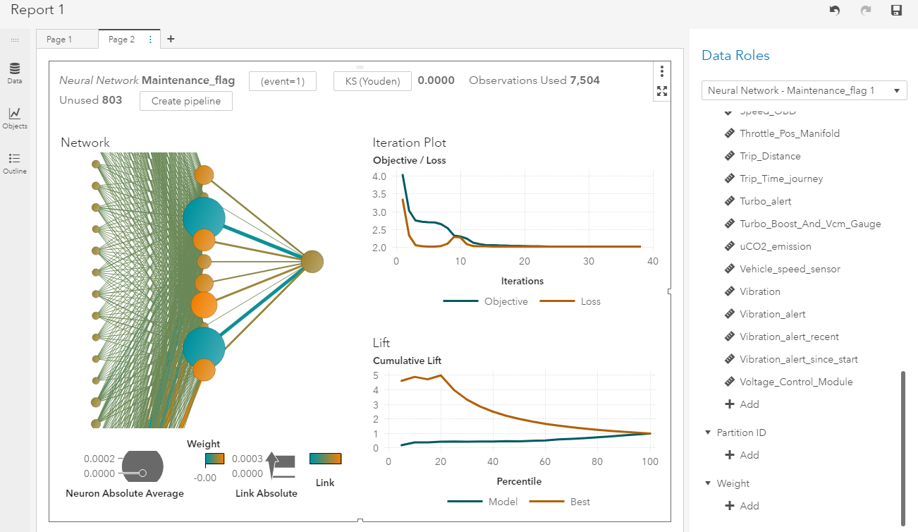
Visual Analytics – one great way to build a model
In this case yet another neural network

Slide 10
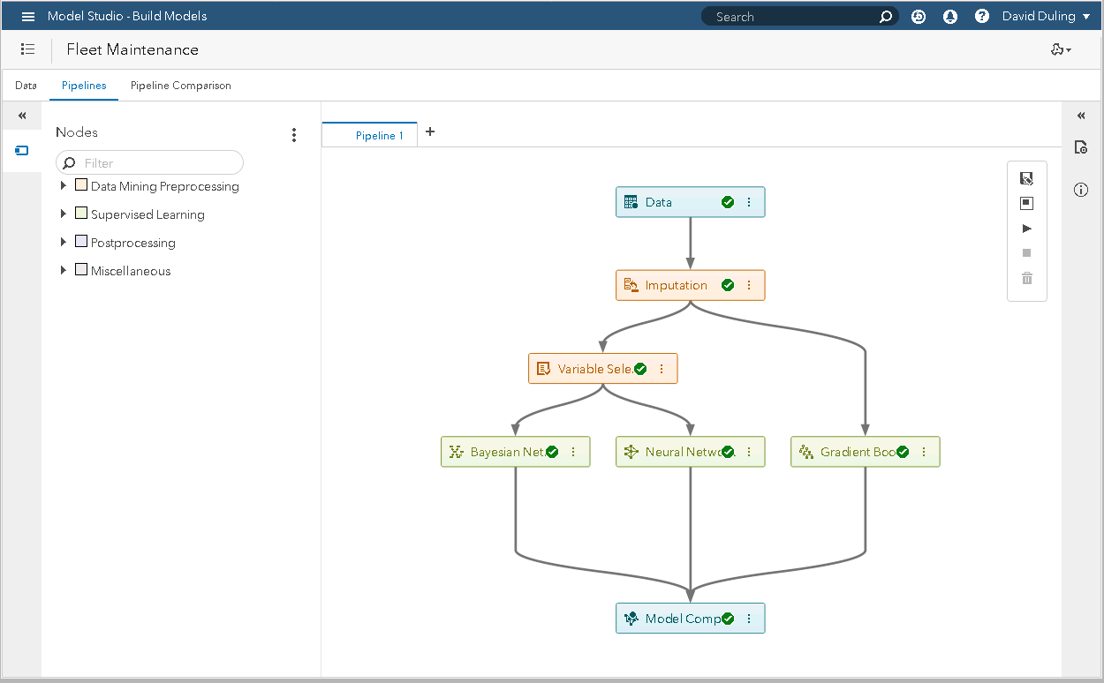
VDMML – another great way to build a model
In fact you can build a model with almost anything….
SAS, VA, VDMML, SAS Studio, Python, Java, PMML, etc…

Slide 11
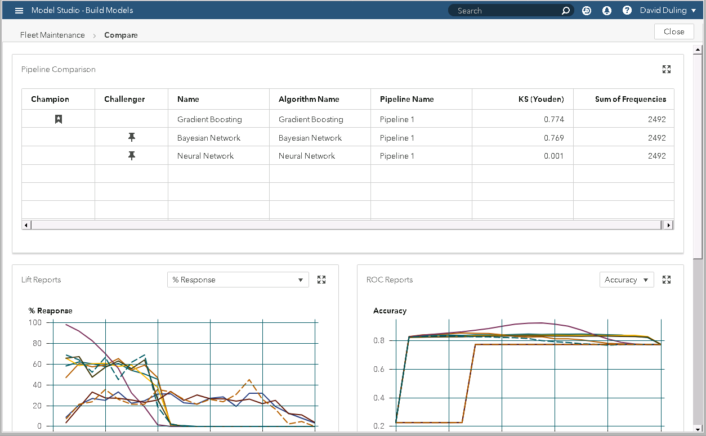
VDMML – list models for this project
Remember this list
Select Register to save and share these models with other users and applications.
… such as …

Slide 12
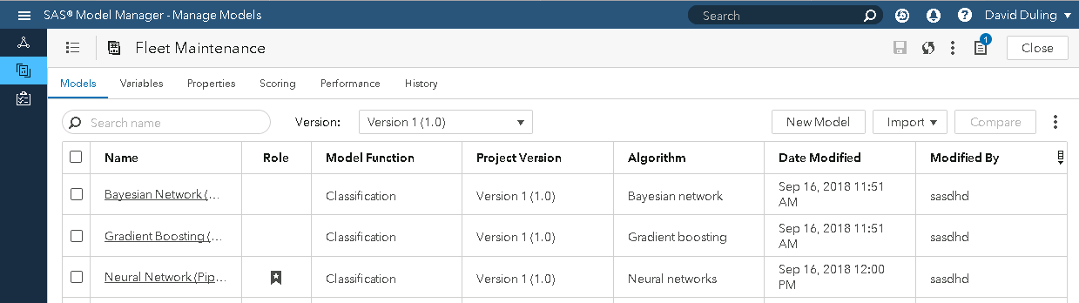
Model Manager
One common platform for storing models from all sources
and deploying models to all targets

Slide 13
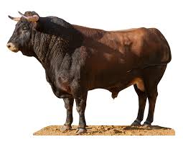
Section 2: Deploy
This is really the software development process
Compare models
Testing the models
Publish a model to production
Use the model in a business application
What does this look like….

Slide 14
SAS Analytics Ecosystem
Dev – Test – Publish – Monitor - Improve
Off Line Analytic Development
SAS Visual Analytics
SAS VDMML
Analytic Execution
Analytical output
SAS Visual Statistics
SAS Visual Text Analytics
SAS Real time (MAS)
Results
Performance Data
Batch
In Database
In Hadoop
Performance results
SAS Cloud Analytic Server(CAS)
SAS Model Manager
Model Management and Monitoring
Publishing
Services
Analytical Models
Streaming

Slide 15

Well then what exactly is model deployment
Run Model Run !
Make this code run in a business application to make optimal data and model driven decisions.
Call center
Loan processing
Supply routing
Patient treatment
Product placement
Dynamic pricing
Phone traffic routing
…Anywhere…
_7OR6RJSERJ6CUFEBZ7DLGD4QN.setvars(allvars);
_7OR6RJSERJ6CUFEBZ7DLGD4QN.setkey(n'98FC3C9FF5F64A9F7E5B711CB5957999CA9656DC');
_7OR6RJSERJ6CUFEBZ7DLGD4QN.setOption('_destroyFirstInstLast_', 0);
_7P0F7BS6MNJJVI9FF82BP8YP4();
_7OR6RJSERJ6CUFEBZ7DLGD4QN.scoreRecord();
post_7OR6RJSERJ6CUFEBZ7DLGD4QN();
if "P_MAINTENANCE_FLAG0" = . then "P_MAINTENANCE_FLAG0" = 0.7730829421;
if "P_MAINTENANCE_FLAG1" = . then "P_MAINTENANCE_FLAG1" = 0.2269170579;
if MISSING("I_MAINTENANCE_FLAG") then do ;
_P_ = 0.0;
if "P_MAINTENANCE_FLAG1" > _P_ then do ;
_P_ = "P_MAINTENANCE_FLAG1";
"I_MAINTENANCE_FLAG" = '1';
end;
if "P_MAINTENANCE_FLAG0" > _P_ then do ;
_P_ = "P_MAINTENANCE_FLAG0";
"I_MAINTENANCE_FLAG" = '0';
end;
end;
EM_EVENTPROBABILITY = "P_MAINTENANCE_FLAG1";
EM_CLASSIFICATION = "I_MAINTENANCE_FLAG";
EM_PROBABILITY = MAX("P_MAINTENANCE_FLAG1", "P_MAINTENANCE_FLAG0");

Slide 16
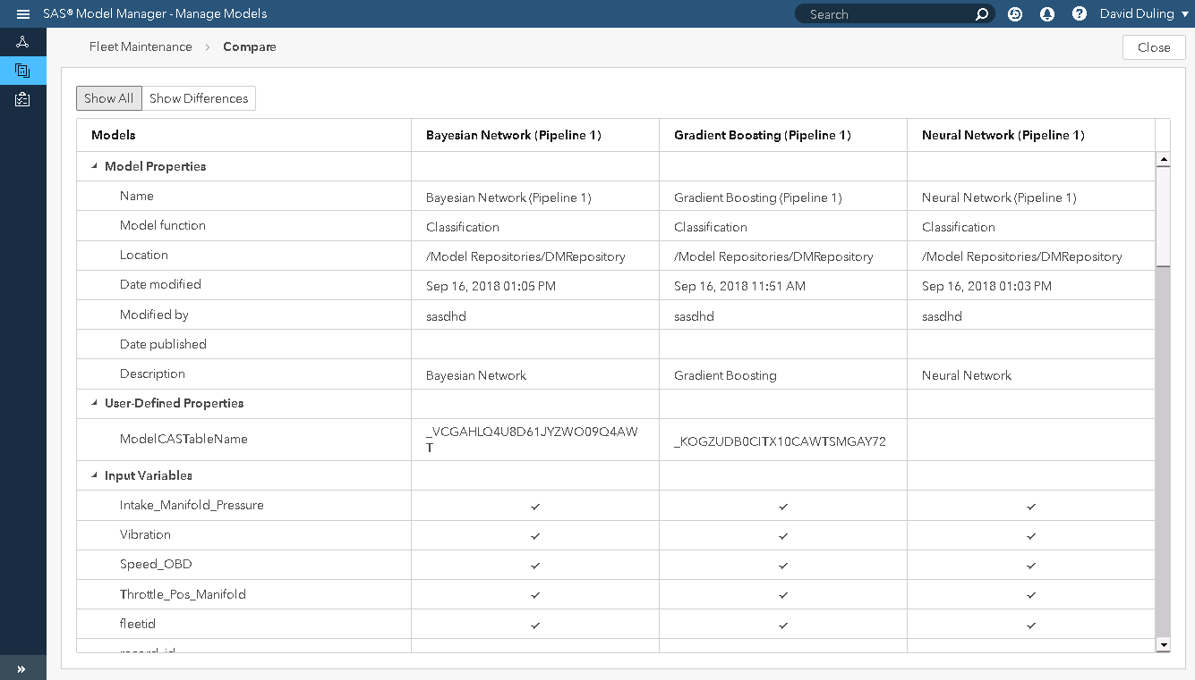
Compare model attributes
Does this look correct? Does it match data governance? Availability?

Slide 17
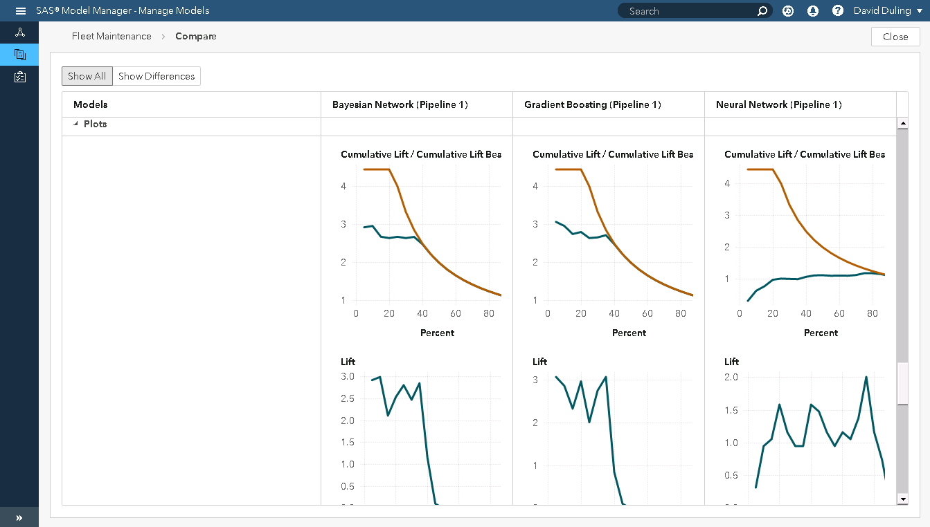
Compare model statistics
Does this predicted performance match expectations. Needs ?

Slide 18
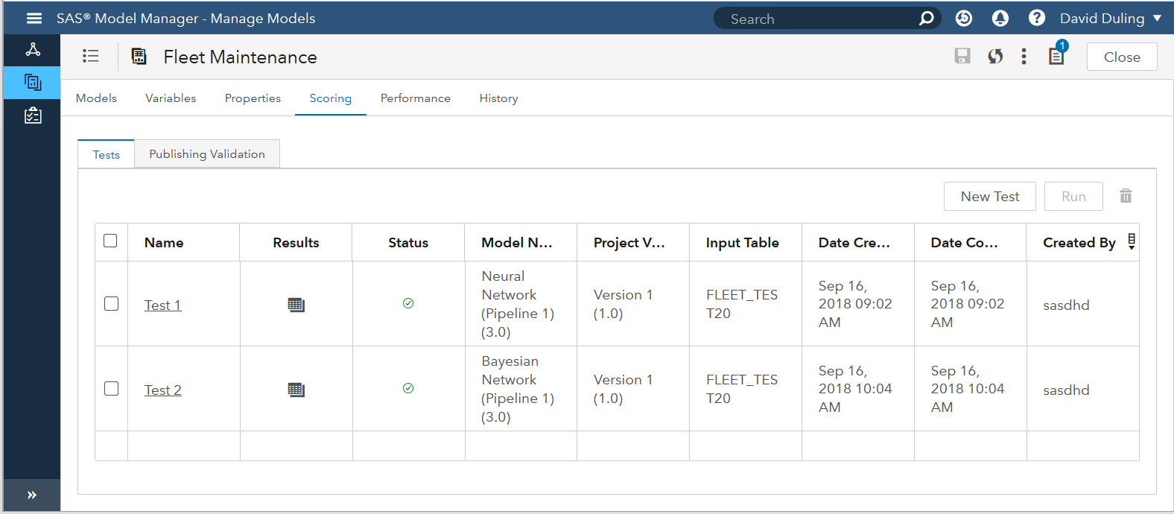
Test the models
Select data. Map Variables. Run code. Examine Results.

Slide 19
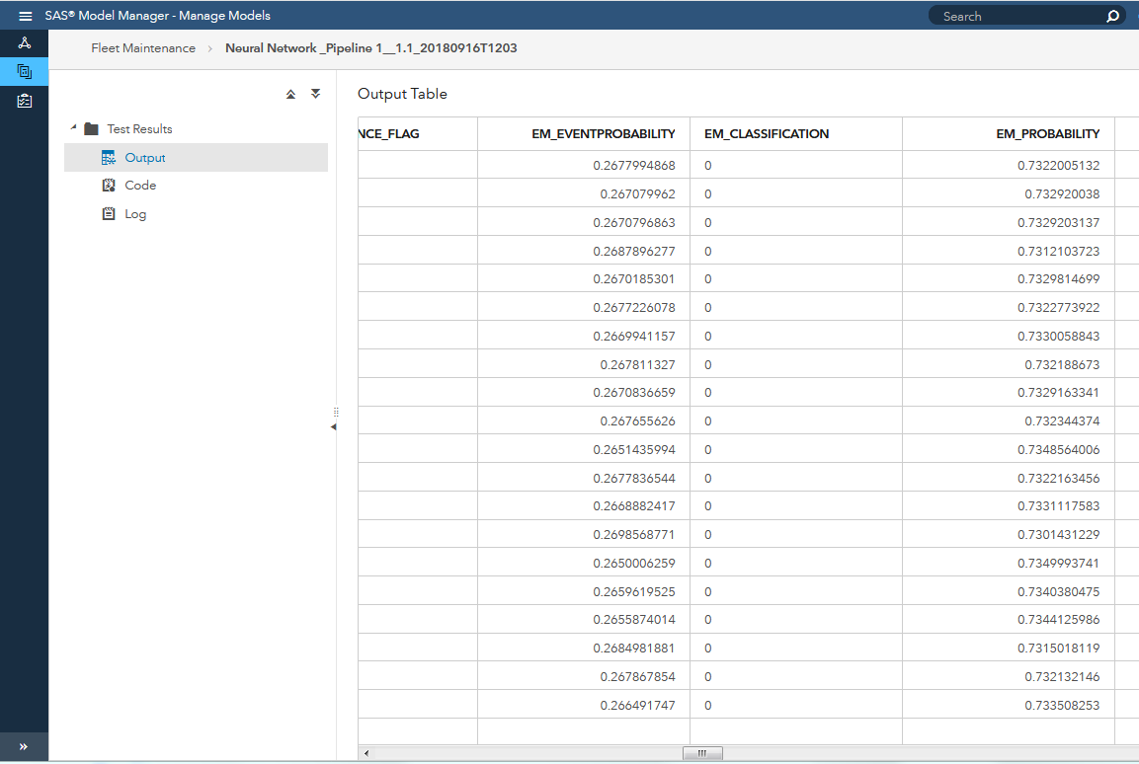
Examine the test results #1
Neural Network.
Notice the predictions are all “0”.
In this case half of them should be “1”.
This model fails the test.

Slide 20
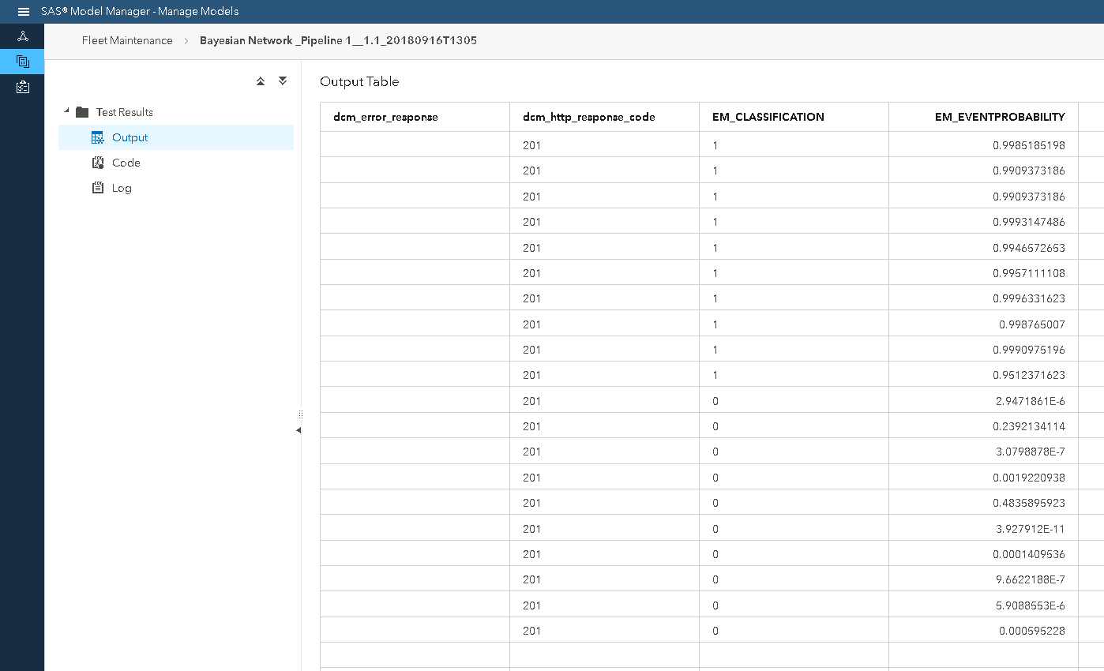
Examine the test results #2
Bayes Network.
Notice the predictions are expected values of “1” and “0”
This model passes the test.
Select this model for production.

Slide 21
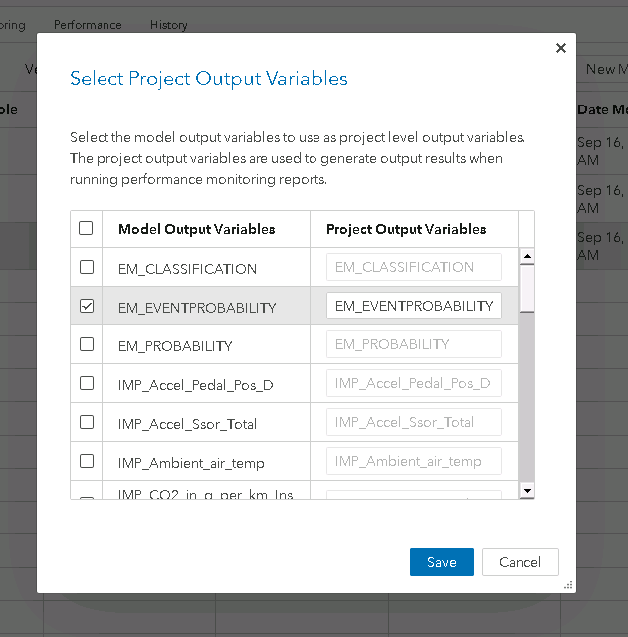
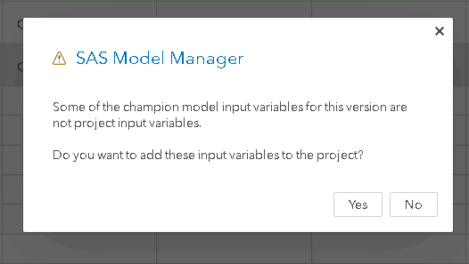
Select champion model
Bayes Network is our champion

Slide 22
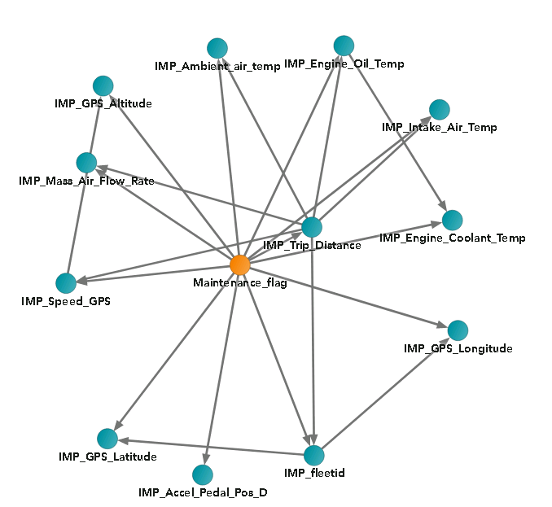
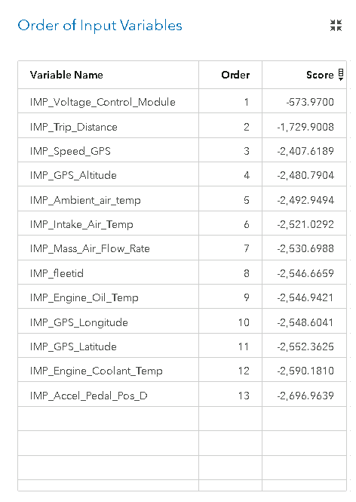
Bayes net – explainable is another reason to select it

Slide 23
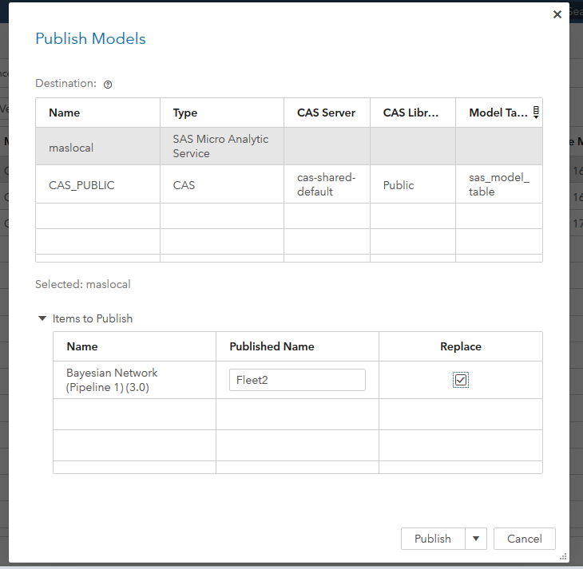
Publish model to run time servers
This will format and stage the code in the run time environment.
No need for model recoding or learning the details of the run time environments:
SAS servers
CAS servers
Web servers
Event Stream servers
Teradata
Hadoop

Slide 24
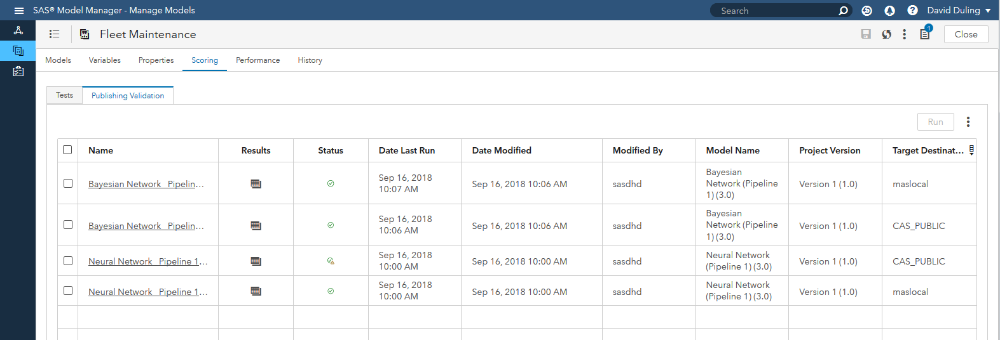
Now one more test in the run time system
Examine results of to make sure the model really performs correctly!

Slide 25

What happens next?
Model must be used by a decision making application
Business application must be developed to use the results of the model.
Read scores from an batch job output table.
Call the SAS web service to execute the scores.
Receive scores from Event Stream Processing
Write results to a shared database for performance monitoring

Slide 26

Section 3: Don’t Forget
When you get results from the business application….
Data monitoring
Model output monitoring
Accuracy models
Correlating with business performance
Targeted model retraining
Continuous model retraining

Slide 27
SAS Analytics Ecosystem
Dev – Test – Publish – Monitor - Improve
Off Line Analytic Development
SAS Visual Analytics
SAS VDMML
Analytic Execution
Analytical output
SAS Visual Statistics
SAS Visual Text Analytics
SAS Real time (MAS)
Results
Performance Data
Batch
In Database
In Hadoop
Performance results
SAS Cloud Analytic Server(CAS)
SAS Model Manager
Model Management and Monitoring
Publishing
Services
Analytical Models
Streaming

Slide 28
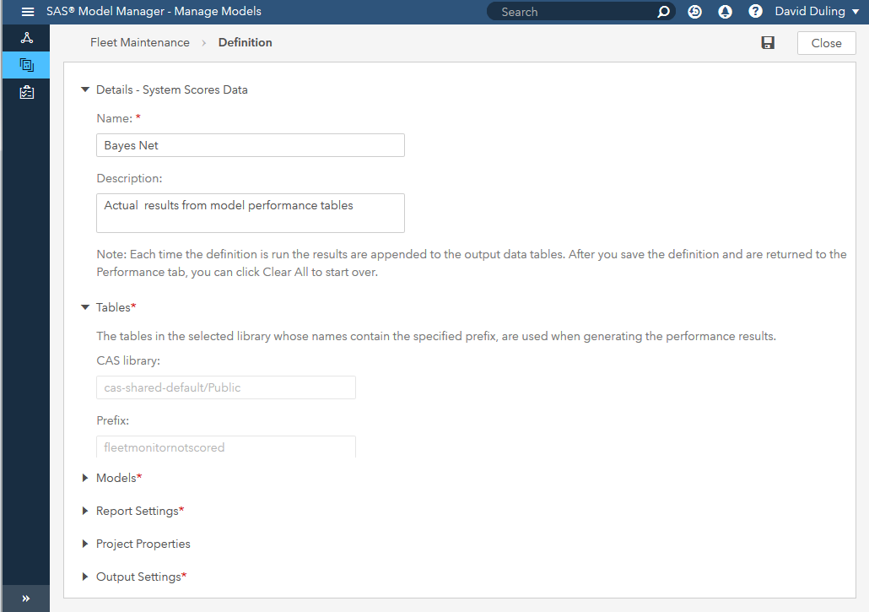
Build a job to examine run time performance
Use the data produced by the business. This will be the same data used to build new models.
Create this job to generate performance metrics that can be used in reports and dashboards.

Slide 29
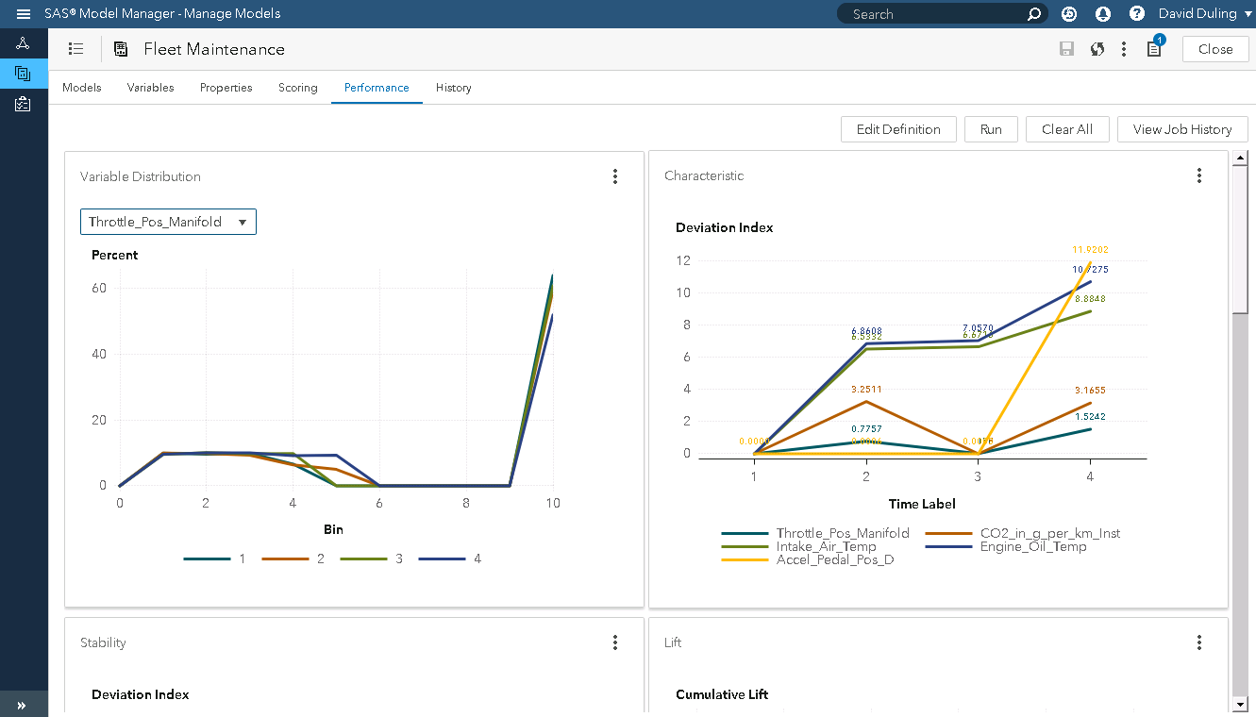
Performance job results. Data Monitoring

Slide 30
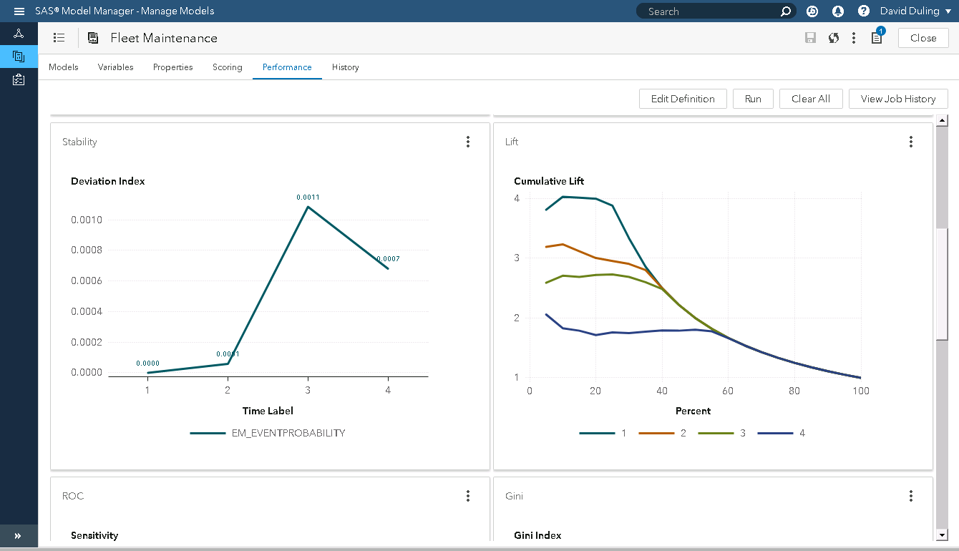
Performance job results: Prediction Monitoring

Slide 31
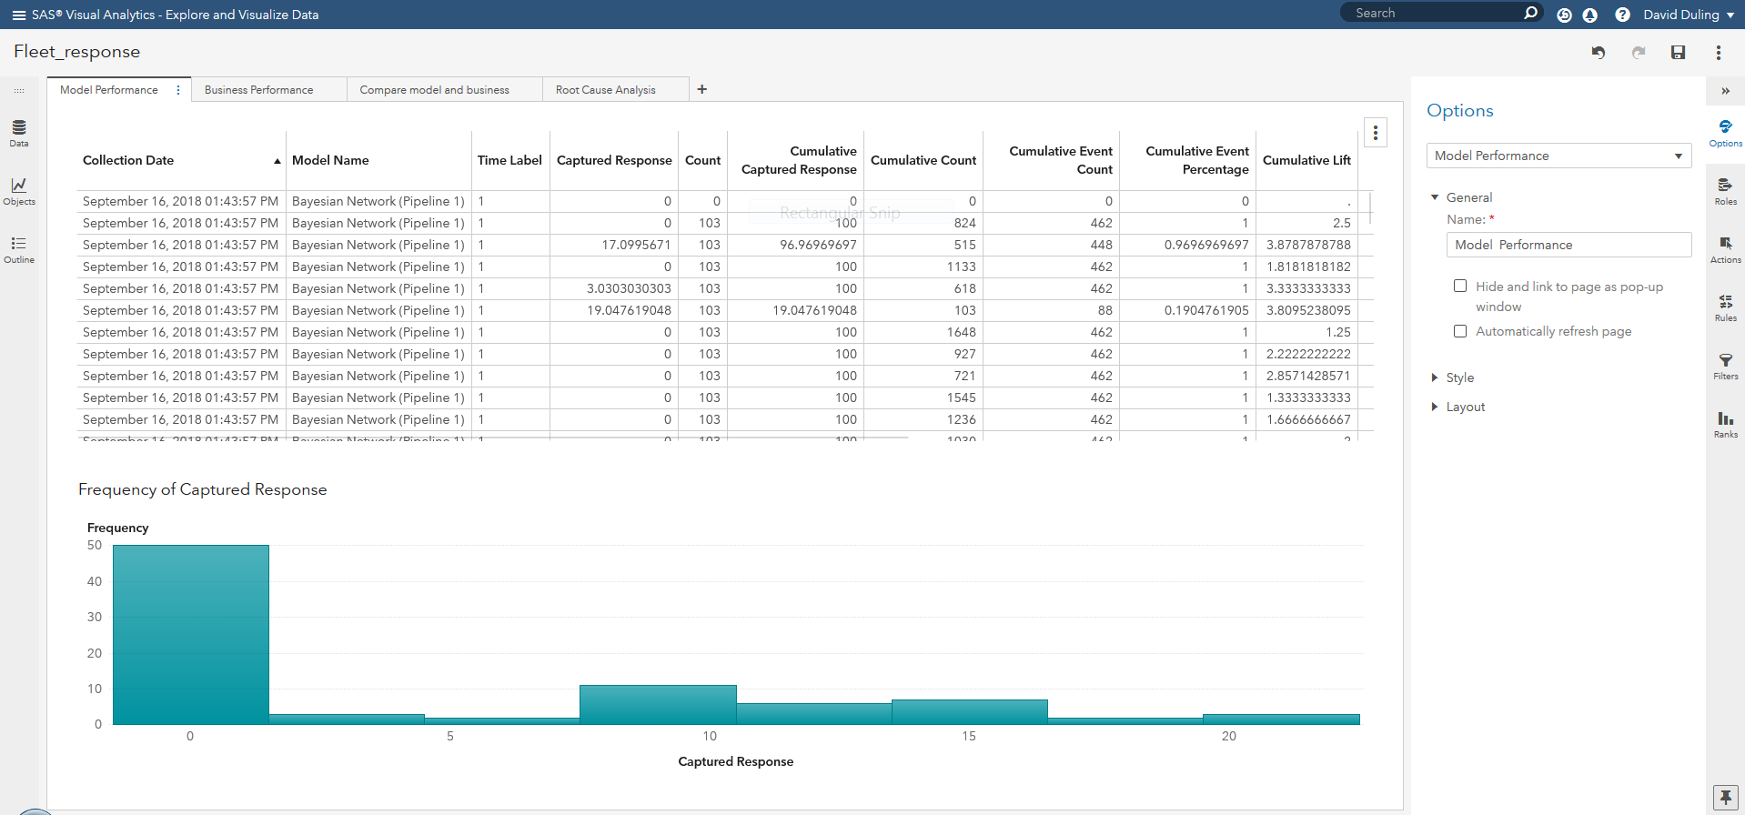
Load performance output for extra reporting
Actual data with predicted and actual maintenance events

Slide 32
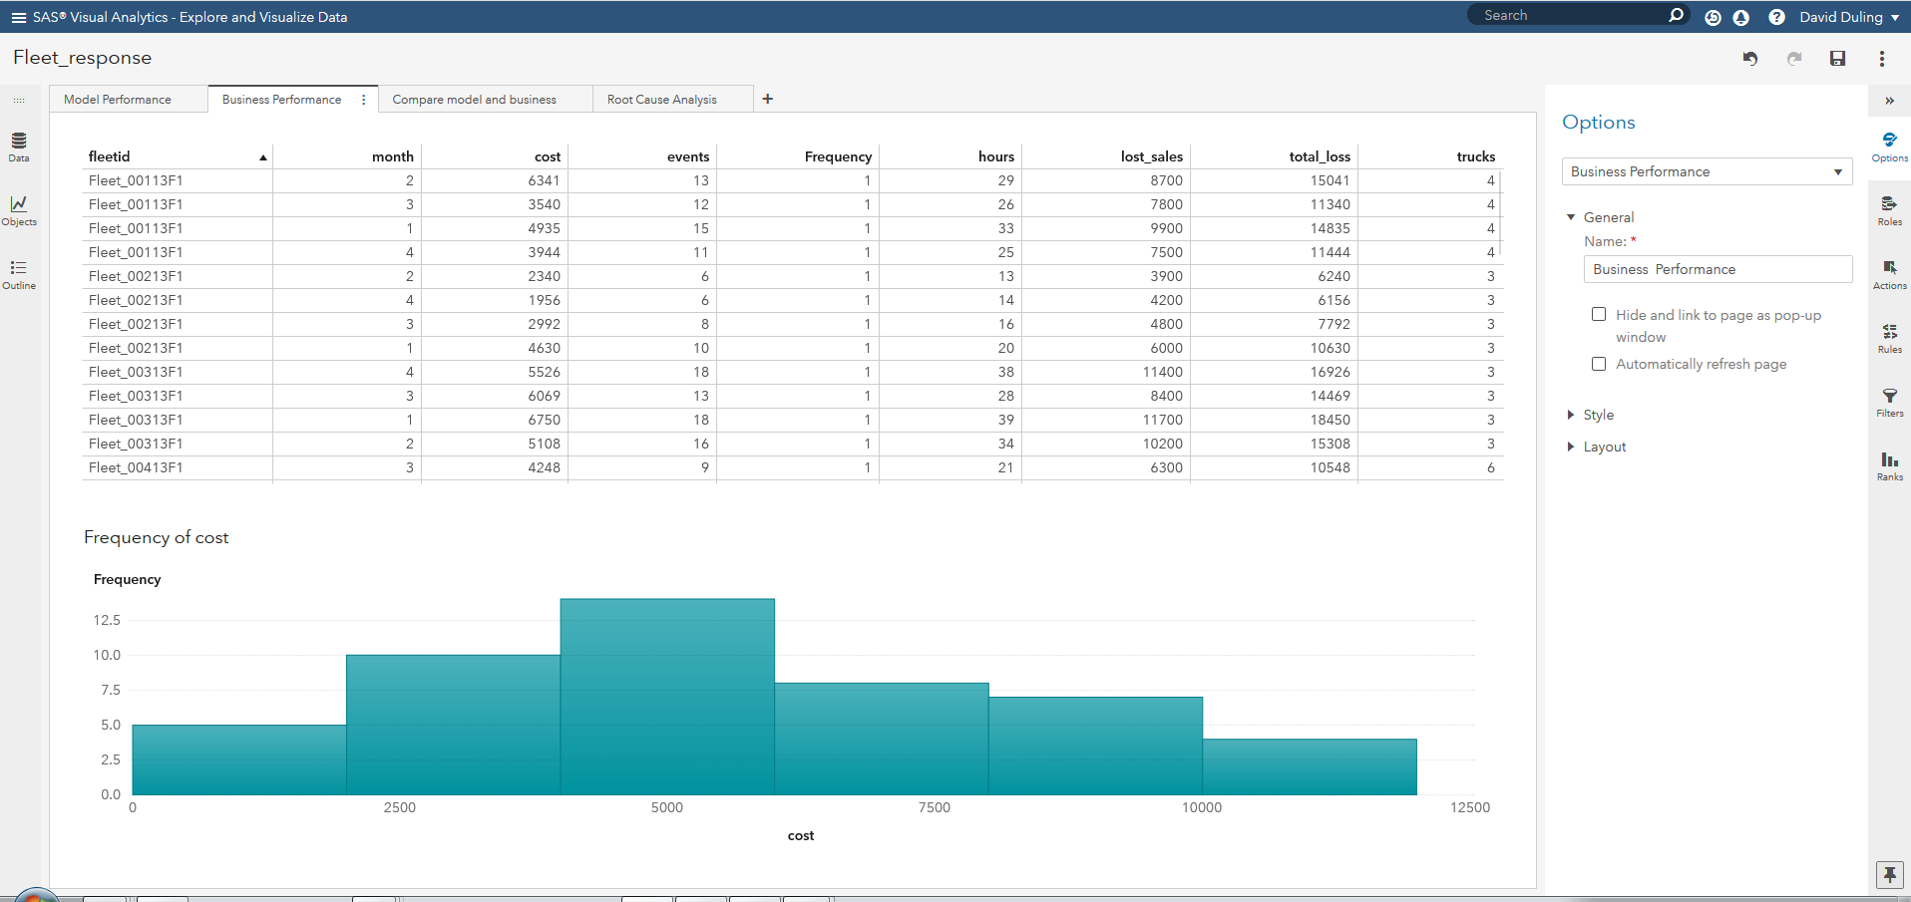
Load business data for extra reporting
Actual results from maintenance events in the repair shops.

Slide 33
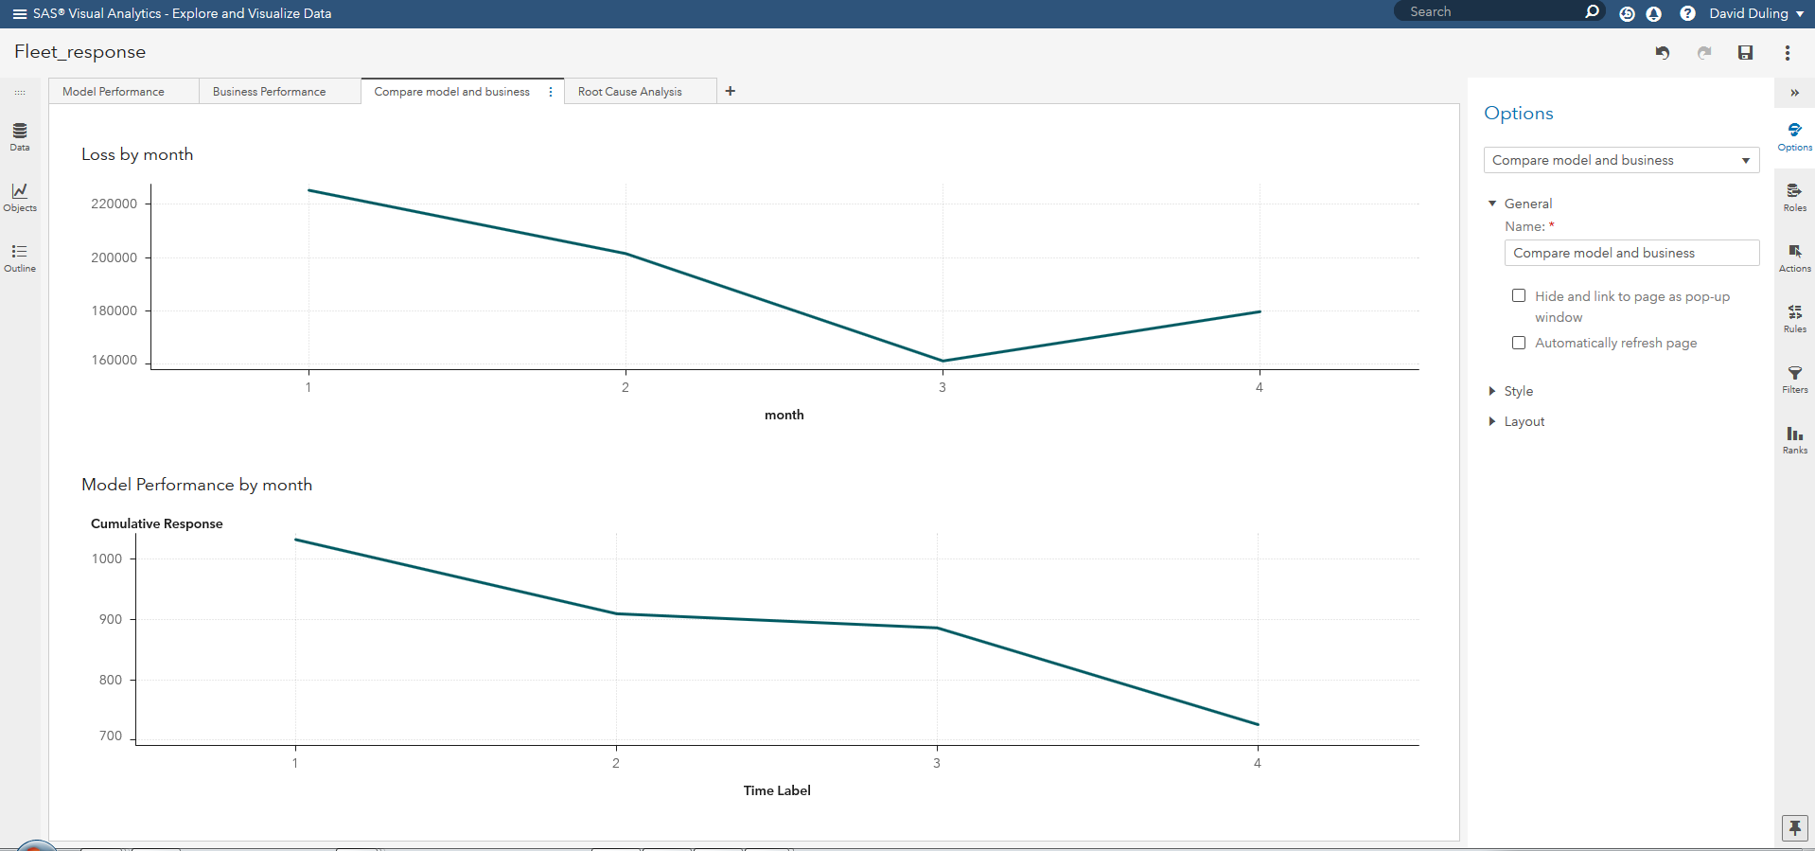
Compare model results with business results
Notice that costs go up when model performance goes down

Slide 34
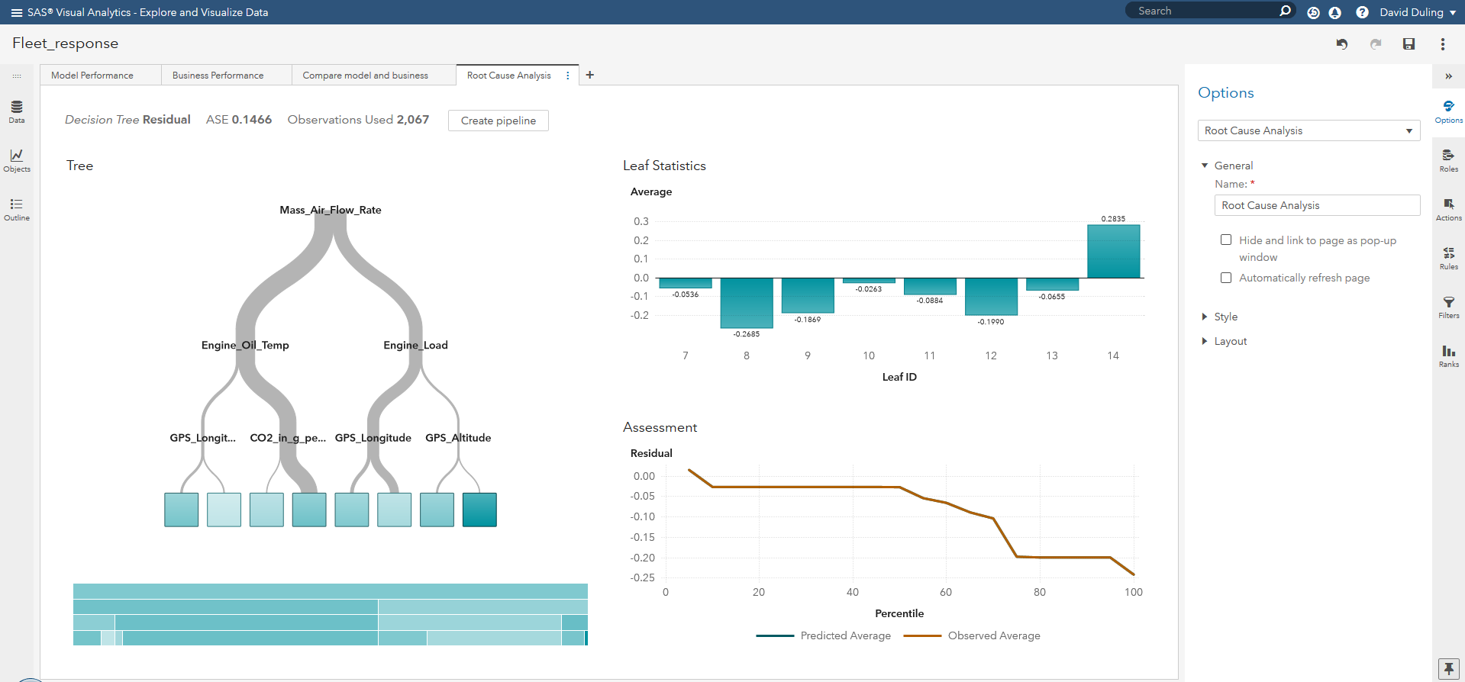
Root cause analysis by modeling the model residuals
Find effects that influenced model error in the last time period

Slide 35
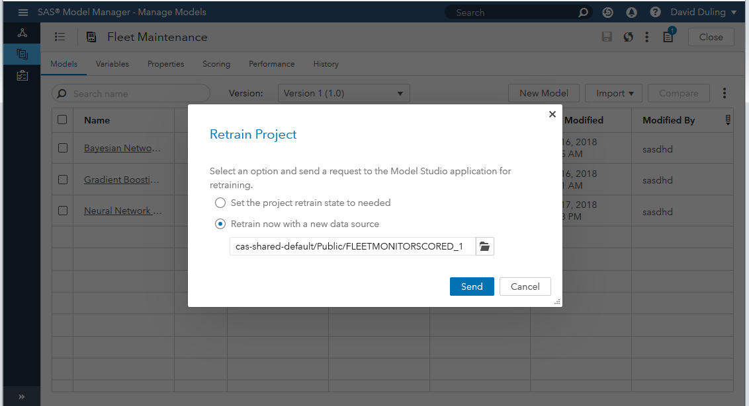
Retrain models on new data
Send request to the VDMML service to create new models

Slide 36
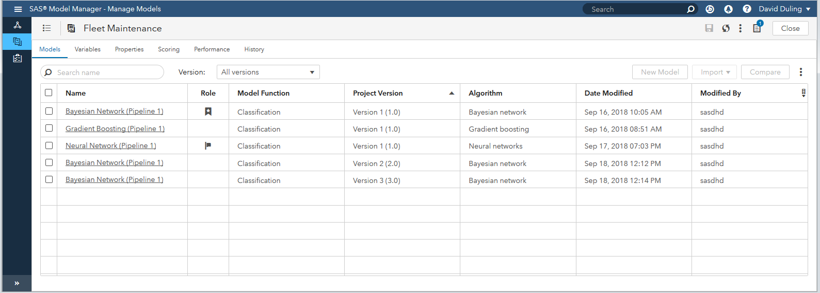
Retrain models show up as new versions
Only the champion model is returned.

Slide 37
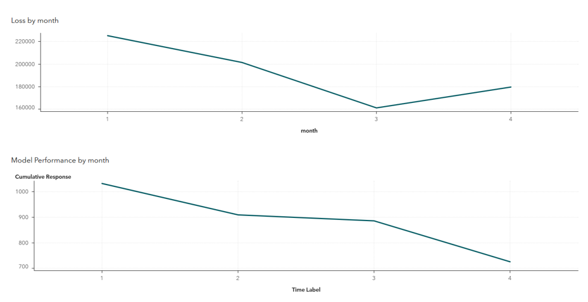
What do we want to happen (theoretical)
Model performance maintained ; business performance improves

Slide 38
Increase the frequency of retraining models
Model performance maintained ; business performance improves

Slide 39
Thank You
Discussion
Contact
Stephen Sparano
SAS Institute,
steve.sparano@sas.com
Dan Soceanu
SAS Institute,
dan.soceanu@sas.com

Slide 40
Questions?

