Slide 1
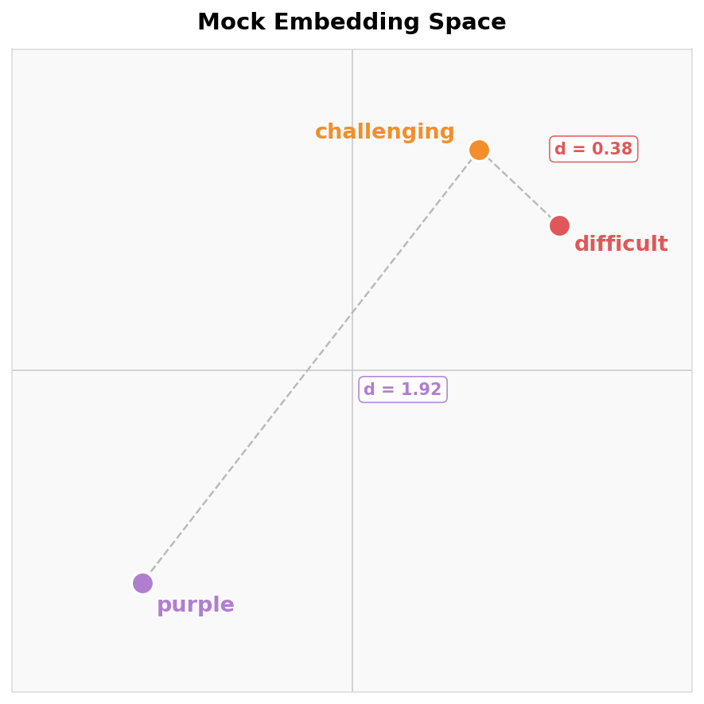
Overview of Method
Next-token prediction:
CE
Similarity
Ground Truth
This class is challenging
0
+ 0.0
Prediction A
This class is difficult
1
+ 0.38
Prediction B
This class is purple
1
+ 1.92
Our approach: reward similarity
Loss = CE + λ · embedding_similarity(gt, pred)
↑ our term

