Slide 1
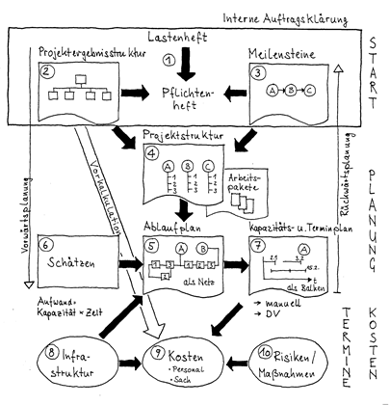
Project name
Concept Presentation
Picture of the Project
student 1, student 2, student 3…...
Darmstadt, dd.mm.yy

Slide 2
Content
  Scope and Requirememts
  System Architecture
  Risks
  Workpackages and Responsibilities
  Samples
  Quality and Test Strategy
  Conclusion
Project Management | Prof. Dr.-Ing. P. Fromm | University of Applied Sciences Darmstadt

Slide 3
Scope
In Scope
  Development of a PCB xyz
  Development of SW Component xyz
  Tests and Reviews
  Documentation
Out of Scope
  Component xyz will only be implemented as an example for further implementations
Specify the scope. Be specific.
Project Management | Prof. Dr.-Ing. P. Fromm | University of Applied Sciences Darmstadt

Slide 4
Requirements
Id | Description | Status
FR xyz | The system shall sniff the CANopen bus | Agreed
NFR xyz | New protocols shall be easily extended | New
 |  | Rejected
Identify the most relevant functional and non functional requirements. Add a link to the requirement specification.
Project Management | Prof. Dr.-Ing. P. Fromm | University of Applied Sciences Darmstadt

Slide 5
System Architecture
Add a block diagram identifying the most important HW and SW blocks as well as the interfaces to the environment.
Project Management | Prof. Dr.-Ing. P. Fromm | University of Applied Sciences Darmstadt

Slide 6
Risks
Id | Description | Severity | Propability | Mitigation
Describe the most prominent technical and organisational risks. Be specific!
Project Management | Prof. Dr.-Ing. P. Fromm | University of Applied Sciences Darmstadt

Slide 7
Workpackages and responsibilities
Id | Artifact | Developer | Reviewer/Tester
Based on the system architecture, describe who will be responsible for which artefact. The focus here are implementation units, not documents.
Project Management | Prof. Dr.-Ing. P. Fromm | University of Applied Sciences Darmstadt

Slide 8
Samples / Deliverables / Prototype
Id | Sample | Date | Content
Describe the Samples / Deliverables / Prototypes which will be developed during the project. Be specific for the content.
Project Management | Prof. Dr.-Ing. P. Fromm | University of Applied Sciences Darmstadt

Slide 9

Quality and Test Strategy
Describe your Q-strategy. Which reviews and tests do you plan. Provide a link to the review and test plan / status list.
Project Management | Prof. Dr.-Ing. P. Fromm | University of Applied Sciences Darmstadt

Slide 10
Summary / Conclusion / Next Steps
Provide a management summary and conclusion.
Project Management | Prof. Dr.-Ing. P. Fromm | University of Applied Sciences Darmstadt

