Slide 1



Transitioning to IEEE Standard
Streaming Telemetry Transport Protocol
P2664

Slide 2
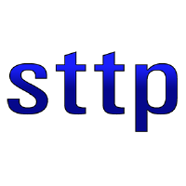
IEEE Updates
P2664
Atomic Measurement Packets
Reduced Data Loss
Lossless Compression
Scalability (to hardware limits)
Publish / Subscribe Model
Publisher Data Access Control
IP Level Security
Configurable Connection Origin

Slide 3
Changes Coming in the IEEE Standard
Added higher time precision options
Some commands simplified / key words changed / unused options dropped
Define Operational Modes now requires a publisher success response to accept proposed subscriber options. Options now include:
Custom compression algorithms selection for data packet, buffer block, signal index cache and metadata
Custom UDP cipher encryption algorithm selection
New commands:
Get Primary Metadata Schema
Get Signal Selection Metadata Schema
Confirm Update Cipher Keys
Suggested Metadata for synchrophasors has been improved / standardized.
Includes a recommended Publisher and Subscriber API

Slide 4


API Status
 | Subscriber | TSCC | Filter Expressions | Reverse Subscriber | Publisher | Reverse Publisher | TLS
GSF
C++
C# / C++ |  |  |  | SWIG Update Needed | SWIG Update Needed | SWIG Update Needed
Go
Python
C# Native | In progress
Rust | In progress
Java | In progress
V | In progress

