Slide 1
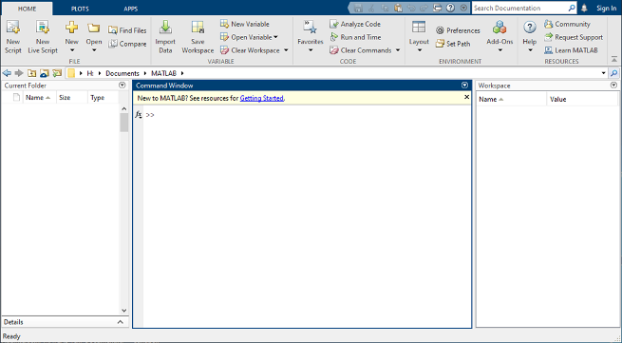



Matlab/Python interface
EasyProp

