Slide 1
DYSLEX-PROBE
Probing Cross-Lingual Lexical Representations in Multilingual Large Language Models for Low-Resource Dyslexia Screening
AUTHORS
SUPERVISOR
Ayesha Siddika 24341144
Nazmoon Nahar Aka 22101649
Dr. Farig Yousuf Sadeque
Mashrafi Rahman 24341197
Hasan Mohammad Sayem 22101116
Co-supervisor: Mr. Md. Tanzim Reza
PROGRAM
BRAC University
Dept. of CSE · CSE400 · June 2026
DysLex-Probe
01 / 15

Slide 2
MOTIVATION
Dyslexia is phonological, but Bangla has no screener
1
Dyslexia is a phonological-processing deficit. Clinical diagnosis depends on standardised, normed batteries (e.g. CTOPP-2) benchmarked against age and grade norms, and those norms exist for English, not Bangla. That absence is itself a barrier to identifying dyslexia in Bangla.
270M+
2
But multilingual LLMs are pretrained on Bangla and may already carry transferable, surface-independent phonological structure, the necessary precondition any screener would rely on.
Bangla speakers worldwide, with no validated, normed dyslexia screener for the language.
Can we read that phonological structure out in Bangla, without training a thing?
English is orthographically opaque, Bangla intermediate; a genuine phonological representation should transfer across that gap, while one that only captures surface statistics should not.
DysLex-Probe
02 / 15

Slide 3
GAP & QUESTIONS
No controlled cross-lingual probing study exists
Prior phonological probing is...
RQ1
How well does each model encode phonological structure in-language (English)?
·
English-centric, on masked encoders only.
·
Rarely controlled for surface features.
RQ2
Does that structure transfer zero-shot from English to Bangla?
·
No controlled four-model cross-lingual comparison.
RQ3
Where does the cross-lingual lexical signal live?
RQ4
Which model family is best, and for what use?
DysLex-Probe
03 / 15

Slide 4
LITERATURE REVIEW
Four strands touch the problem, none covers all six
Prior work spans cross-lingual transfer, phonological probing, dyslexia screening, and mechanistic interpretability. We score each strand on the six requirements this study needs to hold together.
Phono. structure
Cross-lingual transfer
Low-resource (Bangla)
Surface controls
Multiple architectures
Mechanistic account
(a) Cross-lingual transfer in multilingual LLMs
✕
✓
◐
✕
◐
✕
How representations align across languages
(b) Phonological / sub-lexical probing
✓
✕
✕
✓
◐
✕
Control-task critique pushed the field toward sanity checks
(c) Automated dyslexia screening
◐
✕
✓
✕
✕
✕
Low-resource reading resources and screeners
(d) Mechanistic interpretability
✕
◐
✕
✕
◐
✓
Locating circuits in multilingual models
DysLex-Probe (this work)
✓
✓
✓
✓
✓
✓
Sits at the intersection of all six
TAKEAWAY
Prior work covers pieces; none controls surface confounds across architectures in a low-resource language with a mechanism account.
DysLex-Probe
04 / 15

Slide 5
APPROACH
Four models map the design space
X axis: pretraining objective. Y axis: language coverage. Each card lists parameter scale and verdict.
LANGUAGE COVERAGE
Multilingual + Bangla
XLM-R
BLOOM
mT5
0.56B · masked encoder
7.1B · causal decoder
3.7B · enc-decoder
EFFICIENT
TRANSFER
INTERPRETABLE
Llama
8B · causal decoder
NOT RECOMMENDED
English-heavy
Masked encoder
Causal decoder
Span-corruption enc-dec
PRETRAINING OBJECTIVE
TAKEAWAY
Objective and language coverage, not scale, decide cross-lingual transfer.
DysLex-Probe
05 / 15

Slide 6
DATASET
An original bilingual stimulus set
Stimulus counts by category (English / Bangla)
220+ 220
Category
English
Bangla
Total
440
Minimal pair
60
60
120
stimulus items
Multisyllabic
30
30
60
English + Bangla
Pseudoword
25
25
50
Real word
25
25
50
Phoneme-grapheme
25
25
50
Rhyme
20
20
40
7
18
Sentence
15
15
30
phonological categories
metadata columns / item
Core total
200
200
400
+ Extended set
20
20
40
Combined total
220
220
440
Native-speaker validated Bangla.
Length-matched subset n = 50 / language (mean chars EN 6.88, BN 5.20).
Clinically grounded: Bangla items target documented dyslexia error patterns, voiced/unvoiced contrasts, conjuncts and matra (Badsha 2024).
DysLex-Probe
06 / 15

Slide 7
MODELS COMPARED
Four models, four pretraining recipes
XLM-R large
Llama 3.1 8B
BLOOM 7B1
mT5 XL
Architecture
Encoder-only
Decoder-only
Decoder-only
Encoder-decoder
Tokenizer
SentencePiece
BPE
BPE
SentencePiece
Languages
~100
Mostly English
46
101
Layers
24
32
30
24 (encoder)
Hidden size
1024
4096
4096
2048
Parameters
0.56B
8B
7.1B
3.7B (1.67B enc.)
Compute
|
Under 30 GPU-hours on one 24 GB consumer GPU; the 7-8B decoders run 4-bit quantized.
DysLex-Probe
07 / 15

Slide 8
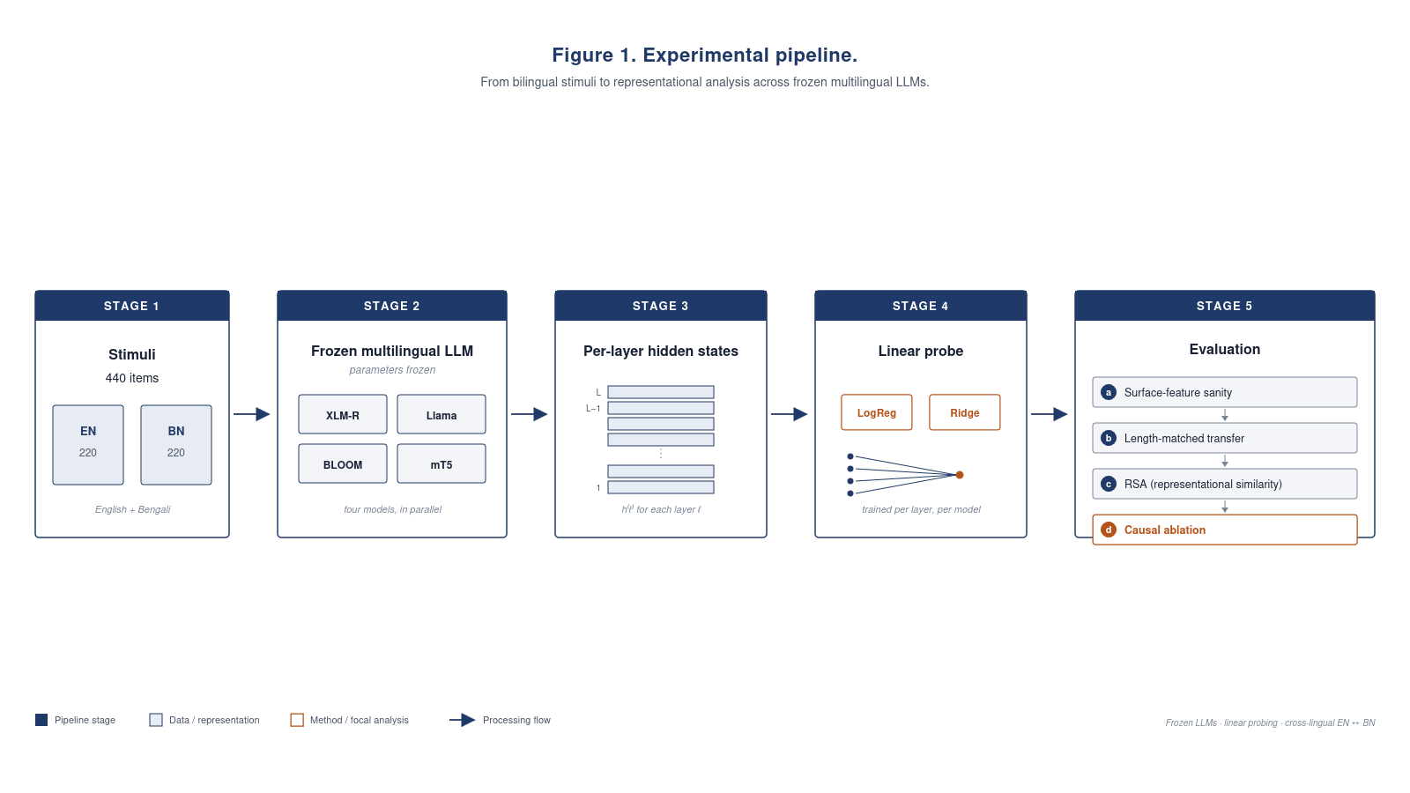
METHODOLOGY
A frozen-model probing pipeline
No fine-tuning, no weight updates. Every model stays frozen.
Pipeline: frozen LLM → per-layer hidden states → linear probe → sanity checks → transfer → RSA → ablation
FLOW
Frozen LLM
→
Per-layer hidden states
→
Linear probe
→
Sanity checks
→
Transfer
→
RSA
→
Ablation
DysLex-Probe
08 / 15

Slide 9
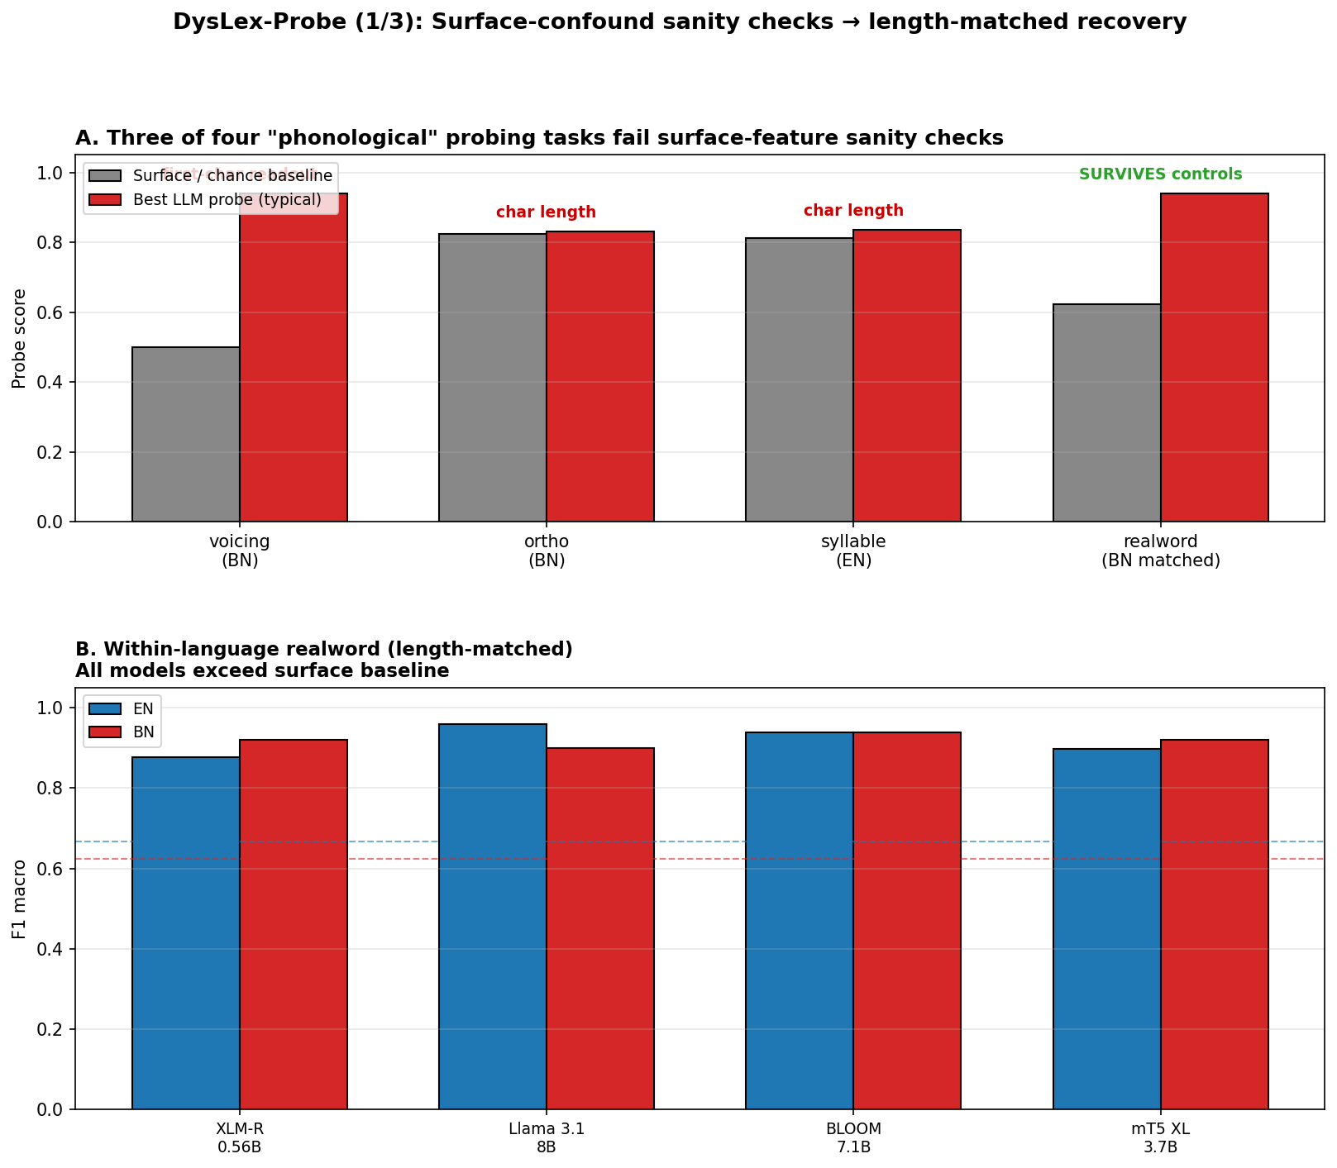
RQ1
· SANITY CHECKS
Most "phonological" tasks fail surface controls
✕
Voicing recoverable from the first character alone (100%)
✕
Orthographic transparency solved by character length
✕
Syllable count is length-confounded
✓
Length-matched real-vs-pseudo word survives the controls
Surface-confound sanity checks and length-matched recovery (panels A + B)
TAKEAWAY
3 of 4 "phonological" tasks fail surface controls; only length-matched real-word survives.
DysLex-Probe
09 / 15

Slide 10
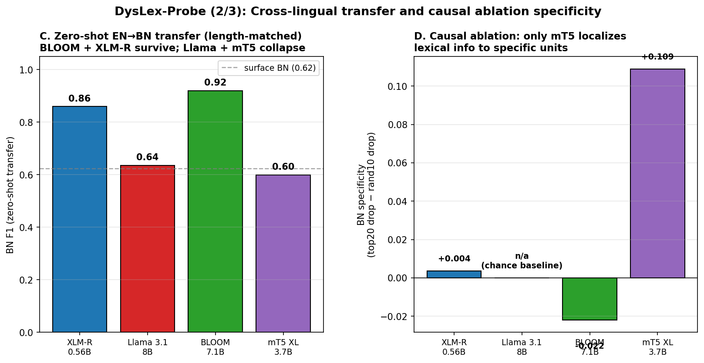
RQ2
· CROSS-LINGUAL TRANSFER
Zero-shot transfer splits the field in two
Length-matched Bangla F1 (gain over surface)
BLOOM
0.92 +0.30
XLM-R
0.86 +0.24
Llama
0.63 +0.01
mT5
0.60 -0.02
RSA independently confirms this split (no probing needed).
Zero-shot EN → BN transfer and causal-ablation specificity (panels C + D)
TAKEAWAY
BLOOM + XLM-R survive; Llama + mT5 collapse. Only mT5 localizes.
DysLex-Probe
10 / 15

Slide 11
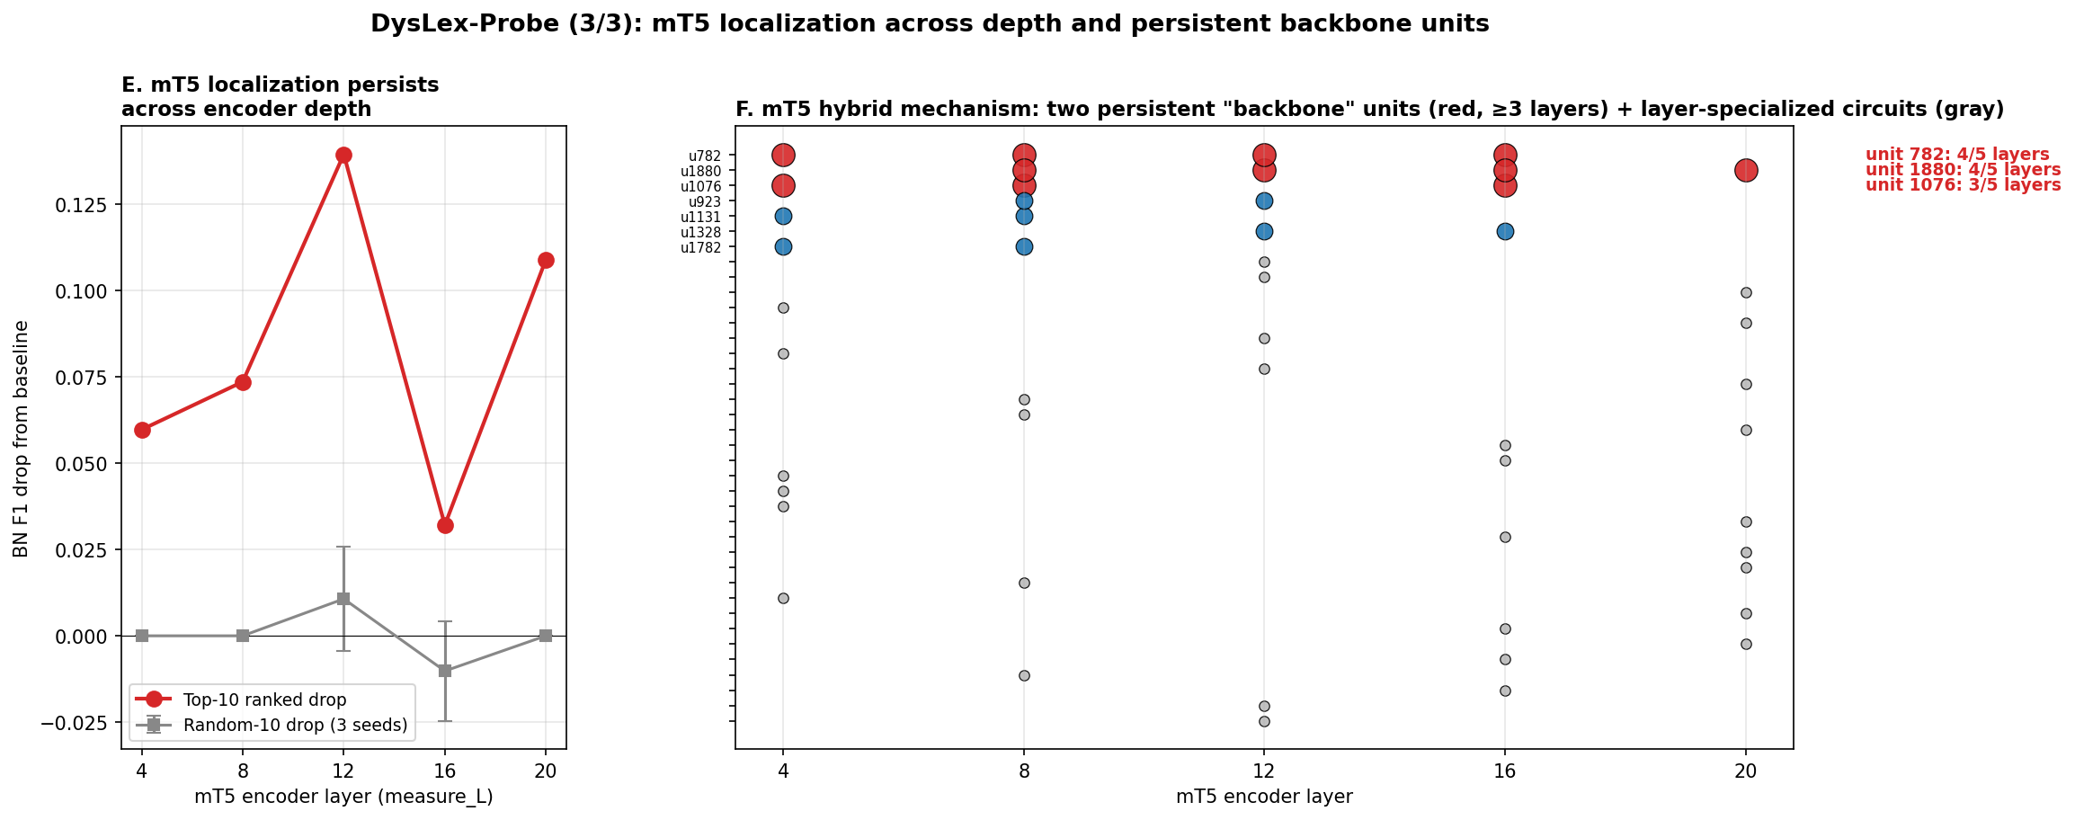
RQ3
· LOCALIZATION IN MT5
Only mT5 localizes the cross-lingual signal
Ablation specificity (top-20 drop minus random-10 drop)
+0.13
+0.11
layer 12
layer 20
Two persistent backbone units u782 & u1880 recur across encoder depth.
Others stay near chance:
XLM-R +0.004 BLOOM -0.022 Llama n/a
mT5 localization across depth + two persistent backbone units u782, u1880 (panels E + F)
TAKEAWAY
A hybrid mechanism: 2 persistent backbone units plus layer-specialized circuits.
DysLex-Probe
11 / 15

Slide 12
RQ4
· RECOMMENDATION
KEY INSIGHT
Pretraining recipe beats scale: 0.56B XLM-R beats 8B Llama cross-lingually.
BLOOM 7B1
mT5 XL
XLM-R large
Llama 3.1 8B
Practical low-resource Bangla screening prototype
Interpretability & mechanism studies
Hardware-constrained deployment (0.86 BN F1 at 0.56B)
Not recommended cross-lingually at the lexical level
DysLex-Probe
12 / 15

Slide 13
FUTURE WORK
Six directions, honest evaluation first
01
02
03
Native-clinician supervision
Stimulus expansion
Encoder-decoder confound
Build a supervised clinical pipeline (clinician stimulus selection, validation against an existing battery, longitudinal follow-up) before any use on children.
Grow the length-matched real-vs-pseudo set from n = 50 to n >= 500 matched pairs per language, stratified by syllable count and morphology.
Replicate the depth-scan ablation on ByT5, T5, and a T5-style model without span corruption to isolate what drives localization.
04
05
06
Backbone-unit mechanism
Language coverage
Clinical-task expansion
Probe what u782 and u1880 encode: stimulus-conditional firing, joint vs single ablation, sparse-autoencoder projection.
Extend beyond Bangla to Hindi, Tamil, Urdu, and Swahili to test whether the BLOOM transfer recipe generalizes.
Add surface-controlled probes for rapid automatized naming, non-word repetition, and rhyme detection (the fuller CTOPP-2 battery).
TAKEAWAY
Honest evaluation first: the sanity-check failure of 3 of 4 tasks tells the next study where the floor is.
DysLex-Probe
13 / 15

Slide 14
CONCLUSION
Four contributions, honestly bounded
1
Methodology. Surface-feature sanity checks (first-character lookup + length-matching) as a required precondition for phonological probing claims.
WHAT WE DO NOT CLAIM
2
Mechanism. Discovery of mT5's two-unit cross-lingual backbone.
·
Small subsets (n = 50 / lang): point estimates only
3
Dataset. An original, native-reviewed 440-item bilingual stimulus set.
·
One encoder-decoder probed: an architectural confound
4
Comparison. A controlled four-model study across the four canonical pretraining recipes.
·
A pre-clinical study, not a diagnostic tool
DysLex-Probe
14 / 15

Slide 15
Thank you.
Questions welcome.
DYSLEX-PROBE
CONTACT
Cross-lingual lexical probing for dyslexia screening
[Your Name · email · ID]
DysLex-Probe
15 / 15

