Slide 1
DYSLEX-PROBE
Probing Cross-Lingual Lexical Representations in Multilingual Large Language Models for Low-Resource Dyslexia Screening
AUTHORS
SUPERVISOR
Ayesha Siddika 24341144
Nazmoon Nahar Aka 22101649
Dr. Farig Yousuf Sadeque
Mashrafi Rahman 24341197
Hasan Mohammad Sayem 22101116
Co-supervisor: Mr. Md. Tanzim Reza
PROGRAM
BRAC University
Dept. of CSE · CSE400 · June 2026
DysLex-Probe
01 / 15

Slide 2
MOTIVATION
The screening gap in low-resource languages
Building a screener per language is expensive. But frozen multilingual LLMs may already carry the cross-lingual lexical structure such a tool needs.
270M+
Bangla speakers worldwide, with no widely deployed normative dyslexia screener.
Can we read that structure out without training a thing?
DysLex-Probe
02 / 15

Slide 3
GAP & QUESTIONS
No controlled cross-lingual probing study exists
Prior phonological probing is...
RQ1
How well does each model encode phonological structure in-language (English)?
·
English-centric, on masked encoders only.
·
Rarely controlled for surface features.
RQ2
Does that structure transfer zero-shot from English to Bangla?
·
No controlled four-model cross-lingual comparison.
RQ3
Where does the cross-lingual lexical signal live?
RQ4
Which model family is best, and for what use?
DysLex-Probe
03 / 15

Slide 4
LITERATURE REVIEW
Four strands touch the problem, none covers all six
Prior work spans cross-lingual transfer, phonological probing, dyslexia screening, and mechanistic interpretability. We score each strand on the six requirements this study needs to hold together.
Phono. structure
Cross-lingual transfer
Low-resource (Bangla)
Surface controls
Multiple architectures
Mechanistic account
(a) Cross-lingual transfer in multilingual LLMs
✕
✓
◐
✕
◐
✕
How representations align across languages
(b) Phonological / sub-lexical probing
✓
✕
✕
✓
◐
✕
Control-task critique pushed the field toward sanity checks
(c) Automated dyslexia screening
◐
✕
✓
✕
✕
✕
Low-resource reading resources and screeners
(d) Mechanistic interpretability
✕
◐
✕
✕
◐
✓
Locating circuits in multilingual models
DysLex-Probe (this work)
✓
✓
✓
✓
✓
✓
Sits at the intersection of all six
TAKEAWAY
Prior work covers pieces; none controls surface confounds across architectures in a low-resource language with a mechanism account.
DysLex-Probe
04 / 15

Slide 5
APPROACH
Four models map the design space
X axis: pretraining objective. Y axis: language coverage. Bubble size: parameter scale (0.56B to 8B). Badge: verdict.
LANGUAGE COVERAGE
Multilingual + Bangla
XLM-R
BLOOM
0.56B
7.1B
mT5
EFFICIENT
3.7B
TRANSFER
INTERPRETABLE
NOT RECOMMENDED
Llama
8B
English-heavy
Masked encoder
Causal decoder
Span-corruption enc-dec
PRETRAINING OBJECTIVE
TAKEAWAY
Objective and language coverage, not scale, decide cross-lingual transfer.
DysLex-Probe
05 / 15

Slide 6
DATASET
An original bilingual stimulus set
440
220+220
7
18
stimulus items
English + Bangla
phonological categories
metadata columns / item
Seven phonological task categories
Native-speaker validated Bangla.
Minimal pair
Multisyllabic
Pseudoword
Real word
Length-matched subset n = 50/lang mean chars: EN 6.88 · BN 5.20
Phoneme-grapheme
Rhyme
Sentence
DysLex-Probe
06 / 15

Slide 7
MODELS COMPARED
Four models, four pretraining recipes
XLM-R large
Llama 3.1 8B
BLOOM 7B1
mT5 XL
Architecture
Encoder-only
Decoder-only
Decoder-only
Encoder-decoder
Tokenizer
SentencePiece
BPE
BPE
SentencePiece
Languages
~100
Mostly English
46
101
Layers
24
32
30
24 (encoder)
Hidden size
1024
4096
4096
2048
Parameters
0.56B
8B
7.1B
3.7B (1.67B enc.)
Compute
|
Under 30 GPU-hours on one 24 GB consumer GPU; the 7-8B decoders run 4-bit quantized.
DysLex-Probe
07 / 15

Slide 8
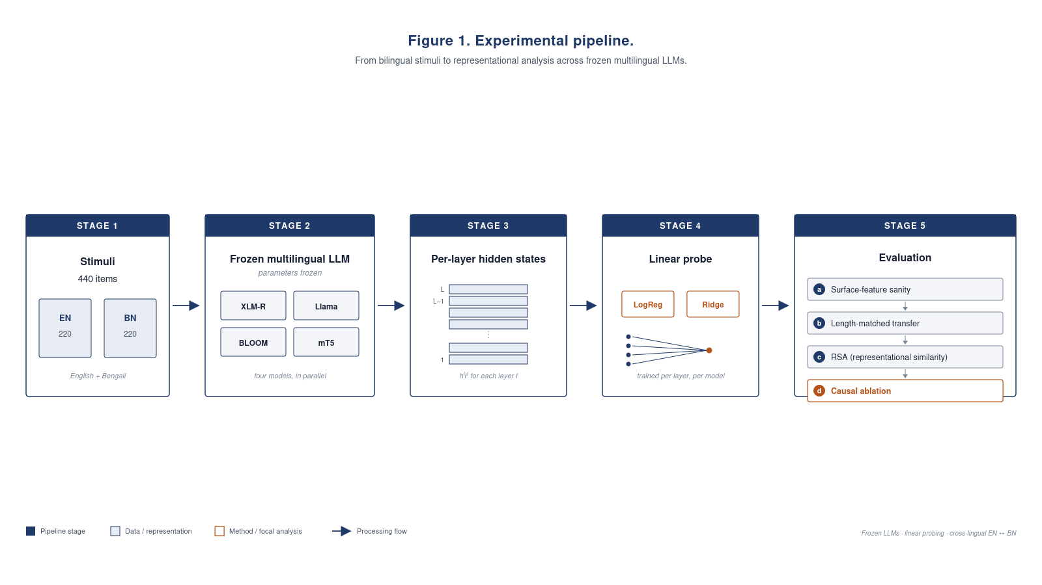
METHODOLOGY
A frozen-model probing pipeline
No fine-tuning, no weight updates. Every model stays frozen.
Pipeline: frozen LLM → per-layer hidden states → linear probe → sanity checks → transfer → RSA → ablation
FLOW
Frozen LLM
→
Per-layer hidden states
→
Linear probe
→
Sanity checks
→
Transfer
→
RSA
→
Ablation
DysLex-Probe
08 / 15

Slide 9
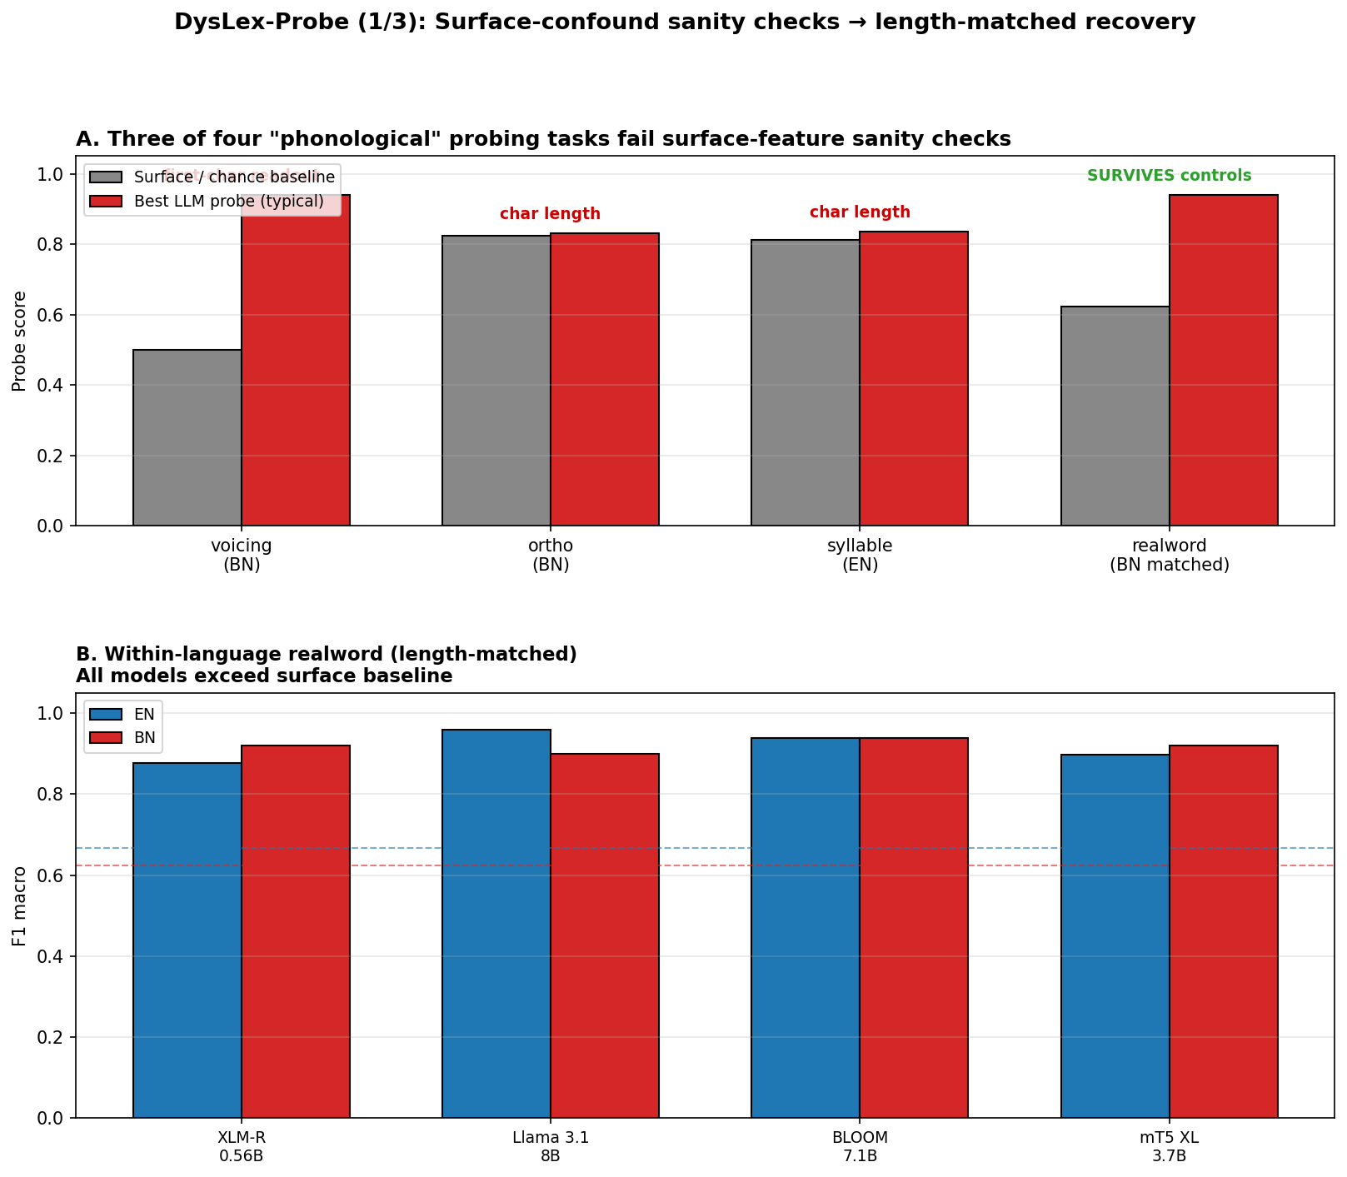
RQ1
· SANITY CHECKS
Most "phonological" tasks fail surface controls
✕
Voicing recoverable from the first character alone (100%)
✕
Orthographic transparency solved by character length
✕
Syllable count is length-confounded
✓
Length-matched real-vs-pseudo word survives the controls
Surface-confound sanity checks and length-matched recovery (panels A + B)
TAKEAWAY
3 of 4 "phonological" tasks fail surface controls; only length-matched real-word survives.
DysLex-Probe
09 / 15

Slide 10
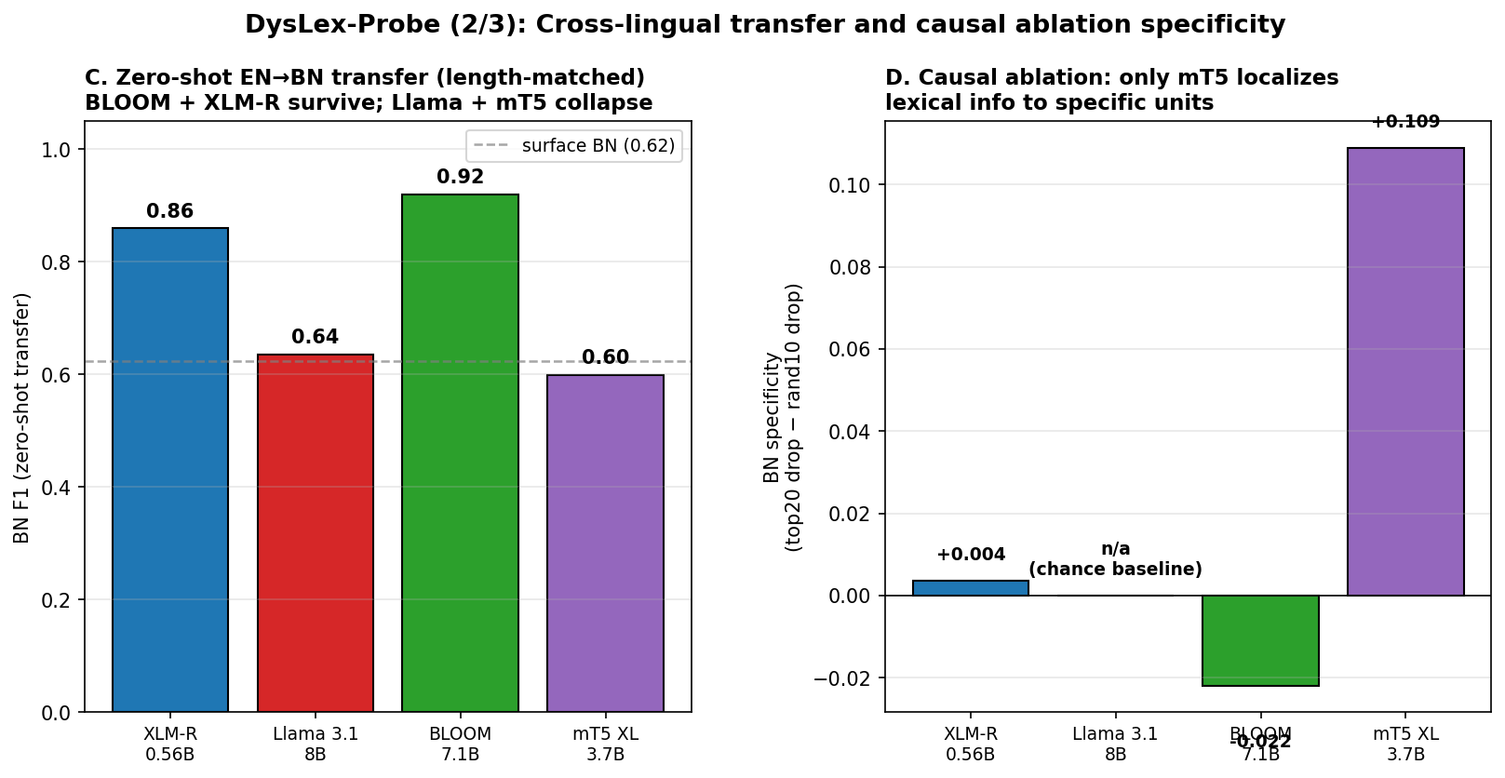
RQ2
· CROSS-LINGUAL TRANSFER
Zero-shot transfer splits the field in two
Length-matched Bangla F1 (gain over surface)
BLOOM
0.92 +0.30
XLM-R
0.86 +0.24
Llama
0.63 +0.01
mT5
0.60 -0.02
RSA independently confirms this split (no probing needed).
Zero-shot EN → BN transfer and causal-ablation specificity (panels C + D)
TAKEAWAY
BLOOM + XLM-R survive; Llama + mT5 collapse. Only mT5 localizes.
DysLex-Probe
10 / 15

Slide 11
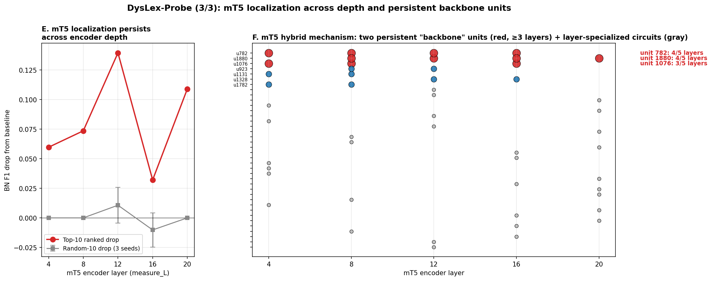
RQ3
· LOCALIZATION IN MT5
Only mT5 localizes the cross-lingual signal
Ablation specificity (top-20 drop minus random-10 drop)
+0.13
+0.11
layer 12
layer 20
Two persistent backbone units u782 & u1880 recur across encoder depth.
Others stay near chance:
XLM-R +0.004 BLOOM -0.022 Llama n/a
mT5 localization across depth + two persistent backbone units u782, u1880 (panels E + F)
TAKEAWAY
A hybrid mechanism: 2 persistent backbone units plus layer-specialized circuits.
DysLex-Probe
11 / 15

Slide 12
RQ4
· RECOMMENDATION
KEY INSIGHT
Pretraining recipe beats scale: 0.56B XLM-R beats 8B Llama cross-lingually.
BLOOM 7B1
mT5 XL
XLM-R large
Llama 3.1 8B
Practical low-resource Bangla screening prototype
Interpretability & mechanism studies
Hardware-constrained deployment (0.86 BN F1 at 0.56B)
Not recommended cross-lingually at the lexical level
DysLex-Probe
12 / 15

Slide 13
FUTURE WORK
Six directions, honest evaluation first
01
02
03
Native-clinician supervision
Stimulus expansion
Encoder-decoder confound
Build a supervised clinical pipeline (clinician stimulus selection, validation against an existing battery, longitudinal follow-up) before any use on children.
Grow the length-matched real-vs-pseudo set from n = 50 to n >= 500 matched pairs per language, stratified by syllable count and morphology.
Replicate the depth-scan ablation on ByT5, T5, and a T5-style model without span corruption to isolate what drives localization.
04
05
06
Backbone-unit mechanism
Language coverage
Clinical-task expansion
Probe what u782 and u1880 encode: stimulus-conditional firing, joint vs single ablation, sparse-autoencoder projection.
Extend beyond Bangla to Hindi, Tamil, Urdu, and Swahili to test whether the BLOOM transfer recipe generalizes.
Add surface-controlled probes for rapid automatized naming, non-word repetition, and rhyme detection (the fuller CTOPP-2 battery).
TAKEAWAY
Honest evaluation first: the sanity-check failure of 3 of 4 tasks tells the next study where the floor is.
DysLex-Probe
13 / 15

Slide 14
CONCLUSION
Four contributions, honestly bounded
1
Methodology. Surface-feature sanity checks (first-character lookup + length-matching) as a required precondition for phonological probing claims.
WHAT WE DO NOT CLAIM
2
Mechanism. Discovery of mT5's two-unit cross-lingual backbone.
·
Small subsets (n = 50 / lang): point estimates only
3
Dataset. An original, native-reviewed 440-item bilingual stimulus set.
·
One encoder-decoder probed: an architectural confound
4
Comparison. A controlled four-model study across the four canonical pretraining recipes.
·
A pre-clinical study, not a diagnostic tool
DysLex-Probe
14 / 15

Slide 15
Thank you.
Questions welcome.
DYSLEX-PROBE
CONTACT
Cross-lingual lexical probing for dyslexia screening
[Your Name · email · ID]
DysLex-Probe
15 / 15

