Slide 1
BRAC UNIVERSITY · CSE400 THESIS · 2026
Probing Cross-Lingual Lexical Representations
in Multilingual Large Language Models
for Low-Resource Dyslexia Screening
AUTHORS
SUPERVISOR
Ayesha Siddika 24341144
Miss Nazmoon Nahar Aka 22101649
Mashrafi Rahman 24341197
Hasan Mohammad Sayem 22101116
Dr. Farig Yousuf Sadeque
Assistant Professor, CSE, BRAC University
CO-SUPERVISOR
Mr. Md. Tanzim Reza
Lecturer, CSE, BRAC University
MAY 2026

Slide 2
WHY THIS THESIS
Dyslexia screening has a low-resource problem
Developmental dyslexia affects 5 to 12 % of school-age children depending on language and orthography.
Clinical screening relies on language-specific phonological batteries (CTOPP-2, etc.) administered by trained clinicians.
Bangla (270 M+ speakers) has no widely deployed normative screener and no consensus diagnostic battery.
Suspected cases are flagged late, or not at all.
Multilingual LLMs already encode rich cross-lingual structure as a by-product of pretraining.
If this structure transfers from English to Bangla, one substrate could anchor many low-resource screeners.
270 M+
Bangla speakers worldwide
with no normative dyslexia screener
0
validated automated screeners
exist for Bangla today
DysLex-Probe · BRAC University CSE400 · 2026
2 / 16

Slide 3
WHAT WE ASK
Four research questions
RQ1
In-language encoding
RQ2
Cross-lingual transfer
Can a frozen multilingual LLM linearly encode phonological and lexical features in English, and at which layers do they emerge?
Does that encoding transfer zero-shot from English to Bangla after surface-feature controls (first-character, character-statistic, length-matched)?
RQ3
Mechanism and localisation
RQ4
Model selection
Is the cross-lingual signal distributed across hidden units or causally localised to a small subset, and does the subset persist across encoder depth?
Which combination of pretraining objective and language coverage best supports surface-controlled cross-lingual lexical transfer at consumer-GPU scale?
DysLex-Probe · BRAC University CSE400 · 2026
3 / 16

Slide 4
WHAT WE PROBE
Four multilingual LLMs span the four pretraining recipes
XLM-R large
Llama 3.1 8B
BLOOM 7B1
mT5 XL
0.56 B params
Encoder-only
MLM
Coverage
100 langs · Bangla explicit
Role here
Smallest model · tests if objective beats scale
8 B params
Decoder-only
Causal LM
Coverage
English-heavy · Bangla minimal
Role here
Largest model · tests if scale alone gives transfer
7.1 B params
Decoder-only
Causal LM
Coverage
46 langs · Bangla in ROOTS
Role here
Multilingual decoder · pairs cleanly with Llama
3.7 B (1.67 B encoder)
Encoder-decoder
Span corruption
Coverage
101 langs · Bangla explicit
Role here
Only encoder-decoder · only model that localises
DysLex-Probe · BRAC University CSE400 · 2026
4 / 16

Slide 5
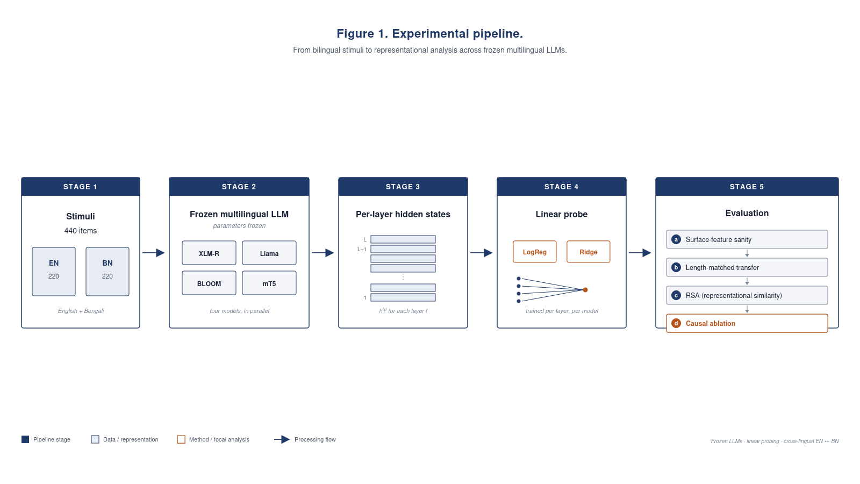
HOW WE PROBE THEM
End-to-end pipeline
Same pipeline for all four models
440 stimuli (EN + BN) feed each frozen LLM.
Per-layer hidden states extracted and mean-pooled.
A linear probe (LogReg / Ridge) trained per layer per task.
Surface-feature sanity checks gate every claim.
RSA and causal forward-hook ablation finish the picture.
DysLex-Probe · BRAC University CSE400 · 2026
5 / 16

Slide 6
WHAT WE FEED THEM
440-stimulus dataset, native-verified
440
Seven task categories
Minimal pair 120 · Multisyllabic 60 · Pseudoword 50
Real word 50 · Phoneme-grapheme 50 · Rhyme 40 · Sentence 30
stimuli · 220 EN + 220 BN
Bangla voicing pairs (from Badsha 2024)
7 categories · 18 metadata columns
ক / গ
প / ব
ত / দ
ট / ড
চ / জ
CLINICALLY GROUNDED
Badsha (2024)
U. Dhaka Master's dissertation; published in IJFMR vol. 6, no. 3.
Documented difficulty patterns of 5 dyslexic Bangla-speaking primary-school children.
k / g
p / b
t / d
ṭ / ḍ
c / j
Voiced vs Unvoiced stop contrasts — the core of the minimal-pair category.
Bangla items inspected by a native speaker for orthographic validity. Pseudowords re-checked to remove accidental real words.
DysLex-Probe · BRAC University CSE400 · 2026
6 / 16

Slide 7
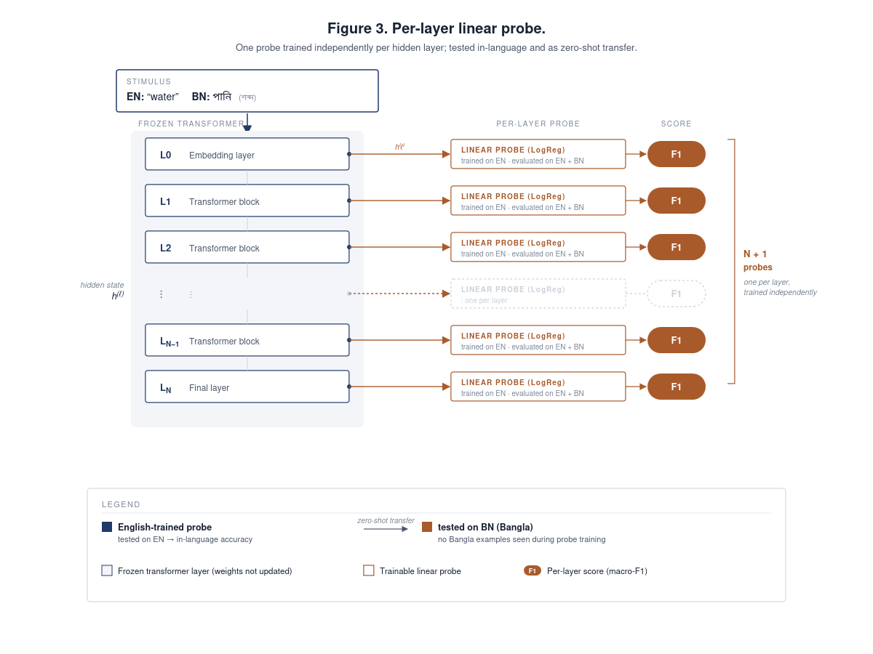
METHOD 1 OF 2
Per-layer linear probing
Frozen model — no fine-tuning.
One linear probe per layer per task.
L2-regularised LogReg (classification) or Ridge (regression).
English-trained probe tested twice: held-out EN and zero-shot BN.
Reports peak layer + 5-fold CV.
DysLex-Probe · BRAC University CSE400 · 2026
7 / 16

Slide 8
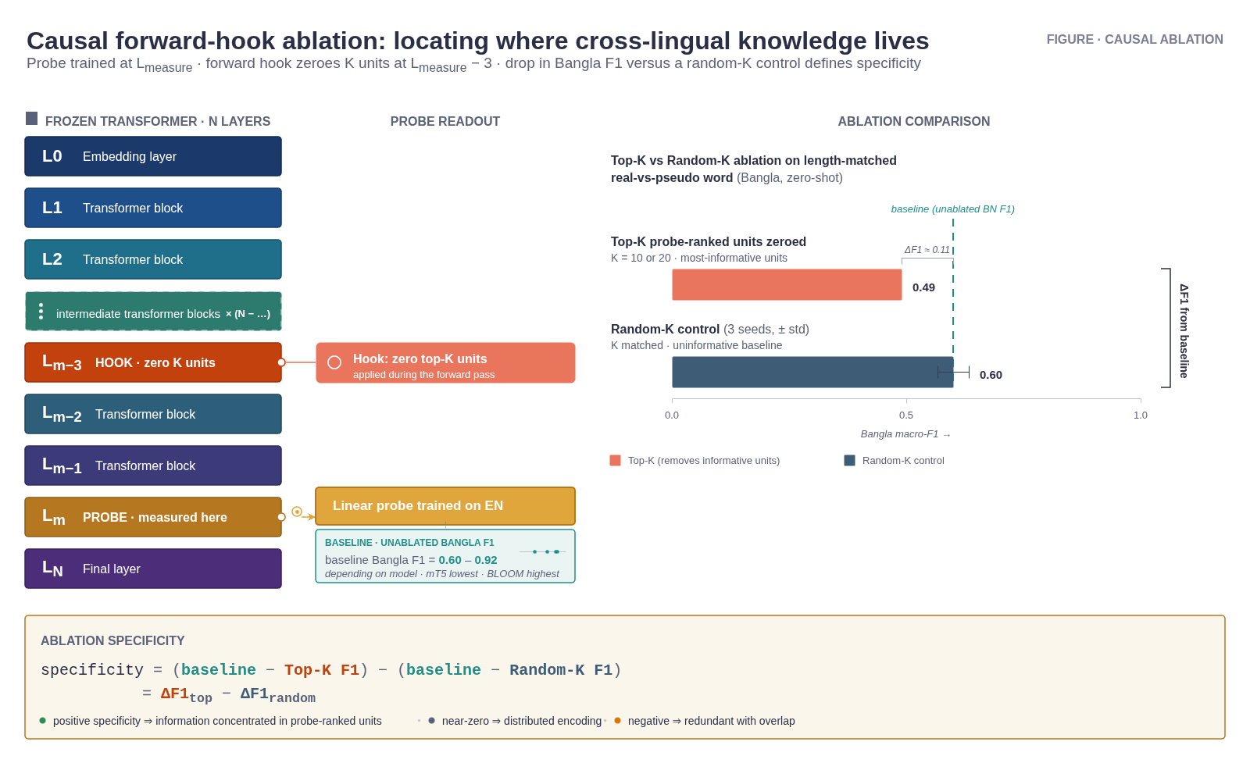
METHOD 2 OF 2
Causal forward-hook ablation
Where does the signal actually live?
Train probe at L_measure.
Forward hook 3 layers earlier zeroes K units.
Compare top-K (probe-ranked) vs random-K (3 seeds).
Specificity = ΔF1_top − ΔF1_random.
DysLex-Probe · BRAC University CSE400 · 2026
8 / 16

Slide 9
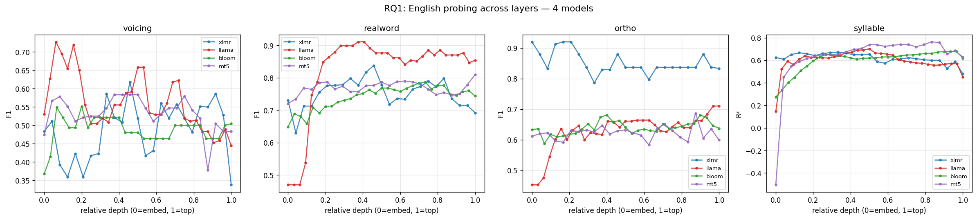
RQ1 RESULT
In-language English probing across 4 models
Peak per-task F1 / R²
Task | Range
voicing | 0.55 – 0.73
realword | 0.79 – 0.91
ortho | 0.68 – 0.92
syllable | 0.67 – 0.76
Apparent signal on every task
but do not read these numbers yet — three of the four are surface artefacts.
DysLex-Probe · BRAC University CSE400 · 2026
9 / 16

Slide 10
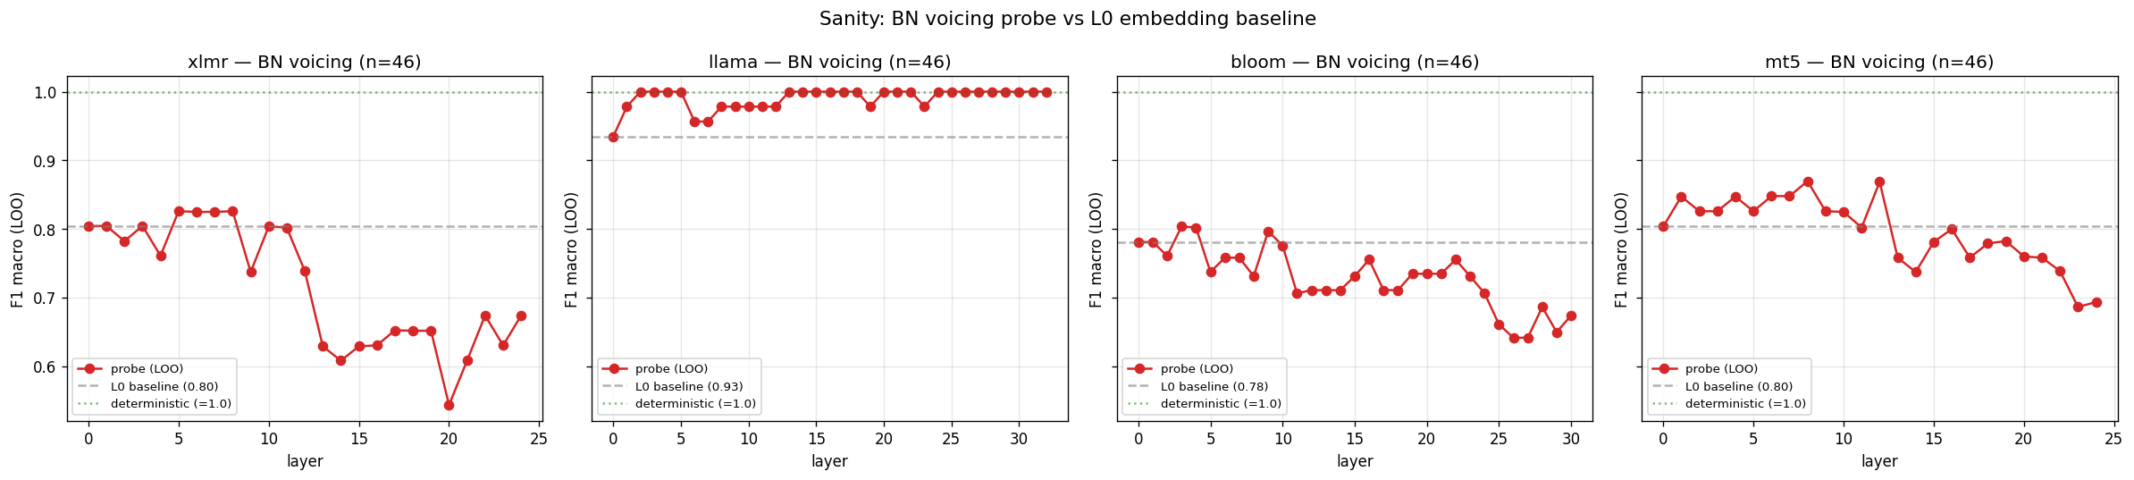
HEADLINE METHODOLOGY FINDING
3 of 4 tasks fail surface-feature sanity checks
Bangla voicing = first character
LOO probe at L0 recovers BN voicing at F1 0.78 – 0.94 across all four models.
Deterministic upper bound = 1.00. The probe is reading letter identity, not voicing.
Ortho and syllable probes do not beat a 5-feature character-statistic baseline.
Only real-vs-pseudo word survives, after 1:1 length matching.
DysLex-Probe · BRAC University CSE400 · 2026
10 / 16

Slide 11
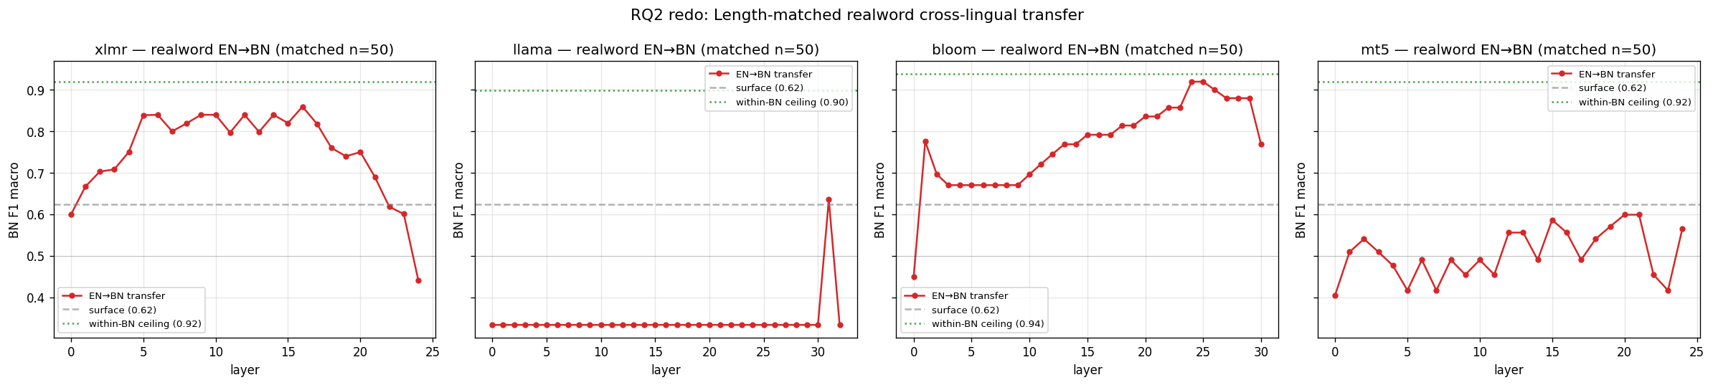
RQ2 RESULT · THE HEADLINE NUMBER
Length-matched cross-lingual transfer
BLOOM 7B1
0.92
+0.30
real transfer
BN F1 gain
XLM-R large
0.86
+0.24
real transfer
BN F1 gain
Llama 3.1 8B
0.63
+0.01
collapsed to surface
BN F1 gain
mT5 XL
0.60
−0.02
collapsed below surface
BN F1 gain
DysLex-Probe · BRAC University CSE400 · 2026
11 / 16

Slide 12
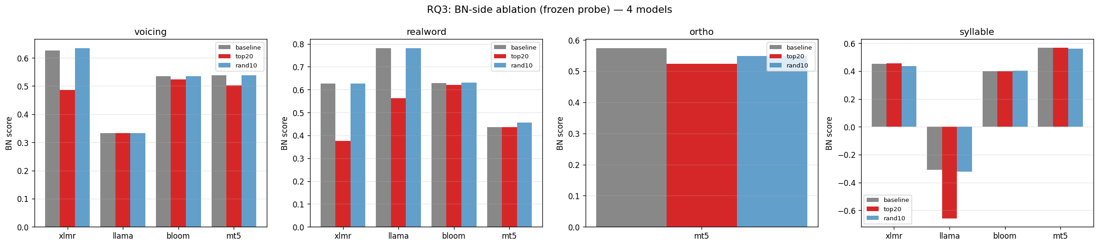
RQ3 RESULT
Causal ablation — only mT5 localises
Ablation specificity
Model | Specificity
XLM-R | +0.004
Llama | n/a (chance)
BLOOM | −0.02
mT5 | +0.11
mT5 alone shows clean specificity.
XLM-R and BLOOM distribute the signal across many units.
Llama has no BN transfer to disrupt.
DysLex-Probe · BRAC University CSE400 · 2026
12 / 16

Slide 13
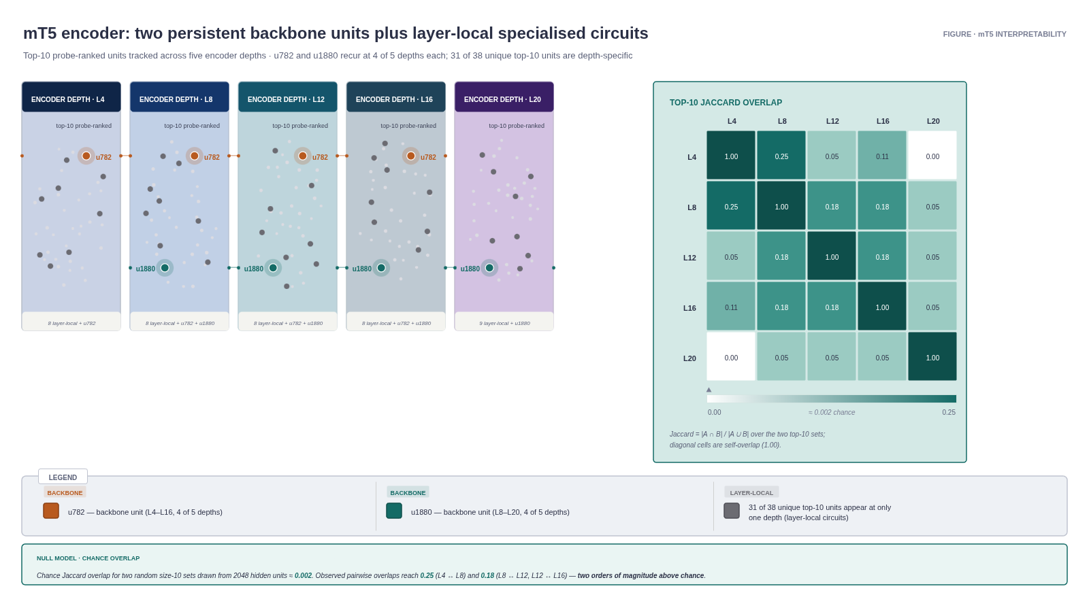
RQ3 EXTENSION
mT5 has a two-unit backbone across encoder depth
u782
Top-10 at L4 · L8 · L12 · L16
Absent at L20.
Backbone unit
u1880
Top-10 at L8 · L12 · L16 · L20
Absent at L4.
Backbone unit
DysLex-Probe · BRAC University CSE400 · 2026
13 / 16

Slide 14
RQ4 · PAIRED RECOMMENDATION
Four models, four different roles
USE
BLOOM 7B1
Highest cross-lingual transfer (0.92 BN F1). Survives surface controls. Frozen feature extractor — no fine-tuning needed.
Practical low-resource Bangla screening
USE
mT5 XL
Only model whose cross-lingual signal localises. Two-unit backbone (u782, u1880) makes mechanism recoverable.
Interpretability and mechanism studies
USE IF SMALL
XLM-R large
0.86 BN F1 at 0.56 B parameters. Runs in 16-bit on a single consumer GPU. 13× smaller than BLOOM.
Hardware-constrained deployments
AVOID
Llama 3.1 8B
Length-matched transfer collapses (0.63 BN F1, +0.01 over surface). Pretraining language coverage matters more than scale.
Any cross-lingual Bangla setting at lexical level
DysLex-Probe · BRAC University CSE400 · 2026
14 / 16

Slide 15
HONEST LIMITATIONS · WHAT COMES NEXT
Limitations and future work
LIMITATIONS
FUTURE WORK
Small length-matched subset (n = 50 per language). Point estimates only.
Original BN voicing labels unusable — recoverable from first character.
EN baseline = 1.00 after matching; only BN drop is interpretable in ablation.
mT5 is the only encoder-decoder probed — objective vs split confound open.
BLOOM specificity marginally negative (−0.02) — distributed redundancy, reported honestly.
Clinician-supervised pipeline before any contact with children.
Expand to 500+ matched pairs per language, stratified.
Probe ByT5 and T5 to resolve the encoder-decoder confound.
Mechanism follow-up on u782 and u1880 (paired ablation, SAE projection).
Extend the BLOOM recipe to Hindi, Tamil, Urdu, Swahili.
DysLex-Probe · BRAC University CSE400 · 2026
15 / 16

Slide 16
Thank you
Questions & Discussion
BLOOM 0.92 · XLM-R 0.86 · Llama 0.63 · mT5 0.60
mT5 backbone units: u782 and u1880
DysLex-Probe · BRAC University CSE400 · 2026

