Slide 1
Predictive Maintenance + MLOps
Part 1: ML Foundations and Baseline System
Part 2: Shippable MVP
Part 3: Model Improvement and Production Thinking
Part 4: Portfolio Presentation and Final Polish

Slide 2
Part 1: ML Foundations and Baseline System
Phase 1.1: Project Framing and Problem Definition
  Define the prediction problem
  Define the prediction unit
  Define the target
  Define success metrics
  Identify practical constraints and leakage risks

Slide 3
Phase 1.1: Project Framing and Problem Definition
Question #1: What problem is this project solving, and why did you frame it as remaining-useful-life regression rather than failure classification?

Slide 4
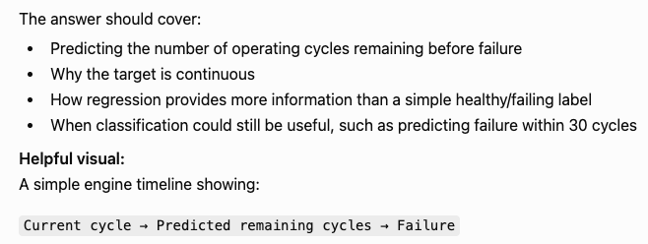

Slide 5
Phase 1.1: Project Framing and Problem Definition
Answer #1: This project is solving the problem of predicting RUL given an engine’s current cycle and historical sensor data. I chose to frame it as predicting RUL instead of failure classification because the goal could be described as “time remaining until failure.” Time is a continuous rather than discreet variable, so this problem lends itself to regression rather than classification. Framing this as a regression problem allows for precise predictions about how far away failure is, rather than just saying “healthy” or “kind of healthy” or “close to failure.” It’s worth noting that classification could still be useful in this situation, such as discerning that there are less than 30 cycles until failure and classifying an engine as “in need of preventative maintenance.”

Slide 6
What problem is this project solving, and why did you frame it as remaining-useful-life regression rather than failure classification?
This project predicts an engine’s remaining useful life from its current cycle and available sensor history. The purpose is to support predictive maintenance by estimating how much operating life remains before failure, which can help avoid both unexpected breakdowns and unnecessarily early maintenance.
I formulated it as a regression problem because RUL is a numeric, ordered quantity. Although the C-MAPPS target is measured in whole cycles, the distance between predictions matters: predicting 10 remaining cycles is meaningfully different from predicting 80. Regression preserves that information and provide a more granular estimate than assigning the engine to broad categories such as healthy, warning, or critical.
Classification could still be useful as a downstream decision layer. For example, the predicted RUL could be converted into a maintenance alert when it falls below 30 cycles. But regression gives the system more flexibility because different users can apply different maintenance thresholds to the same prediction.

Slide 7
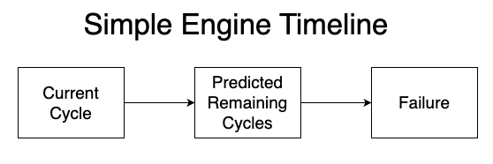
What problem is this project solving, and why did you frame it as remaining-useful-life regression rather than failure classification?

Slide 8
Phase 1.1: Project Framing and Problem Definition
Question #2: What does one row in the training data represent, and what information should the model be allowed to use when making a prediction?

Slide 9
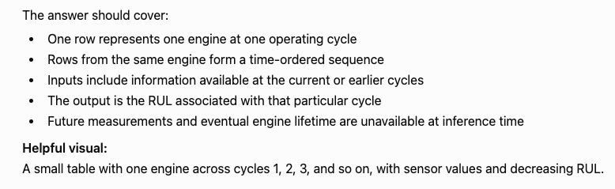

Slide 10
Phase 1.1: Project Framing and Problem Definition
Answer #2: One row in the training data represents all of an engine’s available information at one operating cycle. This includes cycle number, sensor readings, and other bits of data. Rows associated with the same engine form a time-ordered sequence. This leads to being able map inputs in the form of information available at the current cycle or earlier cycles to an output in the form of RUL at that particular cycle. Future measurements and eventual engine lifetime are assumed to be unavailable at inference time.

Slide 11
What does one row in the training data represent, and what information should the model be allowed to use when making a prediction?
One prediction is associated with one engine at one operating cycle. The raw row contains that engine’s cycle number, operating settings, and sensor measurements at that moment. Rows belonging to the same engine form a time-ordered sequence.
The model is allowed to use information available at the current cycle and, when temporal features are included, measurements from earlier cycles for that same engine. For example, it could use lagged sensor values, trailing rolling statistics, or trends calculated only from cycles up through the prediction point.
The target is the RUL at that engine-cycle. Future sensor measurements, the engine’s eventual final cycle, and the true RUL cannot be used as input features because none would be available during real inference. The engine identifier may be use for grouping and sequence management, but not as a meaningful predictive feature.
The prediction unit is an engine at cycle t. The model may use current measurements and casual summaries of that engine’s history through cycle t, but nothing from later cycles or the engine’s eventual lifetime.

Slide 12
Phase 1.1: Project Framing and Problem Definition
Question #3: How could an RUL prediction support a real maintenance decision, and what are the consequences of overestimating versus underestimating RUL?

Slide 13
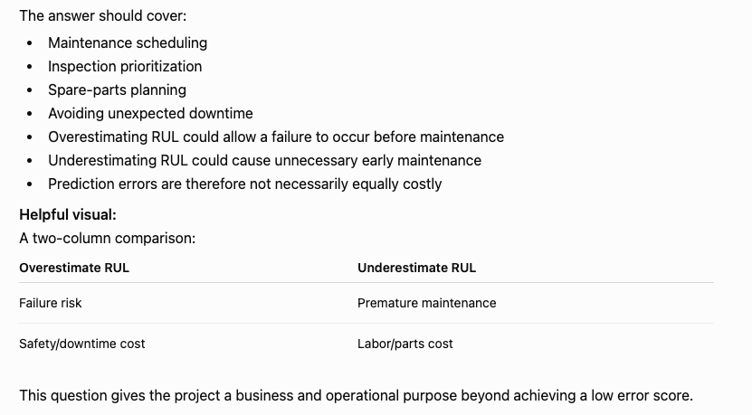

Slide 14
Phase 1.1: Project Framing and Problem Definition
Answer #3: Upon obtaining an RUL estimate, various decisions relating to maintenance decisions can be made. If RUL is found to be very high, then maintenance can be delayed. If RUL is found to be very low, then maintenance must happen soon. When a group of RUL predictions is made, then maintenance scheduling can be done, inspection priorities can be decided, and spare parts planning can be done. All this aids in the process of reducing costs and decreasing the amount of unexpected downtime.
As for the consequences of bad predictions, overestimating RUL can result in unexpected failures, and thereby more costly repairs. Meanwhile, underestimating RUL can result in unnecessary maintenance activities. From this we can infer than overestimating RUL would be more costly.

Slide 15
How could an RUL prediction support a real maintenance decision, and what are the consequences of overestimating versus underestimating RUL?
An RUL estimate can support several maintenance decisions. At the individual engine level, a low predicted RUL could trigger inspection, increased monitoring, or scheduled maintenance. Meanwhile, a high predicted RUL may justify continuing operation. Across a fleet, predictions can help prioritize inspections, schedule maintenance windows, allocate technicians, and plan spare parts inventory. The overall value is reducing unexpected downtime while avoiding unnecessarily early component replacement.
The prediction errors are symmetric. If the model overestimates RUL, the organization may delay maintenance too long, potentially causing an unexpected failure, emergency repair, secondary damage, or safety risk. If it underestimates RUL, maintenance may happen prematurely, wasting useful component life and creating unnecessary labor and downtime.
In a safety-critical application, overestimation would often be treated as the more serious error, although the exact cost balance should be defined with domain stakeholders. The asymmetry could also influence the evaluation metric and maintenance threshold.

Slide 16
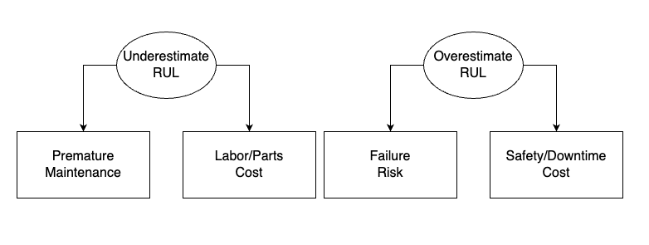
How could an RUL prediction support a real maintenance decision, and what are the consequences of overestimating versus underestimating RUL?

Slide 17
Phase 1.1: Project Framing and Problem Definition
Question #4: How did you define success for this project, both as a machine-learning system and as a portfolio project?

Slide 18
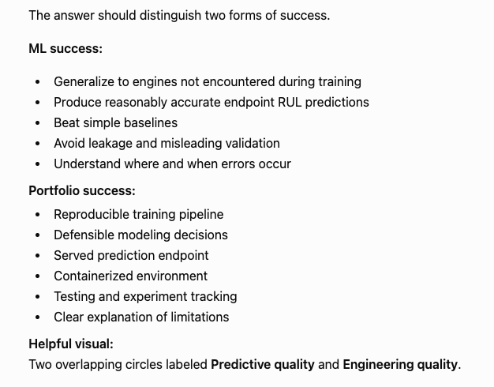

Slide 19
Phase 1.1: Project Framing and Problem Definition
Answer #4: In matters of machine learning, the biggest indicator of success is the model being able to make accurate predictions on engines not encountered during the training process. It should be able to produce accurate endpoint RUL predictions and beat simple baselines. It should also avoid leakage and misleading validation. It should also be possible to discern when and where errors occur.
From an engineering perspective, this project should create a reproducible training pipeline. Any decisions that the model makes should be defensible. The model should serve prediction endpoints in a containerized environment. Testing and experiment tracking should be able to take place, and it should be possible to provide clear explanations of the model’s limitations.

Slide 20
How did you define success for this project, both as a machine-learning system and as a portfolio project?
From a machine learning perspective, success means generalizing to engine units that were not encountered during training. The model should outperform simple baselines on grouped validation using metrics such as MAE and RMSE. It should also perform reasonably well on endpoint RUL prediction and avoid data leakage or misleading validation. I also want enough error analysis to understand when and where the model performs poorly rather than relying on one aggregate score.
From an engineering perspective, success means turning that model into a reproducible and usable system. The training process should be reproducible, experiments should be tracked, important assumptions should be protected by automated tests, and the trained pipeline should be served through a containerized prediction API. The model version and preprocessing should be traceable, and its predictions, design choices, and limitations should be explainable.
From a portfolio perspective, the finished project should demonstrate that I can take an ML problem from raw data through experimentation, deployment, testing, and production-oriented monitoring rather than stopping at a notebook.

Slide 21
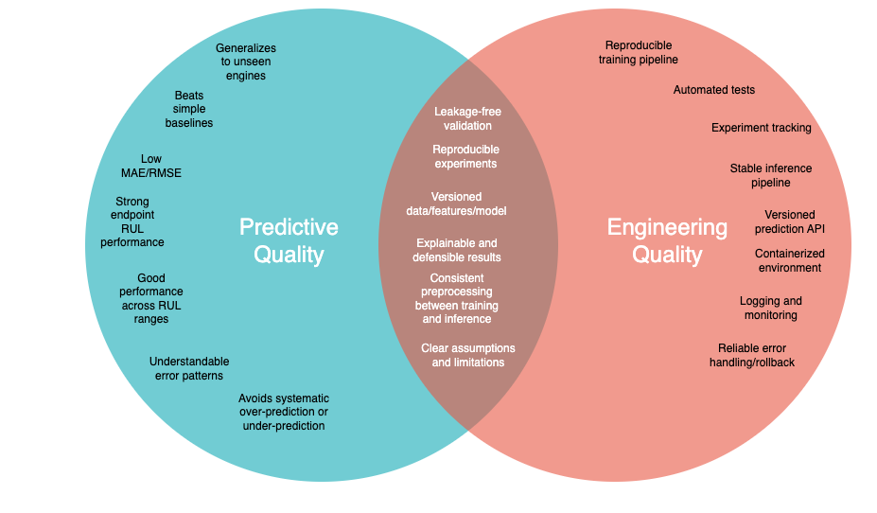
How did you define success for this project, both as a machine-learning system and as a portfolio project?

Slide 22
Phase 1.1: Project Framing and Problem Definition
Question #5: What assumptions does the FD001 project make, and why should the resulting model be treated as a prototype rather than a production-ready maintenance system?

Slide 23
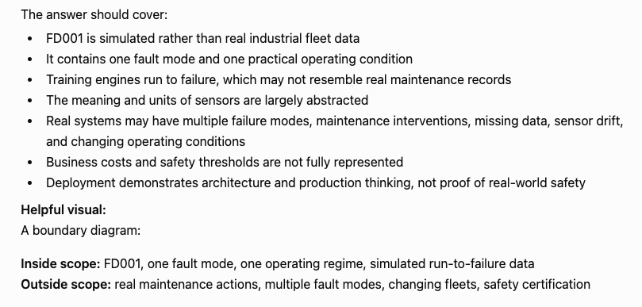

Slide 24
Phase 1.1: Project Framing and Problem Definition
Answer #5: The FD001 project makes at least two assumptions:
The predictions are associated with one fault mode and one practical operating condition.
Training engines run to failure, which might not be reflective of real-life scenarios.
As for why the resulting model should be treated as a prototype rather and a production-ready prediction tool, there are the following reasons:
The meanings and units of sensors have been largely abstracted
Training engines run until failure, which likely won’t be reflective of actual maintenance records
The training data only contains one fault mode and one practical operating condition, whereas real world scenarios often contain multiple fault or failure modes

Slide 25
What assumptions does the FD001 project make, and why should the resulting model be treated as a prototype rather than a production-ready maintenance system?
The first assumption is that the FD001 represents a much narrower problem then real engine maintenance. It only contains one operating condition—sea level—and one fault mode in the form of high-pressure compressor degradation. So, the model is not being trained to handle multiple environments or different failure mechanisms.
Second, the training trajectories run all the way to failure. That’s useful because it gives us complete RUL labels, but real maintenance data may be censored because equipment is inspected, repaired, or replaced before failure.
Third, this is simulated C-MAPPS data rather than measurements collected from a real operational fleet. Performance on this benchmark there fore doesn’t demonstrate that the model will generalize to all of the noise, distribution shifts, sensor issues, and maintenance practices encountered in deployment.
Finally, the sensor channels are largely abstracted, which limits physical interpretation and domain validation.
For those reasons, I view the project as a production-oriented prototype. It demonstrates the ML pipeline, leakage-safe validation, serving, containerization, testing, tracking, and monitoring architecture. But the predictive model itself has not been validated under the data diversity and operational conditions necessary for a real maintenance system.

Slide 26
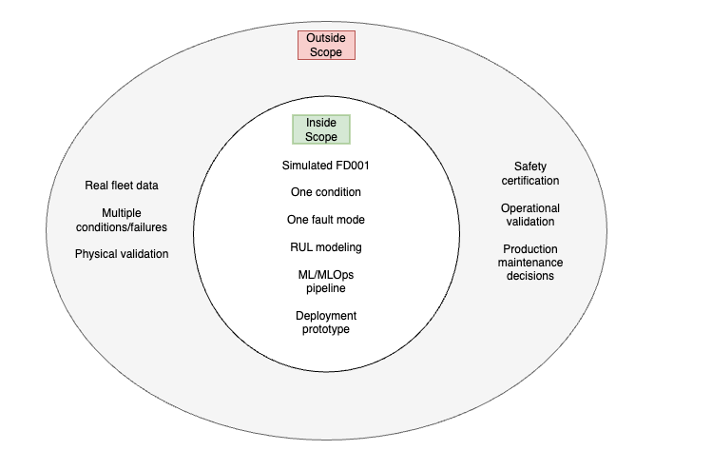
What assumptions does the FD001 project make, and why should the resulting model be treated as a prototype rather than a production-ready maintenance system?

Slide 27
Part 1: ML Foundations and Baseline System
Phase 1.2: Data Understanding and Exploratory Analysis
  Understand the FD001 files
  Validate engine sequences
  Construct and validate training RUL
  Interpret test endpoint RUL
  Examine sensors, operating conditions, and target distribution
  Identify initial modeling implications

Slide 28
Phase 1.2: Data Understanding and Exploratory Analysis
Question #1: How do the FD001 training data, test data, and test RUL labels differ, and how do they work together?

Slide 29
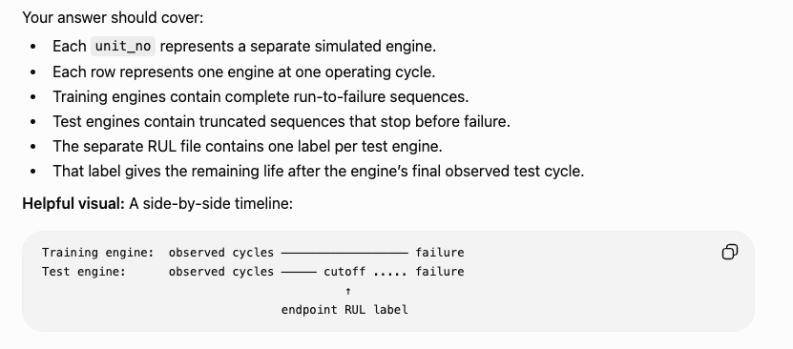

Slide 30
Phase 1.2: Data Understanding and Exploratory Analysis
Answer #1: To begin, it’s worth noting that each unit_no represents a distinct simulated engine. Each row represents strictly one engine at one point in its operating cycle. As for differences between training and test data, the main distinction is that training data runs until failure for each engine while test data does not. The training data is contained in a single file where each engine has a complete lifecycle from start to failure. The test data is distributed across two files, one for a set of truncated lifecycles associated with various engines, and one for a set of labels representing when those engines reached failure (the label gives the remaining life left after the final observed operating cycle).

Slide 31
How do the FD001 training data, test data, and test RUL labels differ, and how do they work together?
Each unit_no represents a distinct simulated engine, and each row represents that engine at one operating cycle with its operating settings and measurements. The training trajectories are complete run-to-failure histories, which allows us to retrospectively construct an RUL target for every training row. The test trajectories are truncated before failure, and a separate RUL file provides one ground truth value representing the remaining life for each test engine at its final observed cycle, which is used for final evaluation of a model.
Training gives complete run-to-failure trajectories for learning. Test gives truncated histories plus one hidden endpoint RUL target per engine for evaluation.

Slide 32
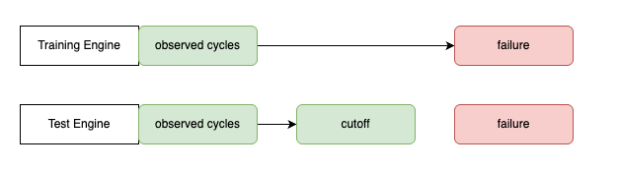
How do the FD001 training data, test data, and test RUL labels differ, and how do they work together?

Slide 33
Phase 1.2: Data Understanding and Exploratory Analysis
Question #2: How did you construct the training RUL target, and what checks confirmed that it was correct for every engine?

Slide 34
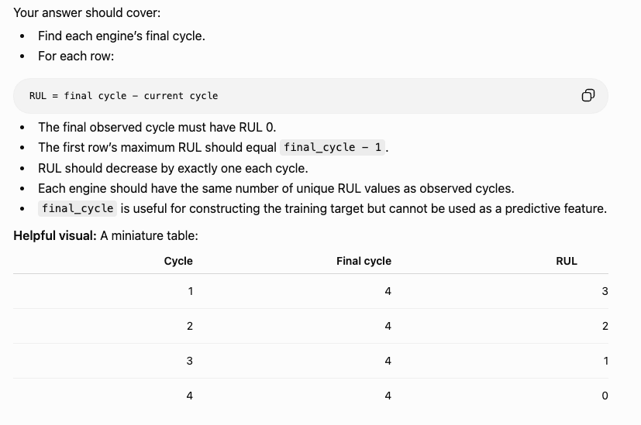

Slide 35
Phase 1.2: Data Understanding and Exploratory Analysis
Answer #2: For each engine, it was possible to find the final cycle of its life. From there, it was possible to make a simple calculation of:
RUL = final_cycle – current_cycle
Then it was possible to make the following confirmations about the various rows associated with each engine:
The final observed cycle must have an RUL of 0
The first row’s should have an RUL of final_cycle – 1
RUL should decrease by exactly one after each cycle
Each engine should have the same number of unique RUL values as it has observed cycles
Finally, it’s worth noting that final_cycle is useful for constructing a training target but cannot be used to make predictions.

Slide 36
How did you construct the training RUL target, and what checks confirmed that it was correct for every engine?
For each training engine, I computed its maximum observed cycle and used RUL = final_cycle – current_cycle. I validated the target by confirming that every engine ended at RUL 0, was nonnegative, and decreased by exactly 1 per cycle. It is also worth noting that because every sequence started at cycle 1 and was consecutive, the number of RUL values matched its trajectory length. final_cycle is useful for retrospective target construction because the training trajectories are complete, but it must be excluded from model inputs because it would leak future information at inference time.

Slide 37
cycle | final_cycle | RUL
1 | 4 | 3
2 | 4 | 2
3 | 4 | 1
4 | 4 | 0

Slide 38
Phase 1.2: Data Understanding and Exploratory Analysis
Question #3: What sequence-integrity checks did you perform, and why are they necessary before modeling time-series engine data?

Slide 39
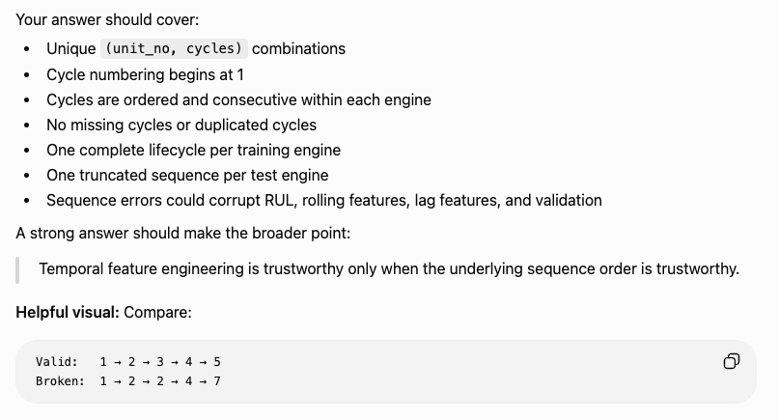

Slide 40
Phase 1.2: Data Understanding and Exploratory Analysis
Answer #3: For each training engine, I confirmed that all cycle numbers were unique (i.e., for the entire dataset all combinations of (unit_no, cycle) only appeared once). I confirmed that all cycles started at 1 and were both ordered and consecutive for each engine. There were also no missing cycles in the dataset. There was one complete lifecycle per training engine and one truncated lifecycle per test engine. In my EDA I tried to embody the fact that temporal feature engineering is only reliable when the underlying sequence is reliable.

Slide 41
What sequence-integrity checks did you perform, and why are they necessary before modeling time-series engine data?
I verified that every (unit_no, cycle) pair was unique, each engine started at cycle 1, cycle numbers were ordered and consecutive with no gaps, and each engine’s row count matched its observed cycle span. These checks matter because lag, difference, rolling, and slope features only have valid temporal meaning if the underlying sequence is complete and correctly ordered. They also establish that temporal operations must be performed within each unit_no so history from one engine never spills into another.

Slide 42
Valid | Invalid
1 | 1
2 | 3
3 | 2
4 | 4
5 | 5

Slide 43
Phase 1.2: Data Understanding and Exploratory Analysis
Question #4: What data-quality checks did you perform, what did you find, and why was it important not to “clean” legitimate degradation behavior?

Slide 44
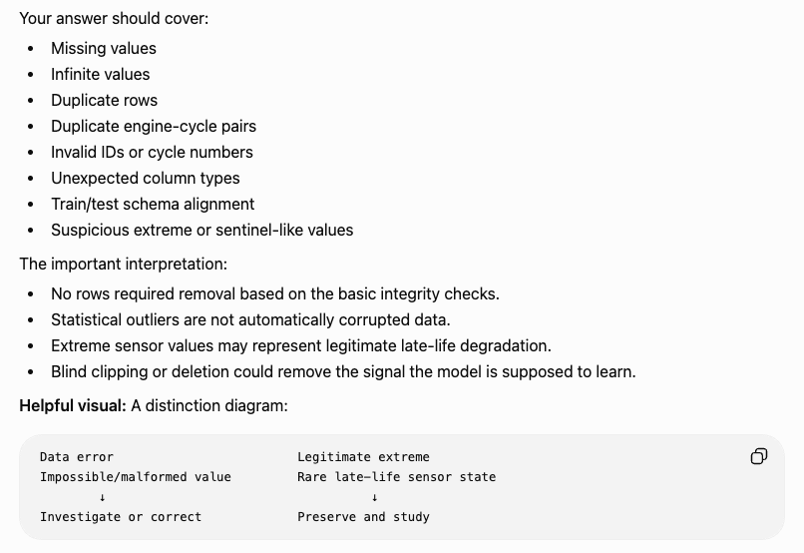

Slide 45
Phase 1.2: Data Understanding and Exploratory Analysis
Answer #4: I confirmed there were no infinite values, no null values, no mismatched datatypes, and no extreme outliers. In analyzing the data there were some statistical outliers that were found, but these could be regarded as legitimate possible associators with degradation behavior (i.e., when statistical outliers come up in readings a failure is likely near). Cleaning these would likely reduce a model’s predictive capabilities.

Slide 46
What data-quality checks did you perform, what did you find, and why was it important not to “clean” legitimate degradation behavior?
I audited missing values, infinite values, duplicates, datatype consistency, descriptive ranges, and extreme observations. The dataset had no missing or infinite values, no exact duplicates, and consistent train/test datatypes. I found no evidence of corrupted measurements that required generic cleaning. I deliberately avoided automatic outlier removal because statistically extreme sensor values may be legitimate manifestations of degradation, so deleting them without evidence could remove useful predictive signal.

Slide 47
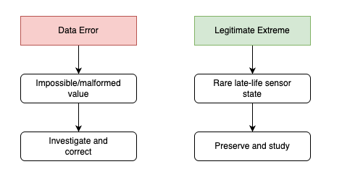

Slide 48
Phase 1.2: Data Understanding and Exploratory Analysis
Question #5: How did you identify constant and near-constant features, and how did those findings affect the feature plan?

Slide 49
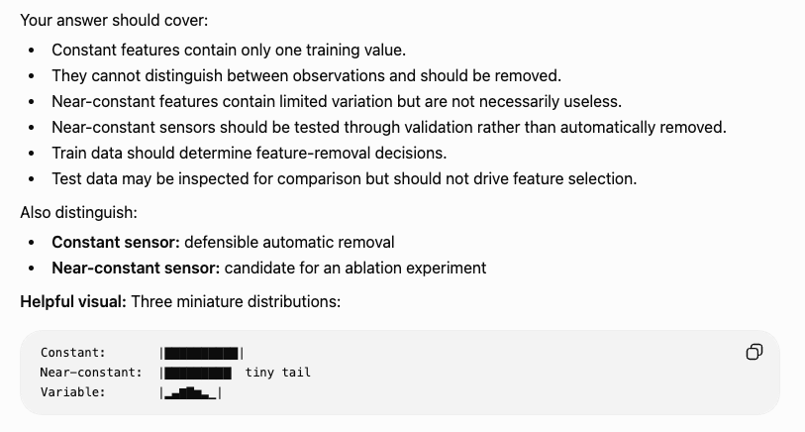

Slide 50
Phase 1.2: Data Understanding and Exploratory Analysis
Answer #5: To identify constant and near-constant features, I used a combination of graphs and statistical summaries. Graphs that showed a flat line as a function of cycle number were regarded as constant features. And in statistical summaries anything with a standard deviation of 0 or near 0 was regarded as a constant feature. All exactly constant features were removed from consideration as they contributed no useful information for making predictions. The near-constant feature (there was just one of them) was left in, as an experiment would be needed to confirm if it doesn’t contribute meaningful information to prediction.

Slide 51
How did you identify constant and near-constant features, and how did those findings affect the feature plan?
I quantified feature variability using unique value counts, ranges, IQR, and dominant value frequency. Seven measurements had exactly one unique training value, so I removed them because they could not distinguish one observation from another. Sensor 6 was flagged as near-constant because almost all observations shared one value but some genuine variation remained, so I retained it for the baseline and planned a later ablation experiment rather than assuming that rare variation was useless.
Exactly constant features can be removed statistically. Near-constant features require evidence before removal.

Slide 52
Phase 1.2: Data Understanding and Exploratory Analysis
Question #6: Why did you examine both overall sensor behavior and within-engine sensor trajectories, and what different information did those views provide?

Slide 53
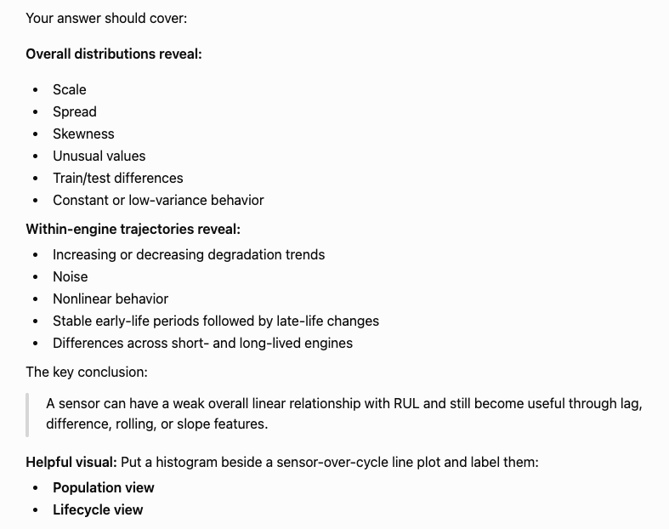

Slide 54
Phase 1.2: Data Understanding and Exploratory Analysis
Answer #6: I examined both overall sensor behavior and within-engine sensor behavior to distinguish between degradation behavior that might be unique to a single engine and degradation behavior that was consistent across the entire fleet. Degradation behavior that was consistent across the fleet allowed me to take note of promising candidates for feature engineering. Within-engine sensor behavior allowed me to take note of outlier behavior that was unique to a single engine.

Slide 55
Why did you examine both overall sensor behavior and within-engine sensor trajectories, and what different information did those views provide?
I examined global sensor distributions first to understand feature scale, skewness, discreteness, concentration, and broad train/test differences. But those distributions pool all engines and lifecycle stages together, so they cannot reveal degradation behavior. I then examined within-engine trajectories to restore the temporal dimension and identify sensors that systematically increased, decreased, or changed near failure across multiple engines. Those patterns gave me evidence for later lag, difference, rolling, and slope feature engineering.
Global distributions tell me what values a sensor takes in; within-engine trajectories tell me how those values evolve as the engine degrades.

Slide 56
Phase 1.2: Data Understanding and Exploratory Analysis
Question #7: How did you determine whether FD001 contained multiple operating regimes, and why does that matter for modeling?

Slide 57
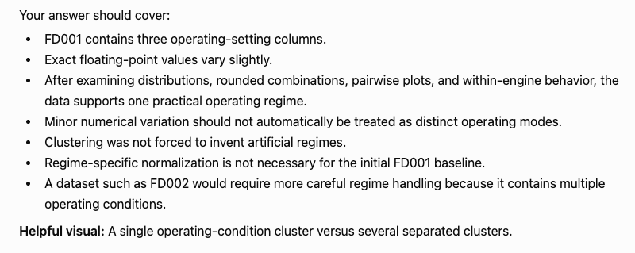

Slide 58
How did you determine whether FD001 contained multiple operating regimes, and why does that matter for modeling?
Answer #7: The number of operating regimes in the FD001 was stated as being just one in the dataset’s description. But in addition to that, I decided to plot the data and confirm that was the case. When making a scatterplot of Operating Setting 2 versus Operating Setting 1 (both standardized), only was cluster was visually present. If there were multiple operating regimes, then we could expect there to be multiple distinct clusters on that plot. As for why that matters when it comes to modeling, this means that the operating settings can be expected to contribute little to no meaningful information to predictive capabilities. But the data is still non-constant, so it was left in to account for the chance that there is some meaningful information in the data.

Slide 59
How did you determine whether FD001 contained multiple operating regimes, and why does that matter for modeling?
FD001 is documented as having one operating condition, and I verified that the varying operating settings occupied one broad joint region rather than clearly separated clusters. That matters because there was no evidence supporting explicit regime clustering or separate regime-specific models. I still retained the two varying operating settings because then can provide context for interpreting sensor measurements even if they do not directly track degradation.
One operating regime means I don’t need explicit regime modeling. It does not mean the operating-setting variables are useless.

Slide 60
Phase 1.2: Data Understanding and Exploratory Analysis
Question #8: What were the most important modeling decisions produced by the EDA?

Slide 61
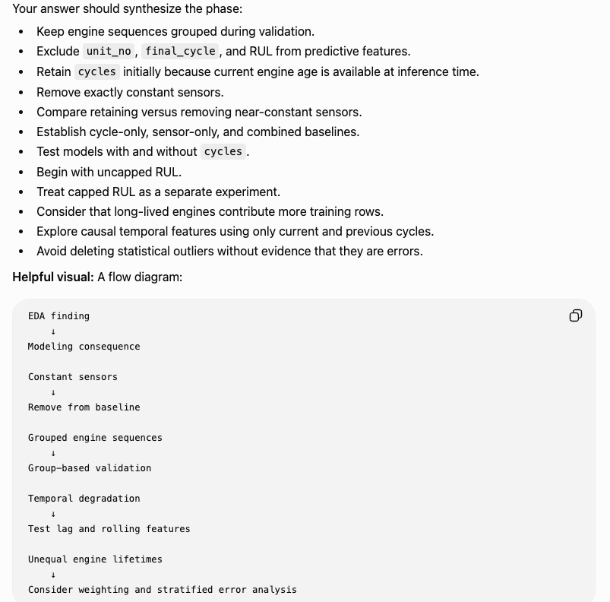

Slide 62
What were the most important modeling decisions produced by the EDA?
Answer #8: The EDA showed that there were multiple features that could be dropped from the dataset, as they were constant and contributed no predictive information (one operating setting and two sensor readings). It also revealed indicators for good experiments and candidates for feature engineering.

Slide 63
What were the most important modeling decisions produced by the EDA?
The most important result of the EDA was recognizing that FD001 is grouped longitudinal data, so validation has to separate complete engines and any temporal features must be causal and engine-specific. The EDA also identified seven constant measurements to remove, revealed several sensors with degradation-related temporal trends that motivate later lag and rolling-feature experiments, and supported a simple uncapped, equal-row-weighted baseline with no explicit operating-regime clustering. It also established the leakage rules that the modeling pipeline has to enforce.

Slide 64
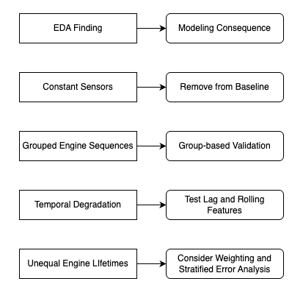

Slide 65
Part 1: ML Foundations and Baseline System
Phase 1.3: Baseline Data Pipeline and Feature Engineering
  Create leakage-safe feature sets
  Remove unusable constant features
  Add simple casual temporal features
  Preserve engine grouping
  Create train/validation splits by engine

Slide 66
Phase 1.3: Baseline Data Pipeline and Feature Engineering
Question #1: Which columns were included in the baseline feature set, which were excluded, and why?

Slide 67
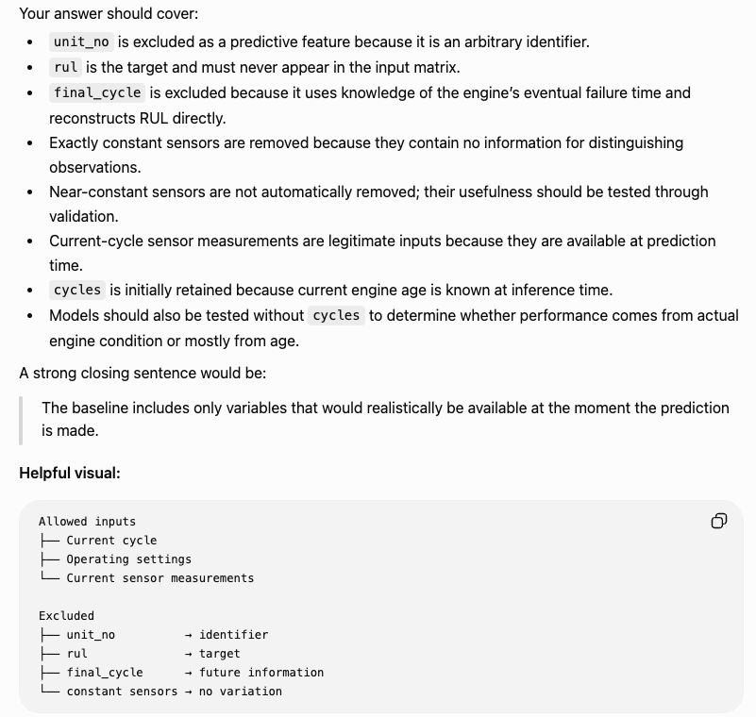

Slide 68
Phase 1.3: Baseline Data Pipeline and Feature Engineering
Answer #1: The columns that were included were the cycle count, 2 operation settings, and 15 sensor readings. These were included because they had variable values over the course of each engine’s lifetime, meaning there could possibly be meaningful predictive information in their trajectories. The columns that were excluded were 1 operation setting and 6 sensor readings. They were excluded because they were found to be constant, meaning they did not change from one cycle observation to another, hence they offered no predictive information and could be removed.

Slide 69
Which columns were included in the baseline feature set, which were excluded, and why?
The raw baseline contained 18 predictors: current cycle count, Operating Settings 1 and 2, and 15 nonconstant sensor measurements. EDA found seven measurement variables to be exactly constant—Operating Setting 3 and six sensors—so those were removed because zero-variance features cannot discriminate between observations. We also excluded unit_no because it is grouping metadata rather than a meaningful numerical predictor, rul because it is the target, and final_cycle along with other future or target-derived columns because they would cause leakage. Near-constant features such as Sensor 6 were retained initially so their usefulness could be tested empirically rather than assumed.

Slide 70
Phase 1.3: Baseline Data Pipeline and Feature Engineering
Question #2: What is the correct order of operations in the baseline data pipeline, and what would go wrong if preprocessing were performed before splitting the engines?

Slide 71
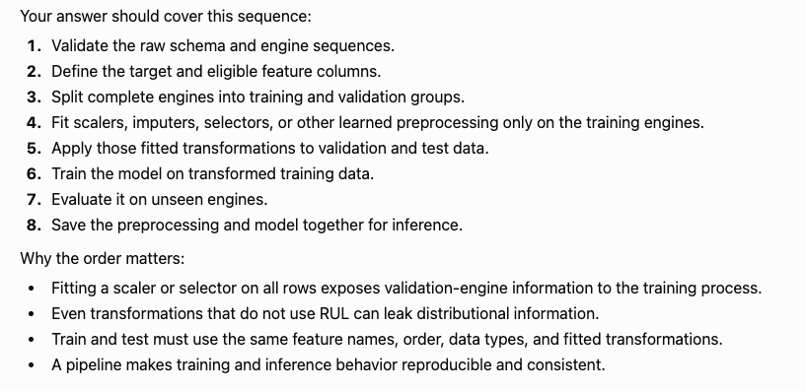
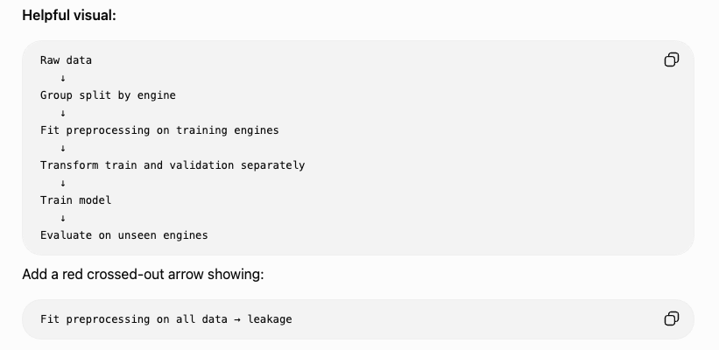

Slide 72
Phase 1.3: Baseline Data Pipeline and Feature Engineering
Answer #2: In the baseline data pipeline, first the boundary between training and cross-validation was determined. Then a standard scaler was fit to the data. The results were then frozen for that particular cross-validation fold. Then the results of the fit were applied via a transform function to both the training and the cross-validation set. If preprocessing were performed before splitting the engines, then information from the training set would leak into the cross-validation set.

Slide 73
What is the correct order of operations in the baseline data pipeline, and what would go wrong if preprocessing were performed before splitting the engines?
The correct order is to split engines first, then fit any learned preprocessing only on the training engines. The fitted preprocessing parameters are then frozen and applied to both the training and validation data. After that, the model is fit on the transformed training data and evaluated on the transformed validation data. If preprocessing were fitted before split, validation engines would influence learned quantities such as feature means and standard deviations, causing preprocessing leakage and making validation performance overly optimistic.

Slide 74
Phase 1.3: Baseline Data Pipeline and Feature Engineering
Question #3: What temporal features could improve RUL prediction, and how would you construct them without introducing future-data leakage?

Slide 75
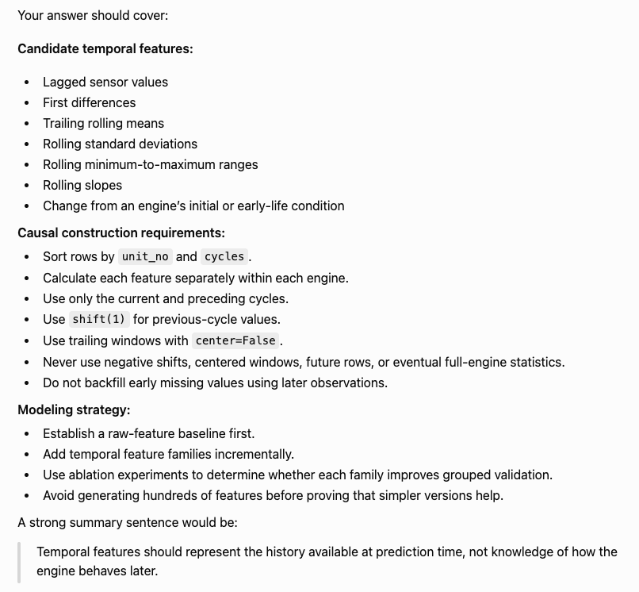
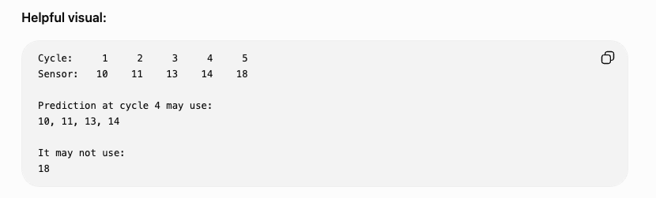

Slide 76
Phase 1.3: Baseline Data Pipeline and Feature Engineering
Answer #3: Three temporal features that could improve RUL predictions are lag, difference, and rolling mean. To construct them without any future data, there are two rules that must always be enforced: the features must be causal and group-bounded. At a given cycle, it is necessary to make sure that the information available comes only from the present and the past, never the future. It must also be the case that all information available in the present and past only comes from a single engine.

Slide 77
What temporal features could improve RUL prediction, and how would you construct them without introducing future-data leakage?
Three useful candidate temporal features are lags, difference, and trailing rolling statistics. To construct them without leakage, I would first sort observations by unit_no and cycles, then perform every temporal operation within unit_no groups so one engine can never borrom history from another. The features must also be causal: at cycle t, they may use only current and earlier observations, never future cycles. For example, shift(1) can create a legal one-cycle lag, diff(1) captures recent change, and a trailing five-cycle mean summarizes recent sensor level, while shift(-1) or a centered rolling window would introduce leakage from future data.

Slide 78
Part 1: ML Foundations and Baseline System
Phase 1.4: Baseline Modeling and Evaluation
  Establish simple benchmarks
  Train baseline regression models
  Evaluate with grouped validation
  Compare cycle-only, sensor-only, and combined models
  Perform error analysis
  Select a baseline model

Slide 79
Phase 1.4: Baseline Modeling and Evaluation
Question #1: Which baseline models did you compare, and what does each baseline tell you about the difficulty of the RUL prediction problem?

Slide 80
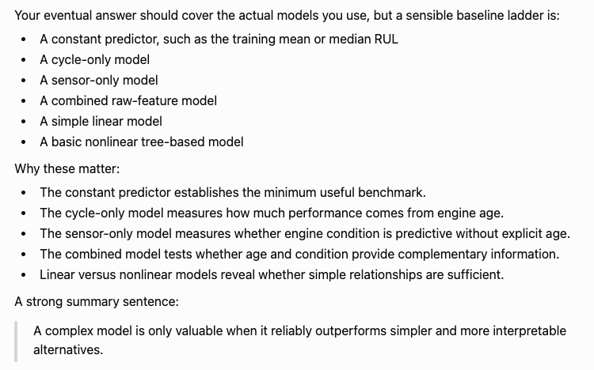
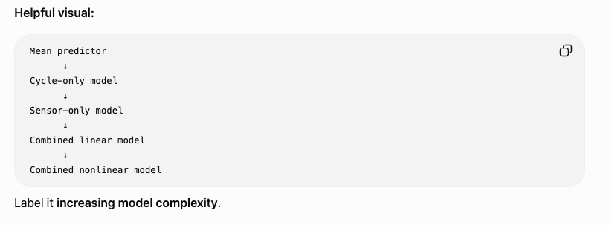

Slide 81
Phase 1.4: Baseline Modeling and Evaluation
Answer #1: I compared an average-only model, a cycle count only model, a raw baseline linear model, a temporal features linear model, and a random forest model with temporal features.
As for what each model tells us about the difficulty of the RUL prediction problem, moving from average only to cycle count only increase predictive accuracy, telling us that RUL is a time-based phenomenon. Moving from cycle-only to raw baseline features increased accuracy, indicating that operating readings and sensor settings contain useful predictive information. Moving from raw baseline to temporal engineered features increased predictive accuracy, indicating that engineered features are an important part of making a model as accurate as possible. Moving from temporal features to random forest did not significantly change predictive accuracy, indicating that a more flexible, nonlinear model may not be able to extract significantly more useful information from the feature set.

Slide 82
Which baseline models did you compare, and what does each baseline tell you about the difficulty of the RUL prediction problem?
I compared six baselines: a mean DummyRegressor, cycle-only Linear Regression, raw Linear Regression, raw Random Forest, temporal Linear Regression, and temporal Random Forest.
The dummy model established how difficult the problem is without using predictive features at all. The cycle-only model tested how much RUL can be predicted from observable engine age and its improvement showed that cycle count contains useful signal, while its remaining error reflects the fact that engines can have different lifetimes even at the same current cycle.
Adding the raw operating settings and sensor measurements improved performance beyond cycle count, showing that current multivariate engine state contains incremental predictive information. Adding causal temporal features improved performance further, indicating that recent sensor history can provide information beyond a current-state snapshot.
Finally, comparing Linear Regression and Random Forest within the same representations tested whether greater nonlinear flexibility could extract additional signal. In my baseline results, the temporal Random Forest did not substantially outperform the temporal linear model, suggesting that additional nonlinear flexibility provided limited incremental benefit for that particular representation and validation split.

Slide 83
Phase 1.4: Baseline Modeling and Evaluation
Question #2: How was the validation strategy designed, and why would randomly splitting individual rows produce misleading results?

Slide 84
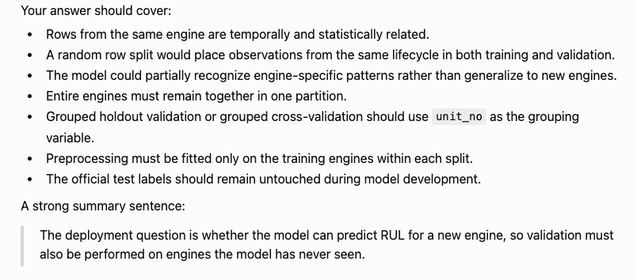
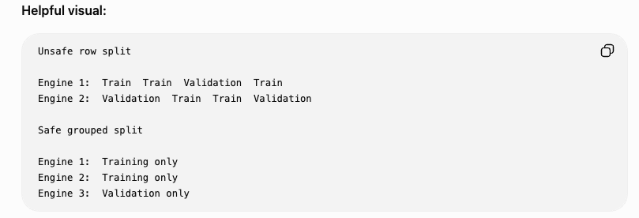

Slide 85
Phase 1.4: Baseline Modeling and Evaluation
Answer # 2: The validation strategy was designed to use grouped splitting, so 80 of the 100 training engines were used to training, and 20 were split off for validation. As for why randomly splitting individual rows would produce misleading results, incorrect splitting can cause a form of leakage, where earlier data from an engine’s lifetime is in the training set and later data from an engine’s lifetime is in the validation set. Or vice versa. This creates a situation where gauging how well the model generalizes to unforeseen data (the whole point of validation) loses its ability to produce legitimate error measurements.

Slide 86
How was the validation strategy designed, and why would randomly splitting individual rows produce misleading results?
I used an engine-grouped validation split. Of the 100 complete FD001 training engines, 80 engines were assigned to model training and 20 entirely separate engines were held out for validation, with unit_no used as the grouping variable.
A random row split would allow observations from the same engine to appear in both the training and validation. Because consecutive observations from one engine are highly related, the model could learn engine-specific or neighboring-cycle patterns during training and then be evaluated on partially familiar trajectories. That would produce an overly optimistic estimate of performance.
Grouped validation instead tests the real generalization question: whether a model trained on one set of engines can predict RUL for completely unseen engines.

Slide 87
Phase 1.4: Baseline Modeling and Evaluation
Question #3: Which metrics did you use to evaluate RUL predictions, and why should performance be examined at more than one level?

Slide 88
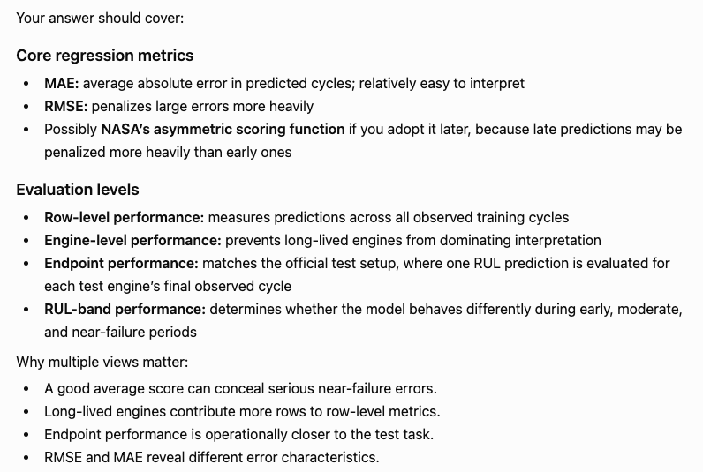
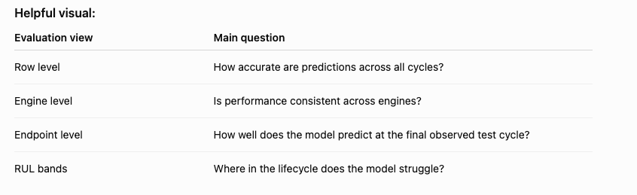

Slide 89
Phase 1.4: Baseline Modeling and Evaluation
Answer #3: I used RMSE (root-mean squared error) and MAE (mean absolute error). Performance should be evaluated at more than one level because there are pros and cons to different performance metrics. MAE is good for getting a general sense for how well a model is predicting values, but RMSE punishes outliers more heavily.

Slide 90
Which metrics did you use to evaluate RUL predictions, and why should performance be examined at more than one level?
I evaluated RUL prediction primarily with RMSE and secondarily with MAE. MAE gives an intuitive measure of the average absolute prediction error, while RMSE penalizes large misses more heavily, which is useful when severe RUL errors are especially important.
I also evaluated performance at multiple levels rather than relying on aggregate metrics. I examined error by RUL band, signed prediction error, and per-engine performance. This was important because a good overall RMSE can hide systematic high-RUL errors, directional bias, or poor generalization to a small subset of unseen engines.

Slide 91
Phase 1.4: Baseline Modeling and Evaluation
Question #4: How did you select the baseline model, and what kinds of errors or failure patterns did you examine beyond the overall score?

Slide 92
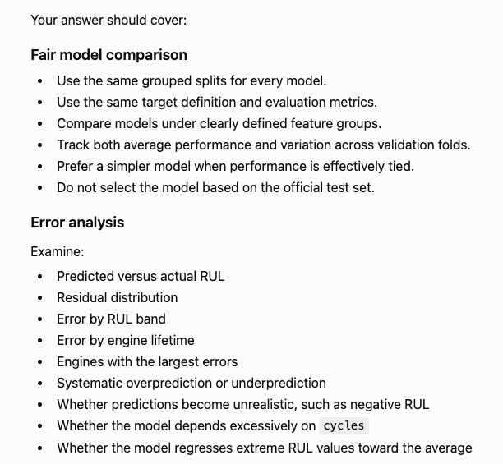
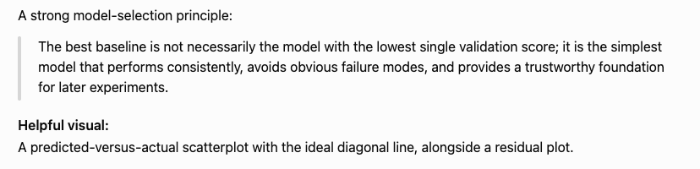

Slide 93
Phase 1.4: Baseline Modeling and Evaluation
Answer #4: The baseline model I chose was the linear model trained on temporal features. (I’m unsure how to confidently answer this one past here...)

Slide 94
How did you select the baseline model, and what kinds of errors or failure patterns did you examine beyond the overall score?
I selected temporal Linear Regression as the leading Phase 1.4 baseline because it achieved the lowest validation RMSE among the tested baselines on the fixed engine-grouped validation split. RMSE had been defined in advance as the primary model-comparison metric, with MAE as a secondary metric.
I did not rely on the aggregate score. I examined predicted versus actual RUL, signed errors to identify systematic overprediction or underprediction, RMSE and MAE across different RUL bands, the largest individual prediction misses, performance across individual unseen validation engines, and the train-validation error gap. Those diagnostic helped identify where the model was failing and generated hypotheses for Phase 1.5, such as whether poor high-RUL performance might justify testing RUL capping.

Slide 95
Part 1: ML Foundations and Baseline System
Phase 1.5: Experiment Tracking and Reproducibility
  Track parameters, features, metrics, and artifacts
  Save preprocessing and model configurations
  Record random seeds and data versions
  Make experiments rerunnable
  Introduce MLflow or a comparable system

Slide 96
Phase 1.5: Experiment Tracking and Reproducibility
Question #1: What did you record for each experiment so that its results could be reproduced and compared fairly?

Slide 97
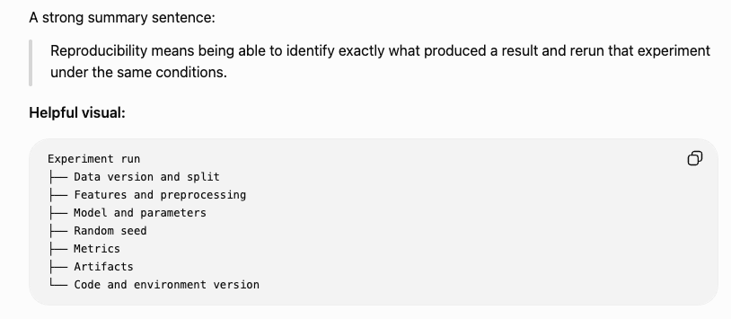
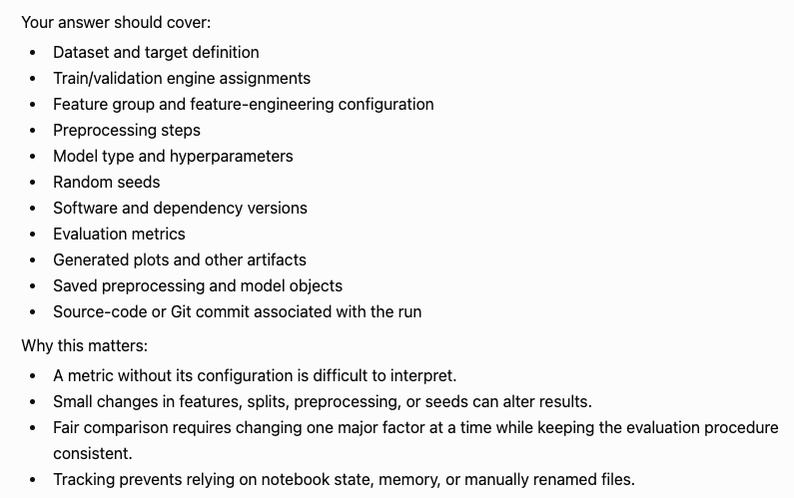
Phase 1.5: Experiment Tracking and Reproducibility
Answer #1:

Slide 98
Phase 1.5: Experiment Tracking and Reproducibility
Question #2: What is the difference between tracking an experiment and making the full training workflow reproducible?

Slide 99
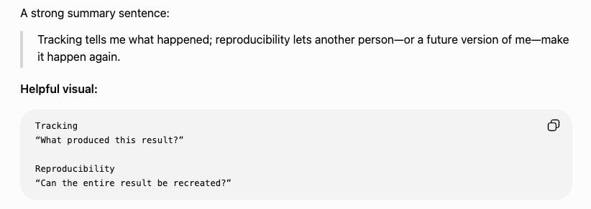
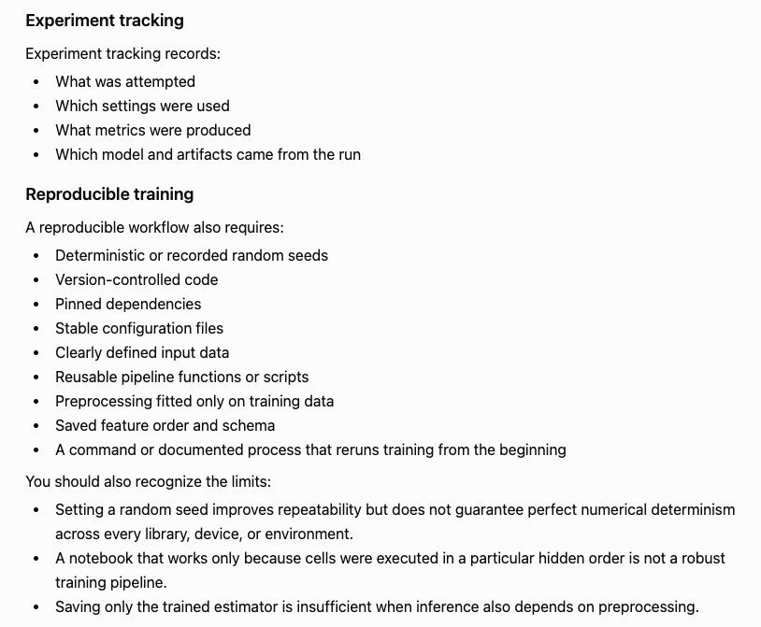
Phase 1.5: Experiment Tracking and Reproducibility
Answer #2:

Slide 100
Part 2: Shippable MVP
Phase 2.1: Inference Pipeline
  Reproduce training-time preprocessing
  Accept valid engine data
  Generate RUL predictions
  Validate input schemas
  Handle insufficient history and bad input

Slide 101
Phase 2.1: Inference Pipeline
Question #1: Walk me through the inference pipeline from incoming engine measurements to the final RUL prediction.

Slide 102
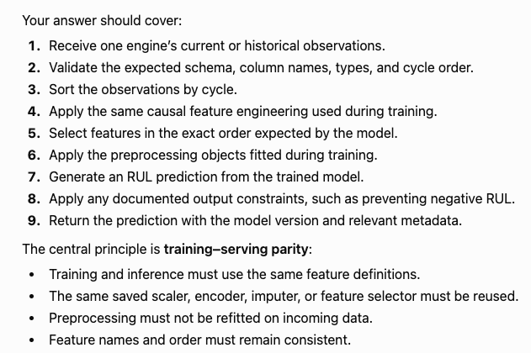
Phase 2.1: Inference Pipeline
Answer #1:

Slide 103
Phase 2.1: Inference Pipeline
Question #2: What input problems and edge cases must the inference pipeline handle, and how should it respond?

Slide 104
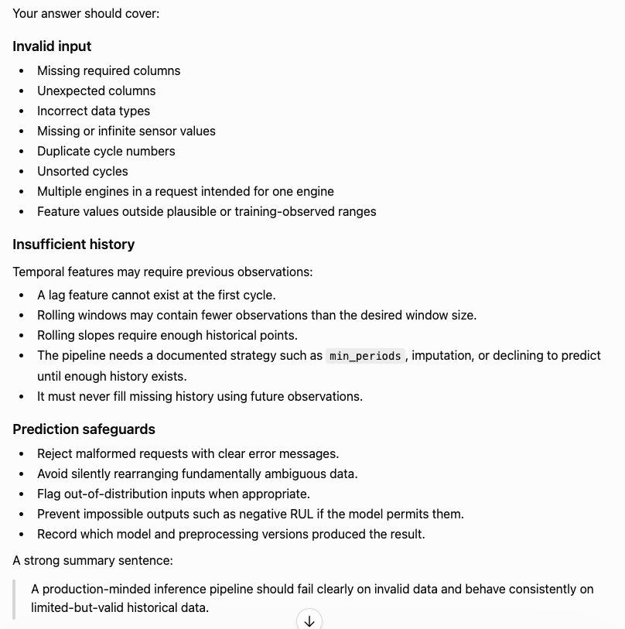
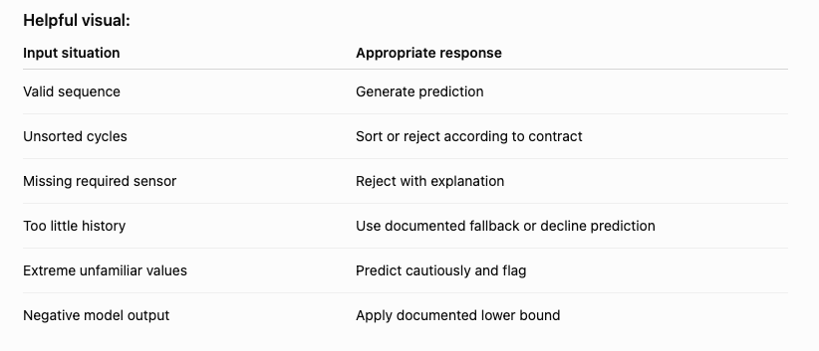
Phase 2.1: Inference Pipeline
Answer #:

Slide 105
Part 2: Shippable MVP
Phase 2.2: Model Serving
  Expose the model through FastAPI
  Define request and response schemas
  Add health and prediction endpoints
  Handle errors cleanly
  Load model artifacts consistently

Slide 106
Phase 2.2: Model Serving
Question #1: How did you serve the RUL model through FastAPI, and what contract does the prediction endpoint provide?

Slide 107
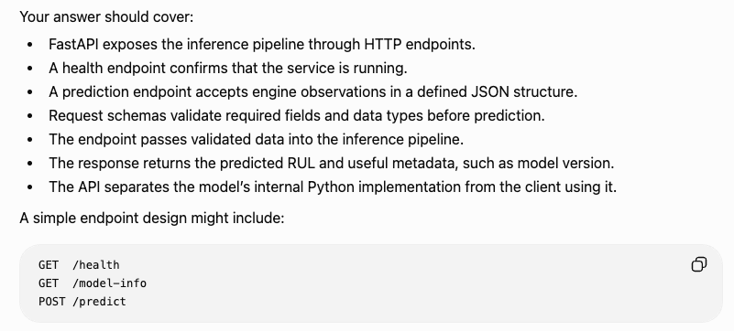
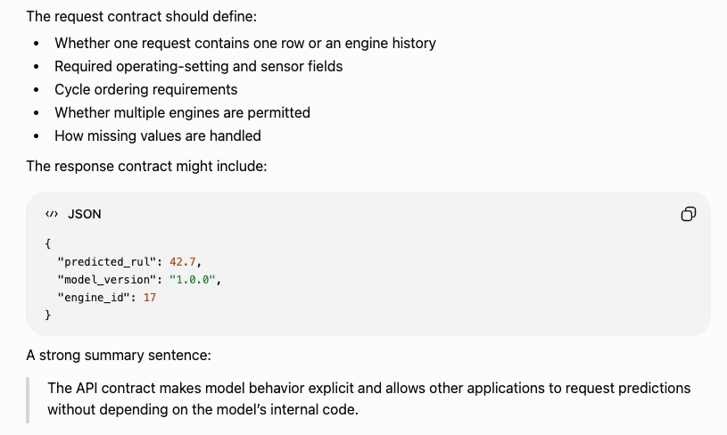
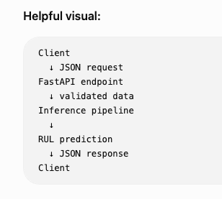
Phase 2.2: Model Serving
Answer #1:

Slide 108
Phase 2.2: Model Serving
Question #2: What reliability, error-handling, and operational concerns must be addressed when serving an ML model through an API?

Slide 109
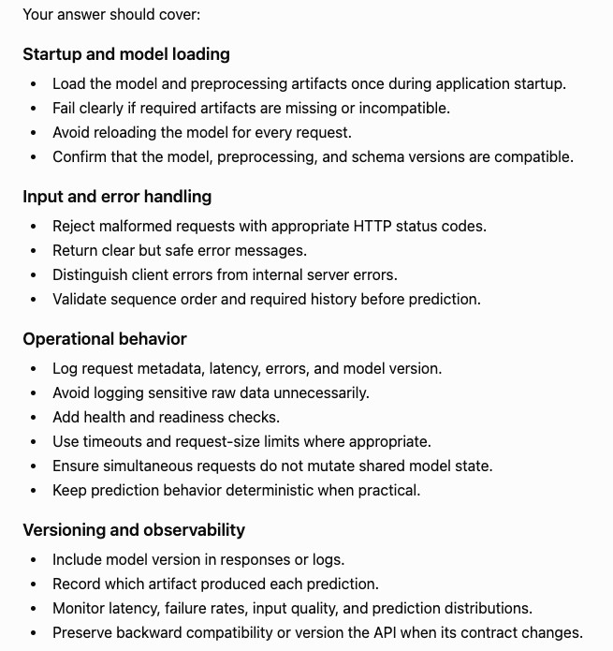
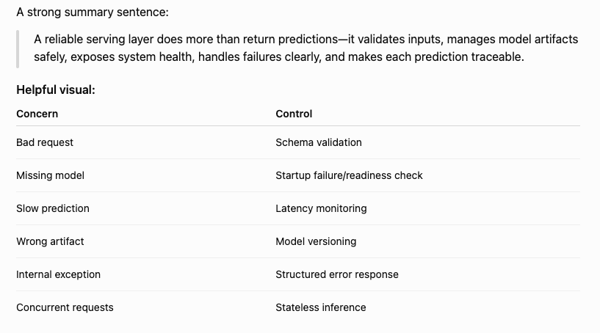
Phase 2.2: Model Serving
Answer #2:

Slide 110
Part 2: Shippable MVP
Phase 2.3: Containerization and Environment Management
  Create a Docker image
  Pin dependencies
  Separate development and runtime configuration
  Confirm reproducible local execution
  Run the API inside the container

Slide 111
Phase 2.3: Containerization and Environment Management
Question #1: Why did you containerize the prediction service, what does the Docker image contain, and what problems does containerization solve–or not solve?

Slide 112
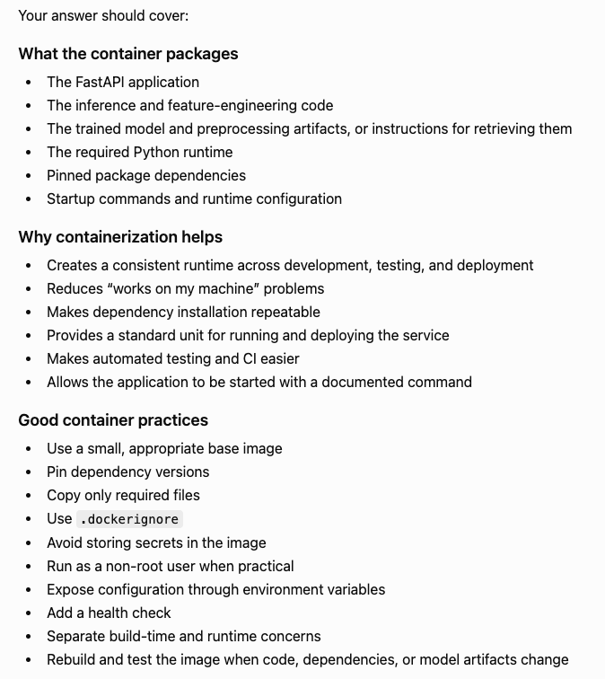
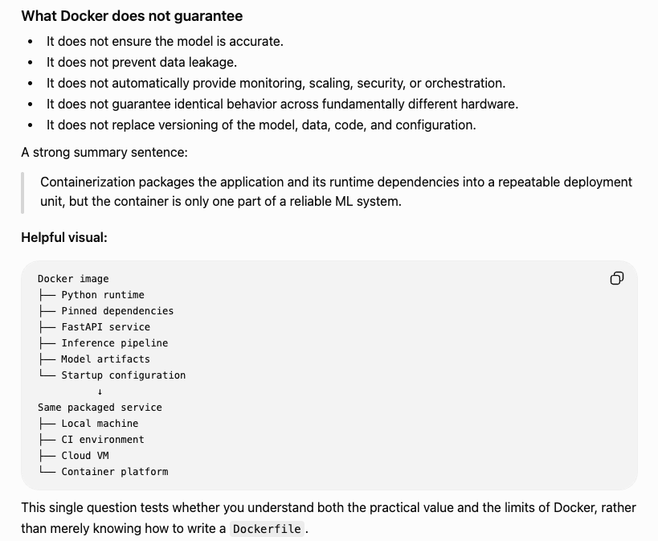
Phase 2.3: Containerization and Environment Management
Answer #2:

Slide 113
Part 2: Shippable MVP
Phase 2.4: Automated Testing and CI
  Data-validation tests
  Feature-engineering tests
  Leakage-prevention tests
  Model-loading tests
  API tests
  Container smoke tests
  Basic CI workflow

Slide 114
Phase 2.4: Automated Testing and CI
Question #1: What layers of the predictive-maintenance system should be tested, and what kinds of failures should those tests detect?

Slide 115
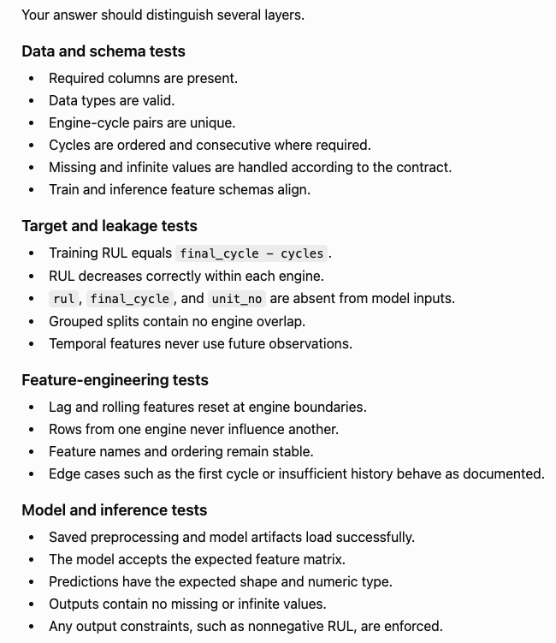
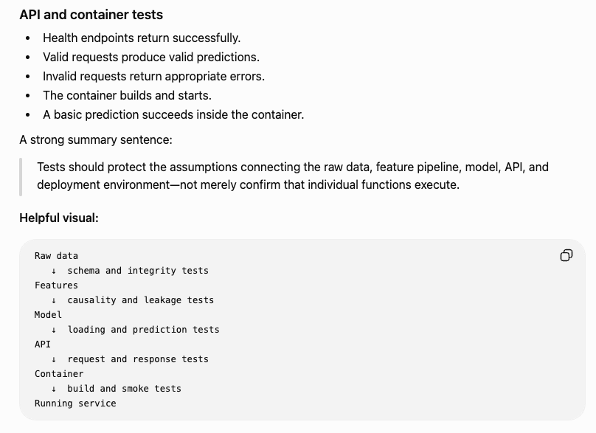
Phase 2.4: Automated Testing and CI
Answer #1:

Slide 116
Phase 2.4: Automated Testing and CI
Question #2: What happens in the CI workflow when code changes, and what does passing CI prove–or fail to prove–about the ML system?

Slide 117
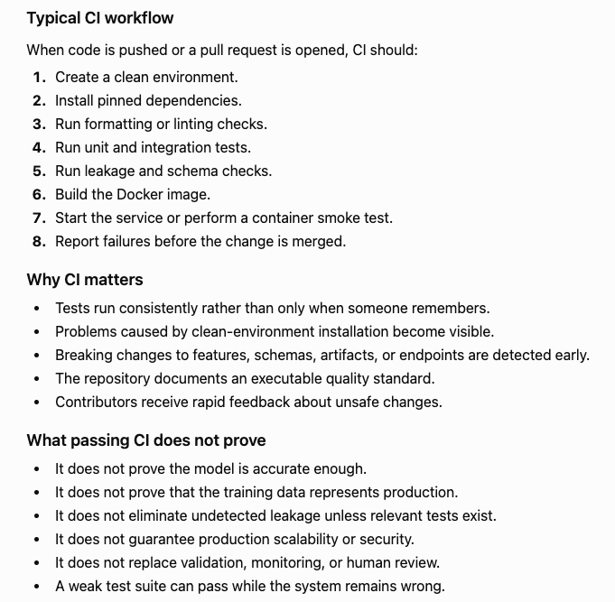

Phase 2.4: Automated Testing and CI
Answer #2:

Slide 118
Part 2: Shippable MVP
Phase 2.5: Minimal Demo Layer
  Simple Streamlit or lightweight front end
  Submit engine data
  Display predicted RUL
  Show recent sensor behavior
  Explain the model output and limitations

Slide 119
Phase 2.5: Minimal Demo Layer
Question #1: What does the minimal demo allow a user to do, and how does it communicate prediction without overstating the model’s reliability?

Slide 120



Phase 2.5: Minimal Demo Layer
Answer #1:

Slide 121
Part 3: Model Improvement and Production Thinking
Phase 3.1: Advanced Modeling Experimentation
  Compare stronger tree-based models
  Tune hyperparameters
  Compare capped and uncapped targets
  Test engine-balanced weighting
  Add and ablate temporal features
  Evaluate error by RUL region

Slide 122
Phase 3.1: Advanced Modeling Experimentation
Question #1: How did you structure advanced modeling experiments to determine whether gains came from the model, feature engineering, target definition, or training strategy?

Slide 123


Phase 3.1: Advanced Modeling Experimentation
Answer #1:

Slide 124
Phase 3.1: Advanced Modeling Experimentation
Question #2: What evidence would justify replacing the baseline model with a more advanced model?

Slide 125



Phase 3.1: Advanced Modeling Experimentation
Answer #2:

Slide 126
Part 3: Model Improvement and Production Thinking
Phase 3.2: Model Selection, Versioning, and Promotion
  Compare candidate models consistently
  Register model artifacts
  Track model versions
  Define promotion criteria
  Preserve the ability to roll back

Slide 127
Phase 3.2: Model Selection, Versioning, and Promotion
Question #1: How did you decide which model should become the deployed version, and how would you version, promote, and roll it back safely?

Slide 128




Phase 3.2: Model Selection, Versioning, and Promotion
Answer #2:

Slide 129
Part 3: Model Improvement and Production Thinking
Phase 3.3: Monitoring and Logging
  Request and prediction logging
  Input-schema monitoring
  Data-quality monitoring
  Feature drift
  Prediction drift
  Latency and error rates
  Delayed performance monitoring when ground truth becomes available

Slide 130
Phase 3.3: Monitoring and Logging
Question #1: What information should the prediction service log and monitor, and how do logging and monitoring serve different purposes?

Slide 131



Phase 3.3: Monitoring and Logging
Answer #1:

Slide 132
Phase 3.3: Monitoring and Logging
Question #2: How would you monitor model health when ground-truth RUL labels are delayed or unavailable, and what actions should different alerts trigger?

Slide 133



Phase 3.3: Monitoring and Logging
Answer #2:

Slide 134
Part 3: Model Improvement and Production Thinking
Phase 3.4: Retraining and Production Failure Modes
  Define retraining triggers
  Consider delayed labels
  Handle distribution shifts
  Document fallback behavior
  Discuss model degradation and rollback

Slide 135
Phase 3.4: Retraining and Production Failure Modes
Question #1: What conditions would justify retraining the model, and how would you respond to production failures without automatically assuming retraining is the solution?

Slide 136



Phase 3.4: Retraining and Production Failure Modes
Answer #1:

Slide 137
Part 4: Portfolio Presentation and Final Polish
Phase 4.1: Documentation and Technical Storytelling
  High-quality README
  Architecture diagram
  Data-flow diagram
  Model-development narrative
  Model card
  Data assumptions and limitations
  Reproduction instructions

Slide 138
Part 4: Portfolio Presentation and Final Polish
Phase 4.2: Demo and Visual Presentation
  Screenshots or short demo video
  Clear example prediction
  EDA highlights
  Model-comparison visuals
  Monitoring dashboard examples
  Business interpretation

Slide 139
Part 4: Portfolio Presentation and Final Polish
Phase 4.3: Repository and Portfolio Polish
  Clean project structure
  Remove exploratory clutter
  Improve naming and comments
  Confirm tests and CI pass
  Add resume bullets
  Prepare interview explanations

