Slide 1

BRITTANY STUART ● ALEX HEIN ● ABHIJITH RAVISHANKAR ● STEPHEN BURD
Final Report : Amphibious Bicycle Kit

Slide 2
Overview
Research Overview and Problem Statement
Concept Generation
Product Design and Function
Engineering Analysis and Design for Assembly
Manufacturing and Materials
Comparison to Benchmarks
Economic Analysis
Notes:
Problem Statement - Brittany
Customer Research - Brittany
Market Research – Alex
Product Research –Alex
Patent Research – Stephen and Ahbi
House of Quality - Stephen
Problem Definition -- Ahbi
Questions – All of us

Slide 3
Research
Market Research
VQDT found out that 96.8 million people are affected by floods annually. The poor and rural areas of cities are largely affected by this disaster.
Customer Research
In addition to the cost and widespread affects, one of the biggest complications associated with flooding is lack of available transportation to safer locations in areas with no immediate aid.
Patent Research
The existing paddle boat was very expensive. This would limit the market size as cost would become a factor.

Slide 4
Problem Definition
Updated problem definition
The transportation of people in post-flood situations using attachments to a bicycle. This is concentrated to people in rural and poor areas.
Creating a list of materials and manufacturing parts required in the Bill Of Materials, making CAD models for our attachments and analyzing an economic model of the design.

Slide 5
Results of Problem Definition
Low cost
Light Weight
Easy to use
Low maintenance
Durable
Takes less than five minutes to install
Supports up to 115 kilograms
Takes less than 60 seconds to deploy

Slide 6
Concept Generation (Chart 1: Function Tree)
Transport people in floods
Keep afloat
Move forward
Turn
Transform between water and land modes
Produce buoyancy
Allow stability
Resist water
Dampen oscillations
Prevent tip-overs
Increase surface area
Move in water
Rotate turning system
Deploy
Retract
Deploy turning system
Deploy propulsion system
Deploy floatation system
Retract turning system
Retract propulsion system
Retract flotation system
Propel forward

Slide 7
Concept Generation (Chart 2: Morphological Chart)
Functions | Possible Solutions
Turning | Back Rudder | Front Rudder
Increase Surface Area | Pontoon | Ripcord Floats | Stabilizers | Pool Noodle
Resist Water | Silicone Spray | Zinc Powder Coat | Paint | PVC Parts
Propel Forward | Fins in Spokes | Sail | Enclosed Propeller | Open Propeller | Paddle
Maneuver Through Water | Front Wedge
Deploy/Retract Floatation | Ripcord | Zip Tie | Snaps | Hand Pump | Motor Pump
Deploy/Retract Propulsion | Slip Fins into Spokes | Fold Fins out of Spokes | Mount Propeller On Wheel
Prevent Tipping | Wide Base | Square Pontoon Base | Triangle Pontoon Base | Ring of Pool Noodles

Slide 8
Final Concept
Final Concept: Primary Concept:
Front Rudder
Clamp
Inflatable Pontoon
T – Base
Pump
Front Wedge
Front Rudder
Paint
Snaps
Rip Cord
Triangle Base
Fold Fins
Front Wedge
Datum Concept
Front Rudder
Paint
Clamps
Inflatable Pontoon
Square Base
Propeller

Slide 9
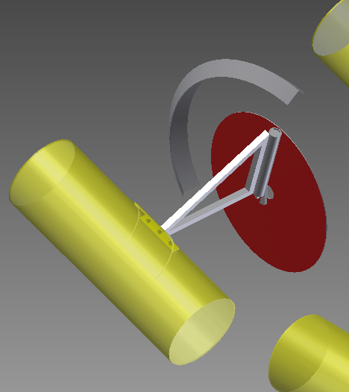
The Design: Front Unit
Connects to bicycle on front axle and on steering column
Has support for pontoons
Comes to point at front, acting as wedge
Disk is inserted into front tire
Unit rotates as steering column is rotated, acting as a rudder

Slide 10
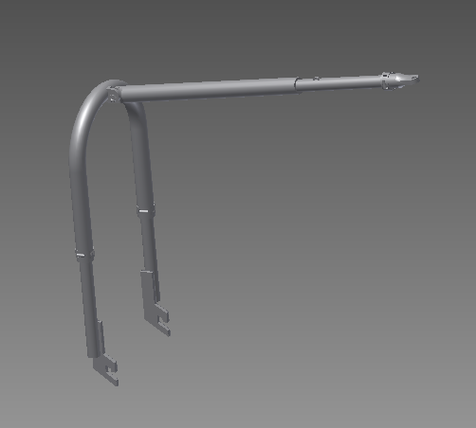
The Design: Rear Unit
Attaches to bicycle on rear axle and seat post
Has support for pontoons

Slide 11
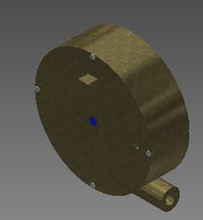
The Design: Centrifugal Pump
Rotates as pedals are rotated
Additional gear is mounted to chain to drive a second axle
This axle drives another chain which drives the pump
Forced rotation of fins inside of pump accelerates internal water velocity
Water exits pump at maximum speed, forcing bicycle in opposite direction

Slide 12
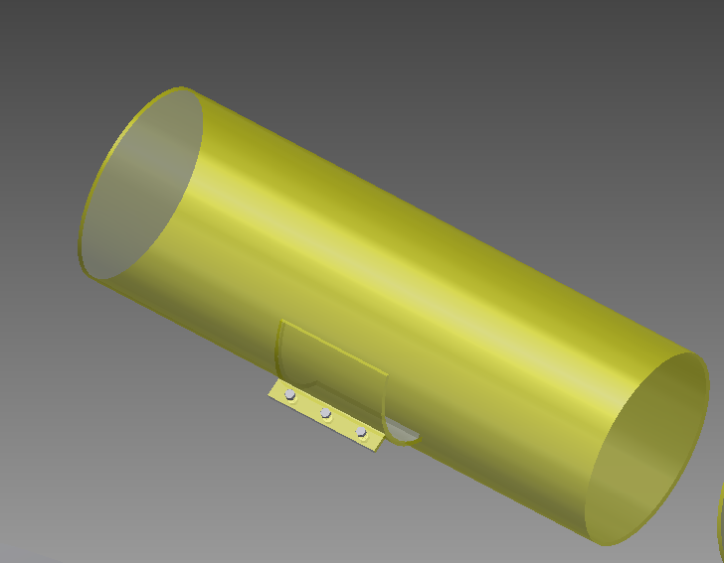
The Design: Pontoons
Flexible PVC inflatable tubes
Have standard valve stems for use with bicycle tire pumps

Slide 13
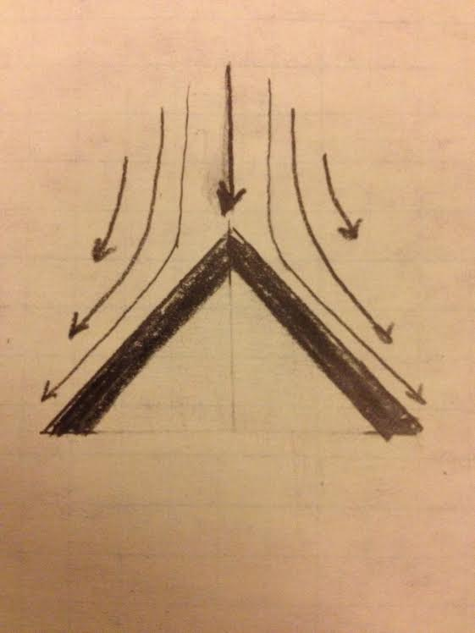
Concept: Front Wedge
Function
Moving debris from path
How it works
Forms wedge to cut through water
Model Findings
Can be helpful in steering
Must be made of thin metal
Diagram: Laminar Flow

Slide 14
Concept: Front Rudder
Function
To allow the bicycle to turn
How it works
Using the surface area created
Model Findings
Consider using hollow rudder
Rudder adds 3.2kg of mass
P-Diagram: Front Rudder
Noise
Waves
Current
Input
Turn Steering Column
Front Rudder
Output
Direction Change
Control
Velocity
Surface Area

Slide 15
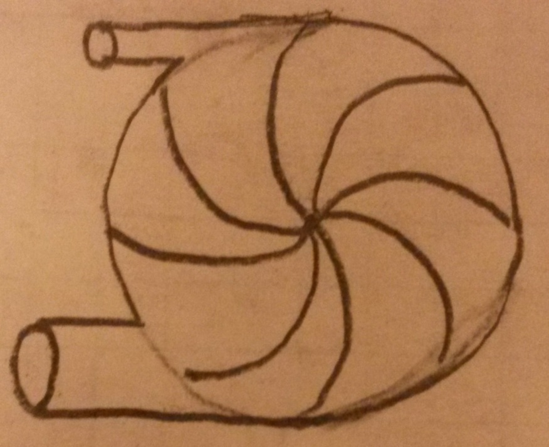
Concept: Centrifugal Pump
Function
Enclosed fin system
Water cycles within case and forced out one outlet.
How
Fins are attacked to rear wheel
Pressure from fins and case’s cylindrical shape causes water to flow in circle
Water is released at one outlet for maximum speed
Model Findings
Most energy is conserved in this method for weight purposes
Diagram: Centrifugal Pump

Slide 16
Concept: Flotation Device
Function
To provide a buoyant force for the whole device
How
Airtight compartment fills with air to provide buoyant force while in water
P-Diagram: Flotation Device
Noise
Weight of bicycle
Weight of user
Salinity of water
Temperature of water
Input
Volume of floatation device
Flotation Device
Output
Buoyant force
Control Factors
Size of floatation device
Shape of floatation device

Slide 17
Design for Assembly

Slide 18
Materials
Aluminum 6061
Pipes and Front Wedge
Corrosion Resistant
Easy to manufacture with (bend)
Light Weight
Lower Cost
PVC 10 oz. Fabric
Pontoons
Water Resistant
Tear and Puncture Resistant
Similar material used on inflatable life rafts
ABS plastic
Pump
Easy to manufacture with
Water Resistant

Slide 19
Manufacturing
Pontoons
Cut Fabric
Sew Fabric
Front Wedge
Bend Sheet Metal
Drill Holes for Mounting
Mounts
Cut Pipes to Length
Bend Pipes
Weld on Axle Mounts
Drill Holes and Chamfer
Pump
CNC Mill pump case and fins
*only assembly is the pump and case
Chart 4: Pump Assembly Flow Diagram
Fin (x4)
Fin Center
Axle
Pump Case Right
Pump Case Left

Slide 20
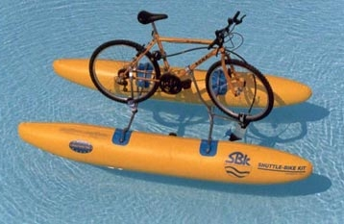
Comparison to Benchmarks
The Shuttle Bike is the only comparable product on the market
Costs $5000
Can be stored in backpack
Takes 15 minutes to deploy
Not amphibious

Slide 21
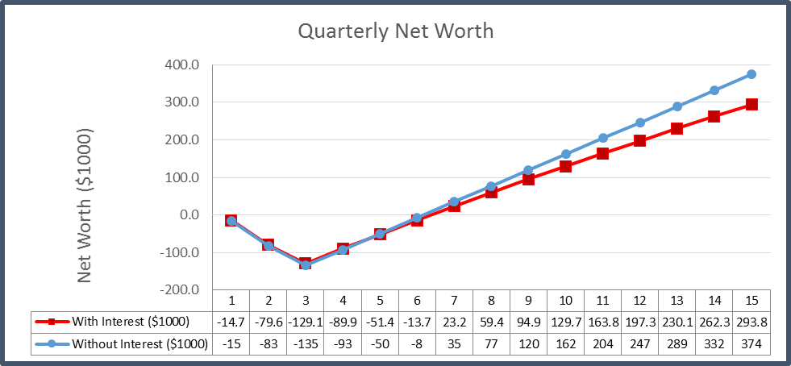
Economic Analysis
Pay Back Period:7th Quarter
Net Present Value: $294k
Min production: 1061
Return on Investment: 74%

Slide 22
Questions
Alex Hein – heina@purdue.edu
Stephen Burd – sburd@purdue.edu
Brittany Stuart – stuartb@purdue.edu
Abhijith Ravishankar – ravishan@purdue.edu

Slide 23
References
[1] Eric Guyer (2011). Expert Witness Painting Aluminum – Paint Failure and Defects. Retrieved from http://www.the-coatings-expert.com/painting-aluminum.htm
[2] SBK-KIT (2014). Shuttle Bike. Retrieved from http://www.shuttlebike.it/index.html

Slide 24
