Slide 1
Training neural networks to predict NBA results
Stuart Robinson • Durham, NC

Slide 2
Training neural networks to predict NBA results
Stuart Robinson • Durham, NC

Slide 3


Feed-forward neural network used to predict a given days' games
Trained on games on prior days
Recent games duplicated in training data
Dropout: 10%
Dimensions:
• Input: 60 (30 teams – away vs home)
• Hidden layer: 30
• Output layer: 1 (classification: didHomeWin)
Accuracy: ≈ 67% (...favored teams win ≈67% of games)
Note: Using 0 hidden layers was about as good (aka linear regression)

Slide 4
Also tried using
• How recently teams played previous 2 games
• One-hot encodings for tv station broadcasts
(didn't help)
Also tried predicting (odds)
• Which team would beat the spread
• Whether the total final score would be over/under the line
(unsuccessful)

Slide 5
Also tried using
• How recently teams played previous 2 games
• One-hot encodings for tv station broadcasts
(didn't help)
Also tried predicting (odds)
• Which team would beat the spread
• Whether the total final score would be over/under the line
(unsuccessful)

Slide 6
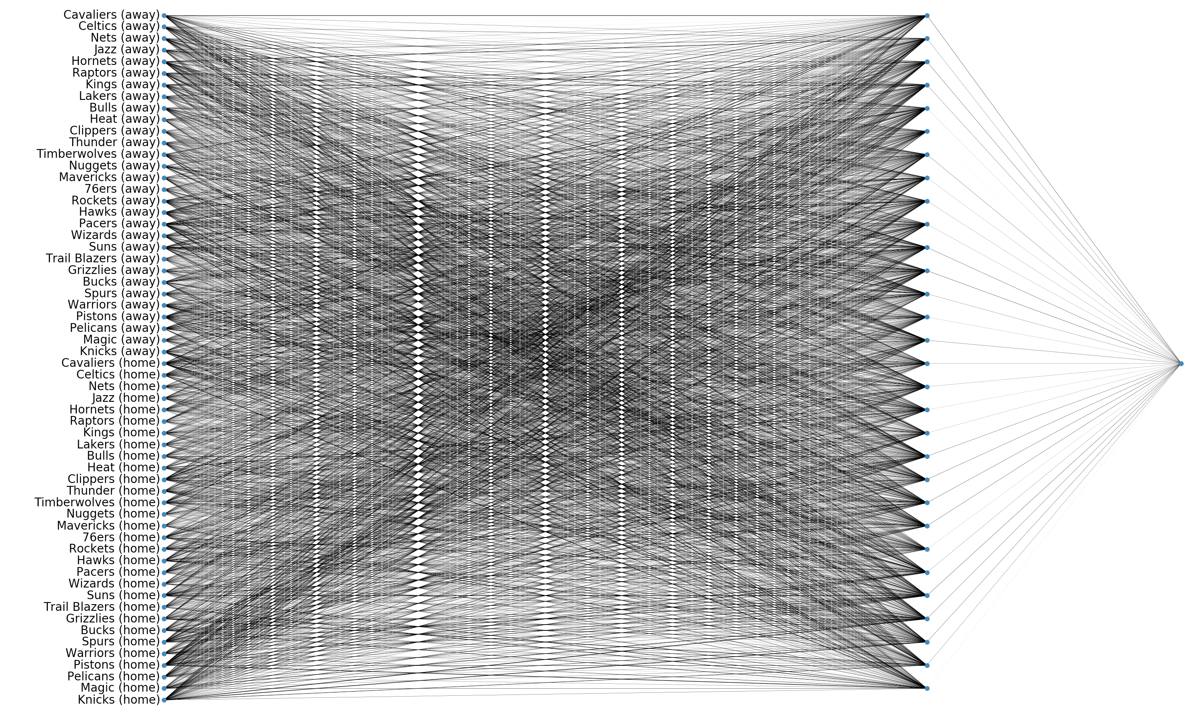

Slide 7
Showing only the maximum weights per team
(I thought the same team nodes (away/home) might have the strongest connections to a shared hidden layer node, but no.)

Slide 8
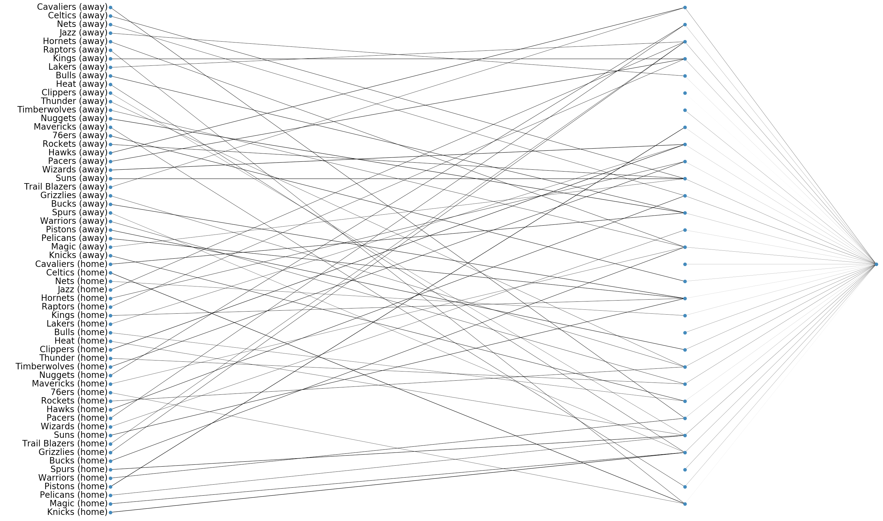

Slide 9
5 teams only:

Slide 10
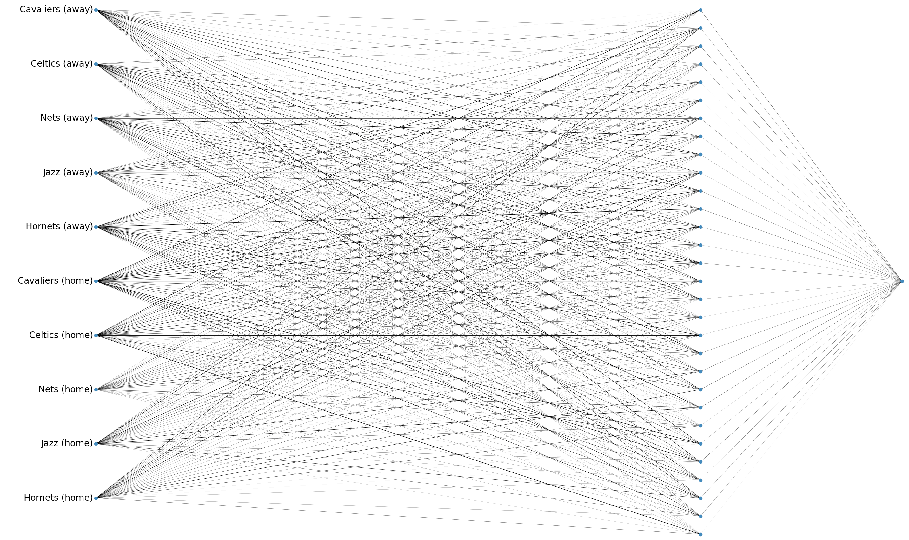

Slide 11
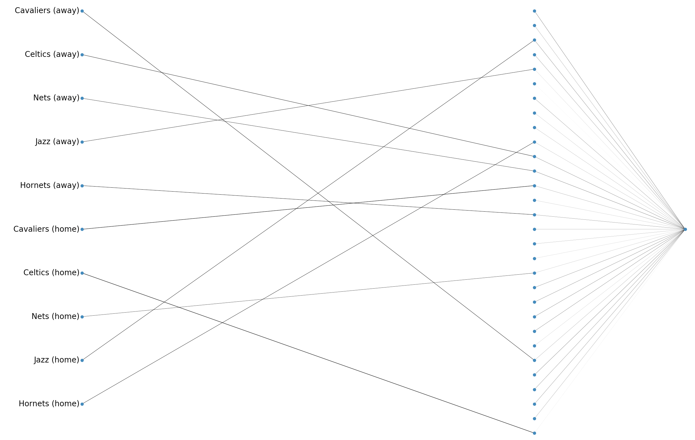

Slide 12
RESULTS OF P.O.C
FILE SIZE | CAPE TOWN CURRENT SOLUTION | CAPE TOWN MULTI-PART P.O.C | SAVINGS %
230 MB | 10mins 15sec | 56 sec | 91% Saving
3.6 GB | 2hr 40mins | 2mins 30sec | 98.5% Saving
5.2 GB | Failed (Too big) | 3mins 50sec
230mb file was the original P.O.C to prove that multi-part would work and provide a time saving. No fine-tuning (10 concurrent parts x ~24mb)
3.6 GB upload was fine-tuned to get as much speed as possible. 100 concurrent parts uploading.

